Slide 1
Five Senses – Part 2
I like to see…
I like to hear…
I like to smell…
I like to touch…
I like to taste…

Slide 2
What do you like to see?

Slide 3
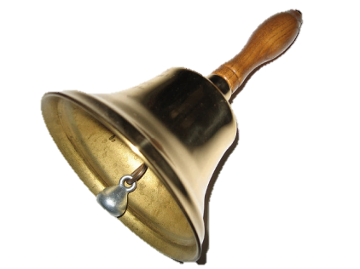
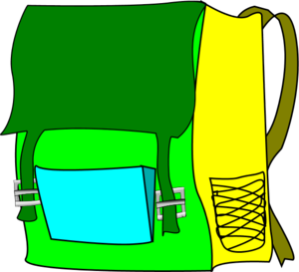
What do you like to hear?
Hurray!
It’s time to go home!

Slide 4
What do you like to smell?

Slide 5
What do you like to taste?

Slide 6
What do you like to touch?

Slide 7
And what do YOU like to…
hear
hear
smell
taste
see
taste
see
touch
touch
smell
?
?
?

