Slide 1
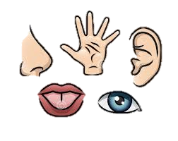
The Five Senses Part 1

Slide 2
Five Senses Chant
I see it
I hear it
I smell it
I taste it
I touch it
Five senses

Slide 3
Watch “The Five Senses”

Slide 4
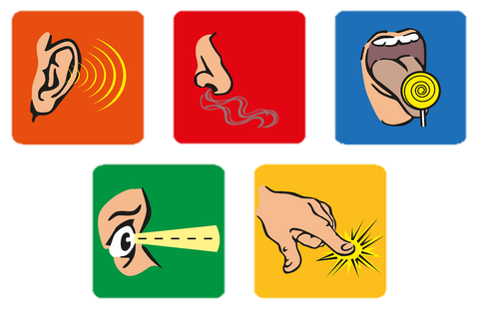
These are the five senses:
רואה
 | seeing
 | hearing
 | smelling
 | tasting
 | touching
שומע
מריח
טועם
נוגע

Slide 5
Vocabulary Check
מריח | senses
שומע | smelling
טועם | seeing
חושים | touching
רואה | hearing
נוגע \ממשש | tasting

Slide 6
Five Senses Chant
I see it
I hear it
I smell it
I taste it
I touch it
Five senses

Slide 7
Seeing
Hearing
Smelling
Tasting
Touching
Five senses

Slide 8
Match:
eye
ear
fingers
nose
mouth

Slide 9
Fill in the sentences:
eyes
I see with my __________.
I hear with my __________.
I smell with my __________.
I taste with my __________.
I touch with my __________.
ears
nose
mouth
fingers
ears, eyes, fingers, mouth, nose

Slide 10
Credits
“The Five Senses Song” downloaded with permission from Silly School Songs.

