Slide 1
Brown Bear, Brown Bear What do you see?

Slide 2
Brown bear, brown bear what do you see?
I see a red bird looking at me.

Slide 3
Red bird, red bird what do you see?
I see a yellow duck looking at me.

Slide 4
Yellow duck, yellow duck what do you see?
I see a blue horse looking at me.

Slide 5
Blue horse, blue horse what do you see?
I see a green frog looking at me.

Slide 6
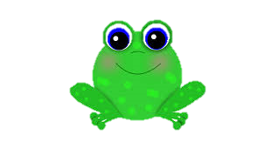
Green frog, green frog what do you see?
I see a purple cat looking at me.

Slide 7
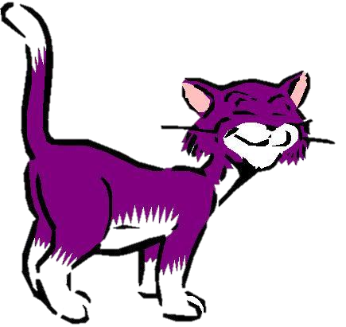
Purple cat, purple cat what do you see?
I see a white dog looking at me.

Slide 8
White dog, white dog what do you see?
I see a black sheep looking at me.

Slide 9
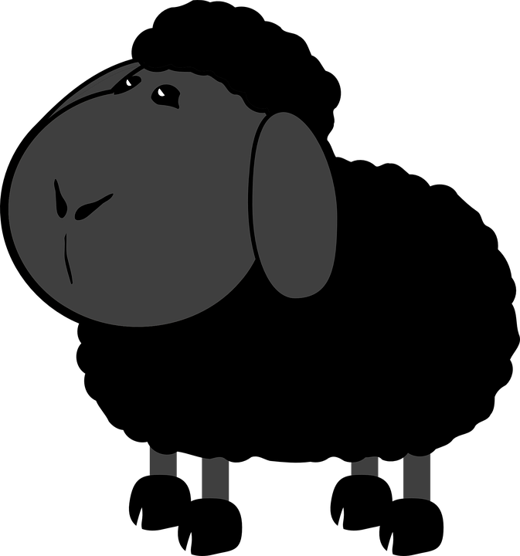
Black sheep, black sheep what do you see?
I see a goldfish looking at me.

Slide 10
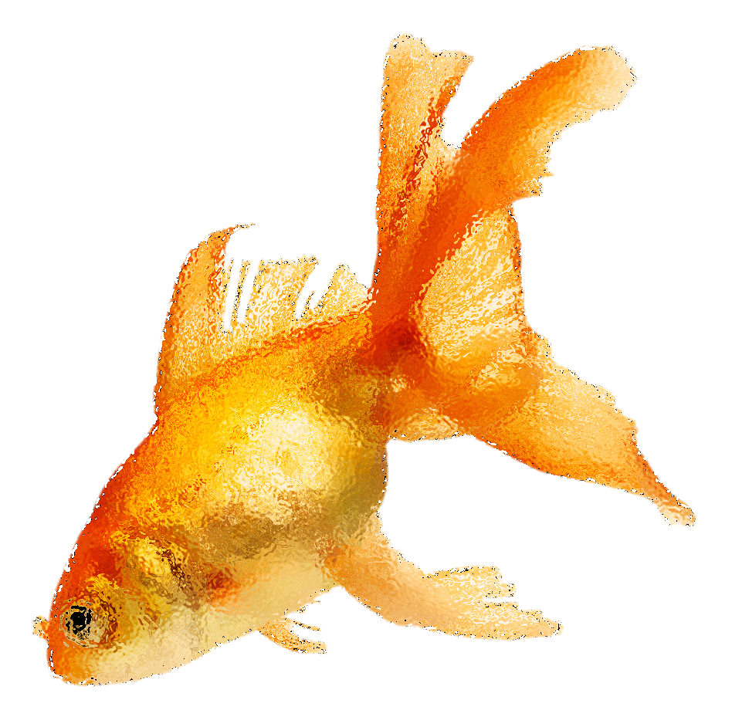
Goldfish, goldfish what do you see?
I see a monkey looking at me.

Slide 11
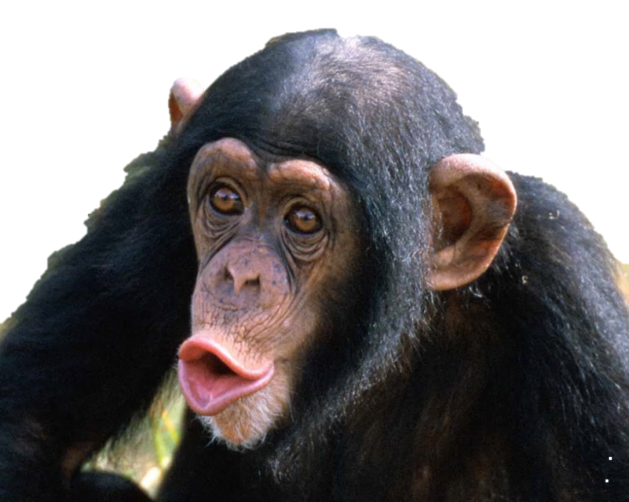
Monkey, monkey what do you see?
I see children looking at me.

Slide 12
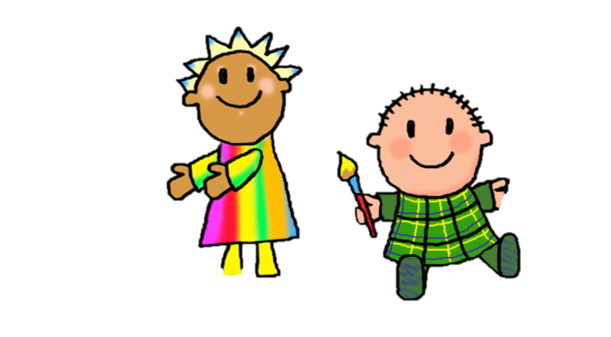
Children, children what do you see?
We see a…

Slide 13
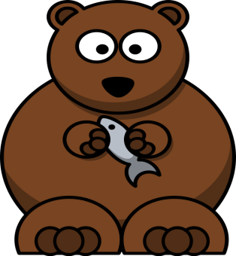
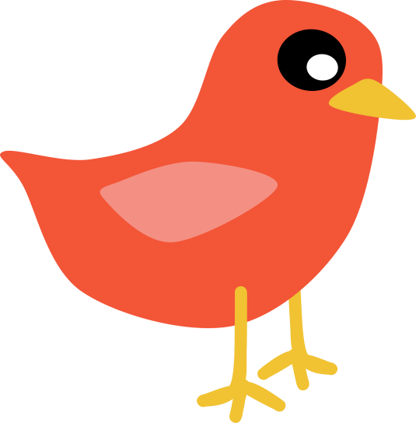
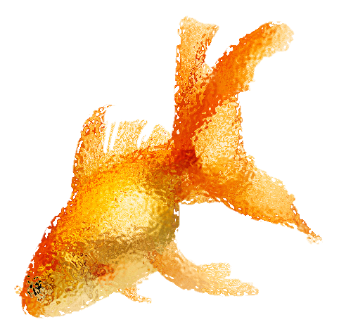
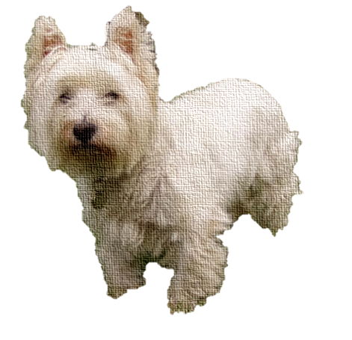
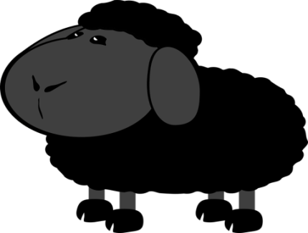
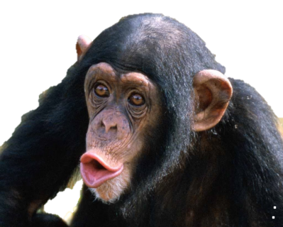
…looking at us.

Slide 14
That’s what we see.
The End

