Slide 1

I Like Gifts
| English
With: Ayelet Nesimi
Notes:
כתבו את המלל בהתאם ואת הציוד הדרוש.

Slide 2
What will we do today?
Today we are going to learn about ‘i’
We are going to read a story.
We are going to answer questions.
We’re going to make a poster.
We are going to have fun! Are you ready? Let’s go!

Slide 3
Can you…?
Say words that begin with short i and long i?
Recognize the letter i?
Write the letter i?
Read words with the letter i?

Slide 4
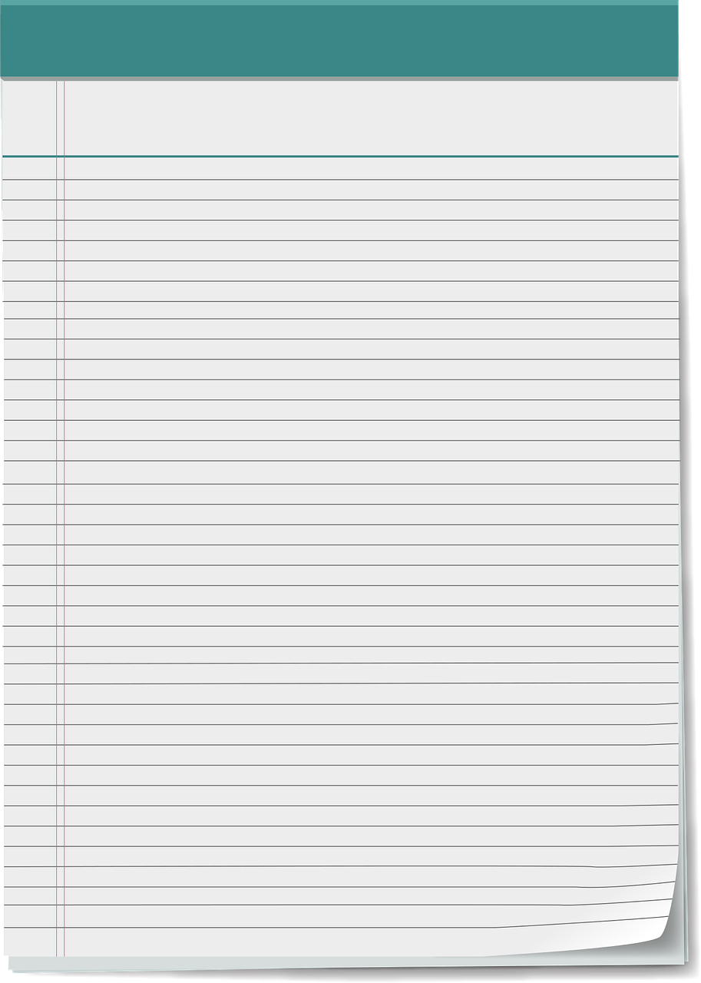

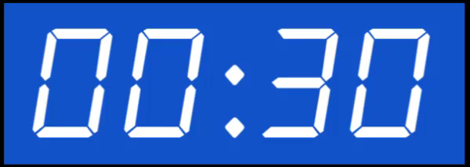
What do you need to prepare for the class?
Notes:
למחוק שקופית זו אם אין בה צורך.
משך השקף: דקה
בשקף זה ודאו שכולם הצטיידו בעזרים הנדרשים (מומלץ שעזרים אלו יהיו גם אצלכם עבור הדגמה).
מחקו את המיותר או הוסיפו במידת הצורך (הקפידו על זכויות היוצרים).
זה הזמן להציג את כללי ההתנהגות בשיעור: בקשו מהלומדים לסגור חלונות של יישומים אחרים במחשב, להרחיק אמצעים מסיחים, להתיישב בחדר שקט, להניח כוס מים לידם, ובעיקר להתמקד במפגש.

Slide 5

I like
Notes:
Hello My name is Ayelet and I like gifts!!!!! I like gifts with chocolate,

Slide 6

I like gifts with….
Notes:
Hello My name is Ayelet and I like gifts. I like gifts with chocolate! What gifts do you like?

Slide 7


Let’s start!

Slide 8
I i
Notes:
This is Ii! Hello Ii! I has 2 sounds- raise two hands for video one hand short I one hand long i

Slide 9
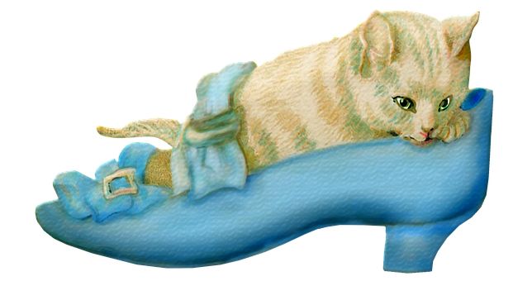
i
1
Notes:
1. in

Slide 10

i
2
1
Notes:
2. smile

Slide 11
i
2
1
Notes:
Let’s start with short I sound

Slide 12
New words
Notes:
The cat is in the shoe- in

Slide 13
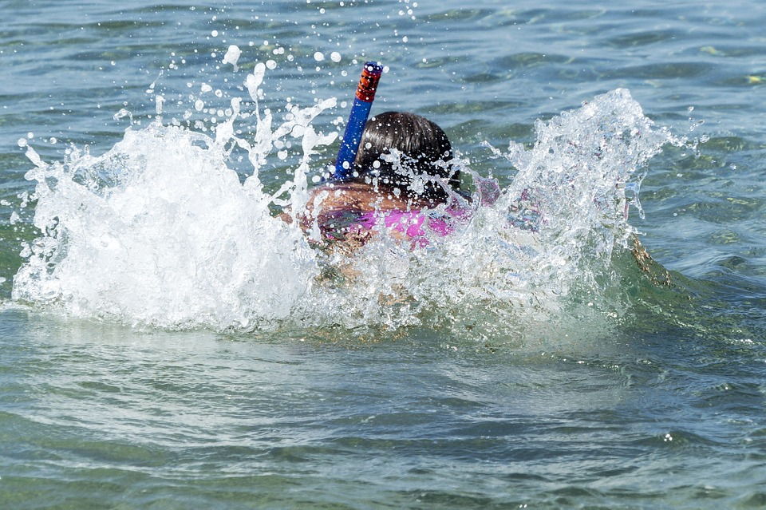
New words
Notes:
The girl swims in the water- swim

Slide 14

New words
Notes:
I have a ticket- ticket

Slide 15
New words
Notes:
It is a gift- gift

Slide 16
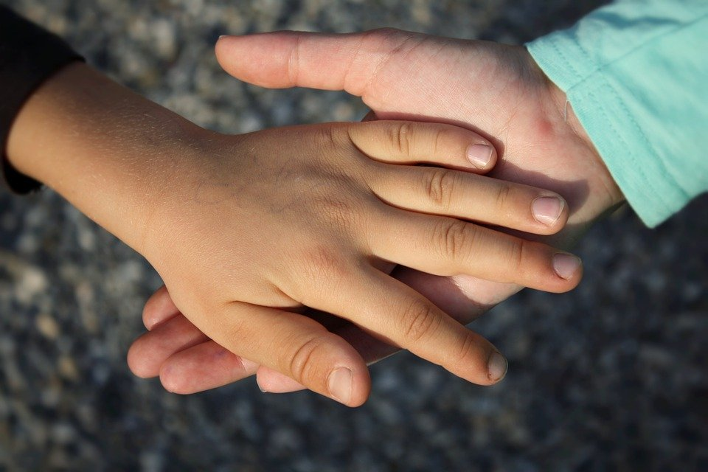
New words
Notes:
I walk with my friend- walk

Slide 17

Notes:
Where is gift?

Slide 19
Notes:
Where is in?

Slide 21
Notes:
Where is swim?

Slide 23
Notes:
Where is ticket?

Slide 25
Notes:
Where is with?

Slide 27
Let’s read
in
it
is
with
gift
swim
ticket

Slide 28
Match
swim
with
ticket
in
a gift

Slide 29

Match
ticket
swim
with
in
a gift

Slide 30
Match
swim
with
ticket
in
a gift

Slide 31
Match
in
swim
with
ticket
a gift

Slide 32
Match
swim
with
ticket
in
a gift

Slide 33
Match
swim
with
ticket
in
a gift

Slide 34
Match
swim
with
ticket
in
a gift

Slide 35
Match
a gift
swim
with
ticket
in

Slide 36
Match
swim
with
ticket
in
a gift

Slide 37
Match
with
swim
ticket
in
a gift

Slide 38
i
2
1
Notes:
2 different sounds Now we’ll do long i sound

Slide 39
i
Notes:
It even has a smiley

Slide 40
New Words
Notes:
Practice- Say it like: we’re sad, we’re bad, say it long

Slide 41
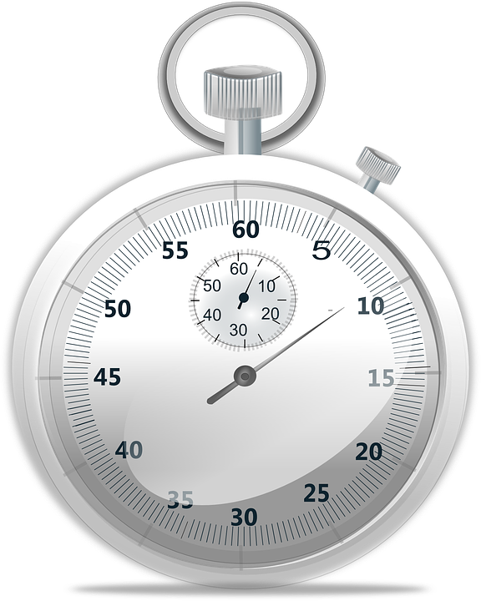
New Words
Notes:
There is time- time
Practice- Say it like: we’re tired, we’re hungry, short

Slide 42

New Words
Notes:
I like pizza- like
Practice- Say it like: we’re good, a mouse, with a zig zag

Slide 43

New Words
Notes:
I write in my notebook- write
Like we’re mad, like we’re falling, like a question

Slide 44

New Words
Notes:
I am happy- I

Slide 45
Notes:
Where is write?

Slide 47
Notes:
Time?

Slide 49
Notes:
Like?

Slide 51
Notes:
i?

Slide 53
Notes:
Smile?

Slide 55
i
2
1
Notes:
Remember? How do I know to say long i?

Slide 56

e
x
i_e
Notes:
The e is quiet shhhhhh…..

Slide 57
?
time
Notes:
How do I say it? timeeeee?

Slide 58


Oh no!
time
Notes:
‘e’ you make too much noise!!!!!! Be quiet!

Slide 59

Oh no!
time
Notes:
Help n Help!!!!!!!
No says n. We are not family

Slide 60
Oh no!
time
Notes:
F, f Help me l!!!!!!!
No says f. We are not family

Slide 61
Oh no!
time
Notes:
I help iiiiiiiiiiiiiiiiiiiiii!!!!!!!!!!!
I will help you e! We are family. You are my sister.

Slide 62
Let’s Read
fine
nine
five
write
time
smile
like
Notes:
Now I helps e. e is quiet (shhh) but I says his name

Slide 63
New Words
I
Notes:
I is special. When its by itself you say it’s name

Slide 64
Match
I
smile
time
like
write
fine

Slide 65
Match
like
I
smile
time
write
fine

Slide 66
Match
I
smile
time
like
write
fine

Slide 67
Match
I
smile
time
like
write
fine

Slide 68
Match
I
smile
time
like
write
fine

Slide 69
Match
time
I
smile
like
write
fine

Slide 70
Match
I
smile
time
like
write
fine

Slide 71
Match
smile
I
time
like
write
fine

Slide 72
Match
I
smile
time
like
write
fine

Slide 73
Match
write
I
smile
time
like
fine

Slide 74
1. in
1. in 2. smile 3. swim 4. ticket 5. like
6. gift 7. write 8. time 9. I 10. with

Slide 75
1. in | 2. smile
1. in 2. smile 3. swim 4. ticket 5. like
6. gift 7. write 8. time 9. I 10. with

Slide 76
1. in | 2. smile
3. swim
1. in 2. smile 3. swim 4. ticket 5. like
6. gift 7. write 8. time 9. I 10. with

Slide 77
1. in | 2. smile
3. swim
4. ticket
1. in 2. smile 3. swim 4. ticket 5. like
6. gift 7. write 8. time 9. I 10. with

Slide 78
1. in | 2. smile
3. swim | 5. like
4. ticket
1. in 2. smile 3. swim 4. ticket 5. like
6. gift 7. write 8. time 9. I 10. with

Slide 79
1. in | 2. smile
3. swim | 5. like
4. ticket
6. gift
1. in 2. smile 3. swim 4. ticket 5. like
6. gift 7. write 8. time 9. I 10. with

Slide 80
1. in | 2. smile
3. swim | 5. like
4. ticket | 7. write
6. gift
1. in 2. smile 3. swim 4. ticket 5. like
6. gift 7. write 8. time 9. I 10. with

Slide 81
1. in | 2. smile
3. swim | 5. like
4. ticket | 7. write
6. gift | 8. time
1. in 2. smile 3. swim 4. ticket 5. like
6. gift 7. write 8. time 9. I 10. with

Slide 82
1. in | 2. smile
3. swim | 5. like
4. ticket | 7. write
6. gift | 8. time
 | 9. I
1. in 2. smile 3. swim 4. ticket 5. like
6. gift 7. write 8. time 9. I 10. with

Slide 83
1. in | 2. smile
3. swim | 5. like
4. ticket | 7. write
6. gift | 8. time
10. with | 9. I
1. in 2. smile 3. swim 4. ticket 5. like
6. gift 7. write 8. time 9. I 10. with

Slide 84
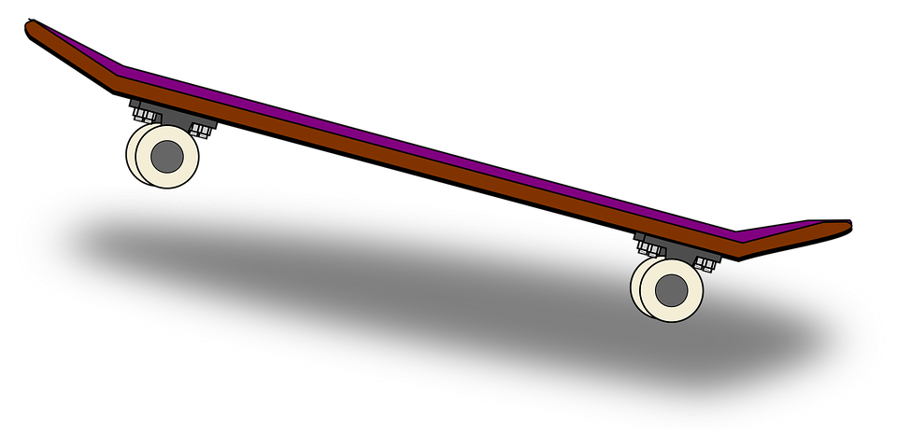
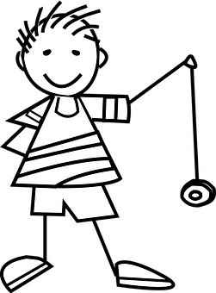


Gifts
Notes:
What do you want for a gift?

Slide 85
What is the gift?
Notes:
We’re going to hear a story.
Listen and find the gift in the story

Slide 86

Story Time
The Gift

Slide 87
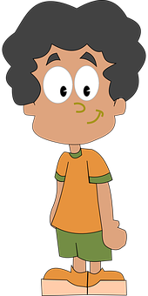


The Gift
This is Tim. Tim is sad.

Slide 88

The Gift
“Are you sad Tim?”

Slide 89

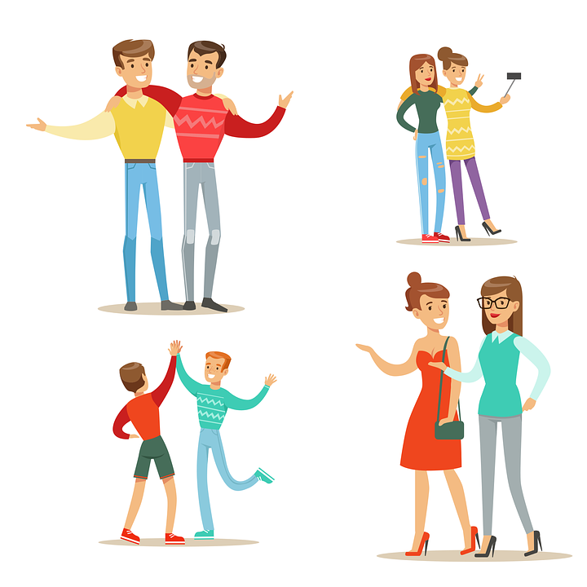
The Gift
“I am sad. I want .
Notes:
I am sad I want friends

Slide 90


The Gift
Tim sits and writes.
I am sad.

Slide 91
The Gift
My Tim is sad. I am sad.

Slide 92

The Gift
Mom has an .
Notes:
Mom has an idea

Slide 93
The Gift
This is a gift.

Slide 94
The Gift
What is it?
It is a gift!

Slide 95
The Gift
What is the gift?
It is a ticket!

Slide 96
The Gift
A ticket to swim!
Swim! ☺

Slide 97

The Gift
Time to swim Tim!

Slide 98
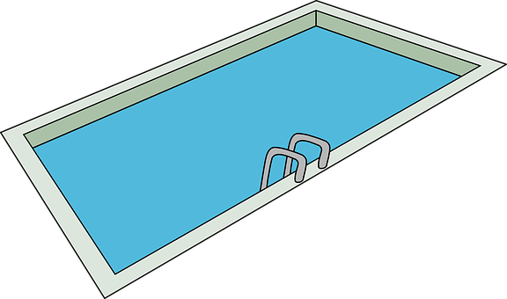
The Gift
Tim swims.

Slide 99
The Gift
Tim likes to swim. Tim swims and smiles.

Slide 100

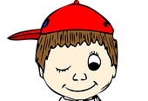
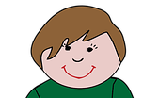
The Gift
Tim swims. Boys swim with Tim.

Slide 101
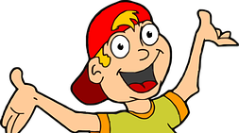
The Gift
Tim is with five boys. Tim likes the boys. The boys like Tim.

Slide 102
The Gift
Tim smiles. Mom smiles. Tim and Mom smile.

Slide 103
The Gift
Tim sits and writes and smiles.

Slide 104

The Gift
The end!

Slide 105
Gift?
Notes:
Did you find the gift?

Slide 106

Gift?
Notes:
Did you find the gift? Right the gift is a ticket!

Slide 107
Yes/No
Tim is sad.
Yes/No

Slide 108
Yes/No
Tim is sad.
Yes/No

Slide 109
Yes/No
2. Mom gives Tim a gift. Yes/No

Slide 110
Yes/No
2. Mom gives Tim a gift. Yes/No

Slide 111
Yes/No
3. Tim swims with nine boys. Yes/No

Slide 112
Yes/No
3. Tim swims with nine boys. Yes/No
Notes:
Tim swims with five boys

Slide 113
Yes/No
5. Tim smiles. Tim is happy. Yes/No

Slide 114
Yes/No
5. Tim smiles. Tim is happy. Yes/No

Slide 115
1,2,3…
2.
3.
4.
5.
1.
Notes:
Let’s put the pictures in the right place

Slide 116
1,2,3…
2.
3.
4.
5.
1.
Notes:
Let’s put the pictures in the right place

Slide 117
1,2,3…
2.
3.
4.
5.
1.
Notes:
Let’s put the pictures in the right place

Slide 118
1,2,3…
2.
3.
4.
5.
1.
Notes:
Let’s put the pictures in the right place

Slide 119
1,2,3…
2.
3.
4.
5.
1.
Notes:
Let’s put the pictures in the right place

Slide 120
1,2,3…
2.
3.
4.
5.
1.
Notes:
Let’s put the pictures in the right place

Slide 121

Make a poster
I like…
gifts
To swim
chocolate
Notes:
Make an I like poster

Slide 122


Now we can:
Say words that begin with short i and long i.
Recognize the letter i.
Write the letter i.
Read words with the letter i.

