Slide 1
מערכת שידורים לאומית
Notes:
כל התמונות כאן מ- freepic ומהספר HIGH SKY שאושר לנו

Slide 2
Mount Everest
English 7th Grade
Name of Teacher: Rivka Rosenberg

Slide 3
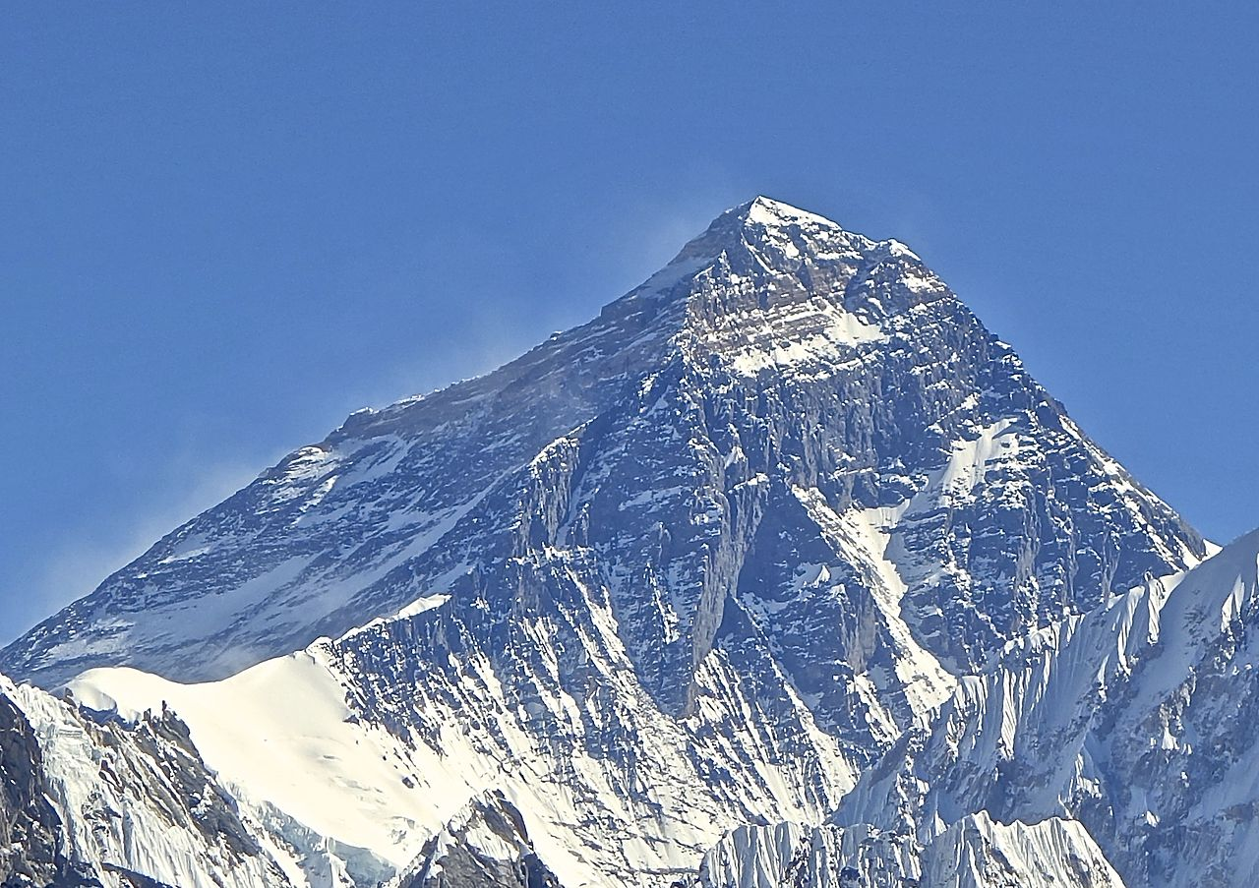
What do you see in the picture? Where do you think this is?

Slide 4
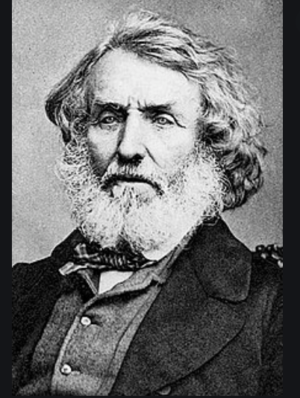
Mount Everest was named after Sir George Everest
of the
United Kingdom.

Slide 5
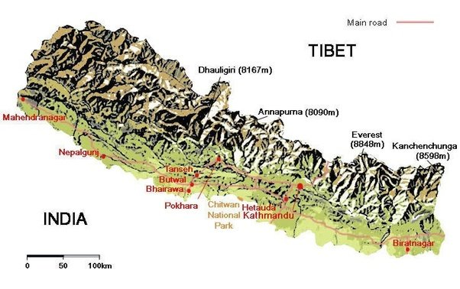
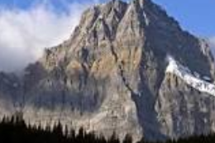
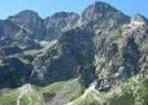
Important Vocabulary
Himalayan Mountain range
Mountain
Mountain range
China
Nepal

Slide 6
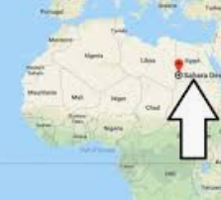
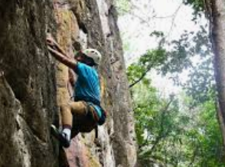
Important Vocabulary
Located
Reached
Climb

Slide 7
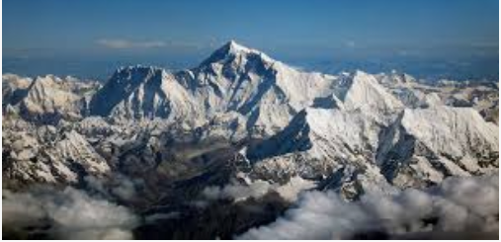
Mount Everest is located in the Himalayan Mountain range.
Mount Everest is the highest mountain the world.

Slide 8
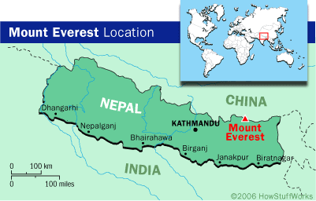
The Himalayan Mountains are also called the Himalayas and form the border between China, Nepal and India .
China
Nepal

Slide 9
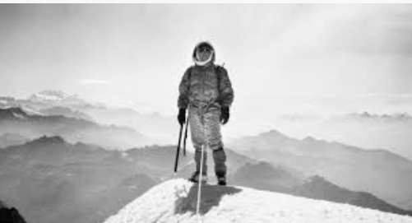
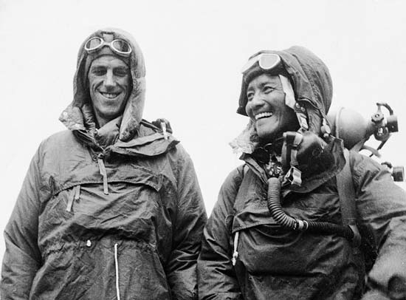
Sir Edmund Hillary from New Zealand and Tenzing Norgay from Nepal were the first to climb Mount Everest.

Slide 10
Answer the Following Questions
Where is Mount Everest?
Why is it named Mount Everest?
The Himalayan mountains are a border between which countries?
Who were the first two men to climb Mount Everest?

Slide 11
Answers
Where is Mount Everest? Mount Everest is located in the Himalayan Mountain range.
Why is it named Mount Everest? Mount Everest is named after Sir George Everest.
The Himalayan mountains are a border between which countries? China, Nepal and India.
Who were the first two men to climb Mount Everest? Sir Edmund Hillary from New Zealand and Tenzing Norgay from Nepal were the first to climb Mount Everest.

Slide 12
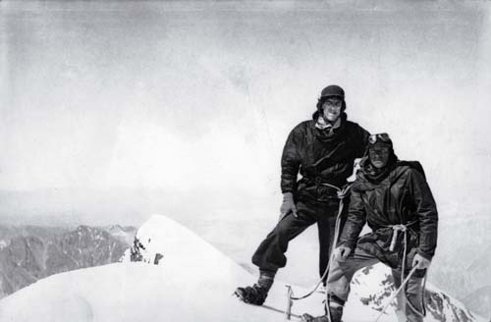
Sir Edmund Hillary and Tenzing Norgay reached the top of Mount Everest on May 29th , 1953

Slide 13
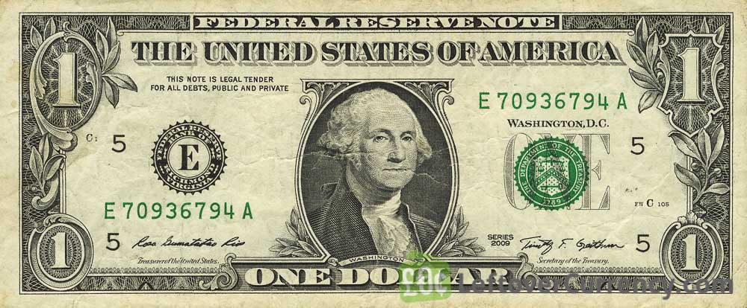
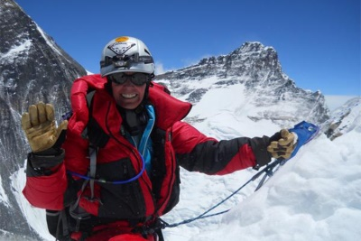
Did you know?
Climbing Mount Everest costs about $65,000 USD.

Slide 14
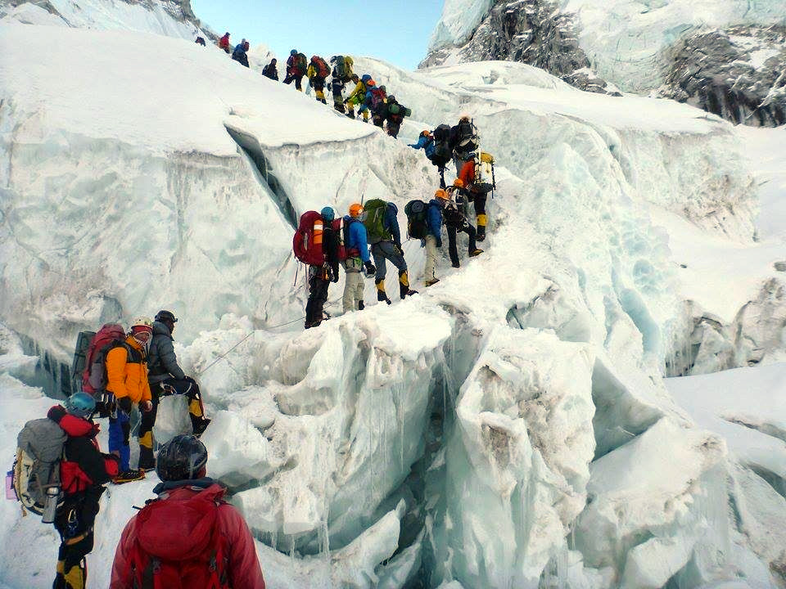
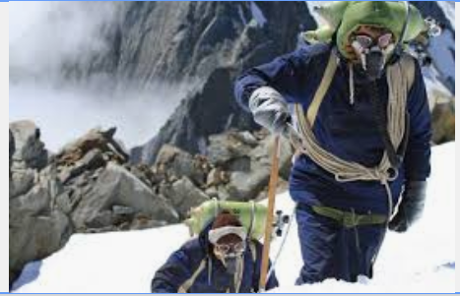
Exercise - Creative Writing
Look at the picture. Imagine you are Sir Edmund Hillary . You have just climbed Mount Everest. Write a letter to your family and friends about it. Share your letter with your teacher.

Slide 15
Break

Slide 16
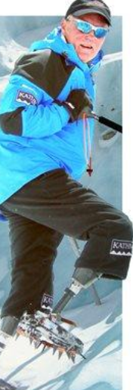
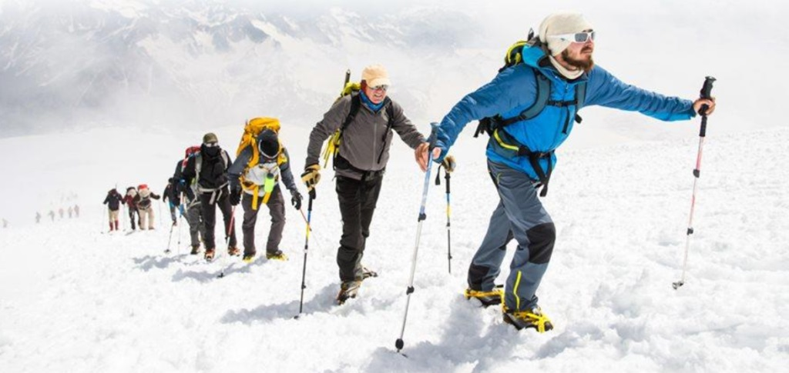
Do you like to climb mountains? Yes, I do. No, I don’t. In your notebook, write 4 sentences about what sports you like or you do not like to do.

Slide 17
Look at this picture. With a friend or with your family, talk about the picture. Use the phrases: Do you like? Yes, I do…. No, I do not.

Slide 18
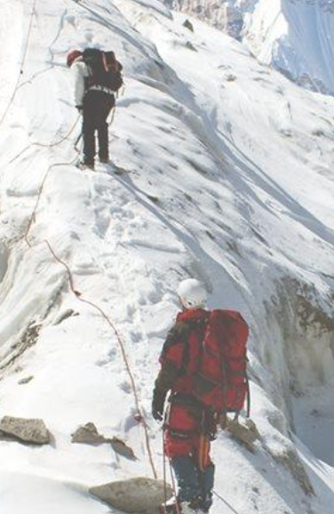

Slide 19
Choose Three Correct Answers

Slide 21
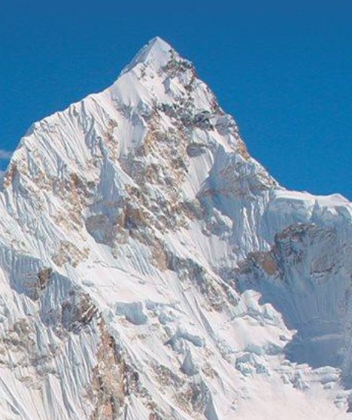
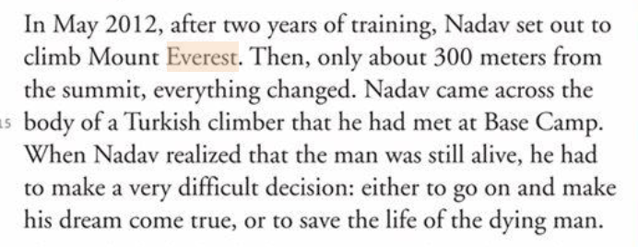
What do you think Nadav decided to do?

Slide 22
Exercise

Slide 24
Creative Assignment
Go on Tik Tok or WhatsApp.
Create a Video on the topic of: Mount Everest
Include the words from this lesson and as many adjectives as possible.
Send the video to your teacher.

Slide 25
Today’s Lesson was about
Mount Everest

Slide 26
השימוש ביצירות במהלך שידור זה נעשה לפי סעיף 27א לחוק זכות יוצרים, תשס"ח-2007. אם הינך בעל הזכויות באחת היצירות, באפשרותך לבקש מאיתנו לחדול מהשימוש ביצירה, זאת באמצעות פנייה לדוא"ל rights@education.gov.il

