Slide 1
מערכת שידורים לאומית

Slide 2
Role Play
English, JH & HS
Renee Binyamini and Rachelle Borenstein

Slide 3
Can you?
Talk to people to give and get information

Slide 4
Personal Information
Meeting someone new

Slide 5

Learning New Words
There are different ways to learn the new words, questions and answers. All of these are on the Let’s Talk site!
Notes:
https://sites.google.com/view/letstalk7/unit-2-role-play/Role-Play-Dialogues/Personal-Information

Slide 6
Which words do you need?
First name | שם פרטי | الاسم الشخصي
Last name | שם משפחה | اسم العائله
How do you spell…? | איך מאייתים...? | كيف تتهجى
How can I help you? | אפשר לעזור לך? | كيف يمكنني مساعدتك
Is this your first day? | יום ראשון שלך? | هل هذا هو يومك الاول
What do you do in your free time? | מה אתה עושה בזמנך הפנוי? | ماذا تفعل في وقت الفراغ؟
What class are you in? | באיזו כיתה את/ה? | في اي صف انت؟
I don’t know anyone. | אני לא מכיר/ה אף אחד. | لا اعرف احد

Slide 7
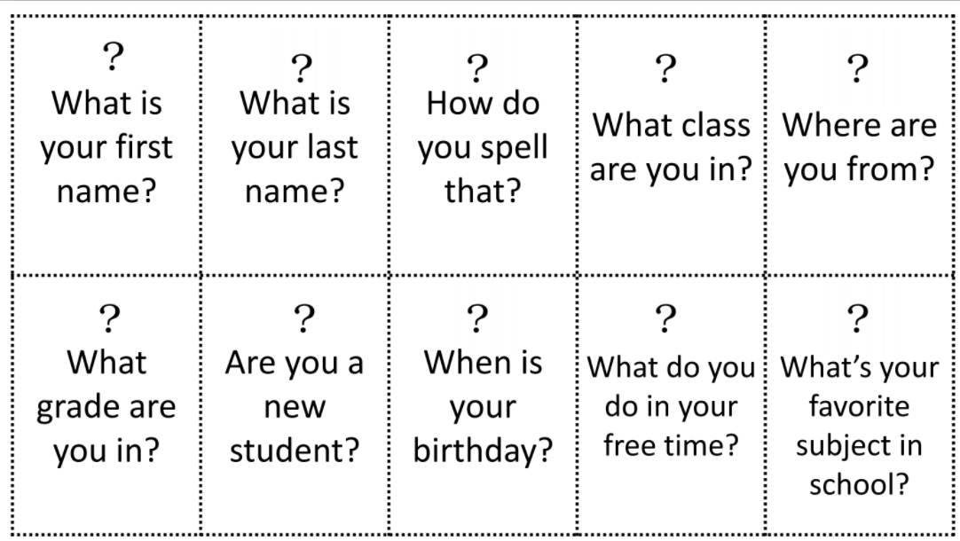
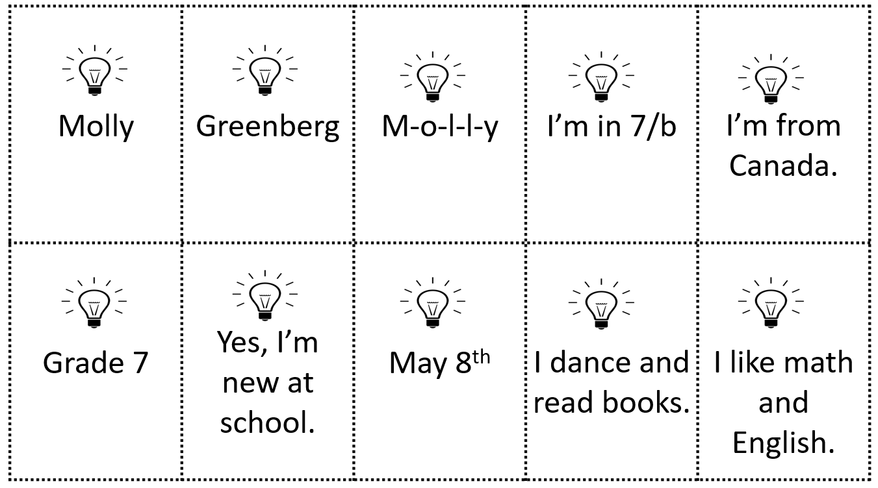
Question Cards for Personal Information
Notes:
https://drive.google.com/file/d/1EDAAQjzKPoE4pAemZIOPrj2HDYf4zWU5/view

Slide 8

Let’s Play with Quizlet
Notes:
https://quizlet.com/542681771/lets-talk-personal-information-questions-and-answers-flash-cards/?x=1jqt

Slide 9
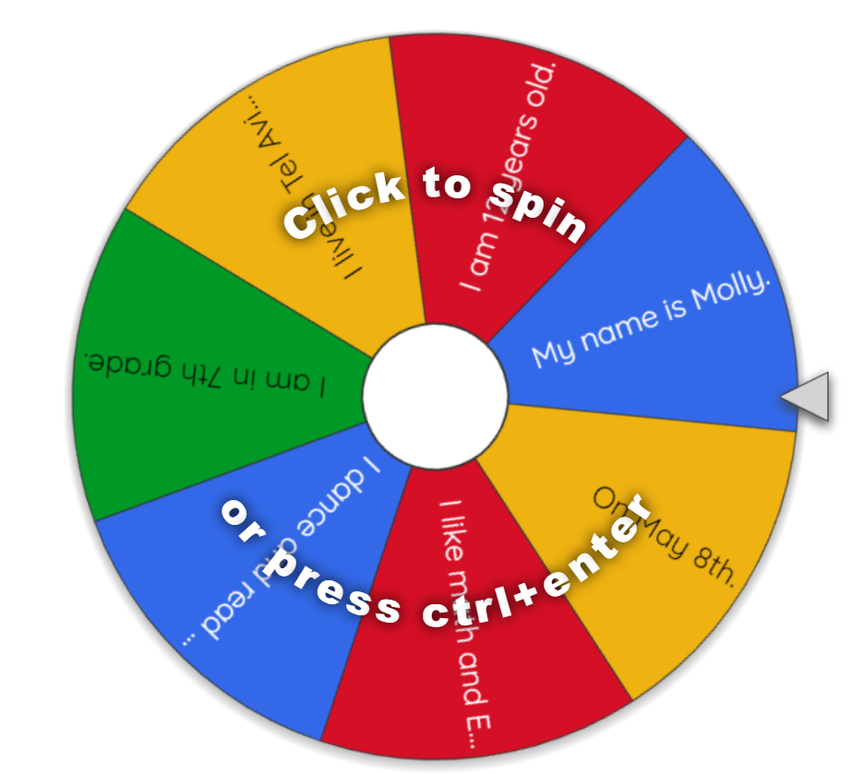
Can you remember the question to each answer?
Notes:
https://wheelofnames.com/view/ud3-mqd/

Slide 10

Watch and practice with a clip from the British Council
Notes:
https://www.youtube.com/watch?v=Ln5qotRMJvI&feature=youtu.be

Slide 11
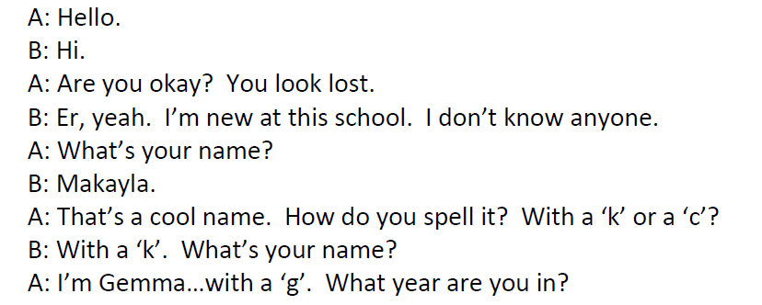
Here are the words of the “dialogue”

Slide 12
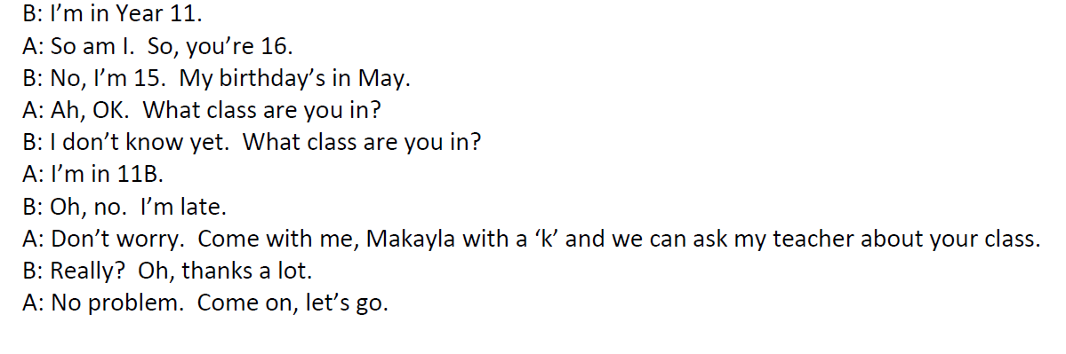
Year 11 = Grade 11

Slide 13

Pretend to be someone else
Think of a name.
Choose your age.
Choose a birthday.
Choose what class you are in.
Notes:
pixabay

Slide 14
Here are the words of the “dialogue”

Slide 16


Assessment تقييم הערכה
2. By yourself
1. In Pairs
Notes:
Dialogue – pixababay

Slide 17
Assessment تقييم הערכה
(1) Working in Pairs: Student A moved into a new house. Student B already lives there. Assessment by the teacher or friends.
A new family has moved into the house next door to you. They have a teenage son/daughter. You are going to get to know each other by asking and answering questions.
Ask about his/her name, age, grade, and where he/she lived before and about his or her hobbies.

Slide 18
OR: Assessment (2)
Prepare a monologue (the student talks about themselves for at least one minute.)
a. Tell your name, age, school, where you live.
b. Choose 2 other topics to speak about:
• Hobbies • Music
• School • Favorite food/ sport/activities
• Favorite movies/ books/ tv shows
(2) Working on your own.
Assessment by teacher.

Slide 19

Checklist
I can speak clearly.
I practiced.
I used the correct words.
I asked for help when I needed it.
Notes:
Image pixabay

Slide 20

Make a video and send it to your teacher

Slide 21

When we come back….

Slide 22
Break

Slide 23
Giving and Getting Directions
First….
Then…
Next…

Slide 24
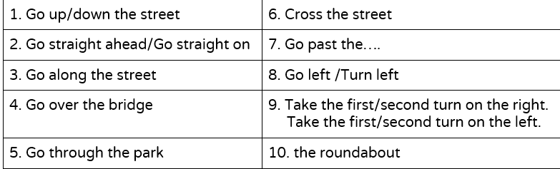
Which words do you need to know?

Slide 25

Giving Directions Vocabulary
Turn off cc – until 3:19
Notes:
https://www.youtube.com/watch?v=-_YoeEY8FPM&feature=youtu.be&t=10

Slide 26
Giving Directions – Match the Word
Right
Cross the street
A roundabout
Left
دوار כיכר
يمين ימין
شمال שמאל
اقطع الشارع לחצות את הכביש

Slide 27
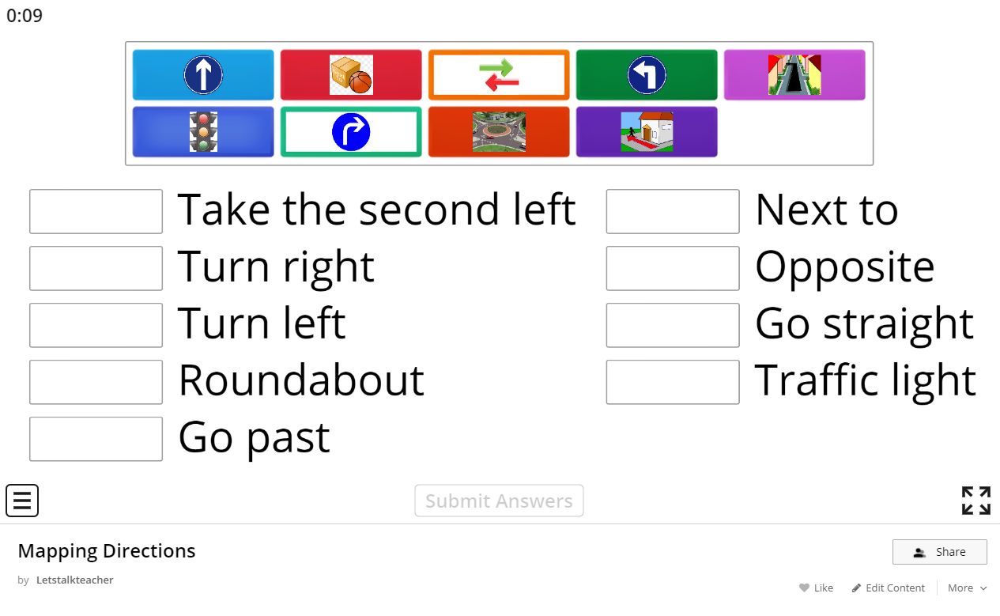
British Council Exercise - Match
https://learnenglishteens.britishcouncil.org/sites/teens/files/giving_directions_-_exercises_4.pdf`
Notes:
https://learnenglishteens.britishcouncil.org/sites/teens/files/giving_directions_-_exercises_4.pdf

Slide 28
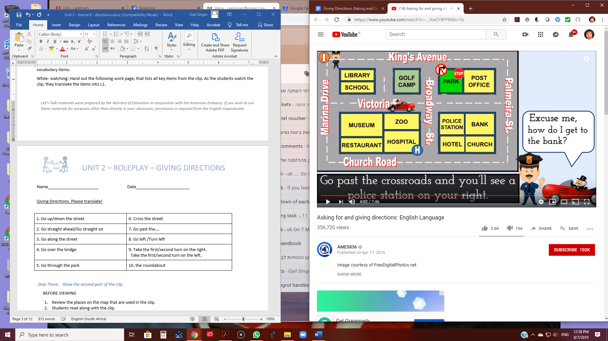
Map

Slide 29
Let’s Practice
Find a place to start.
Think of where you want to go. Ask for help and get directions, step by step, how to get there.

Slide 30
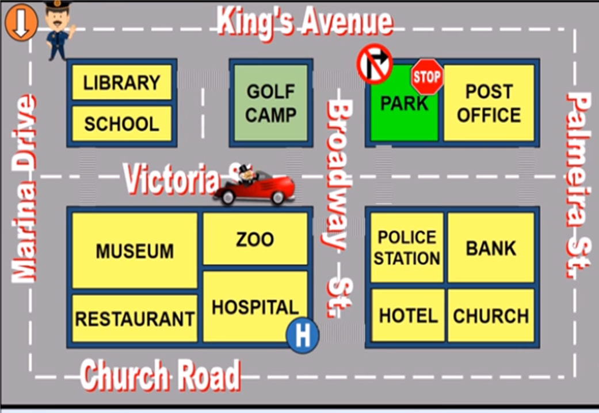
Dialogue 1
A: Excuse me, how do I get to the bank?
B: Go down Marina Drive and take the first left into Victoria St. Go along the street. Go past the crossroads and you’ll see a police station on your right. Go past the police station and you will be there.
A: Thank you.

Slide 31
Dialogue 2
A: Excuse me, can you tell me the way to the park?
B: Go along Church Rd. When you get to the hotel, turn right into Broadway St. and go up the street. Then, at the police station, turn right into Victoria St. and walk up to the crosswalk. Finally, cross the street and you are there.

Slide 32
Assessment تقييم הערכה
Use a map. Make a video explaining how to get from one place to another. Do you know how to give directions if someone asks you?

Slide 33
Checklist
I can speak clearly.
I practiced.
I used the correct words.
I asked for help when I needed it.
Notes:
Image pixabay

Slide 34

Giving Directions - Origami
Notes:
Image pixabay

Slide 35
Words for Origami
fold (verb) | לקפל | يطوي
make a crease | לעשות קפל | يثني
a straight line | קו ישר | خط مستقيم
a square | ריבוע | مربع
a triangle | משולש | مثلث

Slide 36

Making a Fish
Speed 0.75
Notes:
https://www.youtube.com/watch?t=30&v=ipsFC_GM9oc&feature=youtu.be

Slide 37
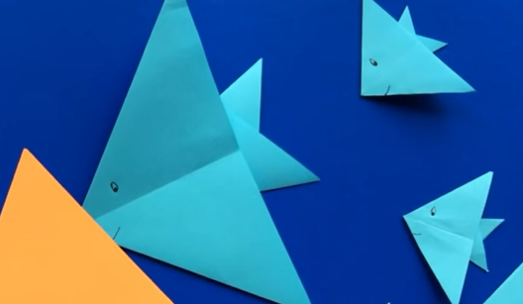
It’s your turn!
Get a piece of paper (a square – ריבוע/ مربع)
Watch the video and do each step as you see it in the clip.

Slide 38
Assessment Origami
Work in pairs. Explain how to make….a bird/a fish/something from the internet. Look online for “Easy Origami”.
Partner A: Describes how to make something.
Partner B: Listens and follows directions.
THEN SWITCH:
Partner B: Describes how to make the item. Partner A: Listens and follows directions.
Work alone: Describe and show how to make something at the same time.

Slide 39
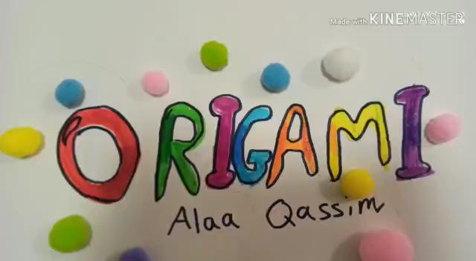
Here is an example from a student in Tira

Slide 40
Now you can …..
Talk to people and give and get information.

Slide 41

שימוש ביצירות מוגנות בזכויות יוצרים ואיתור בעלי זכויות
השימוש ביצירות במהלך שידור זה נעשה לפי סעיף 27א לחוק זכות יוצרים, תשס"ח-2007. אם הינך בעל הזכויות באחת היצירות, באפשרותך לבקש מאיתנו לחדול מהשימוש ביצירה, זאת באמצעות פנייה לדוא"ל rights@education.gov.il

