Slide 1
מערכת שידורים לאומית

Slide 2
Let’s Talk
English – JH & HS
Rachelle Borenstein & Renee Binyamini

Slide 3




Can you
Chant and Cheer
Say a tongue twister
Use your voice when you speak?

Slide 4



How do you feel about speaking English?

Slide 5


Slide 6

What if I make a mistake?
2 + 2 = 5
That’s ok! Nobody is perfect!
The way to learn how to speak is…to speak!

Slide 7

So…

Slide 8
What we will learn?
Fluency
שֶׁטֶף طلاقه
How to speak even with mistakes.
Accuracy دقه דיוק/
Don’t worry. We ALL make mistakes!
ACCENT מבטא/لهجه We ALL have different accents!

Slide 9
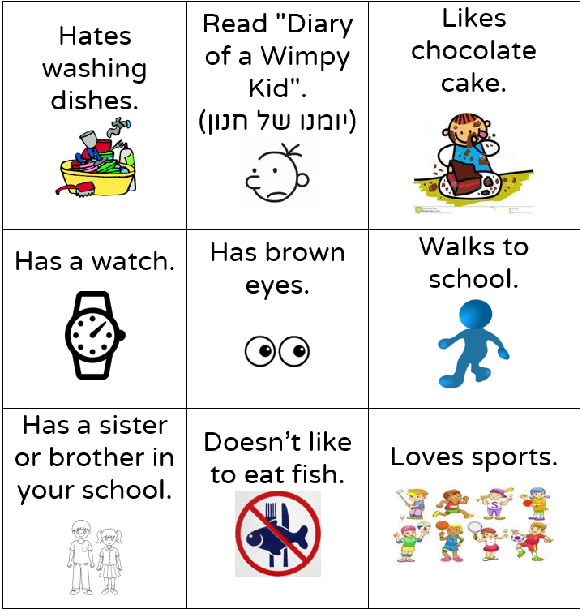
Let’s Play Human Bingo [in class]
Maybe your teacher will play Human Bingo with you. Ask him/her.

Slide 10


Now we will have fun…
…and speak
Notes:
לא מצאנו תמונות בpixabay

Slide 11

Let’s Chant and Cheer
Give me a W
Give me an O
Give me a W
What do you get??
WOW!!!

Slide 12


While you watch the clip:
Is it serious or funny? Can you cheer too?
Notes:
https://cliparts.zone/img/3405.jpg

Slide 13
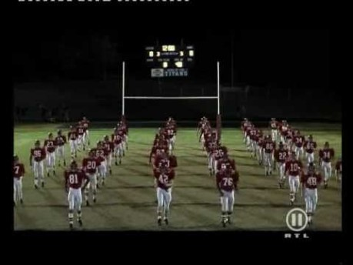
The Mighty Titans’ Cheer
Notes:
https://www.youtube.com/watch?v=betOQUfraN8&feature=youtu.be

Slide 14
Do they look funny?
Are they having fun?
YES!
What did we see in the clip?

Slide 15
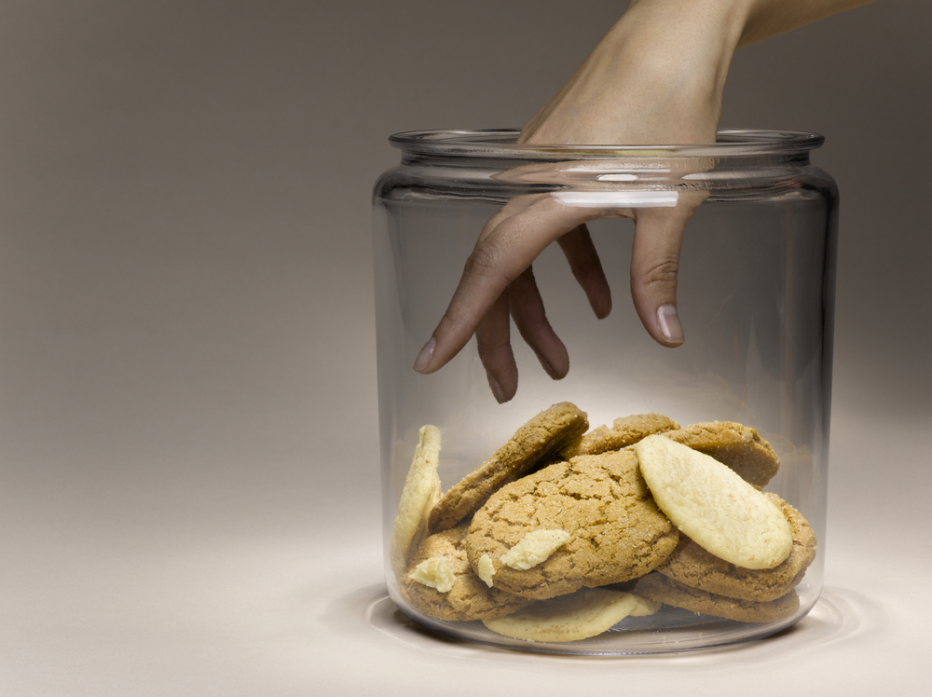
Now let’s listen and play

Slide 16
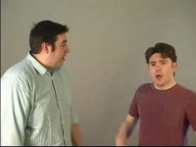
Who Stole the Cookies from the Cookie Jar?
Speed 0.75
Notes:
https://www.youtube.com/watch?v=Zwe6qWtKavY&feature=youtu.be&t=48

Slide 17

Your Turn!
Everyone: Who stole the cookies from the cookie jar?
Student A: Omer stole the cookies from the cookie jar.
Omer: Who me?
Everyone: Yes you!
Omer: Couldn't be!
Everyone: Then who?
Omer: Dina stole the cookies from the cookie jar.
REPEAT with the new name.
Ask your teacher to play this in class.

Slide 18
Using Funny Songs

Slide 19
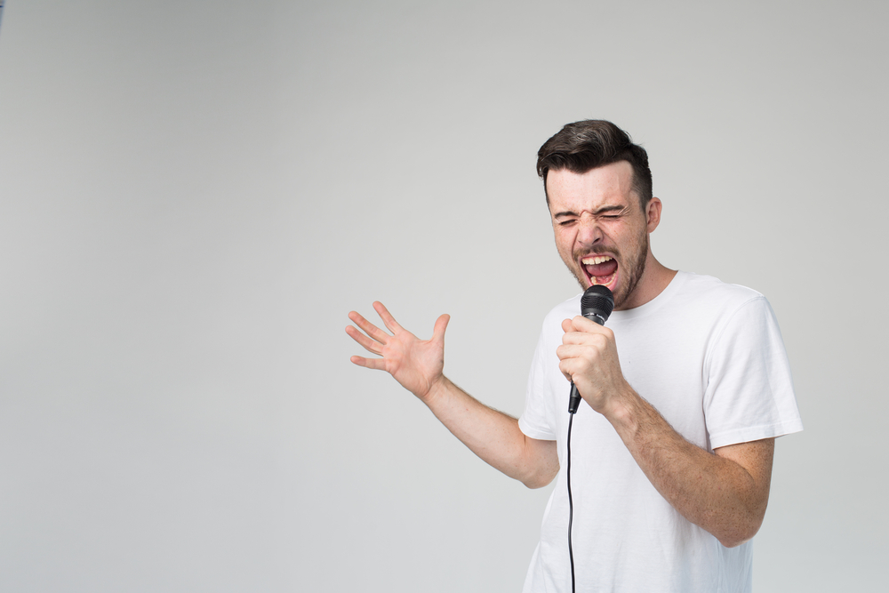
Singing together is lots of fun!
Follow the lyrics (the words of the song)
Listen to the music
Sing TOGETHER! If you make a mistake, no one will hear!

Slide 20
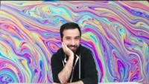
I Am Slowly Going Crazy
Until 2min 38 seconds
Notes:
https://www.youtube.com/watch?v=imM4QEBYn44&feature=youtu.be&t=55

Slide 21
Do you remember the words?
“I am slowly going crazy.
1….2….3…..4….5….6 SWITCH!
Crazy going slowly am I
6….5…..4….3….2…1 SWITCH!”

Slide 22
Summary
We chanted and cheered
We sang songs
We had FUN!

Slide 23
Break
See you soon

Slide 24
Stress and Intonation

Slide 25

How can your voice change what you mean?
Take the word “Today”
Say it as if you are bored. “Today?”
Say it as if you are excited! “Today!”
Say it as if you are surprised: “Today?”

Slide 26
Try it with: “Really”
Teacher: “There is no homework today.”
Student: ________
Student: “My dog ate my homework.”
Teacher: ______________
Parents: “It’s time to go to bed.”
You: ______________

Slide 27
The way you say a word changes the meaning
“I never said she took my money.”

Slide 28
How does the meaning change?
I never said she took my money.
I never said she took my money.
I never said she took my money.
I never said she took my money.
I never said she took my money.
I never said she took my money.
I never said she took my money.

Slide 29
Tongue Twisters

Slide 30
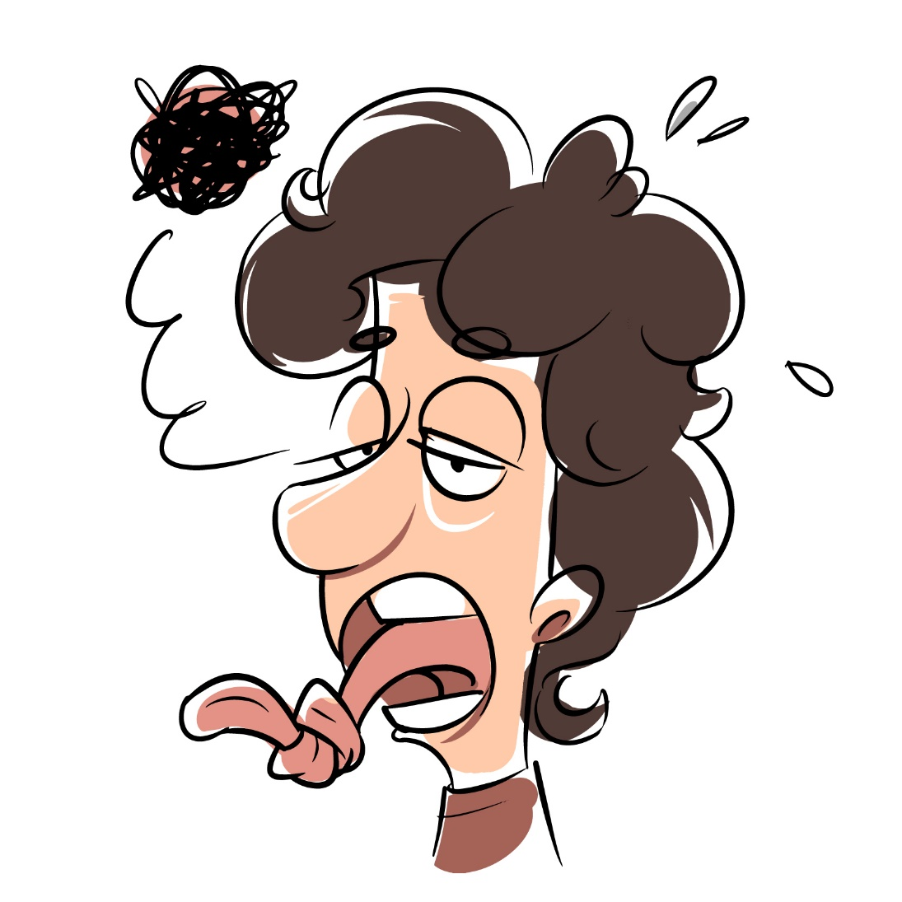
Trying Tongue Twisters

Slide 31

Can YOU try this one?
Until 5:59
Notes:
https://www.youtube.com/watch?v=ZCGnT25PZA4&feature=youtu.be&t=278

Slide 32
Try these:
“She sells sea shells by the sea shore.”
Say it slowly.
Say it quickly
Say it 2X in a row

Slide 33
Let’s write a new tongue twister:
1. Choose a name (Betty)
2. Choose a verb (bought)
3. Choose an adj (beautiful)
4. Choose a noun (bananas)
5. Choose a place (bakery, bar,)
The tongue twister: “Betty bought beautiful bananas in the bakery.”

Slide 34
Name
Verb
Adjective
Noun
Place
ten
took
Tim
Tokyo
teenagers

Slide 35
My Tongue Twister with T
Tim
took
ten
teenagers
to
Tokyo
.

Slide 36

Now it’s your turn:
1. Choose a letter of the ABC.
2.Choose a name
3. Choose a verb (better in the past tense)
4. Choose an adjective and a noun
5. Choose a place

Slide 37

Choose One Task
Make a recording of yourself:
Saying a Chant or a Cheer
OR
2. Singing a song
OR
3. Saying a tongue twister
Send it to your teacher.
Notes:
Image pixabay

Slide 39
Now you can …..
Chant and cheer
Sing songs
Say Tongue Twisters
HAVE FUN!
Use your voice to say what you mean

Slide 40


