Slide 1
מערכת שידורים לאומית
Notes:
כל התמונות כאן מ- freepic ומהספר HIGH SKY שאושר לנו

Slide 2
Dance - Vocabulary Band II
English
Teacher: Rivka Rosenberg

Slide 3
Can you…?
read, understand and use Band II vocabulary words and phrases
engage in creative assignments that include Band II vocabulary words and phrases

Slide 4
Stages to Learning Vocabulary
Exposure
Practice
Review
Production

Slide 5
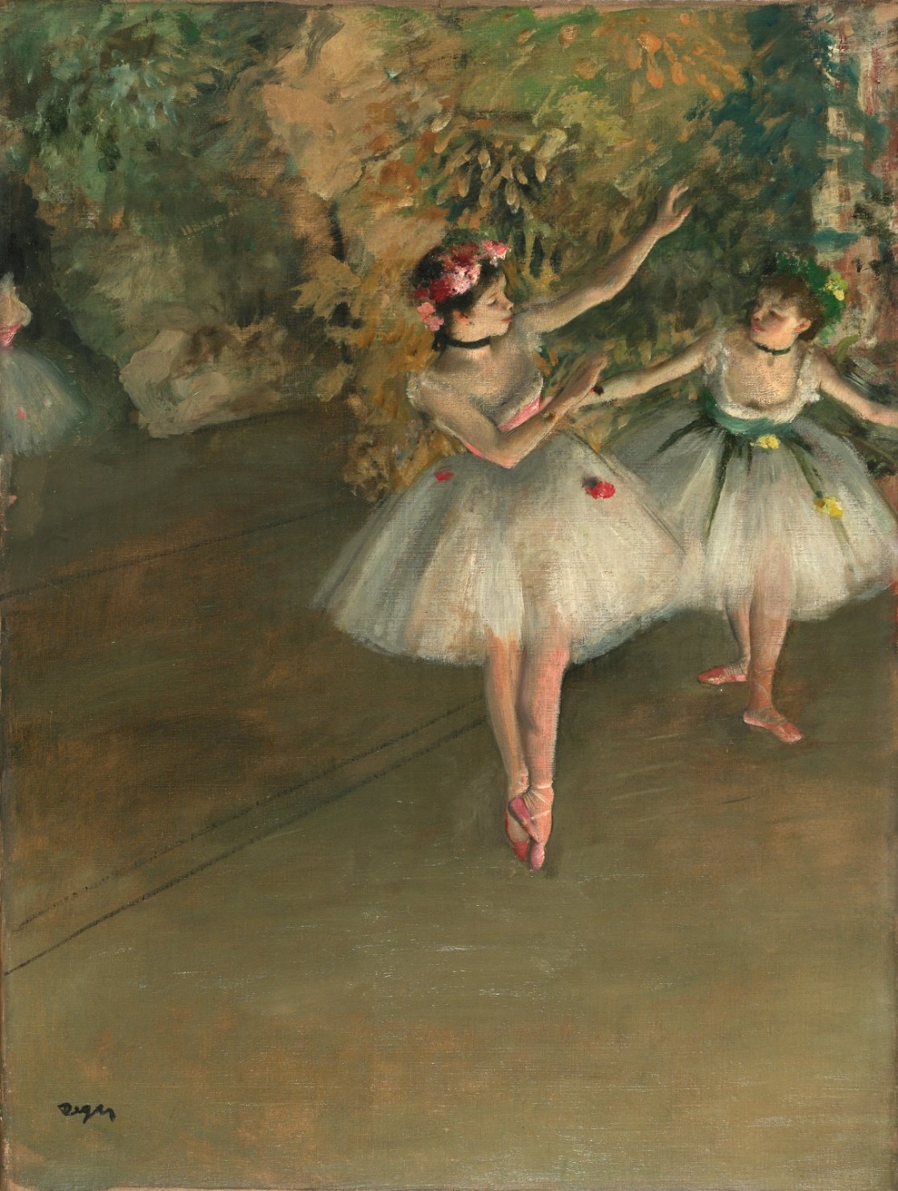
How do you feel when you look at this painting?

Slide 6
New Vocabulary Words
type | סוג | نوع | dance | ריקוד | ارقص
at first | בהתחלה | في البدايه | include | כולל | تتضمن
 |  |  | was born | נולד | ولد

Slide 7
Type
What kind of art do you like? | type (noun) division, kind of thing
I can type the letter on my computer. | type (verb) To write with a keyboard.

Slide 8
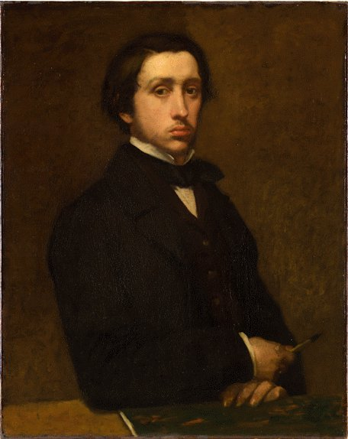
This is Edgar Degas. He was born in Paris, France in 1834.

Slide 9
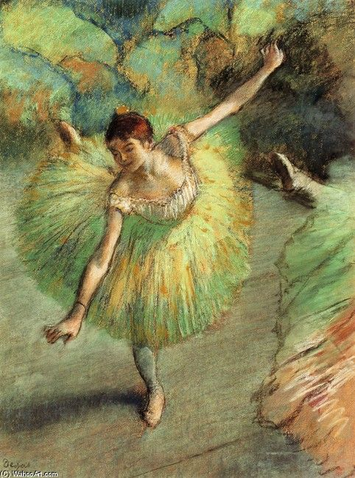
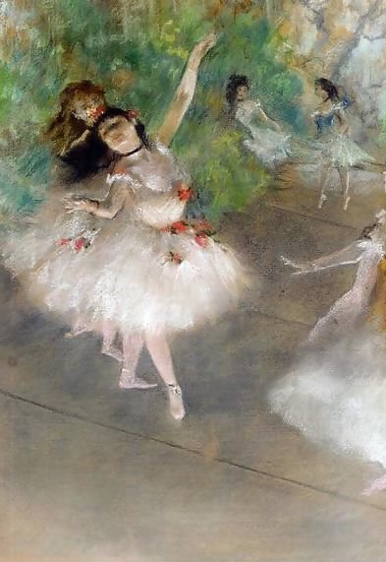
Edgar Degas was a French artist famous for his paintings of ballet dancers.

Slide 10
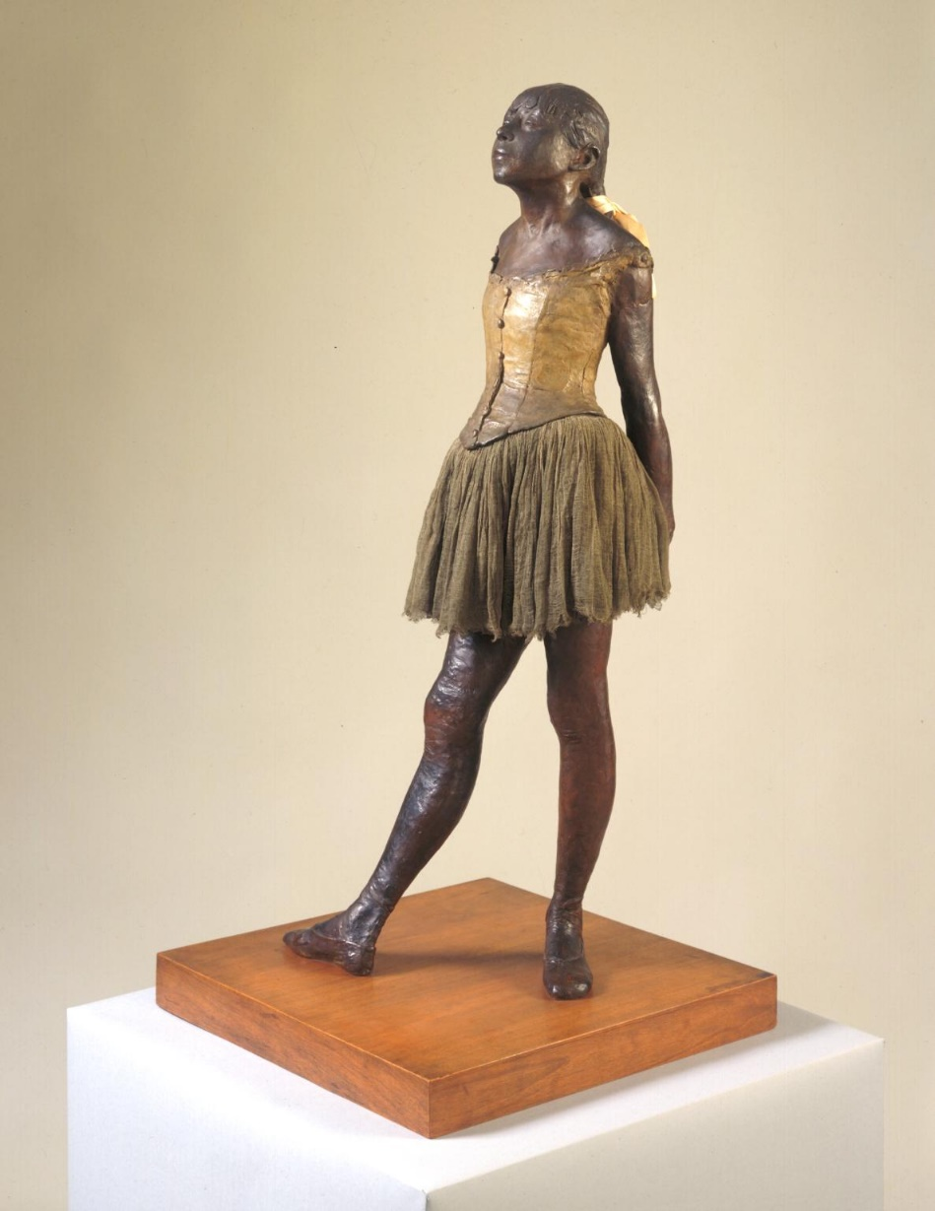
Degas’s art also includes bronze sculptures. All of Dega’s dancers dress in tutu’s. They are ballet dancers. Ballet is a type of dance.

Slide 11
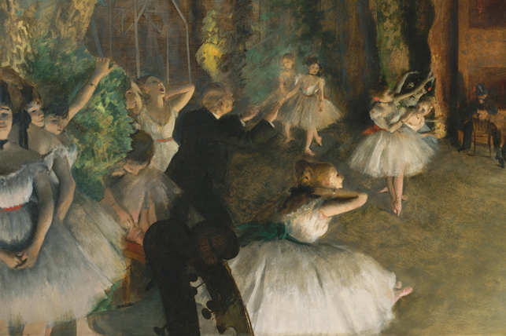
At first, Degas wanted to draw only historical paintings, but then he became interested in drawing dancers.

Slide 12
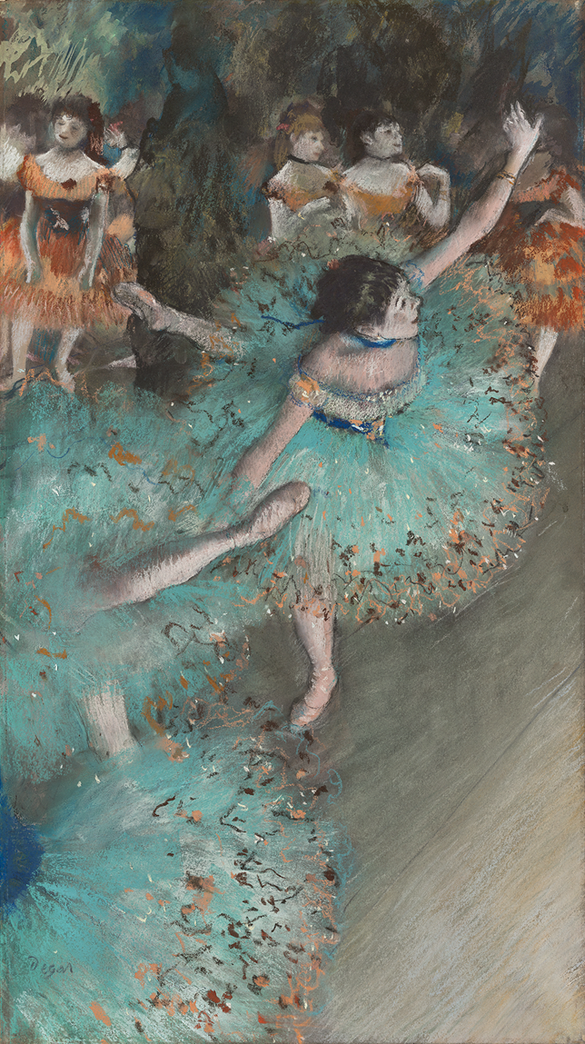
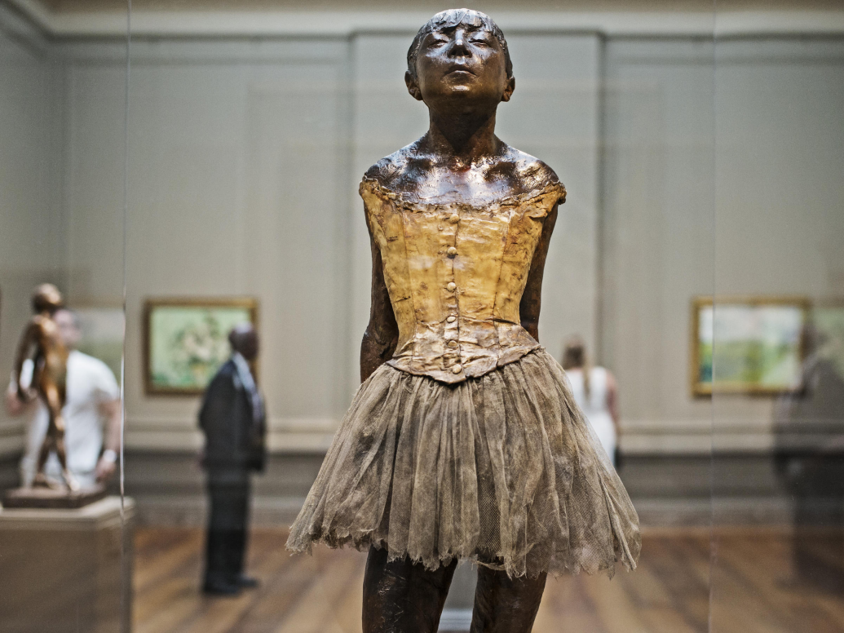

Slide 13
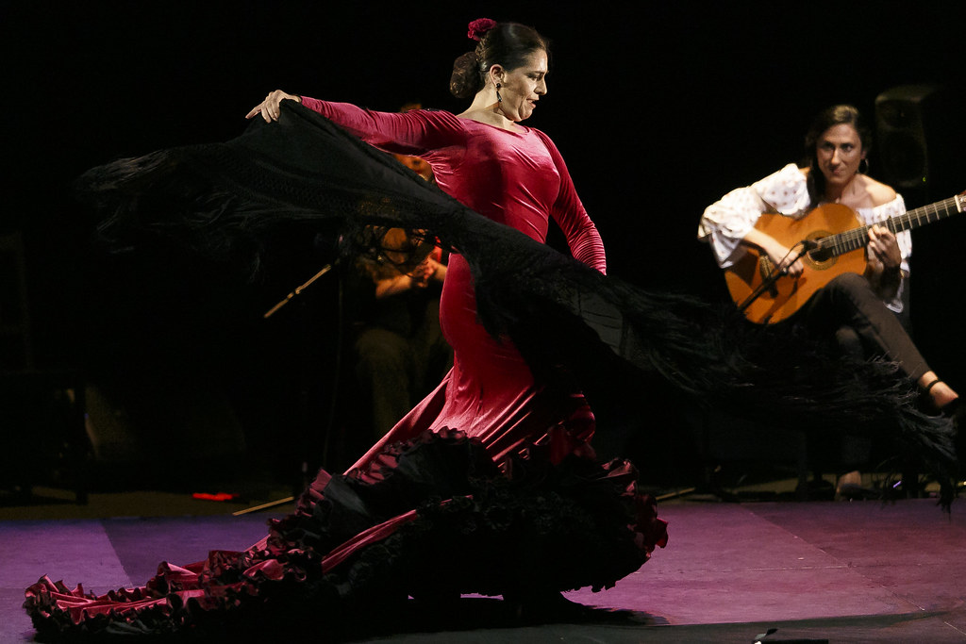
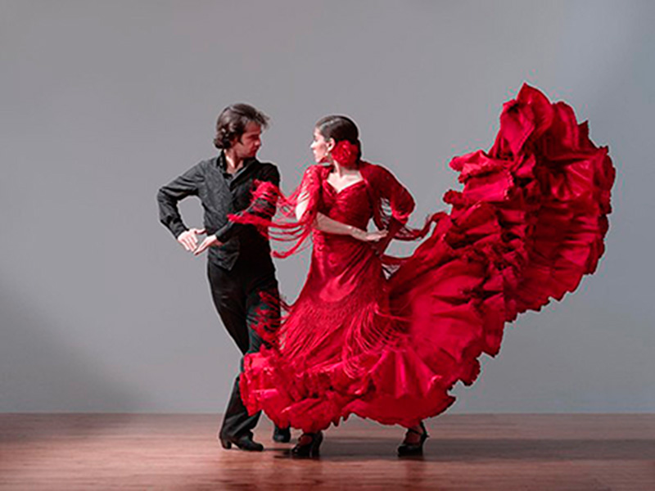
Another type of dance- Flamenco

Slide 14
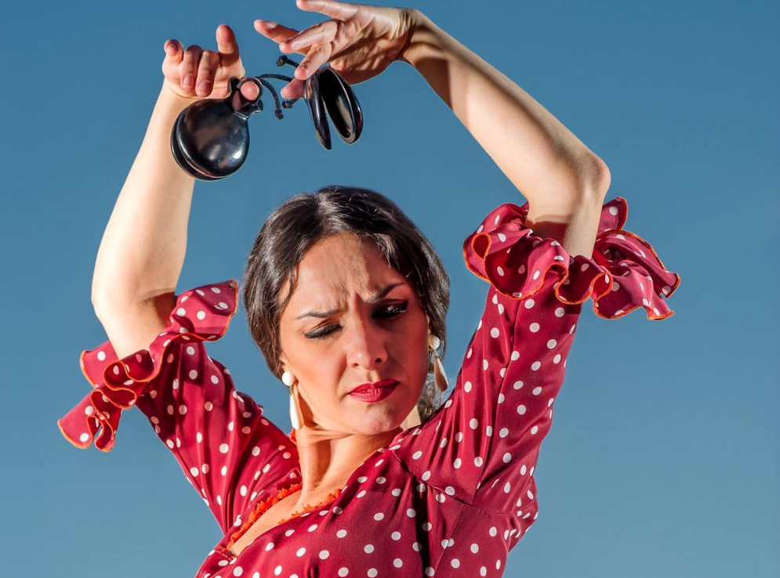
Flamenco Dancers
https://www.youtube.com/watch?v=XNhfV_53W7A

Slide 15
The Flamenco Dance
Flamenco is a Spanish_______ of _______ . Rachel loves to watch Flamenco dance shows.
B. The shows _______ Flamenco dance and Spanish music.
C. ______, Rachel did not like Flamenco shows, but then she went to Spain and watched famous Spanish______ . Right away Rachel fell in love with Flamenco.
1.include 2. at first 3. dance 4. dancers
5. type

Slide 16
The Flamenco Dancers
A. Flamenco is a Spanish _type of dance_ . Rachel loves going to Flamenco dance shows.
B. The shows _include_ dance and music.
C. _At first_, Rachel did not like Flamenco shows, but then she travelled to Spain and saw original shows with famous _dancers_. Right away Rachel fell in love with Flamenco. Would you like to see a Flamenco dance?
1.include 2. at first 3. dance 4. dancers
5. type

Slide 17
Game Complete the picture by filling in the sentences

Slide 18
Degas ____ ____in 1834 Paris.

Slide 19
Degas _was born_in 1834 Paris.

Slide 20
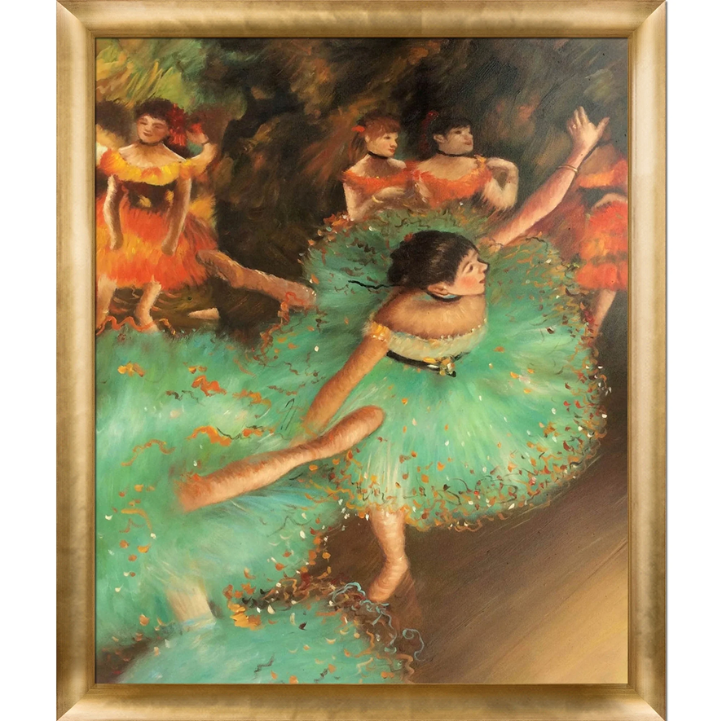
Ballet and Flamenco are ______ of ______.

Slide 21
Ballet and Flamenco are types of dance.

Slide 22
____ Degas drew history paintings, but then he changed to dance.

Slide 23
At first, Degas drew history paintings, but then he changed to dance.

Slide 24
Dance shows ____ music and dance.

Slide 25
Dance shows include music and dance.

Slide 26
Bravo! Congratulations!

Slide 27
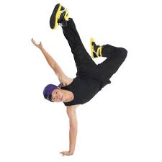
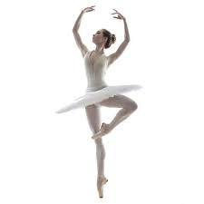
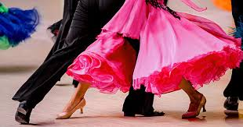
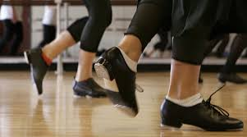
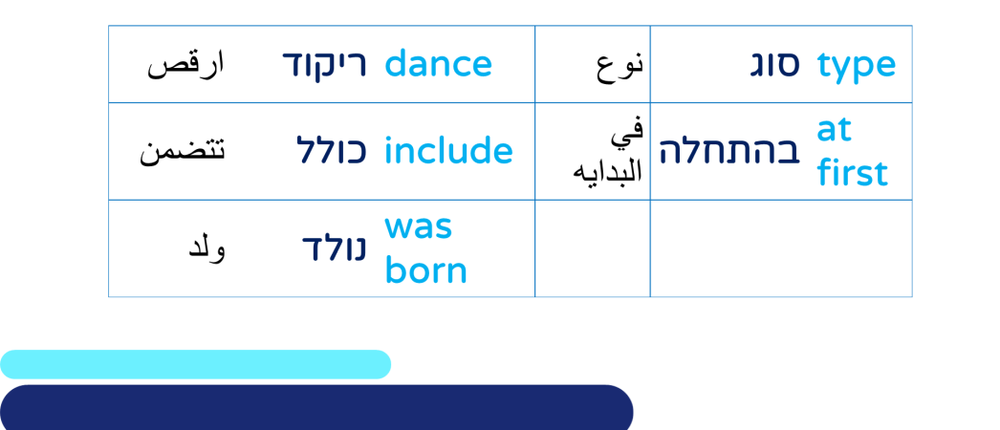
Writing Activity
Please write 2 sentences about the type of dance you like. Please use the new vocabulary words below.

Slide 28
Now you can…
read, understand and use Band II vocabulary words and phrases
engage in creative assignments that include Band II vocabulary words and phrases.

Slide 29
Today’s lesson was about: Dance - Vocabulary Band II
English
Teacher: Rivka Rosenberg

Slide 30
השימוש ביצירות במהלך שידור זה נעשה לפי סעיף 27א לחוק זכות יוצרים, תשס"ח-2007. אם הינך בעל הזכויות באחת היצירות, באפשרותך לבקש מאיתנו לחדול מהשימוש ביצירה, זאת באמצעות פנייה לדוא"ל rights@education.gov.il
שימוש ביצירות מוגנות בזכויות יוצרים ואיתור בעלי זכויות

Slide 31
Break

Slide 32
Opera - Vocabulary Band II
English
Teacher: Rivka Rosenberg

Slide 33
Can you…?
read, understand and use Band II vocabulary words and phrases
engage in creative assignments that include Band II vocabulary words and phrases

Slide 34
Stages to Learning Vocabulary
Exposure
Practice
Review
Production

Slide 35
Close your eyes and listen to this. What do you feel when you hear this?
https://www.youtube.com/watch?v=l1C8NFDdFYg

Slide 36
According to these vocabulary words,
what do you think the text is about?
to imagine | לדמיין | تخيل | singers | זמרים | المطربين
even | אפילו | حتى في | once | פעם אחת | ذات مرة
an experience | חוויה | تجربة | exciting | מרגש | مثير
both... and… | גם... וגם... | كلاهما و...

Slide 37
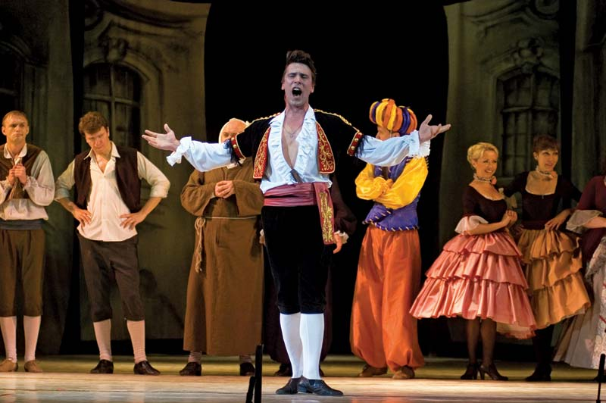
Dan loves opera. Whenever he hears opera, he closes his eyes and imagines the singers.

Slide 38
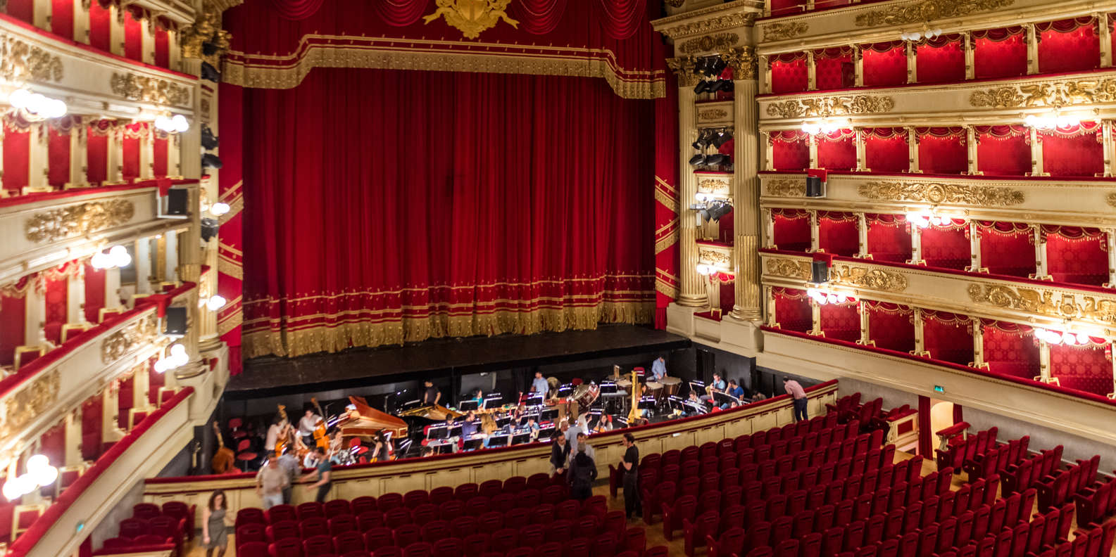
Once, he watched on T.V. an Opera at the most famous La Scala Opera House in Milano, Italy.

Slide 39
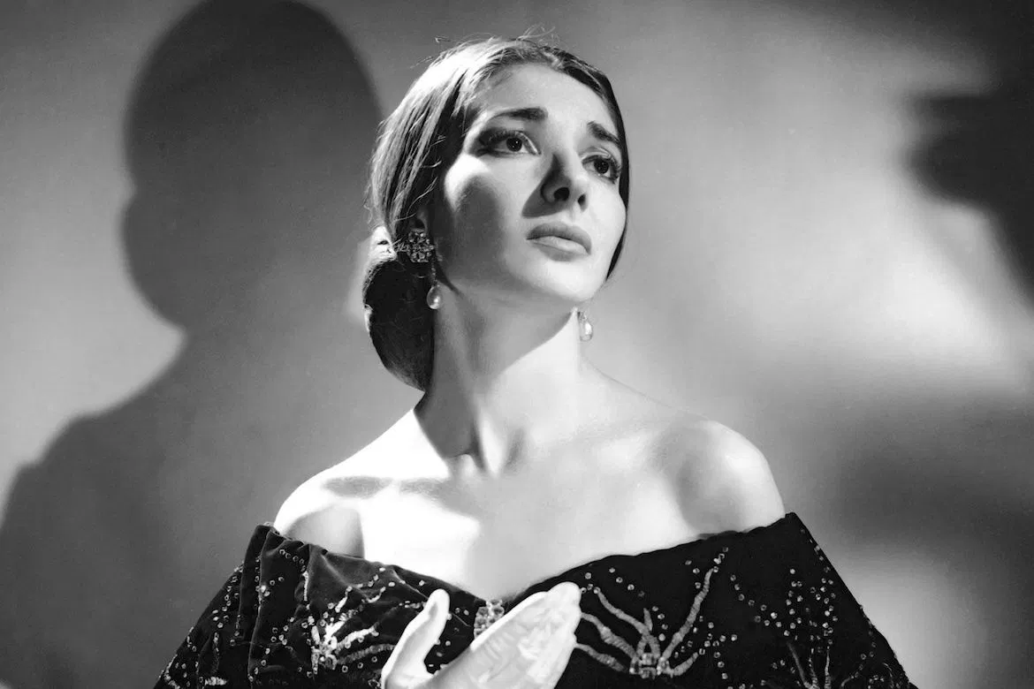
Maria Callas was the most famous opera singer of all times. Dan even has a collection of all of Maria Callas’s opera music recordings at home.

Slide 40
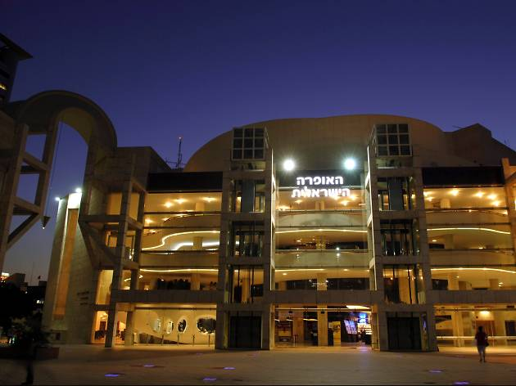
Dan likes to go to the Opera in Tel Aviv. He said: “Some people like to go to basketball games, I love going to the opera . It is an exciting experience. “ Both Dan and his friend Susie go to the opera in Tel Aviv every month.

Slide 41
Connect the word to its meaning
to imagine | one time
once | a special event in your life
an experience | something great happening
exciting | to see a picture in your head

Slide 42
Connect the word to its meaning
to imagine | one time
once | a special event in your life
an experience | something great happening
exciting | to see a picture in your head

Slide 43
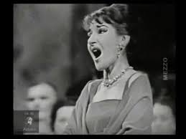
Writing Activity
Listen to this: https://youtu.be/TKDXr_fimQ8
Please write 5-6 words that you feel while listing to the opera.
Please use the new vocabulary words below.

Slide 44
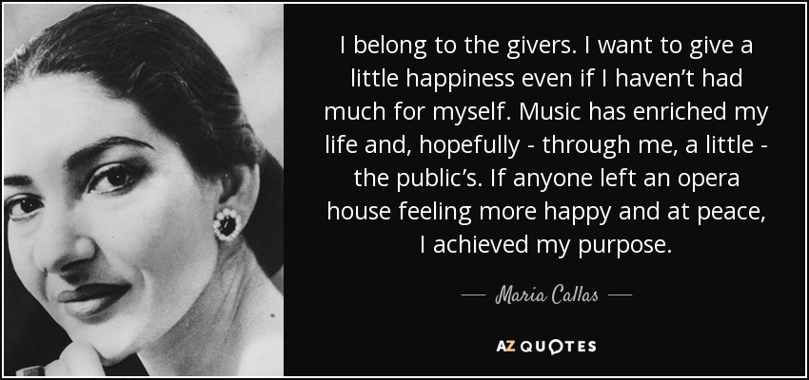

Slide 45
Now you can…
read, understand and use Band II vocabulary words and phrases
engage in creative assignments that include Band II vocabulary words and phrases.

Slide 46
Today’s lesson was about: Opera - Vocabulary Band II
English
Teacher: Rivka Rosenberg

Slide 47
השימוש ביצירות במהלך שידור זה נעשה לפי סעיף 27א לחוק זכות יוצרים, תשס"ח-2007. אם הינך בעל הזכויות באחת היצירות, באפשרותך לבקש מאיתנו לחדול מהשימוש ביצירה, זאת באמצעות פנייה לדוא"ל rights@education.gov.il
שימוש ביצירות מוגנות בזכויות יוצרים ואיתור בעלי זכויות

