Slide 1
מערכת שידורים לאומית

Slide 2
Olympic Sports
English, 9th grade
Galia Vainer

Slide 3
In today’s lesson we will:
Talk about sports
Learn some new words
Read an article and answer the questions
Practice new vocabulary

Slide 4
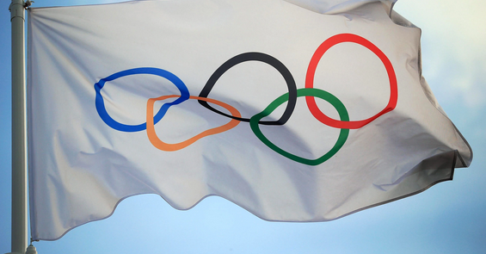
Olympic Sports
1. Do you like sports?
Yes, I like sports / No, I don’t like sports.

Slide 5
Olympic Sports
2. How often do you exercise?
I never exercise /
I exercise once a week // twice a week // often // sometimes.

Slide 6
Olympic Sports
3. What kinds of sports do you know?
Soccer, basketball, tennis.

Slide 7
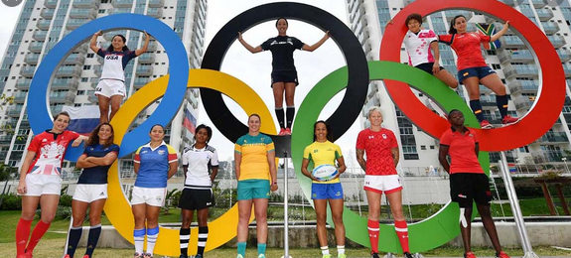
Olympic Sports
1 | competed | - strive to win something by defeating others | התחרה | تنافس
2 | unusual | - not common | בלתי רגיל | غير عادي
3 | opposite | - on the other side | נגדי | عكس
4 | continue | - carry on | להמשיך | يستمر
5 | competitors | - those who want to win by defeating others | מתחרים | متنافسين
6 | similar | - the same | דומה | متشابه
7 | points | - scores | נקודות | نقاط

Slide 8
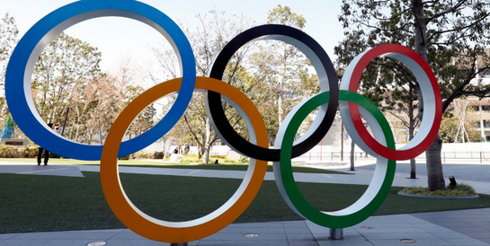
Olympic Sports
8 | disappeared | - be lost, go missing | נעלם | اختفى
9 | competition | - a contest | תחרות | منافسه
10 | exciting | - causing enthusiasm | מרגש | مثير
11 | pull | - move in a specified direction | למשוך | يشد
12 | team | - a group | קבוצה | فريق
13 | once | - one single time | פעם | مره

Slide 9
Olympic Sports
Match the words to their definitions

Slide 10
Olympic Sports
Match the words to their definitions

Slide 11
Olympic Sports
Match the words to their definitions

Slide 12
Olympic Sports
Match the words to their definitions

Slide 13
Olympic Sports
Match the words to their definitions

Slide 14
Olympic Sports
Match the words to their definitions

Slide 15
Olympic Sports
Match the words to their definitions

Slide 16
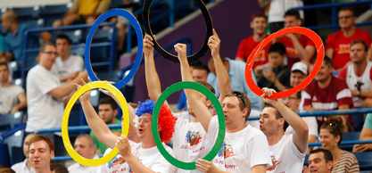
Olympic Sports: Reading
Today's Olympic Games do not have the same sports events as in the past. Some sports disappeared from the Games because people got bored watching them. Another reason is that new sports become popular all the time. When this happens, the less popular Olympic sports have to go.
Why did some sports disappear from the Olympic Games?
Some people got bored watching them
New sports become popular

Slide 17
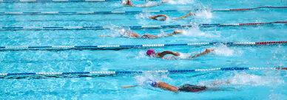
Olympic Sports: Reading
Which sports events have disappeared from the Olympics over the years? In the past, there were many unusual swimming competitions. In 1900, for example, there was an unusual race at the Olympics in Paris, France. Swimmers had to jump into the Seine River, swim to some boats, climb over them, and then continue swimming as fast as they could to the finish.
2. Write the meaning of numbers and names:
1900 – the year of the unusual swimming race at the Olympics in Paris.
Seine River – the river, where competitors had to swim.

Slide 18
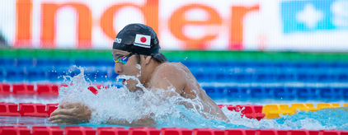
Olympic Sports: Reading
Another race was to see how far swimmers could go without moving their arms and legs. There was also an underwater race. This race was held only once, in 1904 in St. Louis, U.S.A. In this race, swimmers had to swim underwater and they got points for how long they could hold their breath.
2. Write the meaning of numbers and names:
1904 – the year when the underwater race took place.
St. Louis – the city in the USA, where the underwater race took place.

Slide 19
Break

Slide 20
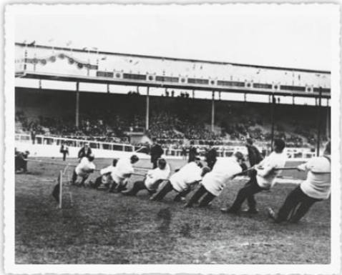
Olympic Sports: Reading
Other popular sports events were similar to summer camp games. Rope climbing, for example, was in four Olympics. There was also a tug-of-war competition. Here, two teams pulled on opposite ends of a rope and the strongest team won. At the time, anybody who wanted to be in the Olympics could compete. In 1908, for example, a team of police officers won the tug-of-war at the Olympics in London, England.
3. Which sports were similar to summer camp games?
Rope climbing and tug-of-war.
4. What happened in 1908?
A team of police officers won the tug-of-war at the Olympics.

Slide 21
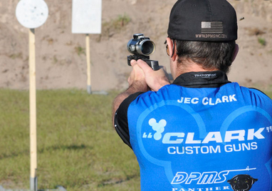
Olympic Sports: Reading
There were also strange shooting competitions. In one competition,
competitors had to shoot at moving paper deer. In another competition, they shot at paper men who were wearing evening clothes.
5. Why shooting competitions were strange?
Because competitors had to shoot a moving paper deer or paper men.

Slide 22
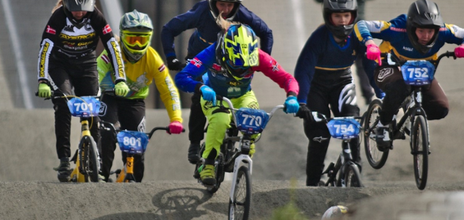
Olympic Sports: Reading
But all that is in the past. Today. there are many new competitions. In the Beijing Olympics in China. For example, there was a BMX biking competition for the first time. In the next Olympics, we will again see exciting, new sports. Which new sport do you hope to see?
6. What example of a new competition is given?
A BMX biking competition.

Slide 23
Olympic Sports: Vocabulary Practice
Complete the sentences with the words below:
competed
unusual
opposite
continue
competitors
similar
"Small" is the ………………………………...of "big".
Fifty boats ………………………………... in the race.
We like the same things. We have ………………………………... interests.
The people in a race are the ………………………………...
You don't have to finish the work today. You can …………………tomorrow.
I saw a movie about the strangest and most ……………… animals in the world.

Slide 24
Olympic Sports: Vocabulary Practice
Complete the sentences with the words below:
competed
unusual
continue
competitors
similar
opposite
"Small" is the ………………………………...of "big".
Fifty boats ………………………………... in the race.
We like the same things. We have ………………………………... interests.
The people in a race are the ………………………………...
You don't have to finish the work today. You can …………………tomorrow.
I saw a movie about the strangest and most ……………… animals in the world.

Slide 25
Olympic Sports: Vocabulary Practice
Complete the sentences with the words below:
unusual
continue
competitors
similar
opposite
"Small" is the ………………………………...of "big".
Fifty boats ………………………………... in the race.
We like the same things. We have ………………………………... interests.
The people in a race are the ………………………………...
You don't have to finish the work today. You can …………………tomorrow.
I saw a movie about the strangest and most ……………… animals in the world.
competed

Slide 26
Olympic Sports: Vocabulary Practice
Complete the sentences with the words below:
unusual
continue
competitors
opposite
"Small" is the ………………………………...of "big".
Fifty boats ………………………………... in the race.
We like the same things. We have ………………………………... interests.
The people in a race are the ………………………………...
You don't have to finish the work today. You can …………………tomorrow.
I saw a movie about the strangest and most ……………… animals in the world.
competed
similar

Slide 27
Olympic Sports: Vocabulary Practice
Complete the sentences with the words below:
unusual
continue
opposite
"Small" is the ………………………………...of "big".
Fifty boats ………………………………... in the race.
We like the same things. We have ………………………………... interests.
The people in a race are the ………………………………...
You don't have to finish the work today. You can …………………tomorrow.
I saw a movie about the strangest and most ……………… animals in the world.
competed
similar
competitors

Slide 28
Olympic Sports: Vocabulary Practice
Complete the sentences with the words below:
unusual
opposite
"Small" is the ………………………………...of "big".
Fifty boats ………………………………... in the race.
We like the same things. We have ………………………………... interests.
The people in a race are the ………………………………...
You don't have to finish the work today. You can …………………tomorrow.
I saw a movie about the strangest and most ……………… animals in the world.
competed
similar
competitors
continue

Slide 29
Olympic Sports: Vocabulary Practice
Complete the sentences with the words below:
opposite
"Small" is the ………………………………...of "big".
Fifty boats ………………………………... in the race.
We like the same things. We have ………………………………... interests.
The people in a race are the ………………………………...
You don't have to finish the work today. You can …………………tomorrow.
I saw a movie about the strangest and most ……………… animals in the world.
competed
similar
competitors
continue
unusual

Slide 30
Olympic Sports: Vocabulary Practice
Complete the passage with the words below.
Sports Day
Last week, we had an unusual sports day at our school. It started with a
tug-of-war ___________. We had to ___________ a big rope. It was really ___________! We tried to win but the other ___________ was stronger. There was also a strange swimming race. We had to keep our heads underwater and we got ___________ for holding our breath. Later, our teachers told us that these sports were in the Olympics. Too bad they ___________from the program. They were a lot of fun!

Slide 31
Olympic Sports: Vocabulary Practice
Complete the passage with the words below.
Sports Day
Last week, we had an unusual sports day at our school. It started with a
tug-of-war ___________. We had to ___________ a big rope. It was really ___________! We tried to win but the other ___________ was stronger. There was also a strange swimming race. We had to keep our heads underwater and we got ___________ for holding our breath. Later, our teachers told us that these sports were in the Olympics. Too bad they ___________from the program. They were a lot of fun!

Slide 32
Olympic Sports: Vocabulary Practice
Complete the passage with the words below.
Sports Day
Last week, we had an unusual sports day at our school. It started with a
tug-of-war ___________. We had to ___________ a big rope. It was really ___________! We tried to win but the other ___________ was stronger. There was also a strange swimming race. We had to keep our heads underwater and we got ___________ for holding our breath. Later, our teachers told us that these sports were in the Olympics. Too bad they ___________from the program. They were a lot of fun!

Slide 33
Olympic Sports: Vocabulary Practice
Complete the passage with the words below.
Sports Day
Last week, we had an unusual sports day at our school. It started with a
tug-of-war ___________. We had to ___________ a big rope. It was really ___________! We tried to win but the other ___________ was stronger. There was also a strange swimming race. We had to keep our heads underwater and we got ___________ for holding our breath. Later, our teachers told us that these sports were in the Olympics. Too bad they ___________from the program. They were a lot of fun!

Slide 34
Olympic Sports: Vocabulary Practice
Complete the passage with the words below.
Sports Day
Last week, we had an unusual sports day at our school. It started with a
tug-of-war ___________. We had to ___________ a big rope. It was really ___________! We tried to win but the other ___________ was stronger. There was also a strange swimming race. We had to keep our heads underwater and we got ___________ for holding our breath. Later, our teachers told us that these sports were in the Olympics. Too bad they ___________from the program. They were a lot of fun!

Slide 35
Olympic Sports: Vocabulary Practice
Complete the passage with the words below.
Sports Day
Last week, we had an unusual sports day at our school. It started with a
tug-of-war ___________. We had to ___________ a big rope. It was really ___________! We tried to win but the other ___________ was stronger. There was also a strange swimming race. We had to keep our heads underwater and we got ___________ for holding our breath. Later, our teachers told us that these sports were in the Olympics. Too bad they ___________from the program. They were a lot of fun!

Slide 36
Olympic Sports: Vocabulary Practice
Complete the passage with the words below.
Sports Day
Last week, we had an unusual sports day at our school. It started with a
tug-of-war ___________. We had to ___________ a big rope. It was really ___________! We tried to win but the other ___________ was stronger. There was also a strange swimming race. We had to keep our heads underwater and we got ___________ for holding our breath. Later, our teachers told us that these sports were in the Olympics. Too bad they ___________from the program. They were a lot of fun!

Slide 37
Olympic Sports: Vocabulary Practice
For additional practice on Quizlet:

Slide 38
השימוש ביצירות במהלך שידור זה נעשה לפי סעיף 27א לחוק זכות יוצרים, תשס"ח-2007. אם הינך בעל הזכויות באחת היצירות, באפשרותך לבקש מאיתנו לחדול מהשימוש ביצירה, זאת באמצעות פנייה לדוא"ל rights@education.gov.il

