Slide 1
מערכת שידורים לאומית

Slide 2
Public Speaking/Speaking Skills
ENGLISH 10th Grade/Yud
Carole Vinick Rosbruch

Slide 3
Oral Presentations
FEAR
FRUSTRATION
ANXIETY
STRESS

Slide 4
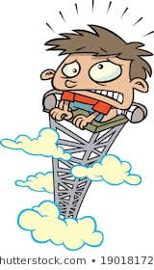
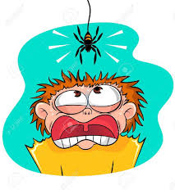
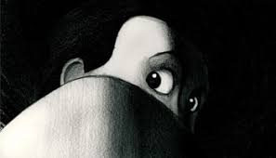
vv

Slide 5
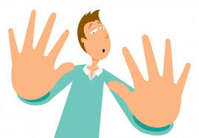
Why do we feel this way?

Slide 6
What IS an oral presentation?
According to an online source:
effective communication with an audience.
WHAT?

Slide 7
You can show off knowledge with audio and visual aids!

Slide 8
What’s in store…..
How to prepare an oral presentation.
How to present an oral presentation.

Slide 9
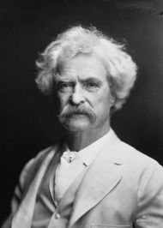
“If you want me to give you a two-hour presentation, I am ready today. If you want only a five-minute speech, it will take me two weeks to prepare.”
― Mark Twain

Slide 10
KEY WORDS PART 1
subject
content
audience
tools
engage
entice
facilitator
“buy in”

Slide 11
Preparation
subject
content
audience
tools

Slide 12
SUBJECT
IDENTIFY MY GOAL:
Inform Convince Persuade Evoke emotion
objectives
need
know

Slide 13
CONTENT
KNOW THE MATERIAL!
Presenter = Expert = Facilitator
Enhance
Encourage
Want More

Slide 14
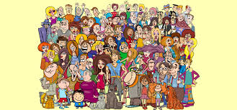
AUDIENCE
KNOW YOUR AUDIENCE!!
“buy in”
humor engage entice
requires research

Slide 15
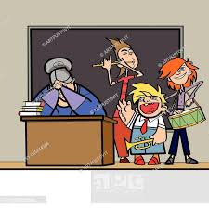
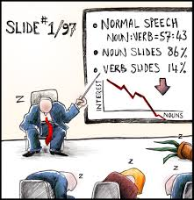
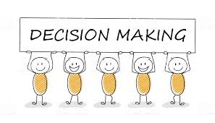
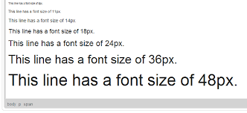
TOOLS
WH ?s
Which aids?
How many?
Where?
What to include?
Why(purpose)?
v

Slide 16
REVIEW
Name the four organizational
tools for preparing an oral presentation:
subject
content
tools
audience

Slide 17
BREAK
Up next:
How to Present Your Oral Presentation

Slide 18
KEY WORDS PART 2
intonation
variation
gestures
body language
movement
eye contact
entrance

Slide 19
Presentation
me
dress
body language
voice

Slide 20
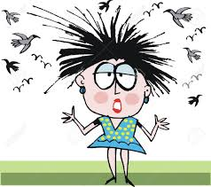
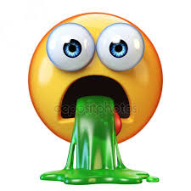
ME
Physically Mentally:
Hair
My English
Positioning
Self Confidence
Shaking, Smiling
Nerves
hmm

Slide 21
DRESS
Fit the Occasion:
Formal
Professional
Casual
Accessories
Jewelry

Slide 22
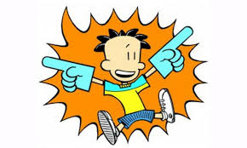
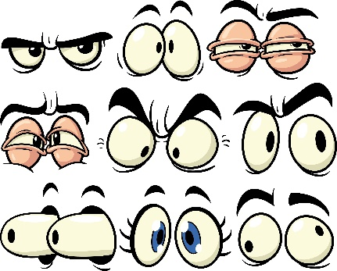
BODY LANGUAGE
What am I really saying?
Entrance
Movement
Gestures
Eye contact

Slide 23
VOICE
Not always what I say, but how I say it?
Intonation
Variation
Speed

Slide 24
REVIEW
How do I make my presentation work?
dress
me
voice
body language
Notes:
..\Downloads\y2mate.com%20-%20Sample%20Student%20Speech_Y45aAZ5-aBw_360p.mp4

Slide 25
LET’S GIVE IT A TRY:
Practice #1
Your teacher just assigned you a speech to talk about your favorite movie to your classmates. What would your opening be like? Write it down and practice it.
Mirror:
Practice your introduction in front of the mirror. Try it two or three times. You can even play around with how you would do it? Watch your eyes, your hands and your posture.

Slide 26
RESULT FROM PRACTICE #1:
Practice #1
Your teacher just assigned you a speech to talk about your favorite movie to your classmates. What would your opening be like? Write it down and practice it.
Result:
You hated it, right? Did you tell a joke? Did you bring up a relevant meme?

Slide 27
GIVE THIS A TRY:
Practice #2
Soccer fans are people who love soccer! They usually have a favorite team, Maccabi Tel Aviv and HaPoel Haifa. When major soccer games are shown on TV, fans have a party and watch the game together. They eat snacks and cheer for their favorite soccer team. Some fans even bet money on which team will win the game!
Mirror:
Practice reading the above paragraph in front of the mirror. Once is enough.

Slide 28
RESULT FROM PRACTICE #2:
Practice #2
Soccer fans are people who love soccer! They usually have a favorite team, Maccabi Tel Aviv and HaPoel Haifa. When major soccer games are shown on TV, fans have a party and watch the game together. They eat snacks and cheer for their favorite soccer team. Some fans even bet money on which team will win the game!
Result:
How’d it go? Did you vary your tone, expression
and speed?

Slide 29
LAST ONE:
Practice #3
Introduce yourself. You can speak about your hobbies, interests, family, favorite subjects in school, friends, or really anything that tells the audience about you. Make it last at least 30 seconds.
Mirror:
You can use your phone or an actual mirror. You can take a minute to write it down and organize your thoughts.

Slide 30
RESULT FROM PRACTICE #3:
Practice #3
Introduce yourself. You can speak about your hobbies, interests, family, favorite subjects in school, friends, or really anything that tells the audience about you. Make it last at least 30 seconds.
Result:
Did you make it to 30 seconds? Did you squirm around? Did you search for things to say? If you were one who wrote it down, your results may have been better.

Slide 31
WHAT DID WE LEARN FROM THE PRACTICE?
That we need a lot more practice!
We need to be organized,
know our material,
know our audience and,
to be a person with movement, eye contact, and reactions.
If you enjoyed this presentation and would like help, feel free to contact me at: crosbruch@gmail.com

