Slide 1
THE WET PET
Fourth and Fifth Grade
With: Shosha Moradov

Slide 2
What will we do today?
Learn a new sound et
Learn new words with the sound et
Read sentences and a story with et

Slide 3
Can you…?
…read words with et ?
…understand words with et ?
…read sentences with et ?
Notes:
Present the Can Do statements

Slide 4
What do you need?
Notes:
We will need
Notebook
Pencil case
Small whiteboard/plain white page
Markers for the board/white page.

Slide 5
Read en
Notes:
I want us to start with a sound you can read in words that you know.
The sound en at the end of words.

Slide 6
Read:
hen
pen
ten
when
men
open
Notes:
Read together

Slide 7
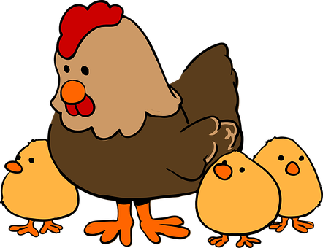
men | ten | hen
pen | open | When?
Notes:
Remember the meaning

Slide 8
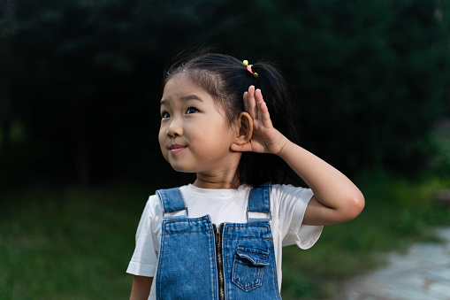
What can you hear?
Notes:
Lets remember another sound you know well.

Slide 9
You know:
E
e
Notes:
This is the letter e and many times it makes the sound e –
can you say words that begin with the sound e?
Good, I have some of my own.

Slide 10
You know:
e
Notes:
E like in elephant egg energy

Slide 11
You know:
e
Notes:
E like in elephant egg energy

Slide 12
You know:
e
Notes:
E like in elephant egg energy

Slide 13
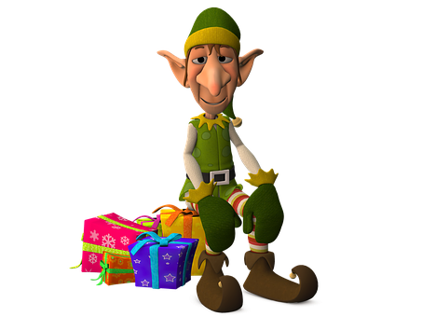
You know:
e
Notes:
E like in elephant egg energy

Slide 14
You know:
e
Notes:
E like in elephant egg energy elf elbow

Slide 15
You know:
_e_
Notes:
This sound can be in the middle not just at the beginning.
E like in

Slide 16
You know:
_e_
Notes:
E like in red

Slide 17
You know:
_e_
Notes:
E like in legs

Slide 18
You know:
_e_
Notes:
E like in yes

Slide 19
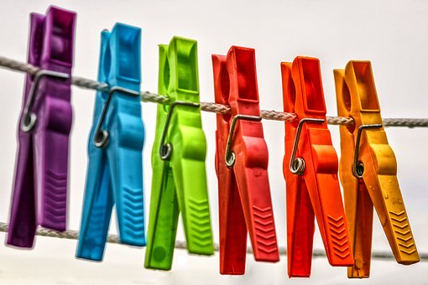
You know:
_e_
Notes:
E like in pegs

Slide 20
What can you hear?
Notes:
Listen to me again. What do you hear?
What did you hear at the beginning?
The sound t

Slide 21
You know:
T
t
Notes:
This is the letter t and it makes the sound t
can you say words that begin with the sound t?
Good, I have some of my own.

Slide 22
You know:
t
Notes:
T like in tea

Slide 23
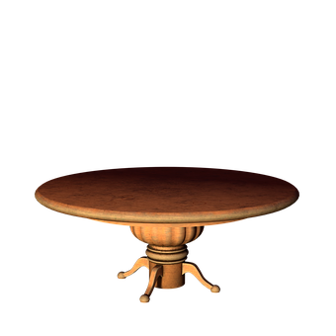
You know:
t
Notes:
T like in table

Slide 24
You know:
t
Notes:
tractor

Slide 25
You know:
t
Notes:
television

Slide 26
You know:
t
Notes:
time

Slide 27
You know:
_t
Notes:
Listen to this sound in the middle or end of a word:
In the middle

Slide 28
You know:
_t
Notes:
T like in hot

Slide 29
How many?
t ?
Notes:
How many t do you hear in the word:
Tablet paint plant battery bottle

Slide 30
Listen:
t ?
Notes:
Where do you hear the sound t:
table

Slide 31
Listen:
t ?
Notes:
Where do you hear the sound t:
table

Slide 32
Listen:
t ?
Notes:
Where do you hear the sound t:
water

Slide 33
Listen:
t ?
Notes:
Where do you hear the sound t:
two

Slide 34
Listen:
t ?
Notes:
Where do you hear the sound t:

Slide 35
Listen:
t ?
Notes:
Where do you hear the sound t:
eat

Slide 36
Listen:
t ?
Notes:
Where do you hear the sound t:
tablet

Slide 37
Listen:
t ?
Notes:
Where do you hear the sound t:
computer

Slide 38
Good for you!
1
Notes:
Super – finished the remembering stage – first stage – you have a good memory
Lets move on to learn a new sound

Slide 39
Listen:
Notes:
This is Ket.
Ket has a pet.
Can you hear the sound? Ket has a pet.
The sound at the end of the words?
You are right! et

Slide 40
Listen:
e
t
___
Notes:
E and t together make the sound et. Like in….
Lets try to read some words.

Slide 41
Listen:
e
t
___
Notes:
E and t together make the sound et. Like in….
Lets try to read some words.

Slide 42
w
+
et
wet
r
Notes:
W and et together are wet.

Slide 43
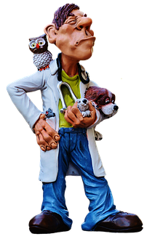
v
+
et
vet
r

Slide 44
n
+
et
net
r

Slide 45
j
+
et
jet
r

Slide 46
g
+
et
get
r

Slide 47
m
+
et
met
r

Slide 48
l
+
et
let
let go
let in
r

Slide 49
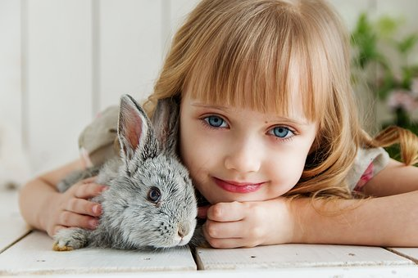
p
+
et
pet
r

Slide 50
vet | net | wet | pet
Notes:
These are the words

Slide 51
vet | net | wet | pet
get | jet | met | let in

Slide 52
vet | net | wet | pet
Notes:
Whats missing?

Slide 53
vet | net | wet | pet
Notes:
Whats missing?

Slide 54
vet | net | wet | pet

Slide 55
vet | net | wet | pet

Slide 56
vet | net | wet | pet

Slide 57
vet | net | wet | pet

Slide 58
vet | net | wet | pet

Slide 59
get | jet | met | let in

Slide 60
get | jet | met | let in

Slide 61
get | jet | met | let in

Slide 62
get | jet | met | let in

Slide 63
get | jet | met | let in

Slide 64
get | jet | met | let in

Slide 65
get | jet | met | let in

Slide 66
Notes:
What’s this?

Slide 69
Notes:
What’s this?

Slide 70
Notes:
What’s this?

Slide 71
Notes:
What’s this?

Slide 72
Notes:
What’s this?

Slide 73
Notes:
What’s this?

Slide 74
Notes:
What’s this?

Slide 75
Notes:
What’s this?

Slide 76
Notes:
What’s this?

Slide 77
Notes:
What’s this?

Slide 78
en
3 | 2 | 1
Notes:
Lets mix word with different ends – en/et
Tick the word that ends with….
Write 1, 2, 3 and tick the words with the sound

Slide 79
en
3 | 2 | 1
Notes:
Write 1, 2, 3 and tick the words with the sound

Slide 80
et
3 | 2 | 1
10
Notes:
Write 1, 2, 3 and tick the words with the sound

Slide 81
et
3 | 2 | 1
10
Notes:
Write 1, 2, 3 and tick the words with the sound

Slide 82
en
3 | 2 | 1
Notes:
Write 1, 2, 3 and tick the words with the sound

Slide 83
en
3 | 2 | 1
Notes:
Write 1, 2, 3 and tick the words with the sound

Slide 84
et
3 | 2 | 1
Notes:
Write 1, 2, 3 and tick the words with the sound

Slide 85
et
3 | 2 | 1
Notes:
Write 1, 2, 3 and tick the words with the sound

Slide 86
en
3 | 2 | 1
Notes:
Write 1, 2, 3 and tick the words with the sound

Slide 87
en
3 | 2 | 1
Notes:
Write 1, 2, 3 and tick the words with the sound

Slide 88
et
3 | 2 | 1
Notes:
Write 1, 2, 3 and tick the words with the sound

Slide 89
et
3 | 2 | 1
Notes:
Write 1, 2, 3 and tick the words with the sound

Slide 90
en
3 | 2 | 1
Notes:
Write 1, 2, 3 and tick the words with the sound

Slide 91
en
3 | 2 | 1
Notes:
Write 1, 2, 3 and tick the words with the sound

Slide 92
et
3 | 2 | 1
10
Notes:
Write 1, 2, 3 and tick the words with the sound

Slide 93
et
3 | 2 | 1
10
Notes:
Write 1, 2, 3 and tick the words with the sound

Slide 94
vet | net | wet | pet
get | jet | met | let in
Notes:
Read the word, say the meaning

Slide 95
vet | net | wet | pet
get | jet | met | let in
Notes:
check

Slide 96
vet | net | wet | pet
get | jet | met | let in

Slide 97
vet | net | wet | pet
get | jet | met | let in

Slide 98
vet | net | wet | pet
get | jet | met | let in

Slide 99
vet | net | wet | pet
get | jet | met | let in

Slide 100
vet | net | wet | pet
get | jet | met | let in

Slide 101
vet | net | wet | pet
get | jet | met | let in

Slide 102
vet | net | wet | pet
get | jet | met | let in

Slide 103
Draw:
Notes:
I need you to get your white board and draw a grid – just like mine.
Nine squares please.

Slide 104
Write:
wet | jet | let in
net | vet | get
met | let go | pet
Notes:
Now we are going to start our reading practice.
Please read the words in my grid.
Read, don’t copy.
I am going to say a number and a word- please write the number in your grid
Lets do the first one together – 1 net

Slide 105
Write:
wet | jet | let in
net | vet | get
met | let go | pet
1
Notes:
Check
2 - jet

Slide 106
Write:
wet | jet | let in
net | vet | get
met | let go | pet
 | 2
1
Notes:
check

Slide 107
Write:
wet | jet | let in
net | vet | get
met | let go | pet
5 | 2 | 4
1 | 6 | 3
9 | 7 | 8
Notes:
check

Slide 108
Write with me
et
Notes:
Show how to write et on the board
Copy as many as you can

Slide 109
Copy:
pet
wet
net
vet
let in
met
jet
get
Notes:
Please copy some words into your notebook
Write the meaning if you remember
We will check together.

Slide 110
vet | net | wet | pet
get | jet | met | let in
Notes:
Check meaning

Slide 111
vet | net | wet | pet
get | jet | met | let in

Slide 112
vet | net | wet | pet
get | jet | met | let in

Slide 113
vet | net | wet | pet
get | jet | met | let in

Slide 114
1
pen
net
pet
Notes:
Look at the box letter
Choose what word can fit in the box

Slide 115
pet
1
pen
net
pet

Slide 116
2
jet
hen
let

Slide 117
jet
2
jet
hen
let

Slide 118
3
vet
met
get

Slide 119
get
3
vet
met
get

Slide 120
4
let
net
get

Slide 121
net
4
let
net
get

Slide 122
5
jet
let
vet

Slide 123
vet
5
jet
let
vet

Slide 124
6
pen
met
let

Slide 125
let
6
pen
met
let

Slide 126
7
jet
let
met

Slide 127
met
7
jet
let
met

Slide 128
8
wet
let
pet

Slide 129
wet
8
wet
let
pet

Slide 130
Good for you!
2
Notes:
Good for you kids, you finished the second step climbing to the top!
you can read words with the sound et

Slide 131
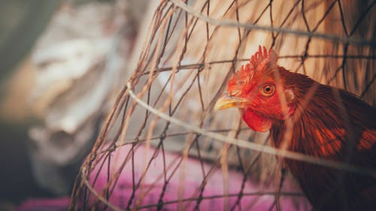
A hen in a net.
Read the words
Notes:
You are so good!
You can read words that end with et

Slide 132
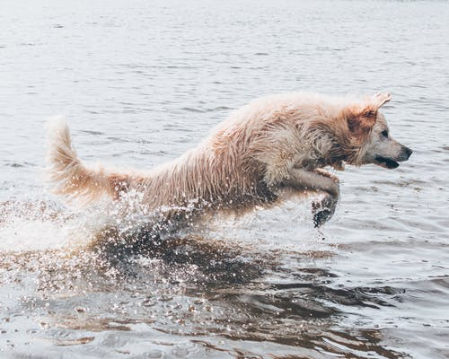
A wet pet.
Read the words

Slide 133
A wet man.
Read the words

Slide 134
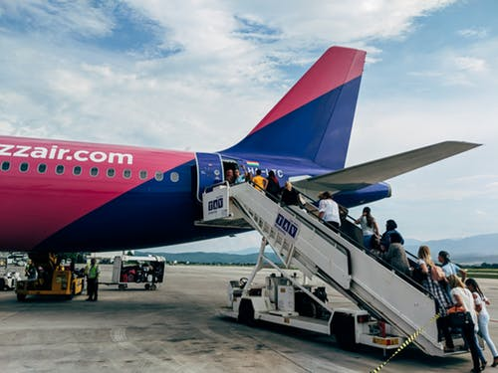
An open jet.

Slide 135
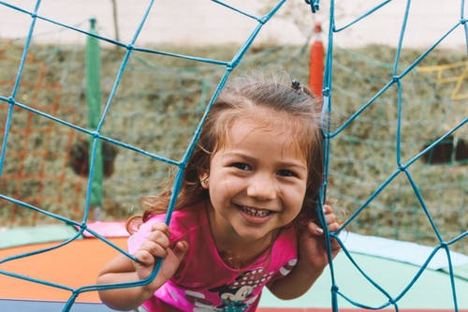
An open net.

Slide 136
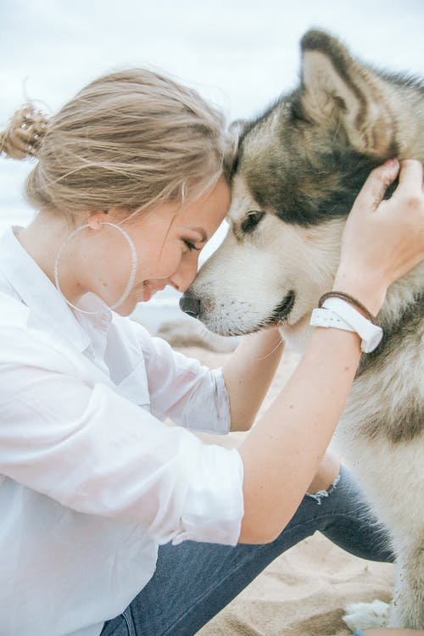
get a pet
Notes:
Carry on - super

Slide 137
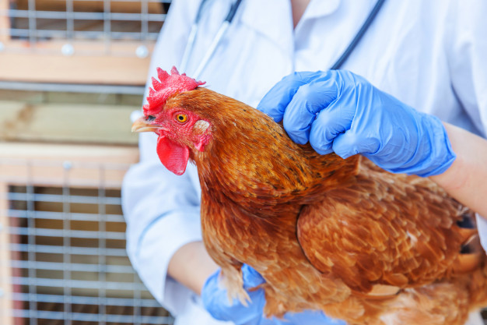
A vet and a hen.
Notes:
Carry on - super

Slide 138
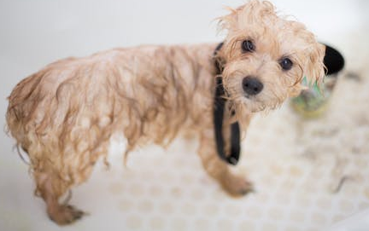
Read:
The wet
pet
is on the
mat.
Notes:
Now you can read sentences.

Slide 139
Read:
The pet
sat
on the mat.

Slide 140
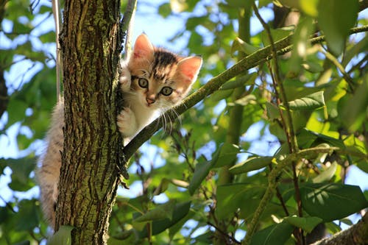
Read:
The pet
gets up
the tree.

Slide 141
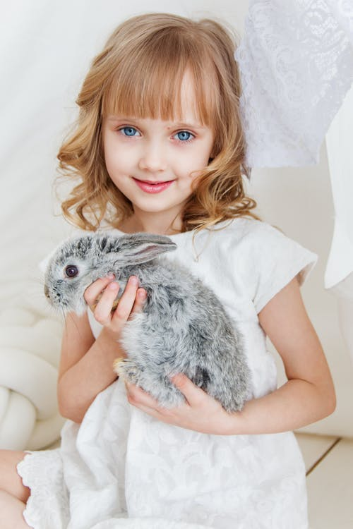
Read:
Ket
met the pet.

Slide 142
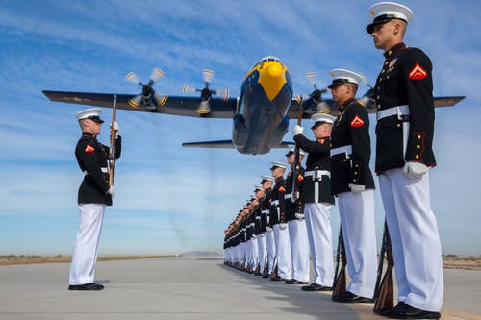
Read:
The men
are near
the jet.

Slide 143
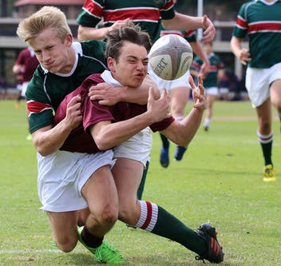
Read:
The men
get the ball.

Slide 144
Read:
The men
get in the jet.

Slide 145
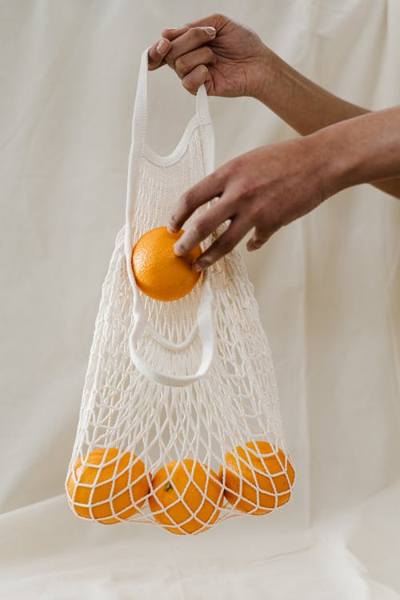
Read:
They are
in the net.

Slide 146
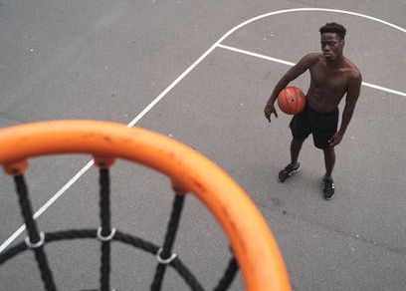
Put the ball
in the
net!

Slide 147
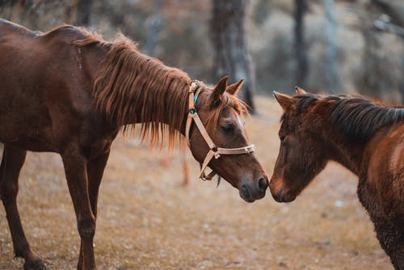
The pets met.

Slide 148
Baby gets in the water.
Baby is wet!

Slide 149
Match:
B | A
D | C
F | E
1. The ball is in the net.
2. The baby is wet.
3. The hen is in the net.
4. Ket met the pet.
5. The men get in the jet.
6. The vet has three pets.
03:00
Notes:
Super!
Please read and match.
Find the picture.
Write in your notebook – number 1 – letter.

Slide 150
Check:
B | A
D | C
F | E
1. The ball is in the net.
2. The baby is wet.
3. The hen is in the net.
4. Ket met the pet.
5. The men get in the jet.
6. The vet has three pets.
F
C
B
D
A
E
Notes:
Super! Please read and match.
Find the picture.
Write in your notebook – number 1 – letter.

Slide 151
Good for you!
3
Notes:
Good for you kids, you finished the third step climbing to the top!
You can read sentences with the sound et
Lets move on to reading a story.

Slide 152
Story time…
The Wet Pet.

Slide 153
falls
dry
water
Notes:
We need some words before we read the story
Ket’s monkey is on the tree eating a banana – it isn’t in the water – it is dry.
Ket falls into the water – she is wet.

Slide 154
This is Ket
Ket has a pet.

Slide 155
Ket’s pet is a .

Slide 156
The pet gets in to the water.

Slide 157
The pet is wet.

Slide 158
The pet is not dry.

Slide 159
Ket is mad!

Slide 160
Ket gets a net.

Slide 161
Ket wants to get the pet.

Slide 162
Oh No!

Slide 163
Kets falls in to the water!

Slide 164
Now Ket is wet too!

Slide 165
This is Ket.
Ket has a pet.
Ket’s pet is a .
The pet gets in to the water.
The pet is wet.
The pet is not dry.
Ket is mad!
Ket gets a net.
She wants to get the pet.
Oh No!
Ket falls in to the water!
Now Ket is wet too!
Read:
Notes:
Lets read together
Kids read the text and then together with me
Make sure they understand
Please count the words with the sound et

Slide 166
This is Ket.
Ket has a pet.
Ket’s pet is a .
The pet gets in to the water.
The pet is wet.
The pet is not dry.
Ket is mad!
Ket gets a net.
She wants to get the pet.
Oh No!
Ket falls in to the water!
Now Ket is wet too!
Read:

Slide 167
Yes/no
No | Yes
 |  | Ket is a pet. | 1
 |  | Ket has a pet. | 2
 |  | The is a pet. | 3
 |  | The pet is dry. | 4
 |  | Ket is happy. | 5
This is Ket.
Ket has a pet.
Ket’s pet is a .
The pet gets in to the water.
The pet is wet.
The pet is not dry.
Ket is mad!
02:00
Notes:
Read – write number 1yes/no

Slide 168
Yes/no
No | Yes
 |  | Ket is a pet. | 1
 |  | Ket has a pet. | 2
 |  | The is a pet. | 3
 |  | The pet is dry. | 4
 |  | Ket is happy. | 5
This is Ket.
Ket has a pet.
Ket’s pet is a .
The pet gets in to the water.
The pet is wet.
The pet is not dry.
Ket is mad!
Notes:
Read – write number 1yes/no

Slide 169
Yes/no
No | Yes
 |  | Ket is a pet. | 1
 |  | Ket has a pet. | 2
 |  | The is a pet. | 3
 |  | The pet is dry. | 4
 |  | Ket is happy. | 5
This is Ket.
Ket has a pet.
Ket’s pet is a .
The pet gets in to the water.
The pet is wet.
The pet is not dry.
Ket is mad!
Notes:
Read – write number 1yes/no

Slide 170
Yes/no
No | Yes
 |  | Ket is a pet. | 1
 |  | Ket has a pet. | 2
 |  | The is a pet. | 3
 |  | The pet is dry. | 4
 |  | Ket is happy. | 5
This is Ket.
Ket has a pet.
Ket’s pet is a .
The pet gets in to the water.
The pet is wet.
The pet is not dry.
Ket is mad!
Notes:
Read – write number 1yes/no

Slide 171
Yes/no
No | Yes
 |  | Ket is a pet. | 1
 |  | Ket has a pet. | 2
 |  | The is a pet. | 3
 |  | The pet is dry. | 4
 |  | Ket is happy. | 5
This is Ket.
Ket has a pet.
Ket’s pet is a .
The pet gets in to the water.
The pet is wet.
The pet is not dry.
Ket is mad!
Notes:
Read – write number 1yes/no

Slide 172
Yes/no
No | Yes
 |  | Ket is a pet. | 1
 |  | Ket has a pet. | 2
 |  | The is a pet. | 3
 |  | The pet is dry. | 4
 |  | Ket is happy. | 5
This is Ket.
Ket has a pet.
Ket’s pet is a .
The pet gets in to the water.
The pet is wet.
The pet is not dry.
Ket is mad!
Notes:
Read – write number 1yes/no

Slide 173
Yes/no
No | Yes
 |  | Pet gets a net.. | 1
 |  | The pet is in the net. | 2
 |  | Ket falls in to the water | 3
 |  | Ket is wet. | 4
 |  | The is mad. | 5
Ket gets a net.
She wants to get the pet.
Oh No!
Ket falls in to the water!
Now Ket is wet too!
02:00
Notes:
Read – write number 1yes/no

Slide 174
Yes/no
No | Yes
 |  | Pet gets a net.. | 1
 |  | The pet is in the net. | 2
 |  | Ket falls in to the water | 3
 |  | Ket is wet. | 4
 |  | The is mad. | 5
Ket gets a net.
She wants to get the pet.
Oh No!
Ket falls in to the water!
Now Ket is wet too!
Notes:
Read – write number 1yes/no

Slide 175
Yes/no
No | Yes
 |  | Pet gets a net.. | 1
 |  | The pet is in the net. | 2
 |  | Ket falls in to the water | 3
 |  | Ket is wet. | 4
 |  | The is mad. | 5
Ket gets a net.
She wants to get the pet.
Oh No!
Ket falls in to the water!
Now Ket is wet too!
Notes:
Read – write number 1yes/no

Slide 176
Yes/no
No | Yes
 |  | Pet gets a net.. | 1
 |  | The pet is in the net. | 2
 |  | Ket falls in to the water | 3
 |  | Ket is wet. | 4
 |  | The is mad. | 5
Ket gets a net.
She wants to get the pet.
Oh No!
Ket falls in to the water!
Now Ket is wet too!
Notes:
Read – write number 1yes/no

Slide 177
Yes/no
No | Yes
 |  | Pet gets a net.. | 1
 |  | The pet is in the net. | 2
 |  | Ket falls in to the water | 3
 |  | Ket is wet. | 4
 |  | The is mad. | 5
Ket gets a net.
She wants to get the pet.
Oh No!
Ket falls in to the water!
Now Ket is wet too!
Notes:
Read – write number 1yes/no

Slide 178
Yes/no
No | Yes
 |  | Pet gets a net.. | 1
 |  | The pet is in the net. | 2
 |  | Ket falls in to the water | 3
 |  | Ket is wet. | 4
 |  | The is mad. | 5
Ket gets a net.
She wants to get the pet.
Oh No!
Ket falls in to the water!
Now Ket is wet too!
Notes:
Read – write number 1yes/no

Slide 179
Who?
Notes:
You know this question word – remind you what it means.

Slide 180
Who?
1. Who is the pet?
a vet Ket
1
This is Ket.
Ket has a pet.
Ket’s pet is a .
The pet gets in to the water.
The pet is wet.
The pet is not dry.
Ket is mad!
2. Who gets in the water?
pet Yen Ren
00:30
Notes:
Now I can ask you questions about the story – with who.
We can get help from the text.

Slide 181
Who?
1. Who is the pet?
a vet Ket
1
This is Ket.
Ket has a pet.
Ket’s pet is a .
The pet gets in to the water.
The pet is wet.
The pet is not dry.
Ket is mad!
2. Who gets in the water?
pet Yen Ren
Notes:
Now I can ask you questions about the story – with who.
We can get help from the text.

Slide 182
Who?
1. Who is the pet?
a vet Ket
1
This is Ket.
Ket has a pet.
Ket’s pet is a .
The pet gets in to the water.
The pet is wet.
The pet is not dry.
Ket is mad!
2. Who gets in the water?
pet Yen Ren
Notes:
Now I can ask you questions about the story – with who.
We can get help from the text.

Slide 183
Who?
3. Who has a pet?
a vet Ket
1
This is Ket.
Ket has a pet.
Ket’s pet is a .
The pet gets in to the water.
The pet is wet.
The pet is not dry.
Ket is mad!
4. Who is not dry?
pet Yen Ren
00:30
Notes:
Now I can ask you questions about the story – with who.
We can get help from the text.

Slide 184
Who?
3. Who has a pet?
a vet Ket
1
This is Ket.
Ket has a pet.
Ket’s pet is a .
The pet gets in to the water.
The pet is wet.
The pet is not dry.
Ket is mad!
4. Who is not dry?
pet Yen Ren
Notes:
Now I can ask you questions about the story – with who.
We can get help from the text.

Slide 185
Who?
3. Who has a pet?
a vet Ket
1
This is Ket.
Ket has a pet.
Ket’s pet is a .
The pet gets in to the water.
The pet is wet.
The pet is not dry.
Ket is mad!
4. Who is not dry?
pet Yen Ren
Notes:
Now I can ask you questions about the story – with who.
We can get help from the text.

Slide 186
Who?
5. Who gets a net
Ket Ben
2
Ket gets a net.
She wants to get the pet.
Oh No!
Ket falls in to the water!
Now Ket is wet too!
6. Who wants to get the pet?
pet Yen Ket
00:30
Notes:
Now I can ask you questions about the story – with who.
We can get help from the text.

Slide 187
Who?
5. Who gets a net
Ket Ben
2
Ket gets a net.
She wants to get the pet.
Oh No!
Ket falls in to the water!
Now Ket is wet too!
6. Who wants to get the pet?
pet Yen Ket
Notes:
Now I can ask you questions about the story – with who.
We can get help from the text.

Slide 188
Who?
5. Who gets a net
Ket Ben
2
Ket gets a net.
She wants to get the pet.
Oh No!
Ket falls in to the water!
Now Ket is wet too!
6. Who wants to get the pet?
pet Yen Ket
Notes:
Now I can ask you questions about the story – with who.
We can get help from the text.

Slide 189
What did we learn?
pet
jet
Ket
get
vet
net
let
met
wet
Notes:
You are so good!
You can read and understand!
I'm proud of you.
You can read these words – so you can write them

Slide 190
has a
vet
Ket
jet
wet
pet
1
Ket
has a
net.
net.
05:00
Notes:
Look and write

Slide 191
1
Ket
has a
jet.
2
Ket
has a
pet.
3
Ket
has a
wet
net.
4
Ket
is a
vet.
Notes:
Write and check

Slide 192
Now you can…
4
…read words with et.
…understand words with et.
….read sentences and a story with et.
Notes:
You reached the top – finished all four stages.
Now you can…

Slide 193
Copy:
I can read words with et.
I can write words with et.
5 | 4 | 3 | 2 | 1
Notes:
Now ask the pupils to copy down the beginning of these two sentences and complete them. If you like you can write the sentences for them, and ask them to rate between 1-5 how far along the scale they feel they got. i.e. pupils that feel that they learnt everything they should have, can give themselves a 5, and pupils that think they very nearly understood everything can give themselves a 4 etc.

Slide 194
freepik.com/

