Slide 1
מערכת שידורים לאומית
Notes:
כל התמונות כאן מ- freepic ומהספר HIGH SKY שאושר לנו

Slide 2
School Subjects
English - Speaking
Teacher: Rivka Rosenberg

Slide 3
Can you…?
understand teacher’s questions
locate specific information in lists and isolate the information required

Slide 5
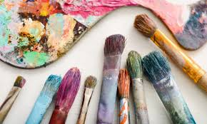
What subjects do you have in school?
English
Gym /
Physical Education
Math
History
Literature
Art

Slide 6
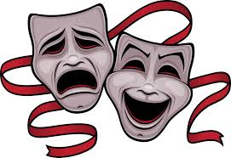
What subjects do you have in school?
Science
Geography
Computers
Drama
Music

Slide 7
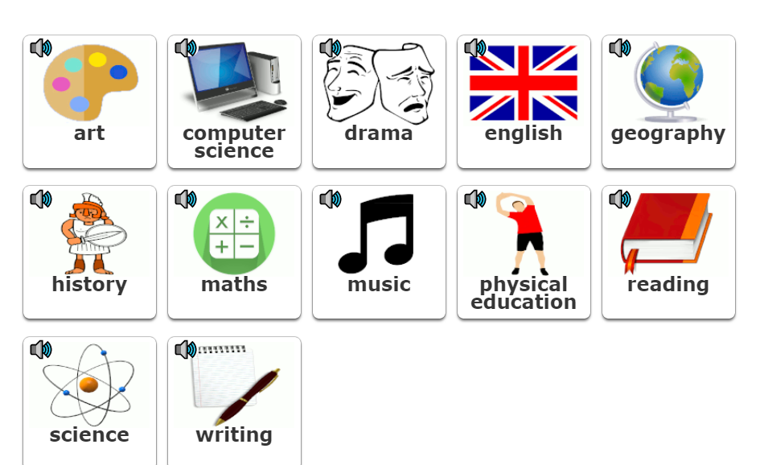
What subjects do you like? Why?

Slide 8
Can you try and guess the subjects?

Slide 9
Bart is sick. He has a cold.
What is the school subject that he can’t say?
Read and guess.
Click on the slide to check.

Slide 10
What’s on Monday at a nine fifteen, and on Friday at eight twenty?
English.
We have ________

Slide 11
What’s on Monday at eight twenty and on Wednesday at ten thirty?
Math.
We have ________

Slide 12
What’s on Tuesday and Thursday
at eight twenty?
Literature.
We have ________

Slide 13
What’s on Tuesday at nine fifteen, and on Thursday at eleven twenty five?
Gym.
We have ________

Slide 14
What’s on Wednesday nine fifteen, and on Friday at eleven twenty five?
History.
We have ________

Slide 15
What’s on Monday at eleven twenty five, and on Friday at a nine fifteen?
Art.
We have __________

Slide 16
What’s on Wednesday at eight twenty and on Thursday at ten thirty?
Science.
We have __________

Slide 17
What’s on Tuesday at eleven twenty five?
Computers.
We have __________

Slide 18
What’s on Friday at ten thirty?
Music.
We have __________

Slide 19
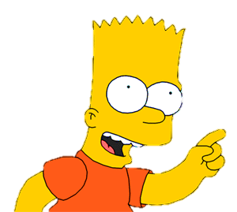
Look at the timetable
and answer the questions.

Slide 20
When do we have English?
On Monday at a nine fifteen, and on Friday at eight twenty.
CHECK

Slide 21
When do we have Math?
On Monday at eight twenty, and on Wednesday ten thirty.
CHECK

Slide 22
When do we have Art?
On Monday at eleven twenty five, and on Friday at a nine fifteen.
CHECK

Slide 23
When do we have Literature?
On Tuesday and Thursday
at eight twenty.
CHECK

Slide 24
When do we have Music?
On Friday at ten thirty.
CHECK

Slide 25
When do we have Computers?
On Tuesday at eleven twenty five.
CHECK

Slide 26
Recording Activity What is your favorite day at school? Why is it your favorite day? What are the subjects you study on that day? Record yourself and share your recording with your friends, family and teacher.

Slide 27
Self Assessment
 | Yes | No | Not sure
I can talk about my favorite subjects at school in English.
I can talk about my favorite day at school in English.

Slide 28
Break

Slide 30
Science

Slide 31
Math

Slide 32
English

Slide 33
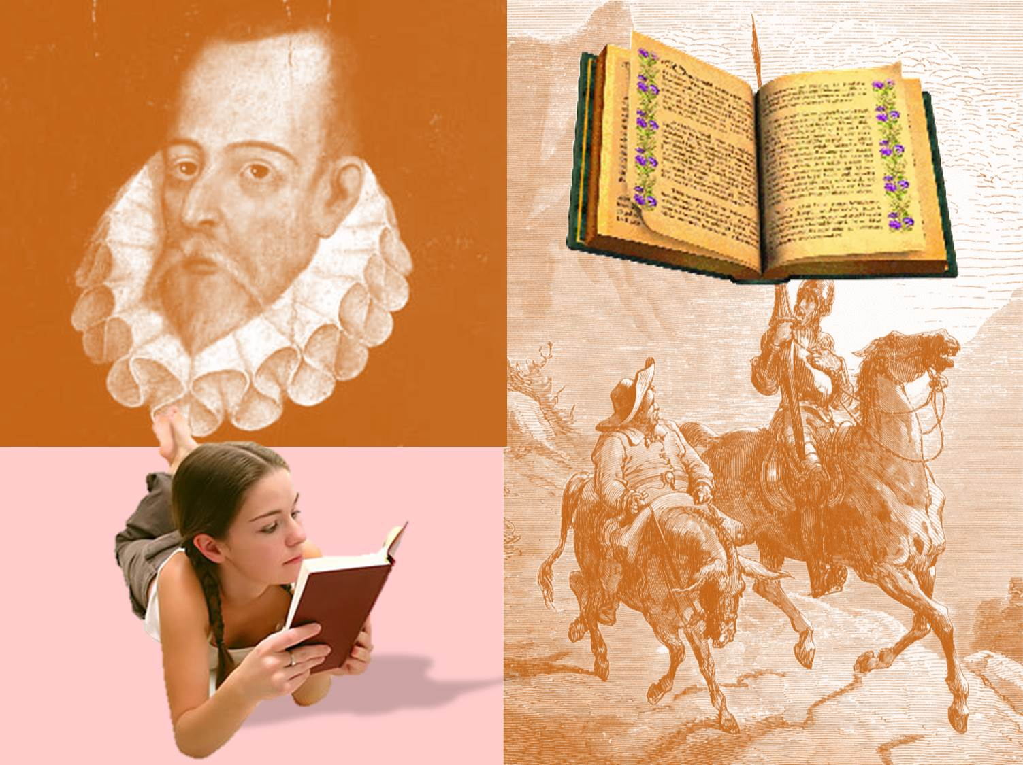
Literature

Slide 34
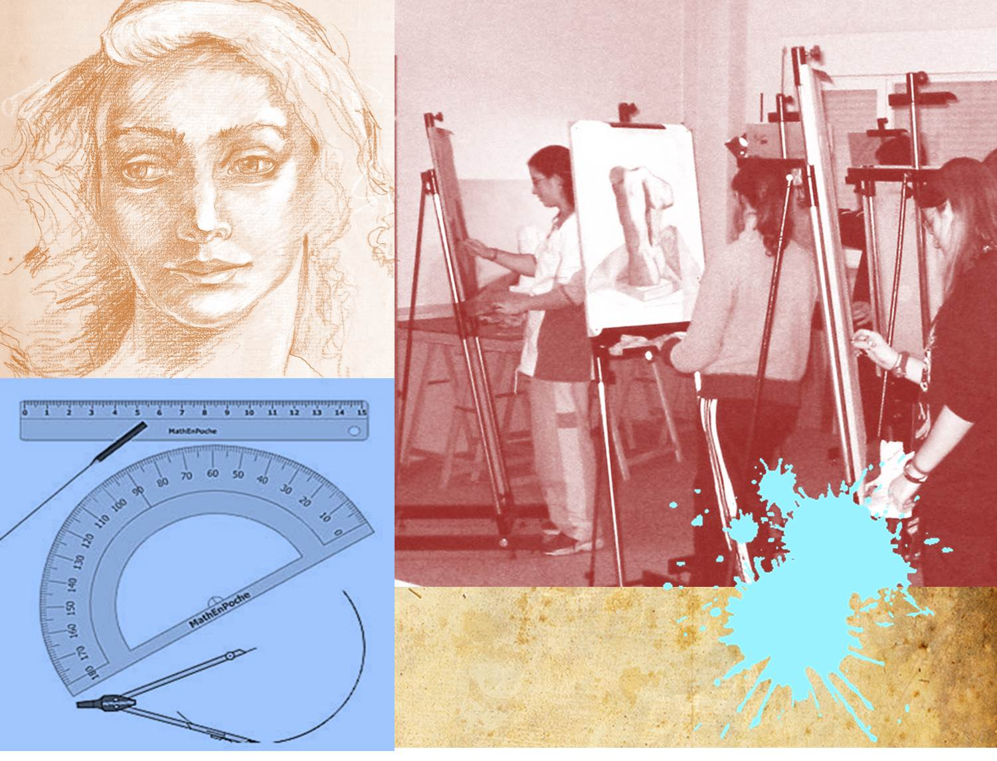
Art

Slide 35
Physical Education
Gym

Slide 36
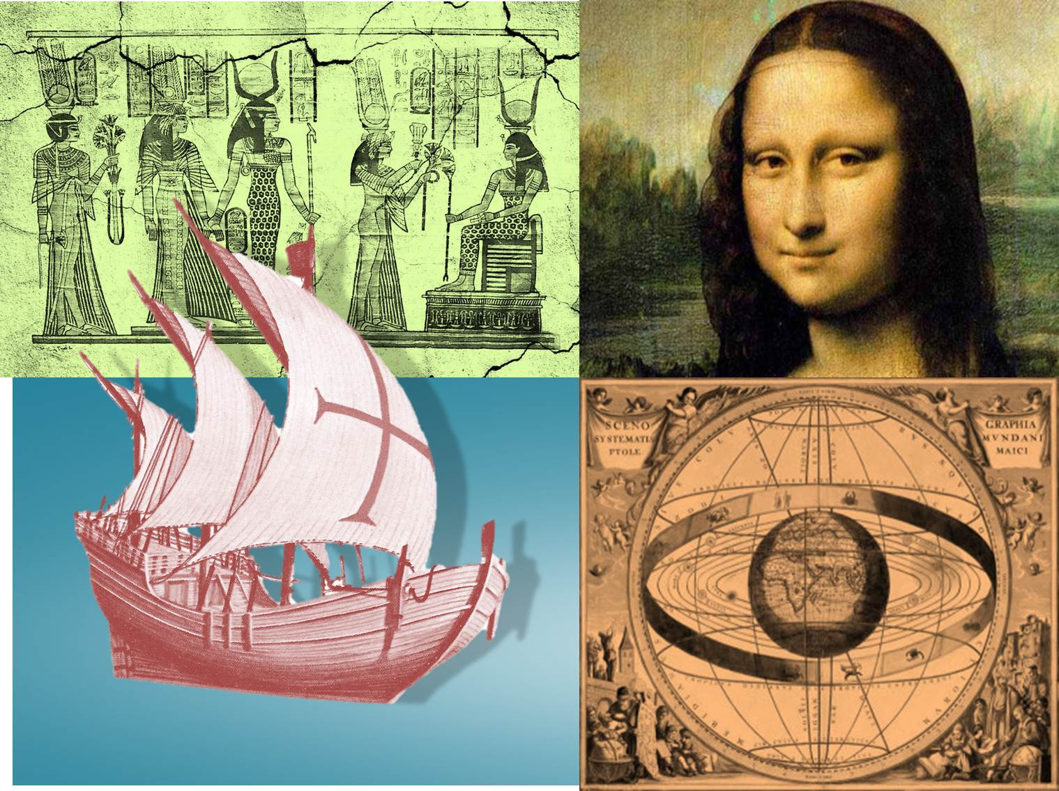
History

Slide 37
Geography

Slide 38
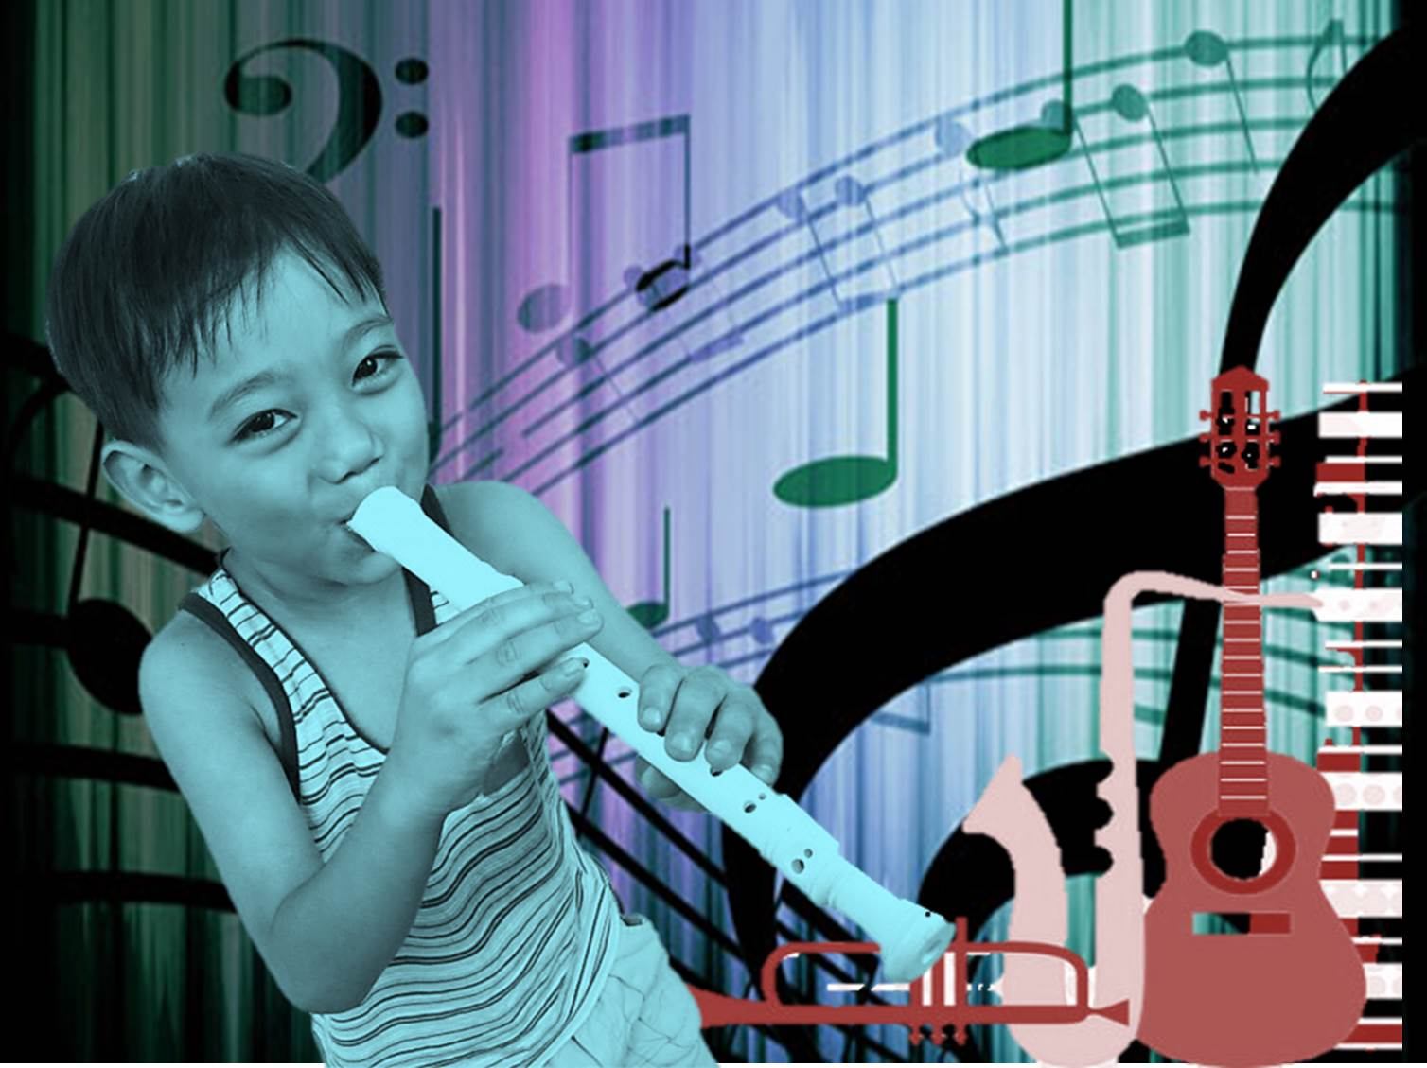
Music

Slide 39
Computer Technology
Computers

Slide 40
What’s your favourite subject?
Why?

Slide 41
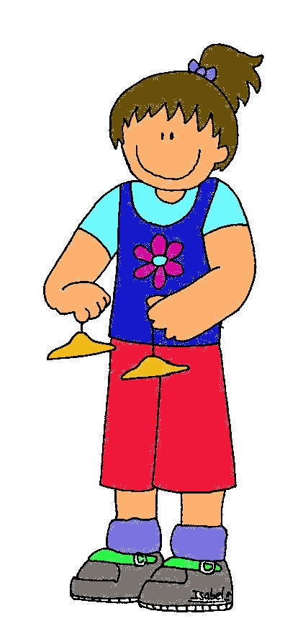
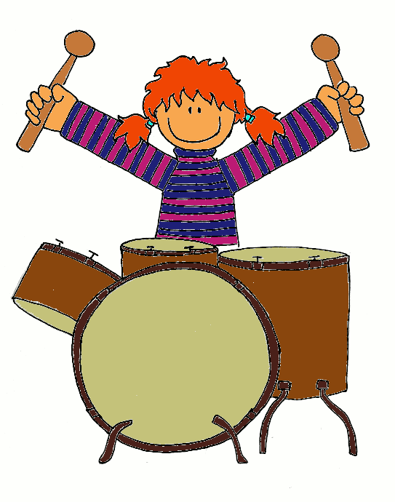
Music
Science
Geography

Slide 42
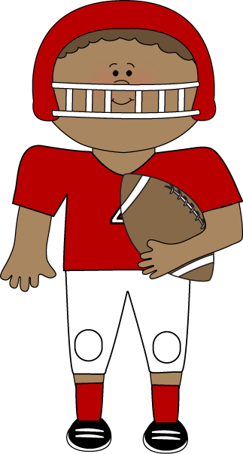
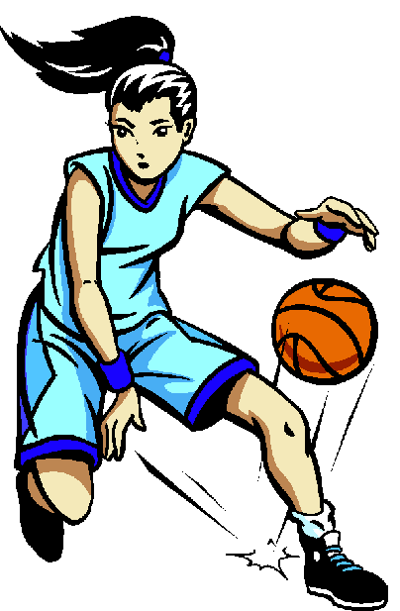
English
Gym
Art

Slide 43
Art
Science
English

Slide 44
Geography
Science
Literature

Slide 45
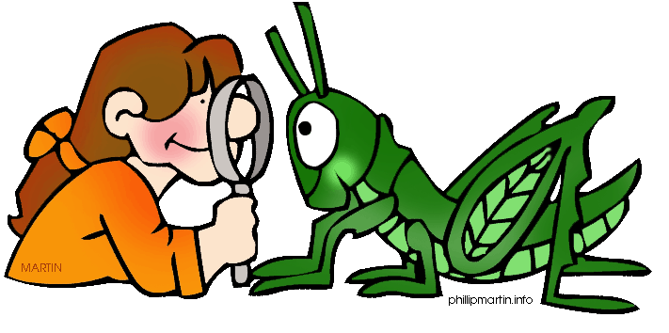
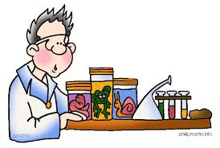
Gym
Science
English

Slide 46
Video Clip Activity
Make a 30 second video clip.
What subjects are you good at?
What subjects don’t you like?
What subject would you like to study in school, that you do not currently have? Why?
Who is your favorite teacher? Why?
Record your answer and share it with your family, friends and teacher.

Slide 47
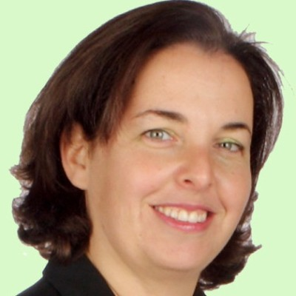
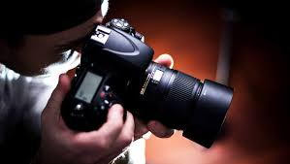
For example
What subjects are you good at? I am good at music and English.
What subjects don’t you like? I don’t like history, because I can’t remember many dates.
What subjects would you like to study in school, that you do not currently have? Why? I would like to study photography, because I love to take pictures.
Who is your favorite teacher? Why? My favorite teacher is Rivki Rosenberg, because her lessons are fun!

Slide 48
Self Assessment
 | Yes | No | Not sure
I can answer questions about school subjects in English

Slide 49
Now you can…
understand teacher’s questions
locate specific information in lists and isolate the information required

Slide 50
School Subjects
English- Speaking
Teacher: Rivka Rosenberg

Slide 51
השימוש ביצירות במהלך שידור זה נעשה לפי סעיף 27א לחוק זכות יוצרים, תשס"ח-2007. אם הינך בעל הזכויות באחת היצירות, באפשרותך לבקש מאיתנו לחדול מהשימוש ביצירה, זאת באמצעות פנייה לדוא"ל rights@education.gov.il
שימוש ביצירות מוגנות בזכויות יוצרים ואיתור בעלי זכויות

