Slide 1
מערכת שידורים לאומית

Slide 2
English Around the World
English, 10th grade
Jessica Goldshlager Kamir

Slide 3
Can you…?
Say words in English in 3 different ways (as if you were from Australia, England, and America)?
Complete online text messages between friends from different countries?
Notes:
Spoken Reception:
Can understand enough to be able to meet needs of a concrete type especially if speech is clearly articulated (adapted CEFR A2)
Can understand straightforward announcements (e.g. a telephone recording or radio announcement of a cinema program or sports event, an announcement that a train has been delayed, or messages announced by loudspeaker in a supermarket), if the delivery is articulated clearly (CEFR A2)

Slide 4
Rationale
British, Australian and American English
The English language is the language that is used most widely in the world.
Whether you learn British English, Australian English, or American English *depends on where you are from, or where you would like to go and work.
There are many similarities between the different types of English, but there are also major differences between them.
In this presentation, we will learn vocabulary words that are said or spelled differently in the countries of Australia, England, and the Unite States.
It is important to know all the different *variations of the words for when you may travel, or work in one of these countries.
Notes:
Depends on - band 2, variation – band 3

Slide 5
Vocabulary
New Word | Meaning
depends on (v) | to be determined or decided by something
variation (n) | something that is similar to something else but different in some way
refer (v) | to call something or someone by a specified name or title
variety (n) | a particular kind of person or thing
expression (n) | a word or phrase
originally (adv) | in the beginning : when something first happened or began
authentic (adj) | real or genuine : not copied or false
emphasis (n) | added force that is given to a word or syllable when speaking
approval (n) | the belief that something or someone is good or acceptable : a good opinion of someone or something
express (v) | to talk or write about something that you are thinking or feeling

Slide 6
Vocabulary Practice
Word | Sentence
variation | What ….. of pink do you like? I like baby pink.
expressed | She ….. surprise at his rude behavior.
depends on | When can you meet? It ….. my day off.
refers | He ….. to his girlfriend as “sweetie”.
originally | The building was ….. a school.
approval | There are children who can never gain their parents’ …..
varieties | We will learn about 3 different ….. of English today.
emphasis | The ….. in the word “happiness” is on the first syllable.
authentic | Experts agree that the signature on the letter is …..
expressions | He uses some very odd …..
authentic expression emphasis originally depends on
variation express refer approval variety

Slide 7
Let’s Watch
Hear the different ways 3 girls from Australia, England, and America
*refer to the same items.
https://www.youtube.com/watch?v=zdow47FQRfQ
Notes:
Refer – band 3,

Slide 8
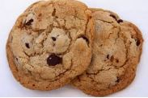
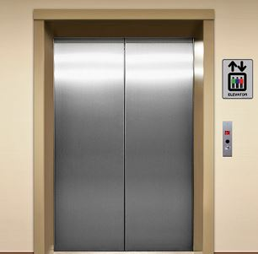
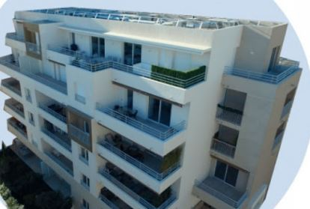
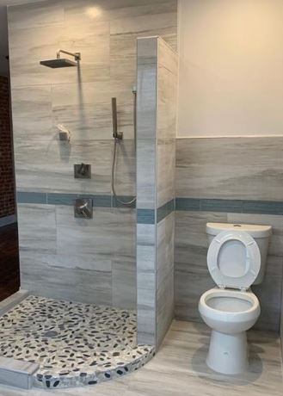
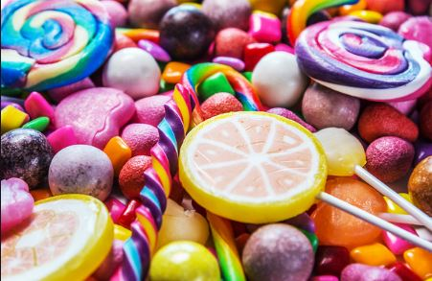
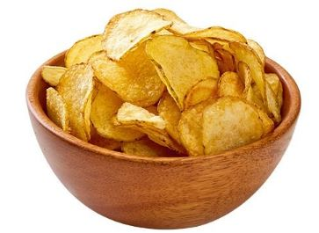
America
cookies
elevator
apartment
eraser
bathroom
candy
potato chips

Slide 9
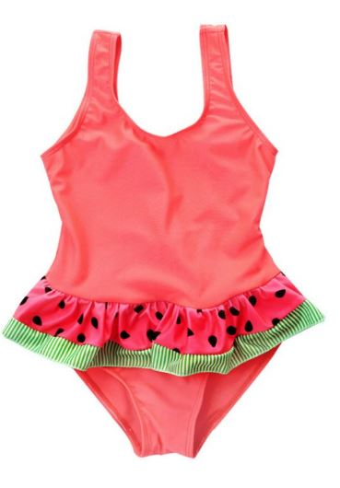
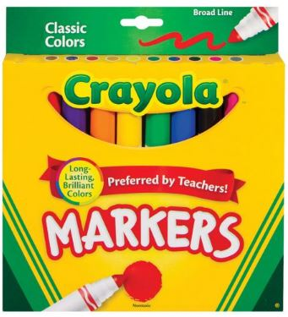
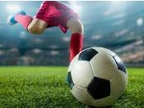
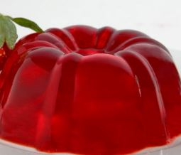
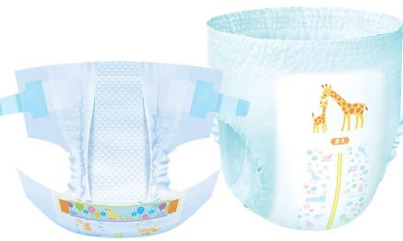
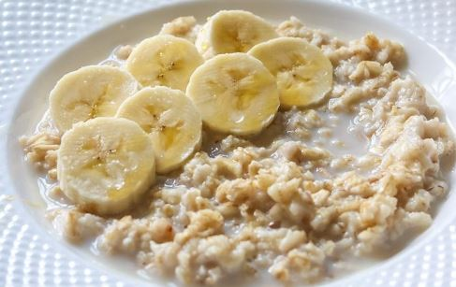
America
french fries
bathing suit
markers
froyo
soccer
jello
diaper
oatmeal

Slide 10
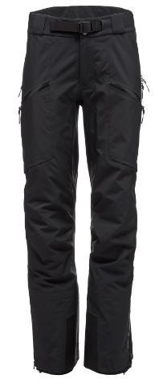
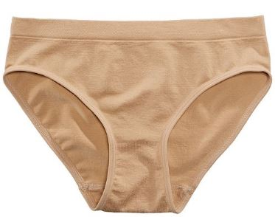
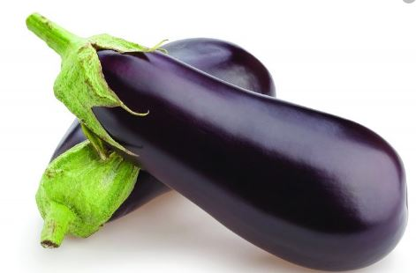
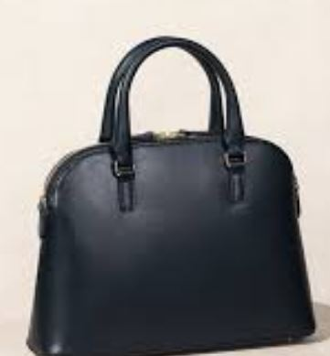
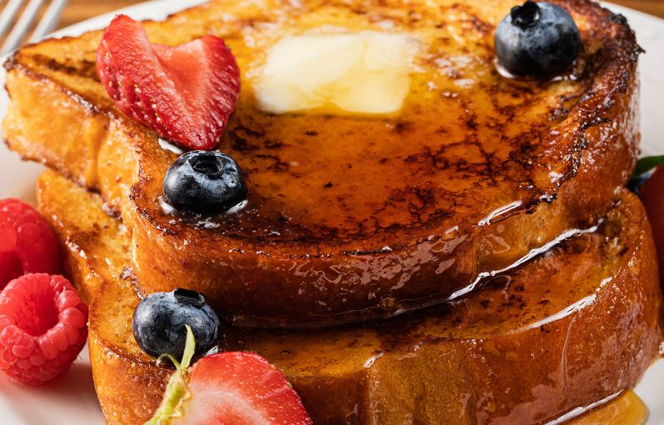
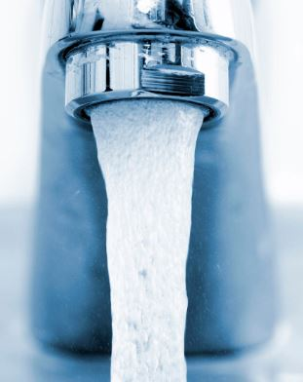
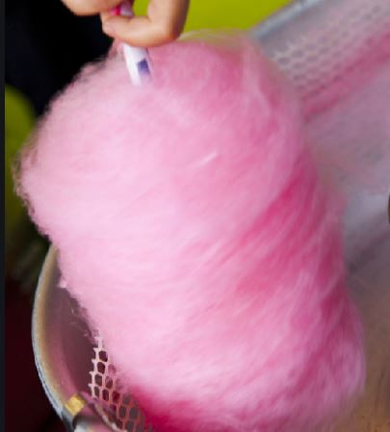
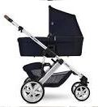
America
pants
eggplant
purse
underwear
french toast
faucet
cotton candy
pitcher
stroller

Slide 11
United Kingdom
biscuits
lift
flat
rubber
loo
sweets
crisps

Slide 12
United Kingdom
chips
swimming costume
felt pens
frozen yoghurt
football
jelly
porridge
nappy

Slide 13
United Kingdom
trousers
aubergine
Handbag
eggy bread
knickers
tap
candy floss
pram
jug

Slide 14
Australia
lift
flat
Anzac biscuits
rubber
loo
lollies
crisps

Slide 15
Australia
chips
togs
felt pens
frozen yogurt
football
jelly
nappy
oats

Slide 16
Australia
pants
aubergine
Handbag
french toast
undies
tap
fairy floss
pram
jug

Slide 17
Can you guess what this is?

Slide 18
Can you guess what this is?
US: eggplant
UK and Australia: aubergine

Slide 19
Can you guess what this is?

Slide 20
Can you guess what this is?
US: jello
UK and Australia: jelly

Slide 21
Can you guess what this is?

Slide 22
Can you guess what this is?
US: cotton candy
UK: candy floss
Australia: fairy floss

Slide 23
Can you guess what this is?

Slide 24
Can you guess what this is?
US: bathing suit
UK: swimming costume
Australia: togs

Slide 25
Can you guess what this is?

Slide 26
Can you guess what this is?
US: cookies
UK: biscuits
Australia: Anzac biscuits

Slide 27
Let’s Watch
Three varieties of English
https://www.youtube.com/watch?v=5OEehlggPp0

Slide 28
Vocabulary Review
Match the word to it’s proper definition
something that is similar to something else but different in some way
a word or phrase
a particular kind of person or thing
to call something or someone by a specified name or title
to be determined or decided by something
depends on
variation
refer
variety
expression

Slide 29
Vocabulary Review
Match the word to it’s proper definition
real or genuine : not copied or false
the belief that something or someone is good or acceptable : a good opinion of someone or something
to talk or write about something that you are thinking or feeling
added force that is given to a word or syllable when speaking
in the beginning : when something first happened or began
authentic
originally
emphasis
approval
express

Slide 30
British, American, and Australian English
Isn’t it hard to believe that “g’day mate”, “you alright?”, and “how’s it going?” are all different ways in English to say hello or ask how someone is doing?
A lot of English language learners find it confusing to understand the differences between British, Australian, and American English.
Believe it or not, British, Australian, and American English are the 3 *varieties of English that are more similar than they are different.
Notes:
Variety – band 3

Slide 31
British, American, and Australian English
The most obvious difference between the British, Australian and American English is the accent, or pronunciation of words.
American English uses a clear “r” sound and Australian and British English don’t pronounce a clear /r/ sound. In Australian or Britain the word “car” would be pronounced without the final “r” sound (i.e. “ca”) and “warmer” would be pronounced without the middle “r” sound (i.e. /wamer/).
Major Differences between the 3 varieties of English

Slide 32
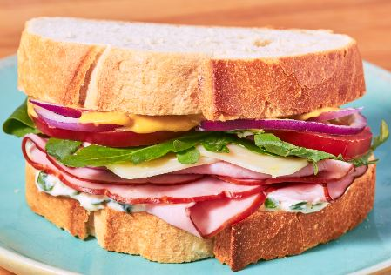
British, American, and Australian English
Major Differences between the 3 varieties of English
Another major difference between American English and British or Australian English is the intonation when asking questions.
One’s voice goes up at the end of a yes or no question with American English, but with Australian and British English one’s voice goes down.
There are also differences between vocabulary and spelling with the three different types of English.
For example, in the United States and Britain they call two pieces of bread with a protein or vegetable in the middle a “sandwich” and in Australia they call this a “sanga.”
ex of spelling: yogurt in US, yoghurt in UK and Australia

Slide 33
Popular Phrases and Words in Australia
“Aussie” *refers to someone who’s Australian.
“Mate” means friend and is also used in British English.
“G’day” (pronounced “geh-day”) means “hello” or “how’re you?”
“Crikey!” or “Streuth!” (pronounced “krai-kee” and “strooth”) are both *expressions of shock or surprise.
Crikey! Did you see the size of that bug? -Streuth! You were almost hit by a bus!
“How ya going?” means “how’re you?”
“Fair dinkum” or “dinky die” are both used to say something is true.
He’s as dinky die as you get. -I finally did it mate! Fair dinkum.
“True Blue” is a way to say “the real thing.” *Originally it meant to be patriotic, but today it means genuine or *authentically Australian.
She’s American and he’s true blue Aussie.
Notes:
Refer – band 3 word, expression- band 3, origanal – band 2, authentic- band 3

Slide 34
Popular Phrases and Words in England
“Bloody” means “very.” This is a great way to show *emphasis when you’re speaking.
That meal was bloody good!
“Rubbish” literally means “garbage” or “trash.” If you don’t like something this is the perfect word to use to say it’s worthless or untrue.
I talked to my boss today and she agreed that my salary is rubbish. She said she’d give me a raise starting next week.
“Lovely” is a common British word to use if you want to *express affection or *approval for someone or something.
This is a lovely cup of tea.
“Bodge” is a word used to say that a repair job is of low-quality or is not done well.
When I was a kid I had a bike that was bodged together.
Notes:
Express- band 2, approve- band 3

Slide 35
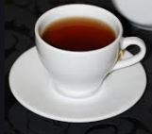
Popular Phrases and Words in England
“Chuffed to bits” is a common way in Britain to say you’re very pleased with someone or something.
If someone is excited about taking a vacation to a new place you could say “they’re chuffed to bits about traveling to Greece.”
“Cheeky” means playful or mischievous.
The boy was cheeky with his mum (“mum” is used in Britain and Australia and “mom” is used in the United States).
“You alright?” or “alright?” is a common way to say “hello!” in Britain. You can simply respond by nodding your head or saying “Hi.” This sounds like a question, but it’s simply a greeting.
“Fancy a cuppa’?” means “would you like a cup of tea?”

Slide 36
Popular Phrases and Words in America
“Hang out” is a way to talk about spending time at a certain place or with someone.
“I just hung out and relaxed at my house all weekend.”
“Chill out” means to relax.
We’re just chilling out at my place.
if someone tells you to “chill out” they’re telling you to not overact about a situation or get too stressed about something small.
“Have a blast” is a way to say that someone or something is fun.
The concert was a blast!

Slide 37
Popular Phrases and Words in America
“How’s it going?” or “what’s up?” is a common way for people from the United States to ask “how’re you?” or “how’re you doing?”
“Awesome” or “cool” are popular ways to express that you think someone or something is amazing or wonderful.
The movie was awesome!”
“Costs an arm and a leg” means that something is really expensive.
I really want to buy that coat, but it costs an arm and a leg.
“Oh my G-d”, “oh my gosh” or “OMG” are all ways to emphasize surprise or shock.
OMG, did you see how big that pizza was?!

Slide 38
Task
Complete the online chat between friends.
Answer once as if you’re from America, and a second time as if you’re from England.
“G’day Dan. How ya goin? Do you want to go the cinema tonight?”
“I’m fine. I’m just chilling out with my brother at home.”
“I am relaxing. I’m drinking a lovely cup of tea.”
Notes:
Can engage in basic social communication online (adapted CEFR A2)
Can write short, simple notes, emails and text messages (e.g. to send or reply to an invitation, to confirm or change an arrangement, to express thanks or apology) (adapted CEFR A2)

Slide 39
Let’s Review - Vocabulary
New Word | Meaning
depends on (v) | to be determined or decided by something
variation (n) | something that is similar to something else but different in some way
refer (v) | to call something or someone by a specified name or title
variety (n) | a particular kind of person or thing
expression (n) | a word or phrase
originally (adv) | in the beginning : when something first happened or began
authentic (adj) | real or genuine : not copied or false
emphasis (n) | added force that is given to a word or syllable when speaking
approval (n) | the belief that something or someone is good or acceptable : a good opinion of someone or something
express (v) | to talk or write about something that you are thinking or feeling

Slide 40
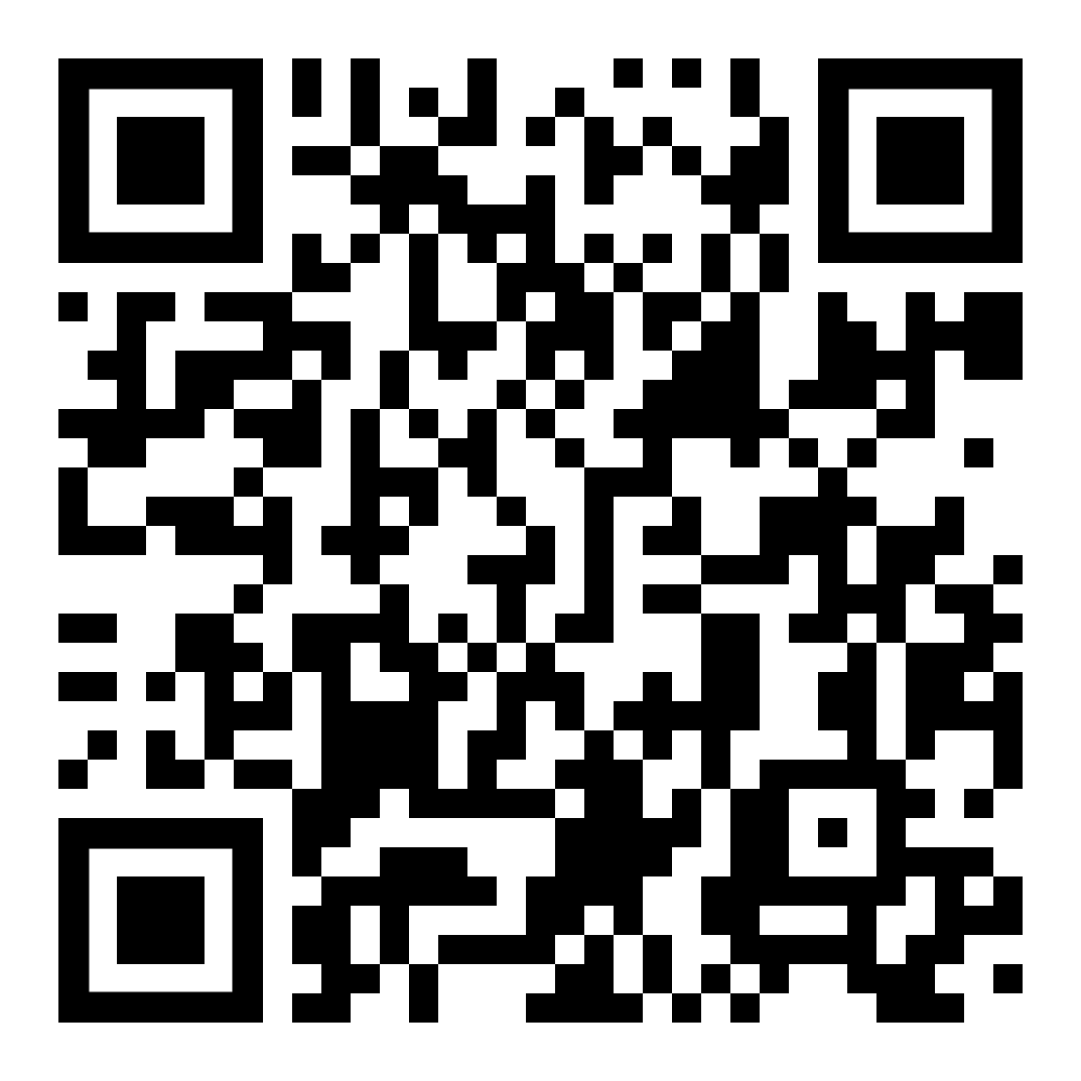
Let’s Review – Vocabulary
https://quizlet.com/_8dy9cb?x=1qqt&i=2r9iph

Slide 41
Now you can…
Say words in English in 3 different ways (as if you were from Australia, England, and America).
Complete online text messages between friends from different countries.
Notes:
Spoken Reception:
Can understand enough to be able to meet needs of a concrete type especially if speech is clearly articulated (adapted CEFR A2)
Can understand straightforward announcements (e.g. a telephone recording or radio announcement of a cinema program or sports event, an announcement that a train has been delayed, or messages announced by loudspeaker in a supermarket), if the delivery is articulated clearly (CEFR A2)

Slide 42
השימוש ביצירות במהלך שידור זה נעשה לפי סעיף 27א לחוק זכות יוצרים, תשס"ח-2007. אם הינך בעל הזכויות באחת היצירות, באפשרותך לבקש מאיתנו לחדול מהשימוש ביצירה, זאת באמצעות פנייה לדוא"ל rights@education.gov.il
שימוש ביצירות מוגנות בזכויות יוצרים ואיתור בעלי זכויות

