Slide 1
מערכת שידורים לאומית

Slide 2
Speaking: A Teacher Tutorial
English |Focus on Elementary School Learners
With: Lori Roth

Slide 3
In this tutorial teachers will learn to
integrate morning greetings in pairs.
activate learners through warm-up chants.
incorporate simple speaking transitions.
implement guessing games on different topics.
design simple pair work tasks to promote speaking.

Slide 4

Following this tutorial, your pupils can
greet friends using a simple dialogue.
recite a chant with appropriate stress, rhythm and intonation.
play a guessing game.
express their preferences.
Notes:
Dear Teacher,
Please review the suggested Can Do statements in the National Curriculum 2020 for the Pre-foundation level. Note that the focus in this tutorial is Spoken Production.

Slide 5
Demonstration time: Four Speaking Activities
Greetings: Turn and Talk
Warm up Chant
Transition Integrating Movement
Guessing Game
Classroom Management: Cues and Signals

Slide 6

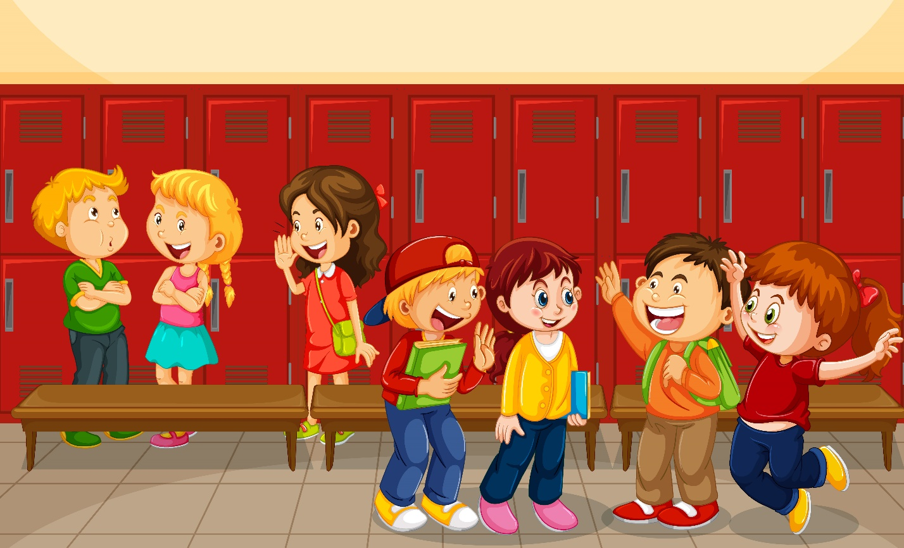
Morning Greetings: Turn and Talk
Good morning.
How are you today?
I’m fine thank you.
How are you today?
I’m fine thank you.
Have a nice day!
Have a nice day.
Notes:
Demonstration:
T-Class
Say it to the right.
Say it to a friend
Audio source: Speak UP Site
https://sites.google.com/view/speakup1/materials/audio-recordings?authuser=0

Slide 7
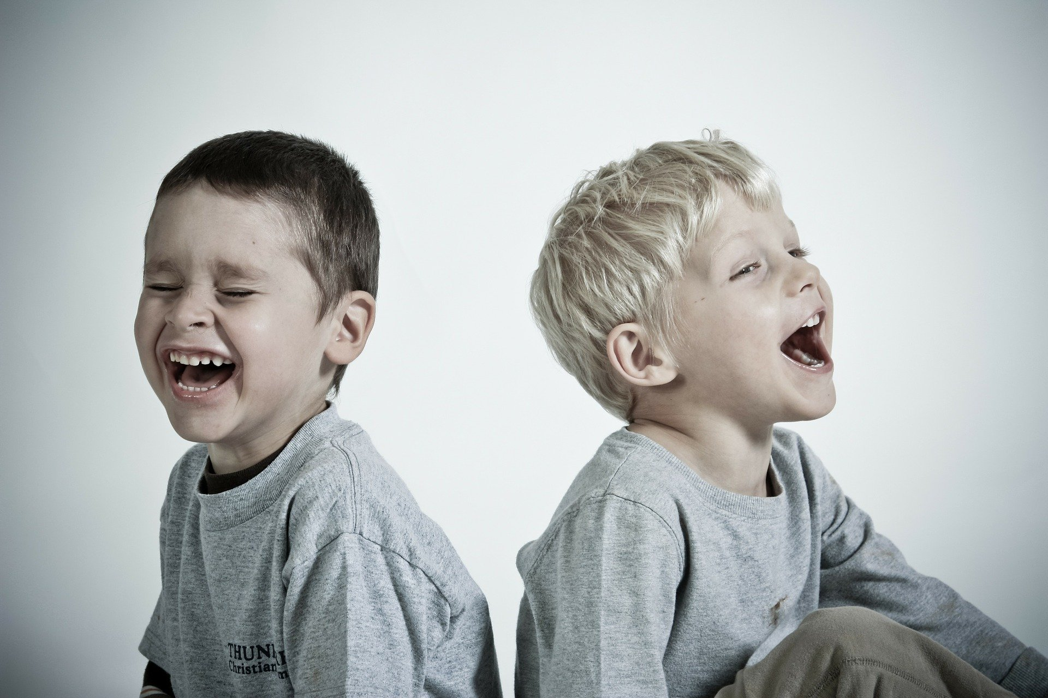
Warm up Chant: I can make you laugh!
I can make you laugh!
No you can‘t
No you can’t
****
3x
Yes you can!
Notes:
Demonstration.
Image Source:
Audio Source: Speak Up site
https://sites.google.com/view/speakup1/materials/audio-recordings?authuser=0

Slide 8

Transitions: Total Physical Response
Hands up ( 4x)
Hands down (4x)
To the right right right
To the left left left
To the front front front
To the back back back
Ssshh…. Quiet.
This activity activates the learners. They repeat after and with the teacher while doing the motions.
Excess energy is released and class quiets in preparation for next task.
Notes:
Demonstration
This activity activates the learners using total physical response- they do the movements and the repeat after and with the teacher doing the motions.
Excess energy is released and class quiets in preparation for next task.

Slide 9
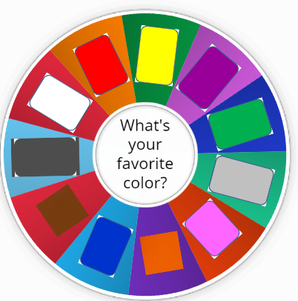


Guessing Game: I’m thinking of my favorite _____
I’m thinking of my favorite color.
Is it_______?
Yes, it is .
No, it’s not.
Notes:
Demonstration: Distribute the color wheel to students for reference during activity,
T- class
Pairs- each in turn
Transition Back
Report to class: What color does ____ like?

Slide 10


Classroom Management: Cues and Signals
T: 5-4-3-2-1 If you hear me …. clap once,
If you hear me … clap two times,
If you hear me…. clap three times.
****************************************
T: 1-2-3 eyes on me
Class: 4-3-2 eyes on you
Notes:
Cues and signals enable us to make a smooth transition back to the frontal/whole-group mode of teaching.
Counting can be very effective with younger learners and can reinforce language learned.
Lights off and a quiet counting chant becomes part of the routine when working in pairs.

Slide 11
A closer look at the guessing game
A well executed speaking activity is broken down into 3 stages:
Before
During
After

Slide 12
Before the activity we need to:
Review Key Vocabulary (Ex: colors)
T says a word, throws a ball and pupils translate.
Model the Speaking Game
Teacher with the whole class
Pupil with the class
Practice Chorally
T shows part of an image and pupils identify the word.
T shows an image quickly and pupils say the word.
Two pupils demonstrate frontally
Opening statement (Ex: I’m thinking of my favorite color)
Questions : Is it_______?
Answers: Yes it is / No, it’s not.

Slide 13
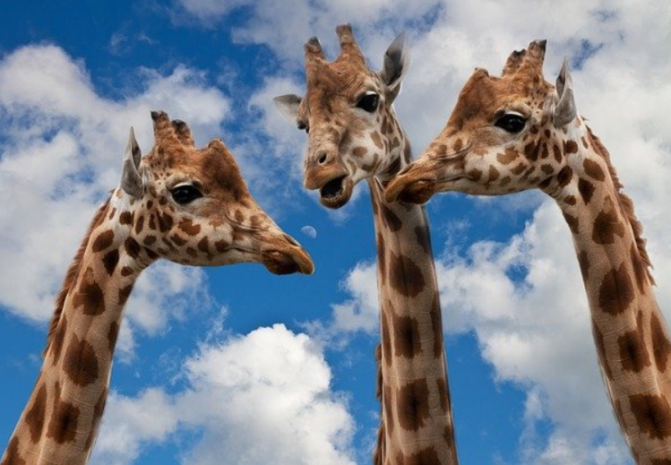
During the activity pupils:
Option 1: Work in pairs or trios.
Option 2: Circulate in the classroom and interview their friends.

Slide 14
During the activity teachers need to:
Give a Time Frame
How does the activity begin? Ex: 1,2,3, begin!
How does the activity end? Ex: Lights out, T counts 1-10
Provide Visual Support on the Board
Pictionary: Images or words Ex: Color Wheel
Questions and answers for readers
Facilitate the Activity
Encourage and support.
Refrain from correcting errors.

Slide 15

After the activity pupils
share with the class what they learned about their friends.
use sentence stems to report to the class :
Ex:
_________ likes ________ but he/she doesn’t like____________.
activate their classmates:
Thumbs up if you agree with what is reported.
Notes:
<a href='https://pngtree.com/free-backgrounds'>free background photos from pngtree.com</a>

Slide 16
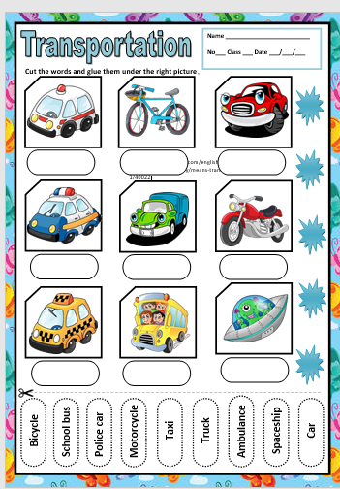
Transportation Guessing Game
Guessing games never get boring.
There is something inherently interesting about guessing what your friend is thinking.
The topics change, the new vocabulary being practiced is different and the model for speaking becomes familiar so that learners feel confident when speaking.
Tip: Always leave a picture dictionary on the board for support.

Slide 17
Guessing Game Sum Up
Step 1: Review of target items
Step 2: Model game
Teacher/Class ⇨ Pupil/Class ⇨ Pupil/Pupil frontal
Step 3: Choral Practice question + answers
Step 4: Speak in Pairs/Trios/Circulate and interview classmates
Step 5: Ask: What did you learn about your friends? (Frontal)
Expansion: Make an audio recording or clip at home
Before
During
After
* This activity can be adapted when practicing any new set of lexical items both at reading and pre-reading stages of language learning. Ex: food items/ numbers/ pets

Slide 18

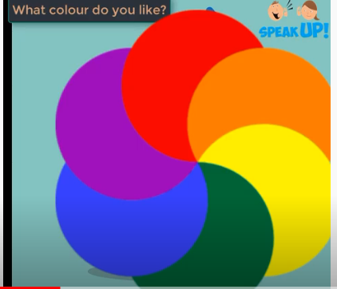
Practice at Home:
What color do you like?...clap (2x)
What color do you like (3x)…clap
I like ___ but I don’t like ___ (3x)
So… what color do you like (3x)…clap
Notes:
A lesson which has a strong spoken production component is easily followed up with a speaking homework task.
Pupils expand speaking practice upon the topic in class with a chant that is easily adaptable to a variety of subjects.

Slide 19

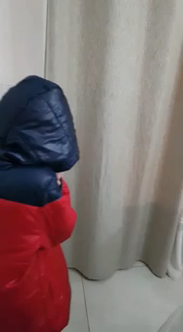
Pupils can practice and create dialogues at home
Listen to Ziv and his father
talk about the weather.
Notice important features:
☞ Repetition
☞ Physical Engagement with the language
☞ Pupil Motivation
☞ Creativity
☞ Interaction with parent or friend
☞ Humor / fun

Slide 20
Demonstration time: More Speaking Activities
Taking Attendance: This or That?
Warm up Chant: Going on a picnic
Memory Chain Game : Going to grandma’s house
Pictures Prompts: Describe a picture with a friend
More Guessing Games : Guess Who
Picture Dictations : Draw my monster

Slide 21

More Speaking Activities for Upper Elementary
Taking attendance can also be an opportunity to promote speaking.
Try the “This or That” or “Would You Rather” Game.
Step 1: Teacher calls out each pupil’s name in turn.
Step 2: Teacher gives two options and asks: This or That?
Example: Watch t.v. or Read a book?
Step 3: Pupil states his/her preference and why.
* Classmates who agree with the pupil stand up.
Notes:
For more ideas: Would you rather app
Special thanks to Rania for her inspiration.
http://clipart-library.com/school-attendance-cliparts.html

Slide 22

This or That?
☞ Hot drinks or cold drinks?
☞ Sweet food or salty food?
☞ Computer games or sports?
☞ Dogs or cats?
☞ Spend time with a good friend or meet a new friend?
☞ Home cooking or restaurant?
☞ Go back in time or go into the future?
☞ Be able to talk to dogs or birds?
☞ Have: world peace or a million dollars?
☞ Loyal friend or rich friend?
☞ Work alone or in a team?
☞ Amusement park or day at the beach?

Slide 23
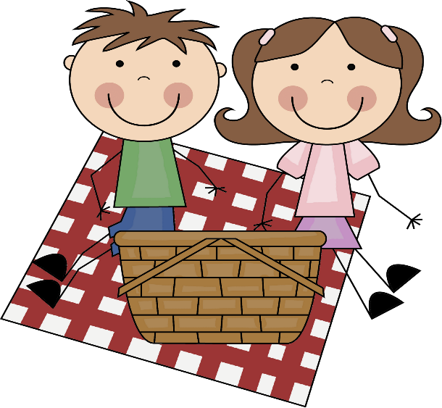

Warm up Chant: Going on a Picnic
Opening the lesson with a song or chant…
☺ sparks good energy.
lowers inhibitions.
gets mouths moving in English!
However….
Not all teachers like to sing.
We can convert a song to a chant.
Song version
Chant version
Notes:
https://www.youtube.com/watch?v=fomN5WI3xro
Going on a Picnic
Provided to YouTube by Universal Music Group
Going on a Picnic · Raffi
Taken from the album At The Corner Store

Slide 24

Demonstration: Going on a Picnic
Set the beat of the chant with a clap and a snap.
T says a line.
Pupils repeat.
Pupils add food items in turn.
Going on a picnic,
Leaving right away,
If it doesn’t rain we’ll stay all day.
Did you bring the____________?
Yes, I brought the ____________?
Ready for a picnic? Here we go!

Slide 25

Memory Chain Game: Going to Grandma’s House
What is a memory chain game?
A memory chain game is a popular circle game for young learners, ages 1-99, which engages and activates as each pupil must remember what previous classmates said.
Why?
Great vocabulary practice
Ex: T can give specific lexical set to be practiced: food / clothing
Excellent for heterogeneous classes – different levels/grades
Pupil choice
Repetition
Cooperation between learners
Fun

Slide 26
Demonstration: Going to Grandma’s House
T gives instructions
T models
Pupils repeat
Pupils in turn add a word or chunk
T gives instructions:
Pupils seated in a circle (optional)
We are going to play a memory game today.
The game is called: Going to Grandma’s House.
Each pupil in turn will say what he/she wants to bring, but must first say what was already said by classmates.
You need to listen very carefully to your friends.
We will keep going around the circle so everyone has a turn. Let’s Begin!
T: I’m going to my grandma’s house and in my bag I am going to take….
my purple pajamas.
Pupil 1: I’m going to my grandma’s house and in my bag I am going to take….
my purple pajamas, and….. a lemon lollipop.
Pupil 2: I’m going to my grandma’s house and and in my bag I am going to take…..
my purple pajamas, a lemon lollipop, and my tiny puppy.
Notes:
https://www.cleanpng.com/png-summer-decorative-picture-png-clipart-58650/download-png.html

Slide 27
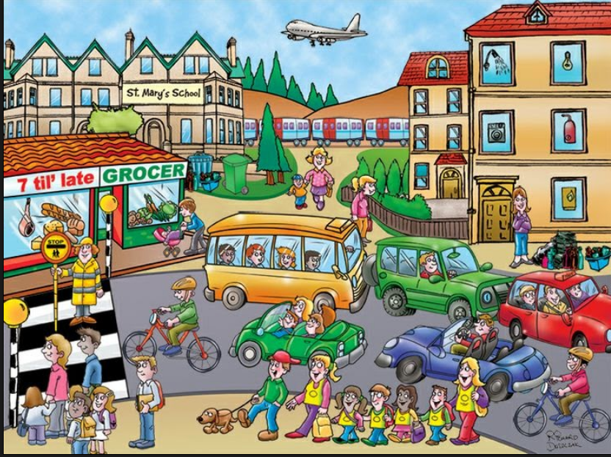
What can you say about the picture?
On board:
I can see_________
There is/are_______.
The _____ is/are _______ing.
The ___is near/behind/in front of the _____.
Step 1: T screens a picture and sentence starters on the board.
Step 2: T give pupils 5 minutes to say as much as they can about the picture and records the number of sentences.
Step 3: Pupils work in pairs/trios and repeat activity . Secretary ticks (✓) every sentence the team creates.
Notes:
In pairs, trios or small groups, students say as many things as they can about a picture in two minutes.
A ‘secretary’ notes for each idea as it is suggested.
After two minutes, the secretary announces the number of ✓s.
They then do the same with another picture, and try to break their previous record. Penny Ur ppt slide 2016

Slide 28
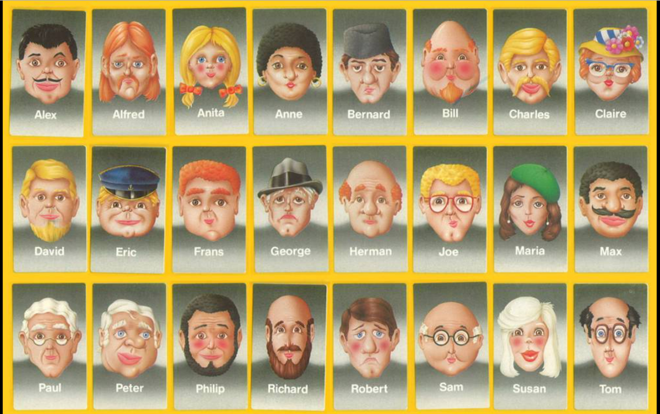
Guess Who!
Instructions
Step 1: Each pupil receives a game card.
Step 2: T reviews language in the help box.
Step 3: Each pupil chooses a character on his/her card.
Step 4: In turn they ask each other yes/no questions to discover the character.
The correct guesser is the winner.
Help Box
Is it a man? a woman?
Does he/she have_______?
glasses,
a hat
a moustache
a beard
long / short / blonde / red / white hair
a bald head
Is he /she_______ above / below / to the right of / to the left of ________?
Notes:
https://www.reddit.com/r/nostalgia/comments/blnxhc/original_guess_who_characters/
https://i.redd.it/ad8maaz1wqw21.jpg

Slide 29
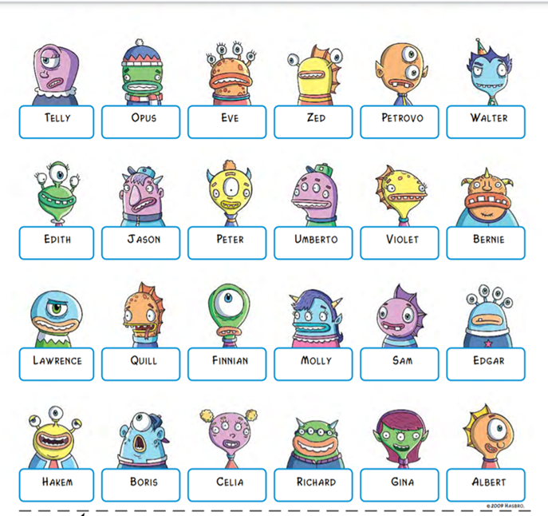
Guess Who?
Help box
Are you……
yellow / blue / pink / purple / blue green / orange?
Do you have (number) eyes / ears / a mouth / horns?
Are you….happy / sad / angry / scared?

Slide 30
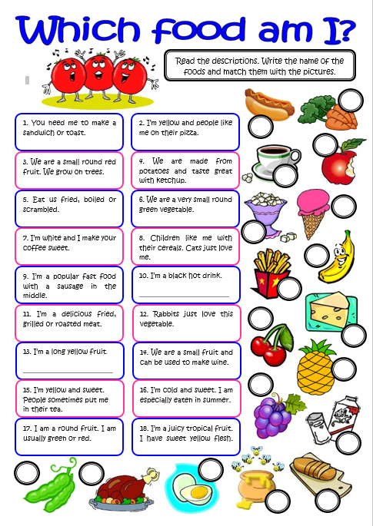
Information Gap Activities
A worksheet can easily be transformed into a speaking activity
which integrates all 4 skills.
In this vocabulary practice activity on foods, pupils match the
descriptions with the correct pictures.
Step 1: Reading and Speaking:
Pupil A reads aloud each description card of different
foods and says: “Which food am I ?”
Pupil B: Identifies the cutout picture and says: I am_______.
Step 2: The pair makes a match, records their answers
in their notebooks by writing the description and correct word.

Slide 31


Picture Dictations: Draw my monster
Step 1: Listening Activity
T describes her monster and kids draw.
Step 2: Pupils compare their picture with the teachers and report back what they drew.
“Your monster is____.
Your monster has_______.
Step 3: Pupils draw a monster at home
They write several sentences.
Step 4: Pupils dictate in class their description to a partner who draws and reports back to check that he/she heard correctly.
Step 5: Pupils compare their drawings.
Pupil A Monster Card
Pupil B Monster Card

Slide 32
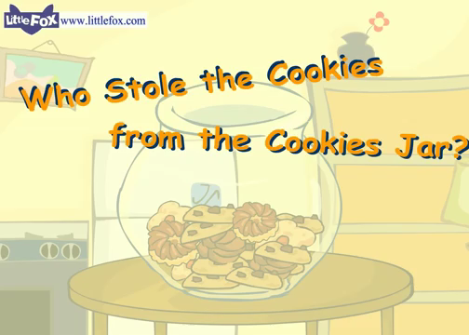
Closure: Who Stole the Cookies
Set the beat of the chant with a clap and a snap.
T says a line.
Pupils repeat.
Pupils say the name of a classmate
☞ Who stole the cookies from the cookie jar?
☞ ________ stole the cookies from the cookie jar!
☞ Who me?
☞ Yes you!
☞ Not me!
☞ Then who?
☞ __________stole the cookies from the cookie jar
Notes:
Can add: He said/ She said.. Who stole the cookies,

Slide 33

Tips for Promoting Spoken Production
Maximize speaking opportunities throughout the lesson:
(Greetings / warmup / transitions / to practice key vocabulary + pronunciation / Speaking at home)
2) Model: Explain less Demonstrate more.
Break it down / Choral repetition / Practice Q/A
3) Work in Pairs or Trios: More pupil talk less teacher talk
4) Use Cues and Signals: Behavior management strategies
5) Focus on Fluency : Motivate, engage, and let students communicate
HAVE FUN
Notes:
Not a “speaking lesson rather a lesson in which speaking is integrated throughout

Slide 34
Thank you for watching!
Notes:
Special thanks to Reut Adam, Tefen School and Shelli Roth for their assistance in creating the audio Speak Up recordings!

Slide 35
Image Sources
Slide 4: https://pixabay.com/vectors/search/think/?pagi=4
Slide 6: <a href="https://www.freepik.com/vectors/school">School vector created by brgfx - www.freepik.com</a>
Slide 7: https://pixabay.com/photos/search/kids%20laughing/
Audio Source: Speak Up Site, Ministry of Education https://sites.google.com/view/speakup1/materials/audio-recordings?authuser=0
Slide 8 :<a href='https://pngtree.com/so/children-clipart'>children clipart png from pngtree.com</a>
Slide 9:: Color wheel from wordwall.net
Slide 10: Image #1 Source: <a href="https://www.freepik.com/vectors/background">Background vector created by freepik - www.freepik.com</a>
Image #2: https://www.cleanpng.com/free/eyes-clipart.html
Slide 12: https://pixabay.com/vectors/beach-ball-ball-inflatable-beach-575425/
https://pixabay.com/illustrations/easter-symbol-easter-greeting-2121022/
https://pixabay.com/illustrations/talk-discussions-kids-clipart-cute-2782767/
Slide 13: https://pixabay.com/photos/giraffes-entertainment-discussion-627031/
Slide 14: https://pixabay.com/photos/young-people-woman-isolated-3061648/
Slide 15: <a href='https://pngtree.com/free-backgrounds'>free background photos from pngtree.com</a>
Slide 16: https://en.islcollective.com/english-esl-worksheets/vocabulary/means-transport/transportation-1/40022
:

Slide 36
Image Sources
Slide 17 +18 : Speak Up Site, Ministry of Education https://sites.google.com/view/speakup1/materials/audio-recordings?authuser=0
Slide 21: http://clipart-library.com/school-attendance-cliparts.html
Slide 22: https://pixabay.com/images/search/confused%20yes%20or%20no/
Slide 23: https://www.youtube.com/watch?v=fomN5WI3xro Going on a Picnic Provided to YouTube by Universal Music Group
Slide 24:https://clipartix.com/picnic-clipart-image-10917/
Slide 25: https://www.cleanpng.com/png-summer-decorative-picture-png-clipart-58650/download-png.html
Slide 26: https://www.cleanpng.com/png-summer-decorative-picture-png-clipart-58650/download-png.html
Slide 27: http://englishteachermargarita.blogspot.com/2014/11/describe-photo-or-picture.html
Slide 28: https://www.reddit.com/r/nostalgia/comments/blnxhc/original_guess_who_characters/
https://i.redd.it/ad8maaz1wqw21.jpg
Slide 29: https://www.hasbro.com/en-gb/guesswho/guess-who-characters
Slide 30:https://en.islcollective.com/english-esl-worksheets/vocabulary/food/which-food-am-i-vocabulary-practice/88756
https://en.islcollective.com/mypage?id=53886
Slide 31:http://clipart-library.com/monsters-cliparts.html
Slide 32: https://www.youtube.com/watch?v=ert9zlCx21E&bu=1510000149
Little Fox: Fairy Tales & Classic Stories for Kids
Slide 33: https://pixabay.com/illustrations/talk-discussions-kids-clipart-cute-2782767/

Slide 37

שימוש ביצירות מוגנות בזכויות יוצרים ואיתור בעלי זכויות
השימוש ביצירות במהלך שידור זה נעשה לפי סעיף 27א לחוק זכות יוצרים, תשס"ח-2007. אם הינך בעל הזכויות באחת היצירות, באפשרותך לבקש מאיתנו לחדול מהשימוש ביצירה, זאת באמצעות פנייה לדוא"ל rights@education.gov.il

