Slide 1
מערכת שידורים לאומית

Slide 2
Do you know what you’re eating?*
Module E - Part One
4/5 Points (B1)
Simone Duval
*Working on Module E Miriam Shtaierman, 2011 UPP

Slide 3
During this lesson...
You will need:
A pen or pencil
A notebook
Your electronic dictionary or a book dictionary.

Slide 4
Can you?
Can understand a text about the food you are eating.
Can present an opinion.

Slide 5
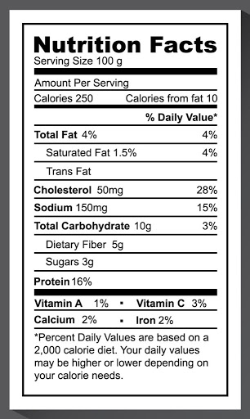
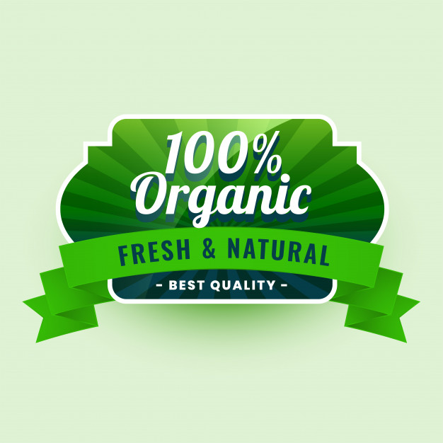
Do you ever look at the nutritional facts on the label of the food?
For example:
vitamins
fats
sugar

Slide 6
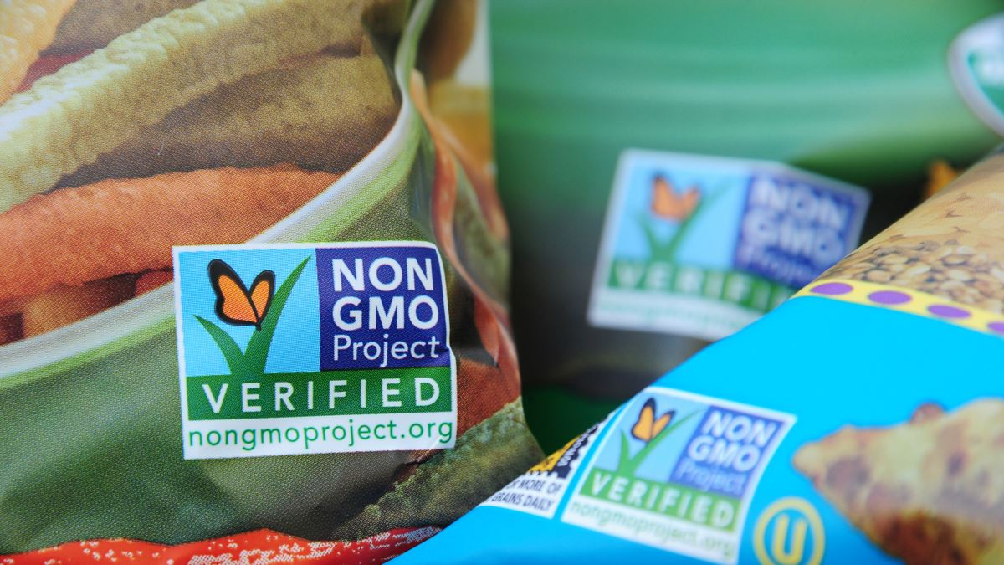
Have you ever seen this label on your food?

Slide 7
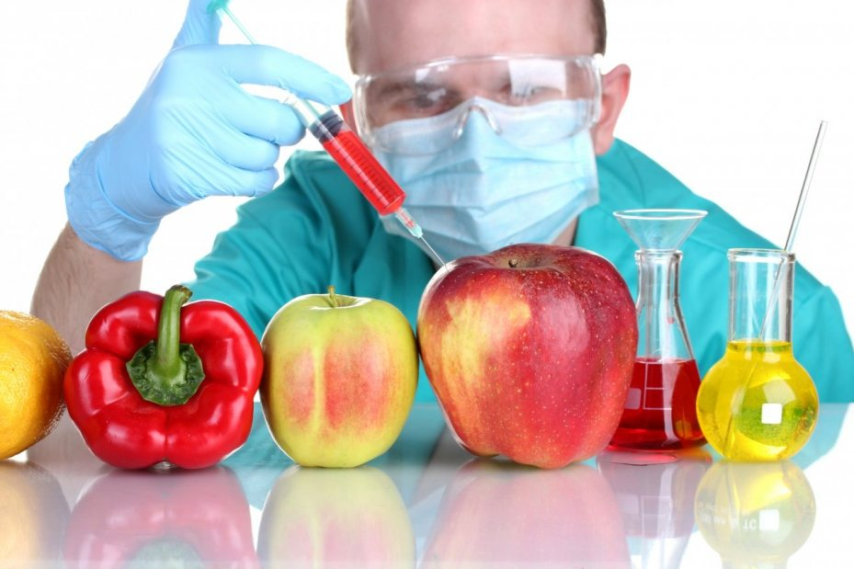
Genetically Modified (GM) Food
Genetically modified foods are engineered in a laboratory and then they grow in nature.

Slide 8
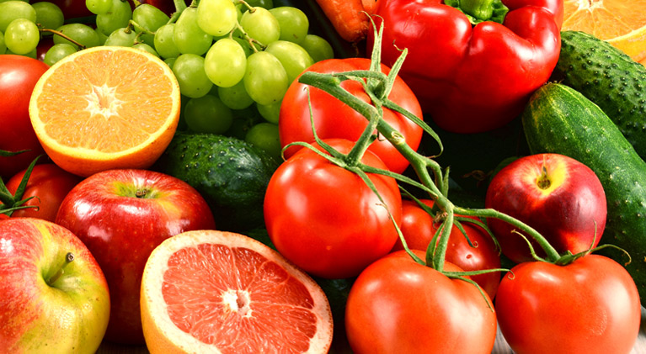
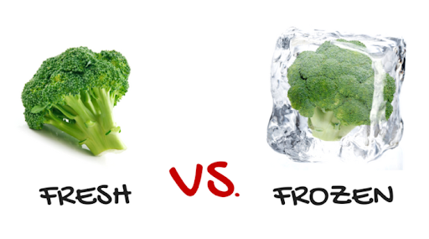
New Words - healthy
produce= fruit/vegetables

Slide 9
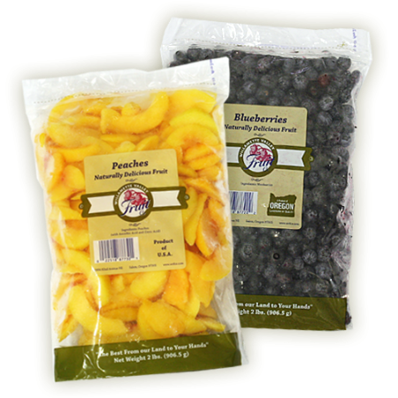
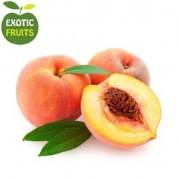
Fresh or packaged food?

Slide 10
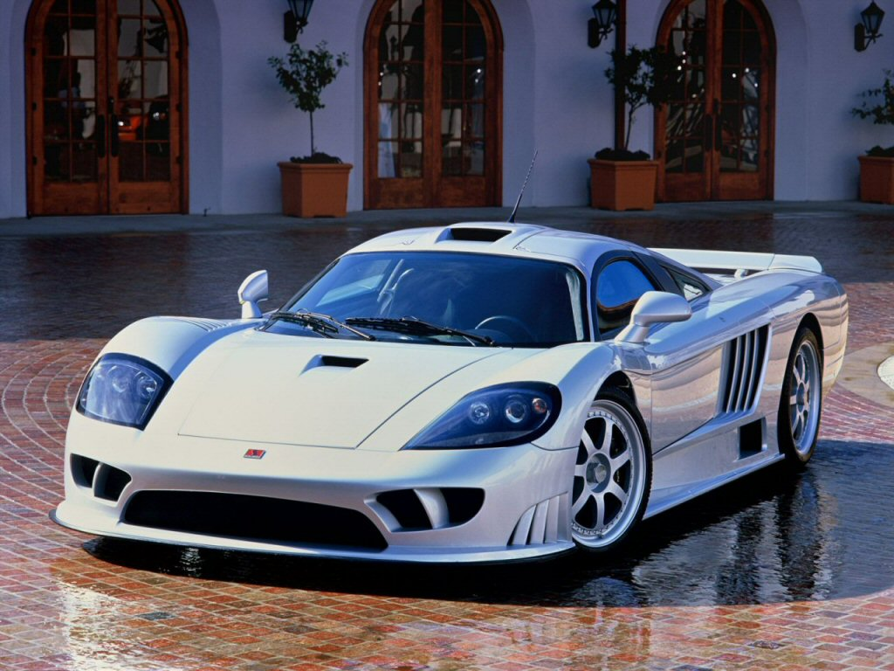
Cheap Expensive

Slide 11
While watching…..
Are genetically modified fruit and vegetables healthy or not?

Slide 12
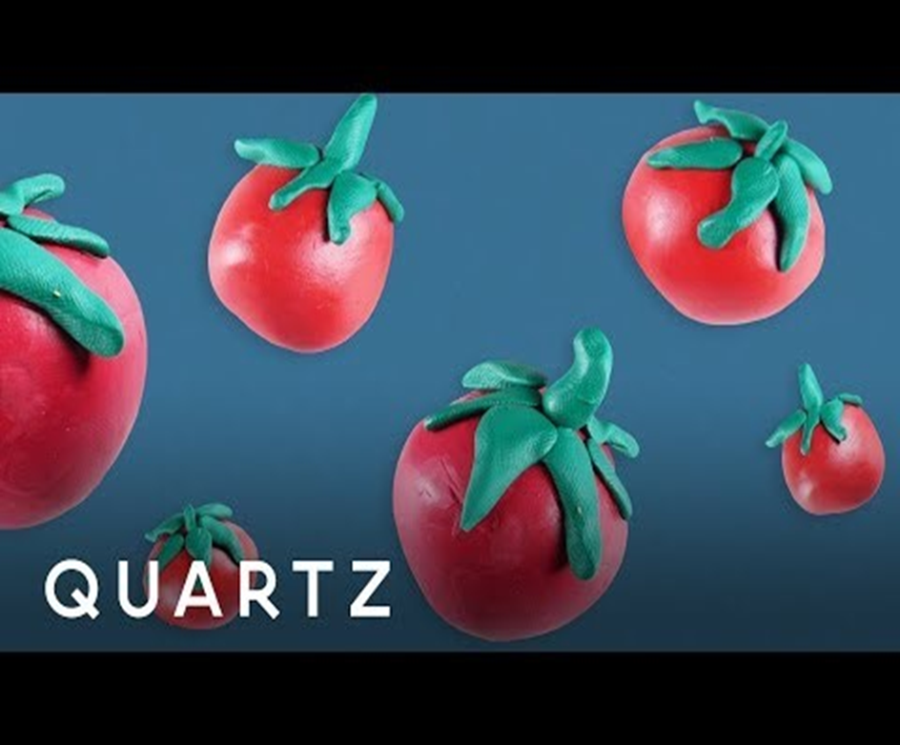
Let’s watch
https://en.islcollective.com/video-lessons/how-eat-healthy
Answer the questions in the video.

Slide 13
Copy this table into your notebook.
Blue | L1 | Brown | L1 | Red | L1

Slide 14
DO YOU KNOW WHAT YOU'RE EATING?
Most of us believe that fruit and vegetables are the healthiest food you can eat. They are full of vitamins, natural fats and natural sugar. It might shock you to know that most of the vegetables in your salad have been genetically modified to make them redder, greener, bigger and juicier. Genetically modified foods are engineered in a laboratory and then they grow in nature. Are they healthy? Are they harmful? Recently, genetically modified (GM) foods have been in the headlines, because public interest groups believe them to be dangerous to our health.
_________________________________________________
1. What do we learn about genetically modified (GM) foods from lines 1-7?

Slide 15
Fill in the table according to lines 1-7.
Blue | L1 | Brown | L1 | Red | L1
 | מהונדס תעשייתי مُعدّل جينيا | healthy |  | engineered
 | אירגונים ציבורים בעלי עניין المجموعات المهتمة العامة | recently
 |  | dangerous
 |  | health

Slide 16
Fill in the table according to lines 1-7.
Blue | L1 | Brown | L1 | Red | L1
genetically modified | מהונדס תעשייתי مُعدّل جينيا | healthy | בריא صحي | engineered | מהונדס تمت هندسته
public interest groups | אירגונים ציבורים בעלי עניין المجموعات المهتمة العامة | recently | לאחרונה مؤخرا
 |  | dangerous | מסוכן خطير
 |  | health | בריאות صحة

Slide 17
So why do we need GM foods? Today the world population is 6 billion people and it is predicted to double in the next 50 years. The challenge to feed this growing population is enormous. Experts say that GM foods are the only solution because they are stronger and grow faster.
-------------------------------------------------------------------------------------
2. Why are GM foods so important today?

Slide 18
Fill in the table according to lines 8-11.
Blue | L1 | Brown | L1 | Red | L1
 |  | predicted |  | challenge
 |  | enormous |  | growing population
 |  | experts |  | solution

Slide 19
Fill in the table according to lines 8-11.
Blue | L1 | Brown | L1 | Red | L1
 |  | predicted | צפויה متوقع | challenge | אתגר تحدي
 |  | enormous | עצום ضخم | growing population | אוכלוסיה הגדלה السكان المتزايدون
 |  | experts | מומחים خبراء | solution | פתרון حل

Slide 20
Break

Slide 22
What are some of the advantages of GM foods? For a start, they can be genetically modified to repel insects that are a serious problem for farmers. The conventional solution is to spray the crops with pesticides, which are harmful to our health because they are poisonous. Therefore, if you don't wash the fruit and vegetables well, you are poisoning your body. Also, pesticides get into the main water supply and poison drinking water.

Slide 23
Fill in the table according to lines 12-17.
Blue | L1 | Brown | L1 | Red | L1
 | דוחה يبعد | advantages |  | conventional solution
 | מדבירים مبيدات حشرية
 | רעיל سام
 | הספקת מים إمدادات المياه

Slide 24
Fill in the table according to lines 12-17.
Blue | L1 | Brown | L1 | Red | L1
repel | דוחה يبعد | advantages | יתרונות إيجابيات | conventional solution | פתרון קונבנציונלי حل تقليدي
pesticides | מדבירים مبيدات حشرية
poisonous | רעיל سام
water supply | הספקת מים إمدادات المياه

Slide 25
3. What is the sequence of cause and effect presented in lines 12-17.
Insects are a serious problem for farmers.
They have to
This is why you must wash fruit and vegetables very well.
If not, you
The same pesticides also get into the water supply and poison our drinking water.

Slide 26
Genetically engineered plants don't need pesticides because they have a gene that repels insects. There are also many viruses, fungi and bacteria that cause plant diseases. Genetic engineers can create plants with a resistance to these diseases. It is even possible to genetically treat plants to overcome negative weather conditions, for example, in the case of extreme cold conditions. Early frost can destroy young plants. Genetic engineers have introduced an anti- freeze gene from cold water fish into potato and tobacco plants and as a result it is possible to grow them in very cold weather.
-------------------------------------------------------------
4. According to lines 19-24 genetic engineers have a way to ___________

Slide 27
Fill in the table according to lines 18-24.
Blue | L1 | Brown | L1 | Red | L1
 | להתגבר يقاوم | create |  | diseases
 |  | treat |  | resistance
 |  | conditions |  | negative
 |  | extreme |  | destroy
 |  | as a result |  | introduced
 |  |  |  | it is possible

Slide 28
Fill in the table according to lines 18-24.
Blue | L1 | Brown | L1 | Red | L1
to overcome | להתגבר يقاوم | to create | ליצור ينتج | diseases | מחלות أمراض
 |  | treat | טיפול معالجة | resistance | עמידות مقاومة
 |  | conditions | תנאים ظروف | negative | שלילי سلبي
 |  | extreme | קיצוני متطرف | destroy | להרוס يدمر
 |  | as a result | כתוצאה מכך نتيجة لذلك | introduced | הציגו عرضوا
 |  |  |  | it is possible | זה אפשרי ممكن

Slide 29
It all sounds amazing and too good to be true. So why are people concerned? Most of the concern about GM foods falls into three categories – environmental hazards, human health risks and economic concerns.
In the case of the environment, there is concern that the introduction of new genes to agricultural plants could create other problems. For example, the insect-repellant gene could transfer to wild plants, allowing them to grow without control. It could also destroy useful insects such as the Monarch Butterfly, which eats weeds and not crops. Many people are also worried about the long-term effects of GM foods in human health.
_______________________________________________________
5. How can genetically engineered plants harm the environment?

Slide 30
Fill in the table according to lines 25-32.
Brown | L1 | Red | L1 | Red | L1
health risks |  | concerned |  | allowing
in the case of |  | environmental hazards |  | long-term
control |  | human
useful |  | economic concerns
effects |  | agricultural
 |  | transfer

Slide 31
Fill in the table according to lines 25-32.
Brown | L1 | Red | L1 | Red | L1
health risks | סיכונים בריאותיים أخطار صحية | concerned |  | allowing | מאפשרים تتيح
in the case of | שמדובר על في حالة الحديث عن | environmental hazards |  | long-term | תווח הארוך على المدى الطويل
control | שליטה سيطرة | human
useful | שימושיים مفيدة | economic concerns
effects | השפעות تأثيرات | agricultural
 |  | transfer

Slide 32
In addition, there is a serious possibility that introducing a gene into a
plant could cause an allergic reaction in people who have food allergies;
for example, if there is a peanut gene in the soybean milk they are
drinking, and they are allergic to peanuts. Economically, farmers are very
worried that GM foods will take over the market and they will lose their
income.
___________________________________________________
6. How can GM foods endanger people with food allergies?
Give an example from the text.

Slide 33
Fill in the table according to lines 33-36.
Blue | L1 | Brown | L1 | Red | L1
 |  | in addition |  | possibility
 |  | serious |  | reaction
 |  | cause |  | income
 |  | take over
 |  | lose

Slide 34
Fill in the table according to lines 33-36.
Blue | L1 | Brown | L1 | Red | L1
 |  | in addition | בנוסף بالإضافة إلى | possibility | אפשרות إمكانية
 |  | serious | רציני جدي | reaction | תגובה استجابة
 |  | cause | גורם يسبب | income | הכנסה دخل
 |  | take over | להשטלת על يسيطر على
 |  | lose | לאבד يفقد

Slide 35
The obvious solution would be to label all GM foods so that the consumer knows what he or she is eating, but currently, even that is not possible, as it is too expensive. So the only other solution is to grow your own fruit and vegetables!

Slide 36
Fill in the table according to lines 37-40.
Blue | L1 | Brown | L1 | Red | L1
 | צרכן مستهلك | expensive |  | obvious solution
 |  |  |  | label
 |  |  |  | currently

Slide 37
Fill in the table according to lines 37-40.
Blue | L1 | Brown | L1 | Red | L1
consumer | צרכן مستهلك | expensive | יקר غالي | obvious solution | הפתרון המובן מאליו حل واضح
 |  |  |  | label | לסמן يميز
 |  |  |  | currently | נכון לעכשיו حاليا

Slide 38
Answers
What do we learn about genetically modified (GM) foods from lines 1-7?
Most of the vegetables we eat have been genetically modified.
It might shock you to know that most of the vegetables in your salad have been genetically modified to make them redder, greener, bigger and juicier.

Slide 39
2. Why are GM foods so important today?
GM foods can feed the growing population.
So why do we need GM foods? Today the world population is 6 billion people and it is predicted to double in the next 50 years. The challenge to feed this growing population is enormous. Experts say that GM foods are the only solution because they are stronger and grow faster.

Slide 40
3. What is the sequence of cause and effect presented in lines 12-17.
Insects are a serious problem for farmers.
They have to spray the crops with pesticides.
This is why you must wash fruit and vegetables very well.
If not, you are poisoning your body.
The same pesticides also get into the water supply and poison our drinking water.

Slide 41
3. What is the sequence of cause and effect presented in lines 12-17.
What are some of the advantages of GM foods? For a start, they can be genetically modified to repel insects that are a serious problem for farmers. The conventional solution is to spray the crops with pesticides, which are harmful to our health because they are poisonous. Therefore, if you don't wash the fruit and vegetables well, you are poisoning your body. Also, pesticides get into the main water supply and poison drinking water.

Slide 42
4. According to lines 19-24 genetic engineers have a way to _______.
..create plants with a resistance to plant diseases.
..treat plants to overcome negative weather conditions.
Genetically engineered plants don't need pesticides because they have a gene that repels insects. There are also many viruses, fungi and bacteria that cause plant diseases. Genetic engineers can create plants with a resistance to these diseases. It is even possible to genetically treat plants to overcome negative weather conditions, for example, in the case of extreme cold conditions.

Slide 43
5. How can genetically engineered plants harm the environment?
The concern is that genetically engineered plants can destroy useful insects.
It all sounds amazing and too good to be true. So why are people concerned? Most of the concern about GM foods falls into three categories – environmental hazards, human health risks and economic concerns. In the case of the environment, there is concern that the introduction of new genes to agricultural plants could create other problems. For example, the insect-repellant gene could transfer to wild plants, allowing them to grow without control. It could also destroy useful insects such as the Monarch Butterfly, which eats weeds and not crops. Many people are also worried about the long-term effects of GM foods in human health.

Slide 44
6. How can GM foods endanger people with food allergies? Give an example from the text.
If a person is allergic to peanuts and there is a peanut gene in the soybean milk they will have an allergic reaction.
In addition, there is a serious possibility that introducing a gene into a plant could cause an allergic reaction in people who have food allergies; for example, if there is a peanut gene in the soybean milk they are drinking, and they are allergic to peanuts. Economically, farmers are very worried that GM foods will take over the market and they will lose their income.

Slide 45
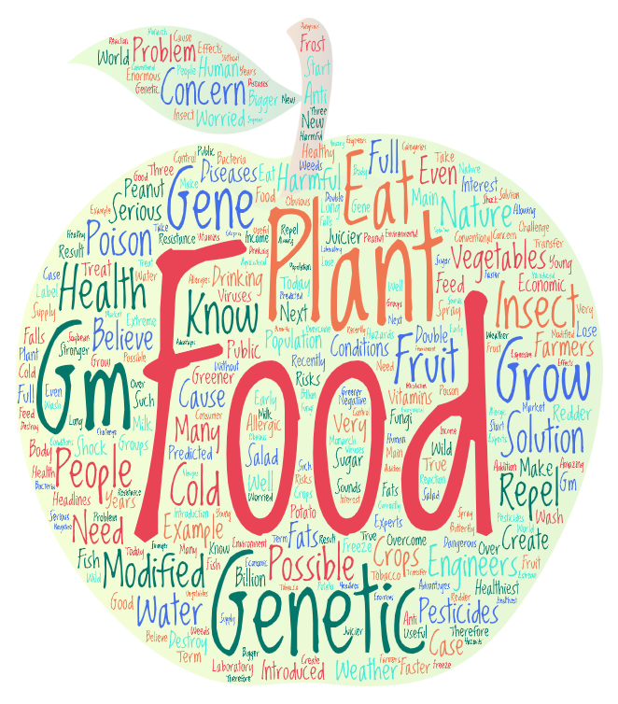
Speaking Task – Give your opinion.
Is genetically modified fruit and vegetables healthy or not? Explain.

Slide 46
Now you can…..
Can understand a text about the food you are eating.
Can present an opinion.

Slide 47
