Slide 1
מערכת שידורים לאומית

Slide 2
Module G Writing
MIKUD = Description
Leah Doryoseph

Slide 3
Bagrut Module G
This test has two parts:
Part I: 60 points
Access to Information from Written Text
Part II: 40 points
Written Presentation
composition, essay, passage, text
Reading comprehension
Notes:
Today we are going to focus on the writing

Slide 4
Writing
Topic: Description

Slide 5
Writing for the G Bagrut
Write 120 - 140 words on the following topic
Opinion Essay
express your view on a controversial topic
Description Essay
choose something that fits
explain your choice

Slide 6
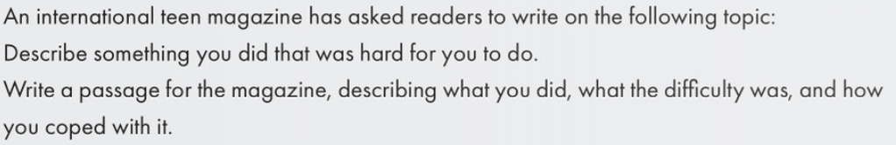
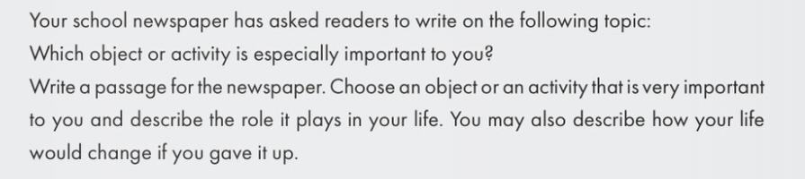
Possible Topics
Finding clues in the topic

Slide 7
Let’s focus on one
Key words
  object
  activity
  important
  role
  change
  if
  gave it up

Slide 8
How many words do you know for:
important | role | gave it up | activity
essential | part | stopped | task
meaningful | job | lost | project
large | task | forced | work
necessary |  | avoid | movement
vital |  | drop out
significant |  | withdraw
Notes:
Brainstorm others … see if you can add two more for each list
Pick 5 words … make a Frayer Square for them

Slide 9
Begin with a Brainstorm
What is important to you?

Slide 10
Objects and activities: important to me
learning
school
security
family
love
friends
basketball
fun
exercise
my car
independence
phone
connect with friends

Slide 11
Objects and activities: important to me
examples
fun & friends
exercise (health)
main idea: basketball is important because it keeps me and my friends healthy
friends
basketball
fun
exercise

Slide 12
Planning
Organize your thoughts into paragraphs

Slide 13
Structure
Paragraph 1
Tell them what you are going to tell them
Paragraphs 2 & 3
Tell them in detail
Paragraph 4
Tell them what you’ve told them
Introduction
Examples and supporting information
Conclusion

Slide 14
Organizing your thoughts
examples:
fun & friends
exercise (health)
main idea:
basketball is important because it keeps me and my friends healthy

Slide 15
Start in the MIDDLE
Firstly, the role basketball plays for me is a way to stay healthy, which is essential in my life. In addition, I enjoy exercising by playing basketball with my friends. We all get an energetic workout and have fun, too.

Slide 16
Start in the MIDDLE
Secondly, if I gave up playing basketball, I would lose the time with my friends. In addition, I would need to replace it with another activity. However, basketball is a meaningful part of my life. Therefore, I do not want to stop playing it with my friends.

Slide 17
A strong opening
Have you ever thought about what is important in life? In my life, basketball keeps me and my friends healthy.
    Firstly, …
    Secondly, …
Notice that the opening includes the key ideas from my brainstorm. These are the same details in my “firstly” and “secondly” paragraphs.

Slide 18
Last Paragraph
Finally, in order to stay in shape it is essential that I play basketball with my friends. Basketball is an activity that is especially important to me.
Notice that the closing includes the key ideas from my brainstorm. These are the same details in my “firstly” and “secondly” paragraphs.

Slide 19
Your Turn
Brainstorm your important objects and activities
Choose one to write about
Organize your thoughts into paragraphs
Begin in the middle

Slide 20
Module G Writing
MIKUD = Description Part 2
Leah Doryoseph

Slide 21
Grading 40 points
How does a tester read your essay?
Content and organization
Vocabulary
Language use
Mechanics
8 points
10 points
16 points
6 points
Word count (subtracted after the points are awarded)

Slide 22
Content and Organization
What you write

Slide 23
Content and Organization
Did you address all elements of the topic?
Do your examples fit your main idea?
Can your ideas be understood?
Did you stay on topic?
Is your writing well organized?

Slide 24
Content and Organization
Paragraph 1:
Paragraph 2:
Paragraph 3:
Paragraph 4:
Have you ever thought about (...)
Firstly, (...)
For example, (...)
Secondly, (...)
In addition, (...)
Finally, (...)

Slide 25
Content and Organization
There are many ways to organize your essay:
Paragraph 1:
Paragraph 2:
Paragraph 3:
Paragraph 4:
Has anyone ever asked you ... (...)
On one hand, (...)
On the other hand, (...)
Although some say, (...).
I believe, (...)
In addition, (...)
For example, (...)

Slide 26
Vocabulary
Which words you choose to use

Slide 27
Vocabulary
Variety
Use the words you know
Register
without repetition
avoid the wrong word
remember your audience
avoid slang
Notes:
BEWARE of the dictionary!!!

Slide 28
Vocabulary
Connectors
however
therefore
although
in addition
for example
in conclusion
in my opinion
so
on one hand
despite
finally
in conclusion
as a result
Find lists of connectors in any textbook!
Notes:
BEWARE of the dictionary!!!

Slide 29

Adjectives are the key to DESCRIPTION
Photo credit: WikiCommons

Slide 30
Descriptive Adjectives
People | Professions | Numbers | Characteristics
popular | environmental | several | strong
well-known | various | additional | useful
historical | technical | entire | similar
political | electrical | rare | cute
responsible | medical | accurate | helpful
competitive | traditional | efficient | typical

Slide 31

Frayer Square
Super
Flash
Card
adjective
anything
related
medicine
medical
רפואי
طبي
Doctors work in the
medical profession.
I feel sick, I need
medical help.
Photo credit: Wikipedia
Notes:
Do this for every word!
Not only is the process amazing, but the result is a useful tool.
Writing it by hand is MUCH better!!!

Slide 32
Language Use
(aka: grammar)

Slide 33

Language Use
Basic Structures
word order
present simple
present progressive
past simple
past progressive
future
singular / plural v
Advanced Structures
perfect tenses
passive
conditionals
reported/indirect speech
relative clauses
temporal clauses
verb complements
Notes:
perfect tenses
passive
conditionals
reported/indirect speech
relative clauses
temporal clauses
verb complements (gerunds & infinitives)

Slide 34
Language Use
Basic Structures
Don’t make mistakes
Advanced Structures
Include at least 5
Notes:
perfect tenses
passive
conditionals
reported/indirect speech
relative clauses
temporal clauses
verb complements (gerunds & infinitives)

Slide 35
Mechanics
details unrelated to meaning

Slide 36
Mechanics
spelling
punctuation
( , . ‘ ; ? . ! “ ” )
Capitalization
(names, beginning of each sentence)
paragraphing

Slide 37
Structure
Paragraph 1
Tell them what you are going to tell them
Paragraphs 2 & 3
Tell them in detail
Paragraph 4
Tell them what you’ve told them
Introduction
Examples and supporting information
Conclusion

Slide 38
Read your essay
Have you ever thought about what is important in life? In my life, basketball keeps me and my friends healthy.
Firstly, the role basketball plays for me is a way to stay healthy, which is essential in my life. In addition, I enjoy playing basketball with my friends. We all get a good workout and have fun, too.
Secondly, if I gave up playing basketball, I would lose the time with my friends. In addition, I would need to replace it with another activity. However, basketball is a meaningful part of my life. Therefore, I do not want to stop playing it with my friends.
Finally, in order to stay in shape it is essential that I play basketball with my friends. Basketball is an activity that is especially important to me.

Slide 39
Before you finish
Read and check your essay
Did you describe what was requested?
Does your conclusion match your introduction?
Do your examples support your choice?
Did you …
  start every sentence with a capital letter?
  end every sentence with a dot? ( . ! ? )
  use connectors? (at least 5?)
  use the present perfect?
  use an if statement?
  include a relative pronoun?
Count how many words are in your first line? How many completed lines?

Slide 40
Read your essay
Have you ever thought about what is important in life? In my life, basketball keeps me and my friends healthy.
Firstly, the role basketball plays for me is a way to stay healthy, which is essential in my life. In addition, I enjoy playing basketball with my friends. We all get a good workout and have fun, too.
Secondly, if I gave up playing basketball, I would lose the time with my friends. In addition, I would need to replace it with another activity. However, basketball is a meaningful part of my life. Therefore, I do not want to stop playing it with my friends.
Finally, in order to stay in shape it is essential that I play basketball with my friends. Basketball is an activity that is especially important to me.

Slide 41
120 Words
If you followed the plan you are already there!
Paragraph 1: 2 sentences
Paragraph 2: 2-4 sentences
Paragraph 3: 2-4 sentences
Paragraph 4: 1-2 sentences
(In conclusion, remind us why you are describing this)
(Have you ever thought about … introduce idea 1&2)
(explain idea 1 with example)
(explain idea 2 with example)

Slide 42
Done!
You are ready to hand in your essay.

Slide 43
Keep up the great work!

Slide 44
השימוש ביצירות במהלך שידור זה נעשה לפי סעיף 27א לחוק זכות יוצרים, תשס"ח-2007.
אם הינך בעל הזכויות באחת היצירות, באפשרותך לבקש מאיתנו לחדול מהשימוש ביצירה,
זאת באמצעות פנייה לדוא"ל rights@education.gov.il

