Slide 1

What Are You Doing?
Class | 5 English
With: Asnat Notkin Lumer & Easy English

Slide 2
Video
Notes:
I will do a lot of games

Slide 3
What will we do today?
We will use new verbs to say what’s happening now.
We will watch a short clip.
Notes:
I will not teach the spelling rules
. *I will say that we add ing to the verb when we talk about activities\actions that are happening now

Slide 4
At the end of this lesson, can you…?
talk about actions that are happening now?
read and write about actions that are happening now?

Slide 5
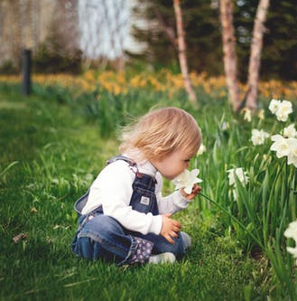
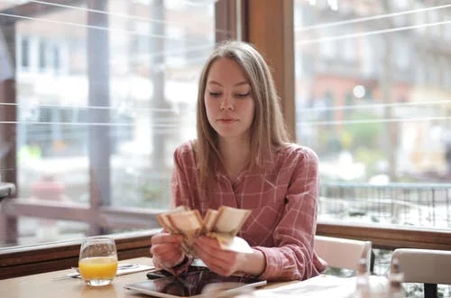
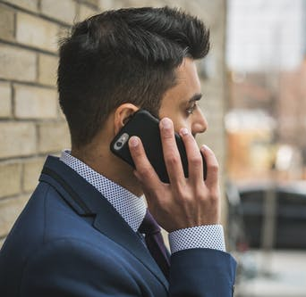
Vocabulary
calling | counting | smelling

Slide 6

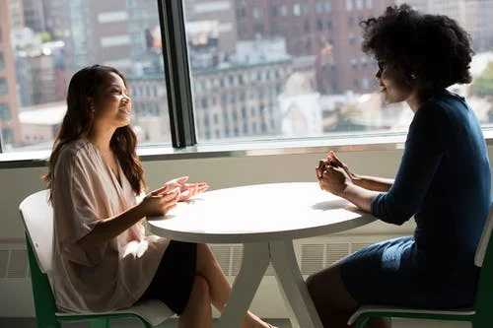
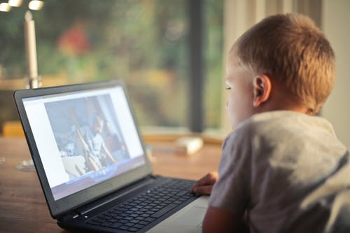
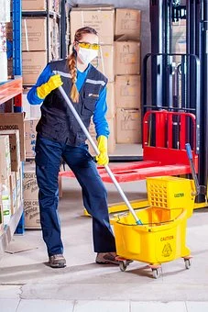
Vocabulary
cleaning | watching | talking | reading
Notes:
I will teach the sound ea-reading

Slide 7
Vocabulary
1 I am smelling the flowers.
2 I am counting the cards.
3 I am taking a nap.
Notes:
Here I pantomime the sentences
Then, they have to guess
I read the words and they “show” me the number with their fingers.

Slide 8
Vocabulary
4 I am reading.
5 I am calling my friend.
6 We are talking.
7 You are watching.
Notes:
The same

Slide 9

What’s the Verb?

Slide 10
What’s the Verb?
reading

Slide 11
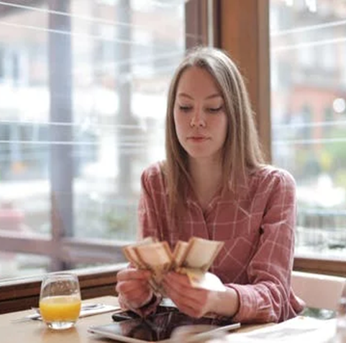
What’s the Verb?

Slide 12
What’s the Verb?
counting

Slide 13

What’s the Verb?

Slide 14
What’s the Verb?
watching

Slide 15
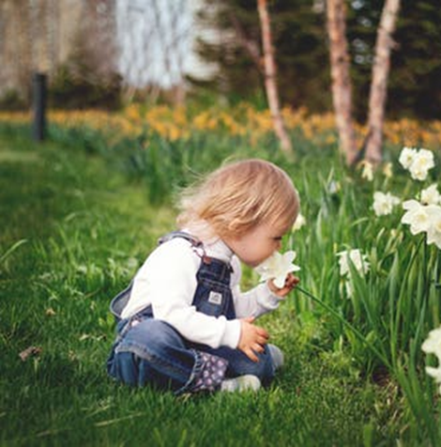
What’s the Verb?

Slide 16
What’s The Verb?
smelling

Slide 17

What’s the Verb?

Slide 18
What’s the Verb?
talking

Slide 19
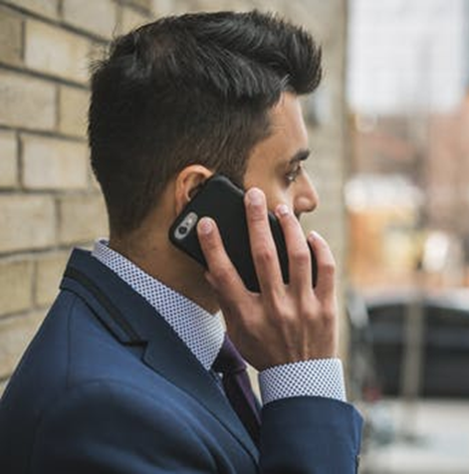
What’s the Verb?
calling

Slide 20
What’s the Verb?
calling

Slide 21
What Are You Doing?
Now you say:
I am ______.

Slide 22
Easy’s Clip
https://www.youtube.com/watch?v=Q4HItuy7yoM
Notes:
The pupils will read the words that pop.

Slide 23
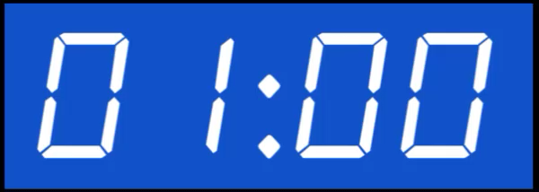
What Is Easy Doing?
She is the flowers.
She is Grandma and Grandpa.
She is a nap.
She is not______.
Word Bank
calling
smelling
taking
counting
cleaning

Slide 24
Write Five Sentences
Word Bank:
smelling the flowers
counting the cards.
calling my friend.
reading a book.
talking on the phone.
taking a nap.
watching TV.
I am________.
I am_________.
I am_________.
I am_________.
I am_________.

Slide 25
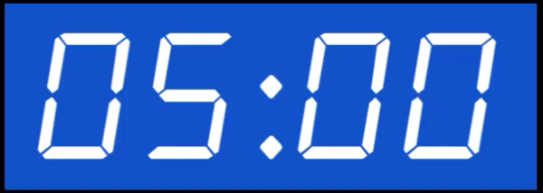
Read And Answer
Hi Mom
Hi Dana. How is the party? What are you doing?
Tali and Yam are playing ball. Ron is watching TV.
Tamar and Sari are singing and I am eating popcorn.
1. Who is playing ball?
2. Who is singing?
3. What is Dana doing?
4. You are at the party now. What are you doing?

Slide 26
Calling Easy
Notes:
Here I will talk with Easy.
Hi
What are you doing?

Slide 27
At the end of this lesson, you can …
talk about actions that are happening now.
read and write about actions that are happening now.

Slide 28
Credits:
https://www.youtube.com/channel/UCSutzo9oU7F18MakPtwxSpQ - Easy’s channel.
pixabay.com – Background photos.
Pexels.com– Background photos.
freesound.org – Sfx.
Notes:
אור
האם את יכולה להעתיק את השקופית של הקרדיטים ממצגת אחרת?

