Slide 1
Tips on teaching writing to beginners
Penny Ur
January 28 2026
Notes:
add”
corpus frequency
affixes
L1

Slide 2
Slogans to bear in mind
Writing is important!
We learn to write by writing!
Anyone can write!
Writing can be fun!

Slide 3
Tip 1: Get students to write a bit in every lesson
Even if only for five minutes!
Importance of short, accessible writing tasks
… that don’t all need to be checked
… with teacher support

Slide 4
For example
Brainstorming: How many … can you think of and write down?
Translation: How many of these L1 letters/words/phrases can you write in English?
Recall: How many English letters / words we learnt recently can you recall and write down?

Slide 5
Tip #1a: Spelling is not that important! The main thing is the message!
A response that is understandable, even if misspelt …
(e.g. ‘cet’ for ‘cat’ in a brainstorm of animals)
Deserves a ✓!
There’s plenty of time to work on spelling afterwards …

Slide 6
Tip 2: Use mini-whiteboards for short writing
Paper within a plastic envelope + a marker + a tissue for deleting
mini-whiteboards
Clear, bold letters
Immediate disappearance of mistakes

Slide 7
Tip 3: Use ‘do at least’ instructions
Not ‘Do this exercise’
(implying they’ve failed if they don’t finish)
But ‘Do at least … more if you can’

Slide 8
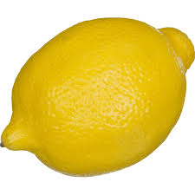
Conventionally…
A picture:
Write the word.

Slide 9
Better:
A picture:
Write at least one letter you hear in this word, more if you can

Slide 10
Conventionally: Write the words in the correct column
a clock, a dog, a dress, a mother, black, a pen, bread, pants, bag, a husband, red, boots, a cat, rice, a frog, a baby, pink, a teenager, a hat, a banana, a book, a sheep, meat, kids, a desk, green, an elephant, salt, a t-shirt, white
people | clothes | food | things | colours | animals

Slide 11
Better: Write at least one word in each column: more if you can!
a clock, a dog, a dress, a mother, black, a pen, bread, pants, bag, a husband, red, boots, a cat, rice, a frog, a baby, pink, a teenager, a hat, a banana, a book, a sheep, meat, kids, a desk, green, an elephant, salt, a t-shirt, white
people | clothes | food | things | colours | animals
headings in L1?
Notes:
headings could be in L1

Slide 12
Tip # 4: Make it interesting and fun 1: games
Game:
A goal they can easily achieve
BUT
add a limitation (rule) that makes it more challenging.
e.g. ‘recall and share’

Slide 13
only want look
please sorry ready
what listen
yes great

Slide 15
only want look
please sorry ready
what listen
yes great

Slide 16
Tip # : Make it interesting and fun 2: challenge
Use challenges based on higher order thinking skills:
prioritizing, ordering, drawing conclusions, exemplifying, connecting, reasoning, classifying …

Slide 17
Example 1:
Copy out these words in order of size (biggest first)
sixteen, a hundred, twenty-two, one
a baby, a girl, a man
a room, a pencil, a table, a house

Slide 18
Example 2
Copy out the list without the one that doesn’t belong.
pasta, an egg, a book, an apple
jump, run, walk, read

Slide 19
Example 3: writing contexts for new words
only want look please sorry ready
what listen yes great
Conventionally: Write a sentence using one of the words.
Better:
‘Write a sentence using this word which is true of you’
or
‘Write a sentence using the word which is a false statement’
or
‘Write a negative sentence using one of the words’
or
‘Write a story using as many as you can of the words’

Slide 20
What makes for interest in writing exercises?
Accessibility (‘I can do this’)
Meaningfulness (I understand what I am writing)
Game-like challenge (An achievable goal + ‘rules’ or limitations)
Open-endedness (responses not determined in advance)
Thinking Challenge (higher-order thinking skills)
Personalization (relates to the writer him/herself)
Notes:
Input: factors that lead to interest

Slide 21
Tip # 5: Have students create written compositions they can be proud of
Students copy out what they wrote …
neatly
in color(s)
illustrated with drawings
with colored frames
… then you display on a board or the classroom wall
… and the compositions are later preserved in portfolios.

Slide 22
Tip # 6: It’s OK to use the students’ mother tongue as cues for writing
‘Translation dictation’
Or:
Challenge students to write translations from L1 to English (of a short set of items they know)
Letters
Words
Phrases
(But not entire paragraphs!)

Slide 23
ת | t T
ג | g G
ד | d D
אֶ | e E

Slide 24
שמח | happy
שולחן | table
ספר | book
דברים | things

Slide 25
מה השעה? | What’s the time?
בוקר טוב! | Good morning!
אניי לא יודע/ת | I don’t know
הִכּנסו! | Come in!

Slide 26
Tip # 7: Avoid ‘jumbles’
E.g. jumbled words
What are these animals?
NILO, FAIGRFE, SOHRE
Or jumbled sentences
bed want go to does He to not.
Or ‘wordsearches’
Students spend more time puzzling out than they do writing.

Slide 27
Tip # 8: Use open-ended writing tasks
No predetermined answer
(as in conventional gapfill, matching, multiple-choice)
e.g. ‘sun-ray’ brainstorms: all the words you can think of …
Fun challenge, lots of writing!

Slide 28
round things

Slide 29
words with ‘g’ in them

Slide 30
foods

Slide 31
things I like

Slide 32
small things

Slide 33
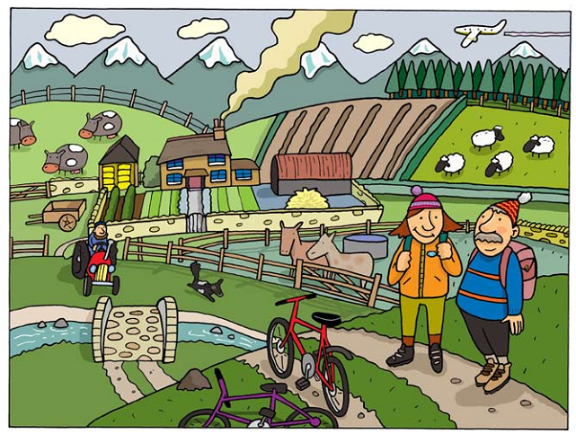
Tip # 9: Use plenty of visuals
Write all the words you know that relate to this picture.
Write about this picture.
Write at least six sentences about this picture.

Slide 34
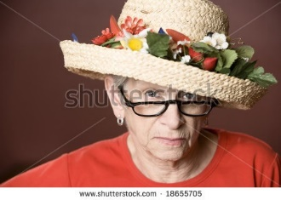
Example 2: People
Write sentences about this person…
(name? country?
personality? job?
family? likes? dislikes? hopes?)

Slide 35






Example 3: Symbols
1
2
3
6
5
4
Write one or two words for each sign.
Or
Write a full sentence for each sign explaining what it means.
Notes:
Challenge teachers to do this one, as much as they can in a couple of minutes. Why was it interesting (or wasn’t it?)

Slide 36
Tip 10: Avoid group work for the actual writing process
If you ask students to write something in pairs or groups…
…normally only one student does the actual writing!
Notes:
If you ask students to write in pairs or groups, typically only one will write, the others are getting no writing practice.

Slide 37
Bonus Tip 11: Read aloud students’ compositions to the class
If students have created short texts in class …
…read selected ones aloud, yourself, to the class.
It’s a compliment to the writer
You can make the texts sound much better
It motivates other writers (‘maybe she’ll read out mine next time!’)
Notes:
And of course correct as you go if necessary

Slide 38
Thank you for your attention and participation
pennyur@gmail.com

