Slide 1
HOPE National Writing Project Elementary English 2025
Dr. Nicole Broder
National Elementary Counselor

Slide 2
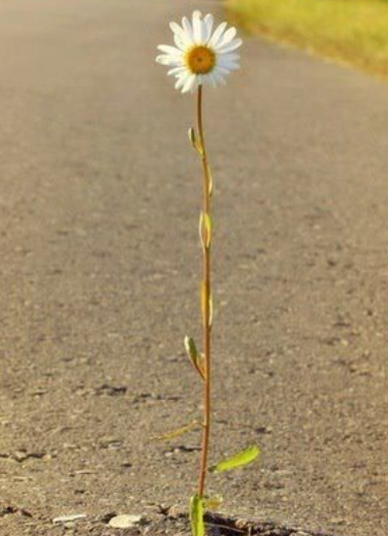
Contents
Rationale
Can-Do’s at the A1 Level
The Writing Environment
Write with Purpose
Hope
Competition Timeline

Slide 3
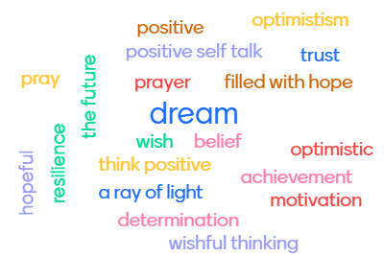
Rationale
This project will focus on teaching children about the concept of hope and how it can positively impact them and others. Hope plays a pivotal role in an individual's overall well-being and academic success. By cultivating hope, pupils can develop a positive mindset, enhance their motivation, and ultimately improve their English language skills.
By exploring strategies to foster hope, such as setting achievable goals, encouraging a growth mindset, boosting resilience, an optimistic outlook and motivation to succeed.
Hope allows us to believe that anything is possible!

Slide 4
Hopeful Quotes
“Hope is important because it can make the present moment less difficult to bear. If we believe that tomorrow will be better, we can bear a hardship today.”
Thich Nhat Hanh
“Three grand essentials to happiness in this life are something to do, something to love, and something to hope for.”
Joseph Addison

Slide 5
Writing it Real: Teaching Social Emotional Learning Skills through Writing
Writing assignments can provide opportunities for students to cope with difficult situations, or just explore developmentally-appropriate topics.
Writing can reinforce
SOCIAL AND EMOTIONAL COMPETENCIES

Slide 6
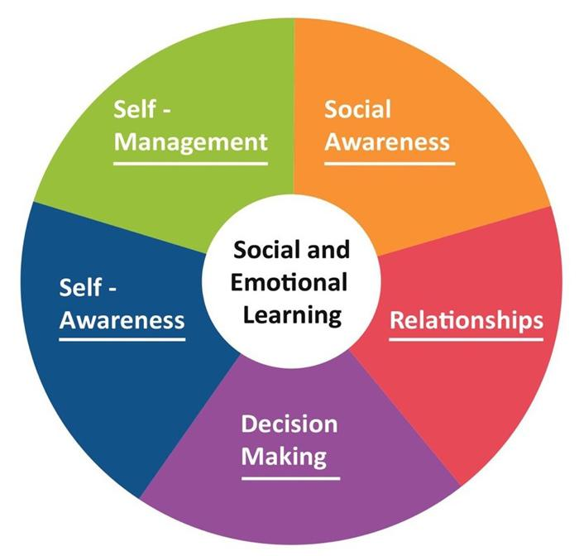
What are Social Emotional Competencies for Kids?
Self-Awareness
Emotional Regulation
Empathy
Friendship & Communication Skills
Resilience
Self-Esteem & Confidence
Responsible Decision-Making
Problem Solving
Respect for Diversity

Slide 8
Let’s Sing Hope
https://youtu.be/hhJPn-nufUg?si=Bg3O689Xjb9eXjbJ
https://youtu.be/tptPct-lBl4?si=i-Zf-qXqFa6djkED

Slide 9
Why Teach Writing?
Boosts reading comprehension
Improves organizational and study skills
Enhances speaking abilities
Provides opportunities for language production, interaction and mediation
Leads to academic success and confidence
This Photo by Unknown Author is licensed under CC BY-SA-NC

Slide 10
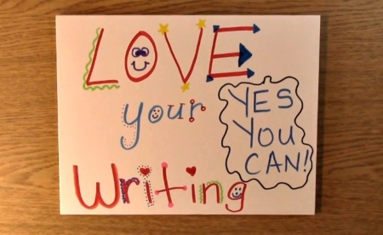
Why is Writing a Useful Way to Cater to SEL?
encourages communication
feels therapeutic
creative way to respond to literature and the world around us
helps to internalize social and emotional competencies
motivates pupils to succeed
This Photo by Unknown Author is licensed under CC BY

Slide 11
What makes writing in L2 so difficult?
having something to say
spelling
mixed tenses
vocabulary
punctuation
L1 interference
limited background knowledge
organizing ideas

Slide 13
Writing Projects From Beginning to End
INTRODUCTION
CONTENT
PRESENTATION
THE WRITING PROCESS
EXAMPLES
EXPECTATIONS AND ASSESSMENT
DISPLAY

Slide 14
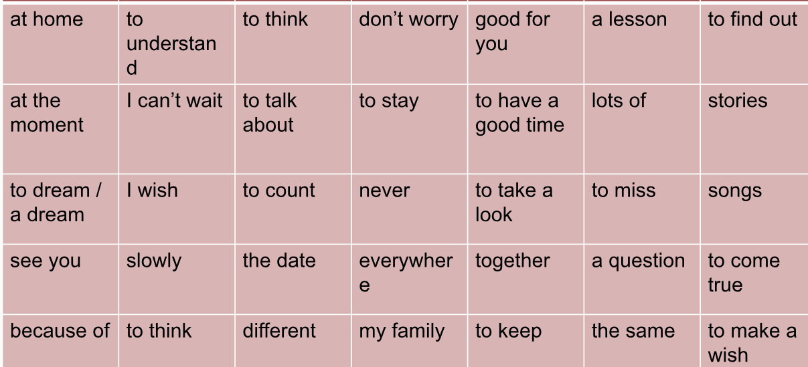
Teach Relevant and Useful Lexical Items Vocabulary Band 1

Slide 15
Introduction Teacher introduces the writing project to the class.
What’s the purpose of this writing project?
Is this a mandatory or voluntary writing task?
Can we work alone or in pairs or small groups?
Is there a competitive element?
What would an example look like?
What’s the timeline?
This Photo by Unknown Author is licensed under CC BY

Slide 17
Content
Write a short story about a time when you felt hopeless, and how you found hope again.
Write a poem about hope. What does hope look like, feel like, and sound like to you?
Write a letter to the tooth fairy,
Create a comic strip about a superhero whose superpower is hope. What kind of adventures does this superhero have?

Slide 18
Hope During the War
Imagine a Peaceful World: Draw a picture of a world where there is no war. What does it look like? What sounds can you hear? What do people do there?
A Letter to a Friend: Write a letter to a friend who lives far away. Tell them about your day, your feelings, and what you miss most.
A Story of Hope: Write a short story about a brave person who overcame a challenge. What qualities made them strong?
A Thank-You Note: Write a thank-you note to someone who has helped you during this difficult time. What did they do that made you feel better?
A Poem of Peace: Write a poem about peace. What does peace look like, feel like, and sound like to you?

Slide 20
Now Write …
a personal narrative
a fictitious story
a poem
a letter of appreciation
a Whatsapp chat between two friends
a recipe for joy through giving
a diary entry

Slide 21
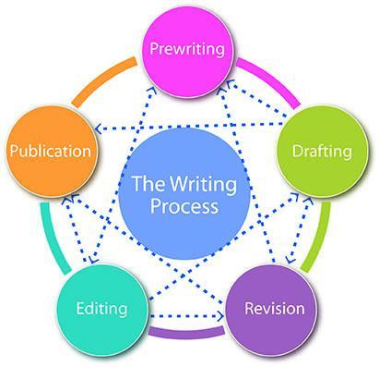
The Writing Process (in teacher lingo!)
Prewrite
Prewrite: brainstorm, vocabulary, genre, story jumper ideas
Draft
Draft: use ideas to write a first draft
Revise
Revise: reread, rearrange, use synonyms
Proofread
Check for capitals, punctuation, correct spelling and grammar
Publish
Publish: Write and submit your final draft

Slide 22
The Writing Process
Plan
What do you want to write about?
Which words can help you? Use a dictionary.
Add photos.
Write
Choose a style: e.g. story, letter, recipe, menu, tips, advert, tips, comic, news article, diary etc.
Start writing. Don’t worry about correct spelling, punctuation or grammar at this stage. Now leave your work alone and put it in a drawer or save it on your computer.
Edit
Can you choose more interesting words? Are there capital letters, full stops, commas in the right places?
Is your message clear and your writing organized well?
Before you send it to your teacher, ask a friend to read it and tell you what could make it even better! Offer to do the same for him or her!

Slide 23
Why Use Class Time for Writing?
Students can bounce brainstorming ideas off each other.
Collaborative writing makes writing more fun!
Beginner writers need immediate guidance with word choice, spelling and formulation of ideas.
Speaking usually gets an immediate response. The rate of communication is high. Writing generally gets a delayed response. But if writing is done in class, it can be a communicative task, leading to a faster response.
Writing takes a long time as there are so many aspects of the language that need to come into play. At home, children get bored and tend to get their homework done in the shortest possible time.

Slide 24
How can we prevent our pupils
from getting AI to write for them?

Slide 25
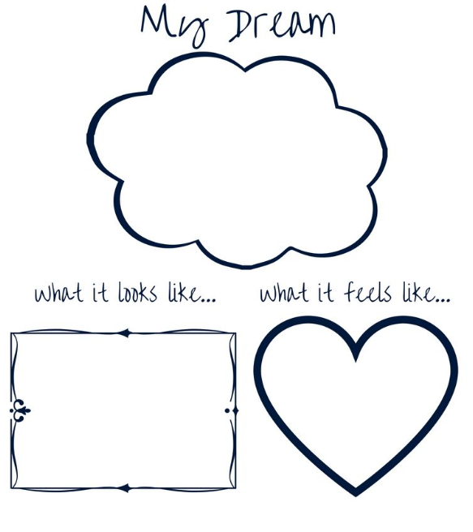

Slide 26
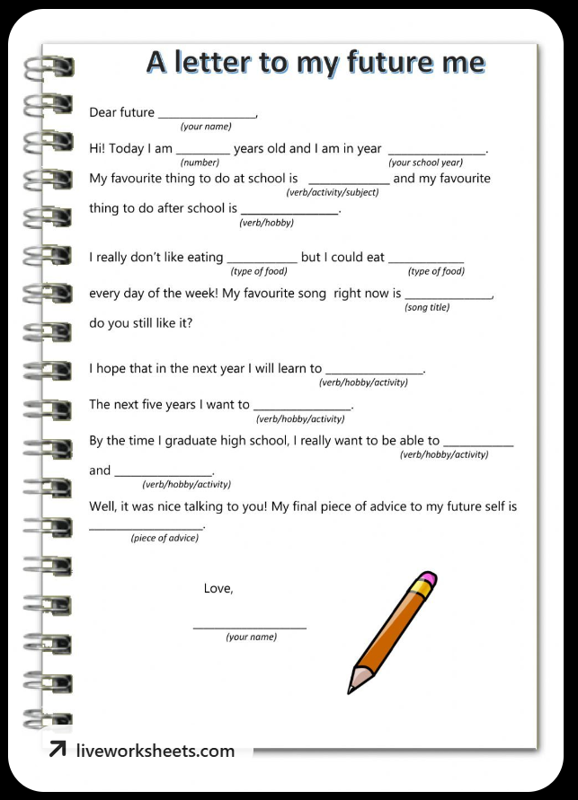
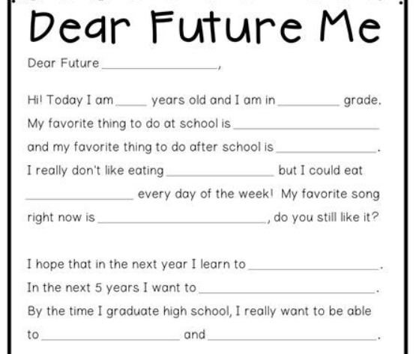

Slide 27
Assessment
Student’s Own Checklist:
Sample Self-Assessment Rubric
Have I remembered to …? | Check!
* write a beginning, middle and end? * begin with an interesting opening?
write enough details so that my ideas are clear?
choose interesting words?
use capital letters, commas, question marks, speech marks and full stops?
tidy up my work so it’s clear and neat?
You can find many kinds of assessment rubrics online. Choose those that are relevant for the level and assignment topic.

Slide 28
Sample Teacher’s Assessment Sheet
Assessment Sheet: Criteria | Performance Scale: 1-3
1. organization | 1 2 3
2. content | 1 2 3
3. quality of language | 1 2 3
4. mechanics | 1 2 3
5. presentation | 1 2 3

Slide 29
Writing Competition Grading Rubric
Criteria | 1 | 2 | 3
Organization | The beginning, middle and end are unclear. | Organization is fair but a little unclear. | There is a clear beginning, middle and end.
Content | The writing does not make sense and has few details. | The writing mostly makes sense and has some details. | The writing makes sense. There are many details that help the reader understand what is being described.
Quality of Language (grammar, vocabulary and syntax) | Writing provides little new information; errors in choice of vocabulary, grammar and syntax making language difficult to understand. | Piece is written in a fairly interesting style and voice; choice of vocabulary, grammar use and syntax are fair. | Writing is very informative; good choice of vocabulary; pupils shows own personality in a variety of ways.
Mechanics | The writing is missing many capital letters and punctuation marks. | Virtually no spelling or punctuation errors. | All sentences have capital letters and punctuation marks in the right places.
Presentation | The work is difficult to read. | The work is fairly neat and can be read. | Work is neat and easy to read.
Notes:
Note that the checklist, student’s assessment sheet and grading rubric all have the same criteria

Slide 31
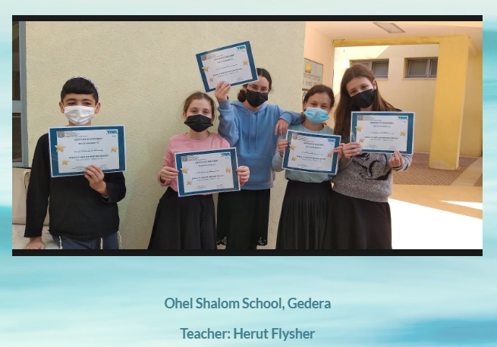
Acknowledge & Display
* The work of each and every child - no matter on what level - should be acknowledged and celebrated by the teacher.
* The pupils’ work is displayed in a digital or physical format e.g. on a classroom wall or in the school corridor / on the school website / in the school newsletter.

Slide 32
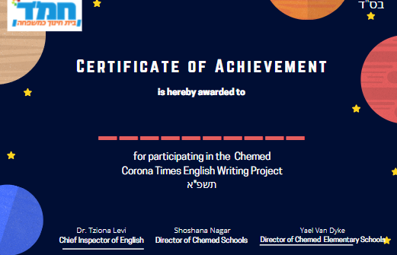
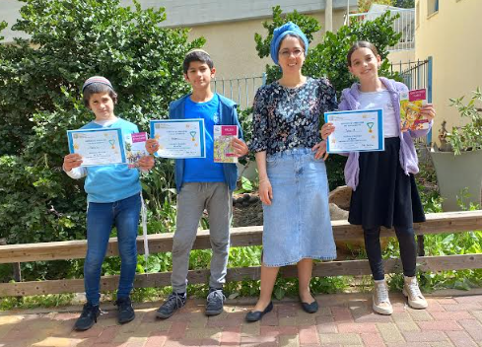
Every Child’s a Winner!
Yefe Nof, Tel Aviv
Teacher: Tamara Bairamov

Slide 33
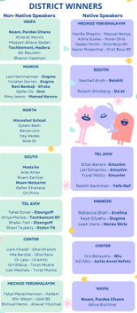

Slide 34
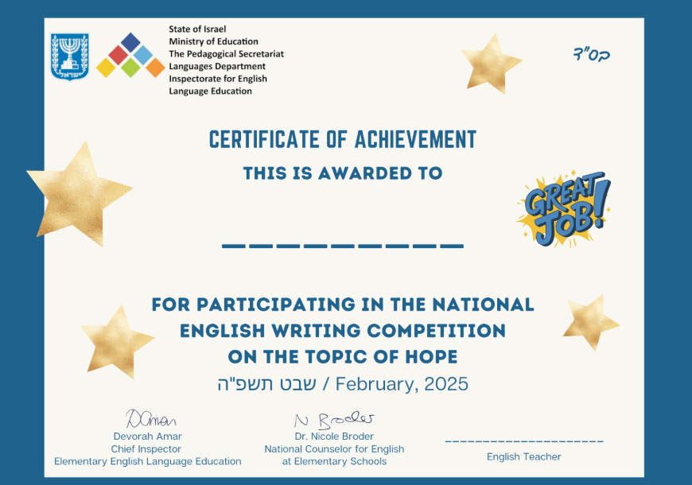

Slide 35
Timeline HOPE 6th Grade Writing Competition 2025
This Photo by Unknown Author is licensed under CC BY
Teacher announces competition winners in each class. All entries are displayed by teacher in school and the school website.
Teacher submits 5 native speaker entries (if relevant) and 5 non-native speaker entries on this form. Late entries will not be accepted.
Teacher presents the writing project / competition in 5th and 6th grade classes.
START HERE
January, 2025
February 27th, 2025
March 13th, 2025
27th March 2025
Regional English inspectors submit the names of 5 native speakers’ entries and 5 non-native speakers’ entries for the national competition.
The names of 12 native speaker winners and 12 non-native speaker winners will be publicized. There will be an award ceremony at which the winners will receive certificates and prizes.

Slide 36
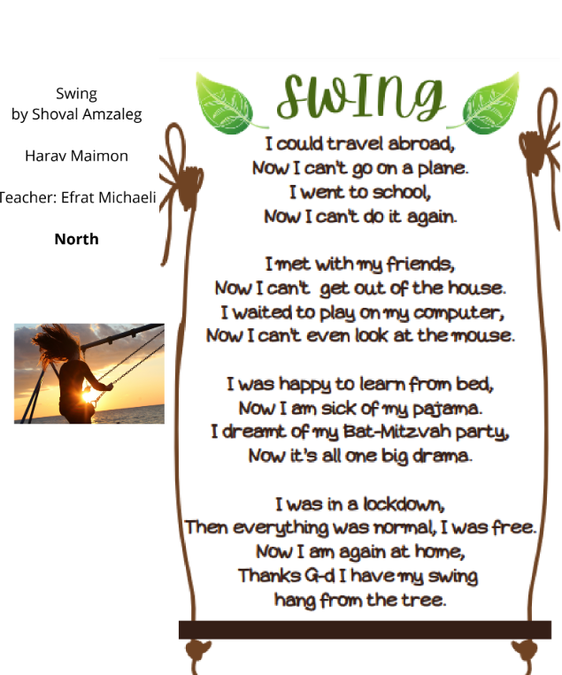

Slide 37
No matter the method, getting children to express hope is a powerful way to foster their emotional well-being and resilience.

