Slide 1
LET’S PLAY
bankrupt

Slide 2
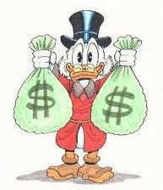
PLAY IN PAIRS: “A” and “B”.
CHOOSE YOUR ANSWER.
COMPETE AGAINST EACH OTHER.
IF IT’S CORRECT, YOU WIN MONEY.
IF IT’S WRONG, YOU LOSE MONEY.
IF IT SAYS “DONATION”, THE MONEY GOES TO THE OTHER STUDENT.
IF IT SAYS “BANKRUPT”, YOU LOSE ALL YOUR MONEY!
BE SMART! CHOOSE WISELY.

Slide 3
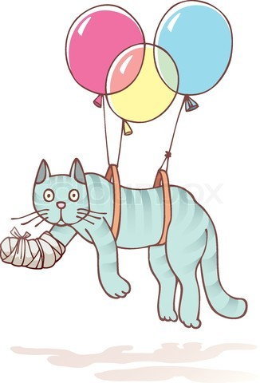
1
THE CAT HURT IT’S / ITS PAW.

Slide 4
1
THE CAT HURT ITS PAW.
WIN
$500.00

Slide 5
1
THE CAT HURT IT’S PAW.
$500.00
DONATION

Slide 6
2
GUESS
WHOSE / WHO’S HERE!

Slide 7
2
GUESS
WHOSE HERE!
LOSE
$600.00

Slide 8
2
GUESS
WHO’S HERE!
WIN
$600.00

Slide 9
3
I LIKE YOU’RE / YOUR MONKEY.

Slide 10
3
I LIKE YOUR MONKEY.
WIN
$600.00

Slide 11
3
I LIKE
YOU’RE MONKEY
DONATE
$600.00

Slide 12
4
THE HOLE / WHOLE WORLD IS WATCHING.

Slide 13
4
THE HOLE WORLD IS WATCHING.
BANKRUPT

Slide 14
4
THE WHOLE WORLD IS WATCHING.
WIN
$600.00

Slide 15
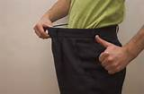
5
These pants are too
lose / loose.

Slide 16
5
These pants are
too lose.
Lose
$400.00

Slide 17
5
These pants are
too loose.
WIN $400.00

Slide 18
6
I fell /
felt
dizzy.

Slide 19
6
I fell
dizzy.
Lose
$600.00

Slide 20
6
I felt
dizzy.
WIN $600.00

Slide 21
8
WE HAD LOTS
OF fun / funny
AT THE FAIR.

Slide 22
8
WE HAD LOTS
OF FUN AT
THE FAIR.
WIN $300.00

Slide 23
8
WE HAD LOTS
OF funny AT
THE FAIR.
LOSE
$300.00

Slide 24
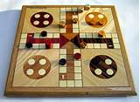
9
THIS / THESE
GAME IS COOL!

Slide 25
9
THIS
GAME IS COOL!
WIN $600.00

Slide 26
9
THESE
GAME IS COOL!
LOSE
$600.00

Slide 27
10
Thank G-d
IT’S / ITS
Friday!

Slide 28
10
Thank G-d
ITS FRIDAY!
$700.00
DONATION

Slide 29
9
Thank G-d
IT’S FRIDAY!
WIN
$700.00

Slide 30
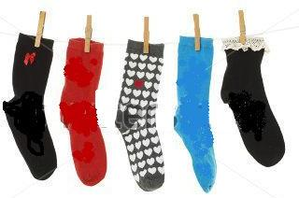
11
WHOSE / WHO’S SOCKS ARE THESE?

Slide 31
11
Whose SOCKS ARE THESE?
WIN
$800.00

Slide 32
11
WHO’S SOCKS ARE THESE?
DONATE
$800.00

Slide 33
12
YOU’RE / Your the best!

Slide 34
12
YOU’RE
the best!
WIN
$500.00

Slide 35
12
Your
the best!
DONATE
$500.00

Slide 36
13
There’s a
hole / whole in the wall.

Slide 37
13
There’s a
hole in the wall.
WIN
$800.00

Slide 38
13
There’s a
whole in the wall.
lose
$800.00

Slide 39
14
Don’t lose / loose your head.

Slide 40
14
Don’t loose your head.
Lose $500.00

Slide 41
14
Don’t lose your head.
WIN $500.00

Slide 42
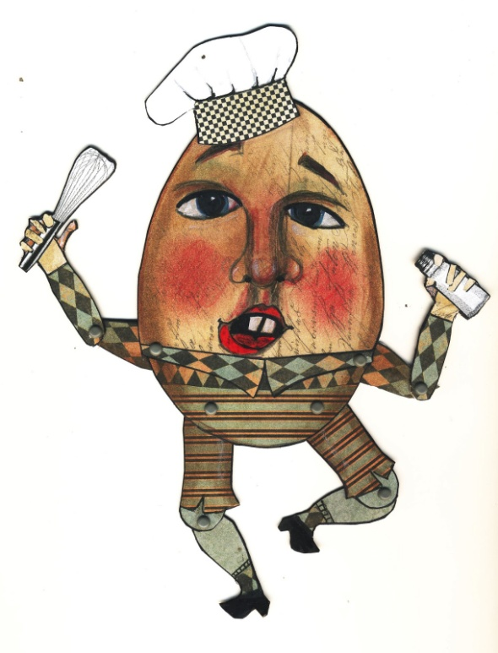
15
Humpty Dumpty fell / felt
off the wall.

Slide 43
15
Humpty Dumpty fell off
THE WALL.
WIN $600.00

Slide 44
15
Humpty Dumpty felt off
the wall.
DONATE
$600.00

Slide 45
17
Clowns are
supposed to be
fun / funny.

Slide 46
17
Clowns are
supposed to be
FUN.
BANKRUPT

Slide 47
17
Clowns are
supposed to be
FUNNY.
WIN $400.00

Slide 48
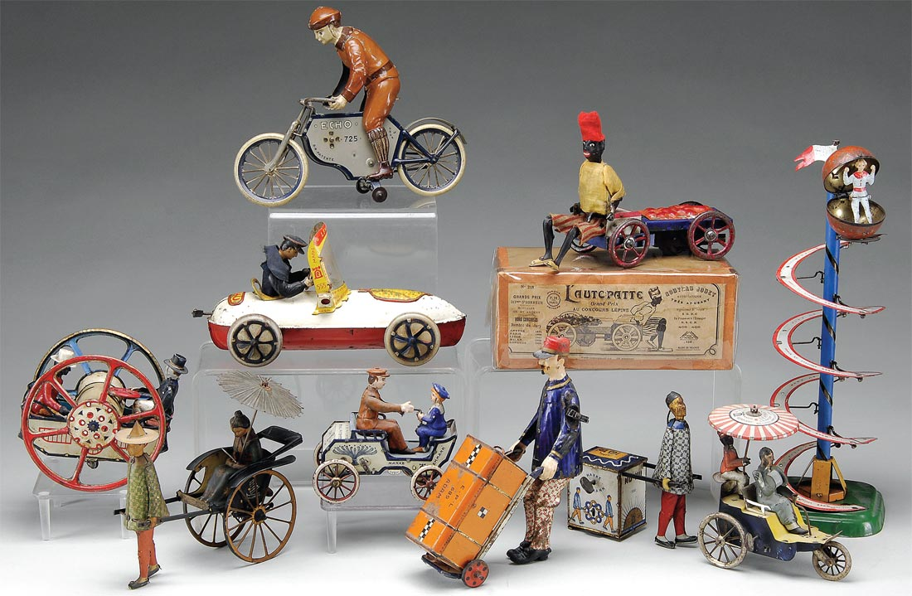
18
THIS / THESE toys are
really old!

Slide 49
18
THIS toys are
really old!
Lose $500.00

Slide 50
18
THESE toys
are
really old!
WIN $500.00

Slide 51
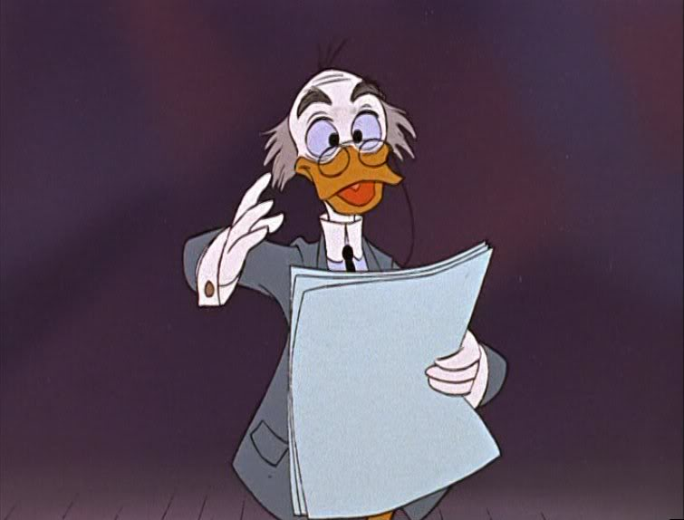
LET’S
RECAP…

Slide 52
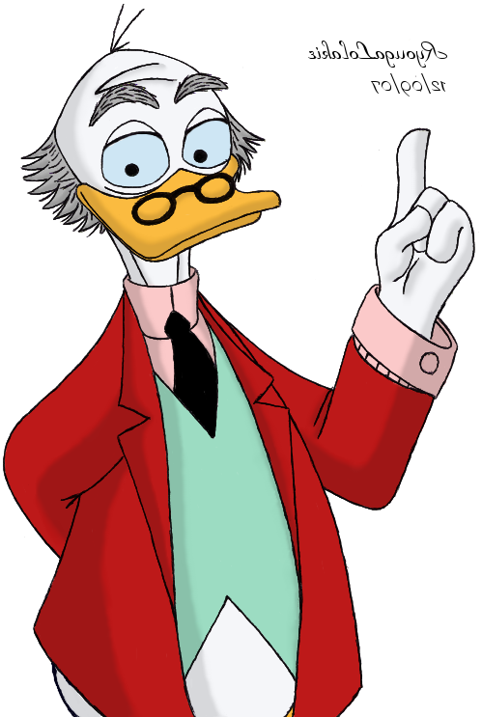
fell - PAST TENSE OF FALL
felt – PAST TENSE OF FEEL

Slide 53
FUN – (noun)
a good time
FUNNY – (adj.) humorous, comical

Slide 54
Lose – (Verb)
not find
Loose – (Adj.)
not tight

Slide 55
IT’S – it is
Its – possessive,
belonging to it.

Slide 56
this – singular
these- plural

Slide 57
WHOLE - COMPLETE
HOLE - ORIFICE

Slide 58
WHO’S – who is
Whose - possession

Slide 59
You’re – you are
Your - possessive

Slide 60
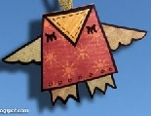
Your turn:
Working in pairs, write 5 sentences with two
options each.
Swap papers and choose
the correct option in
your partner’s paper!

Slide 61
That was exhausting!

