Slide 1
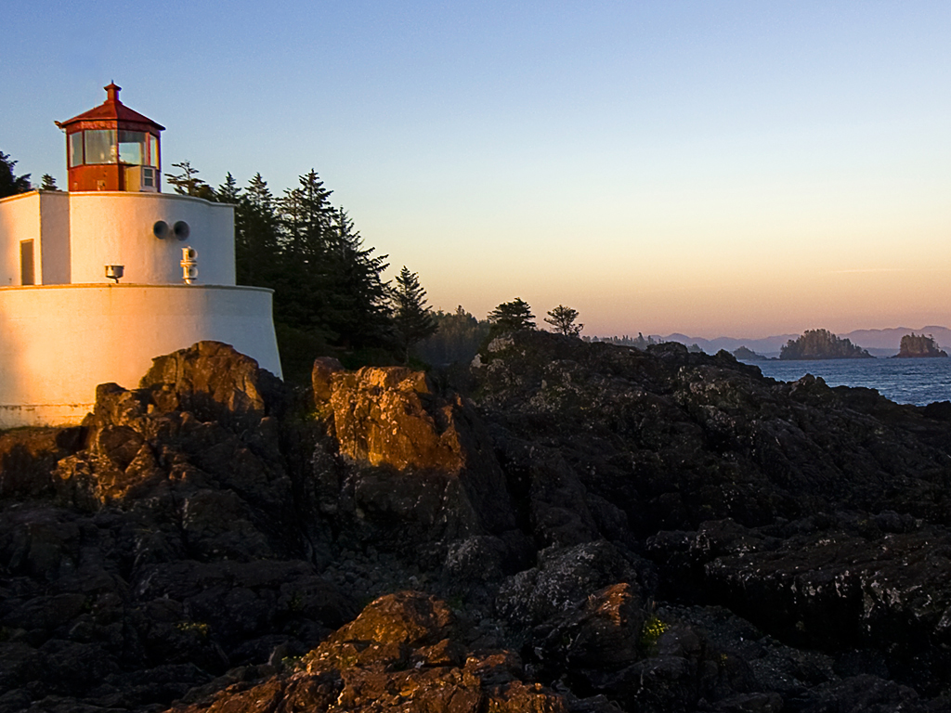
As I grew older
Langston hughes

Slide 2
It was a
I have
almost
long time
forgotten
ago.
my dream.

Slide 3
In front of me,
But it was there then,
n front of

Slide 4
Bright like a sun--
My dream.

Slide 5
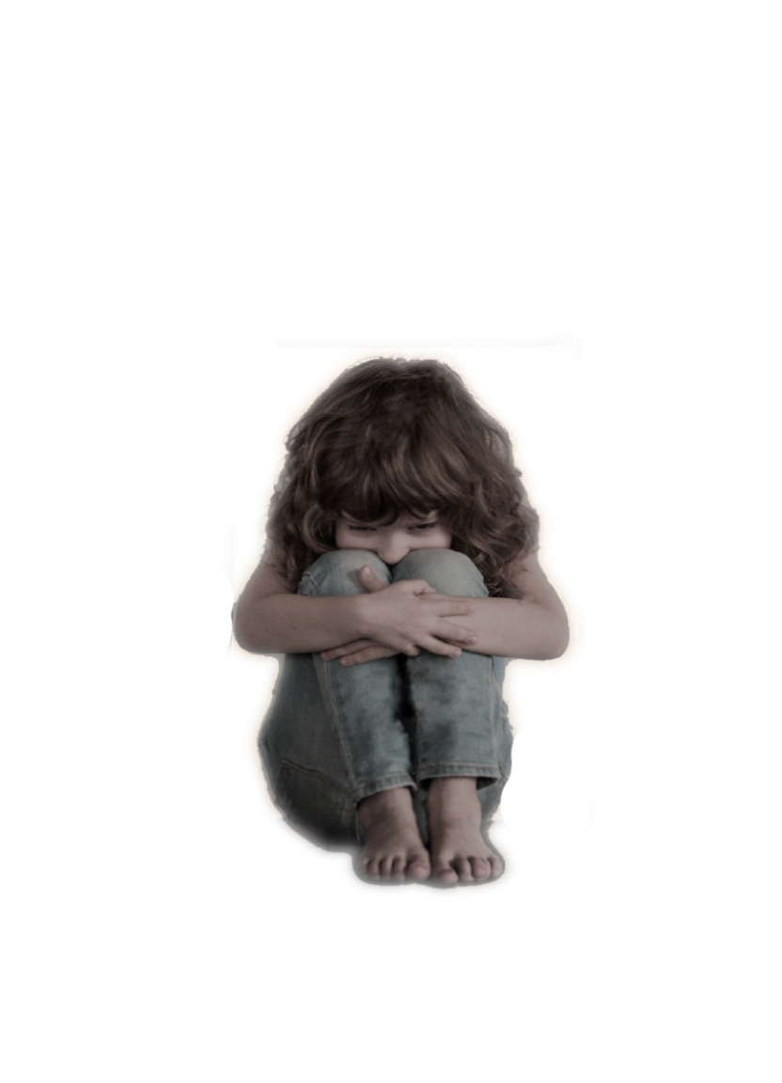
And then the wall rose,
Rose slowly,
Slowly,

Slide 6
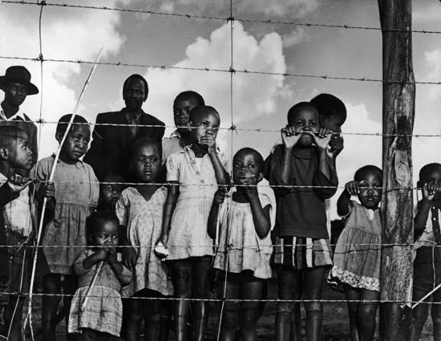
Between me
And my dream.

Slide 7
Rose until it touched the sky--
The wall.

Slide 8
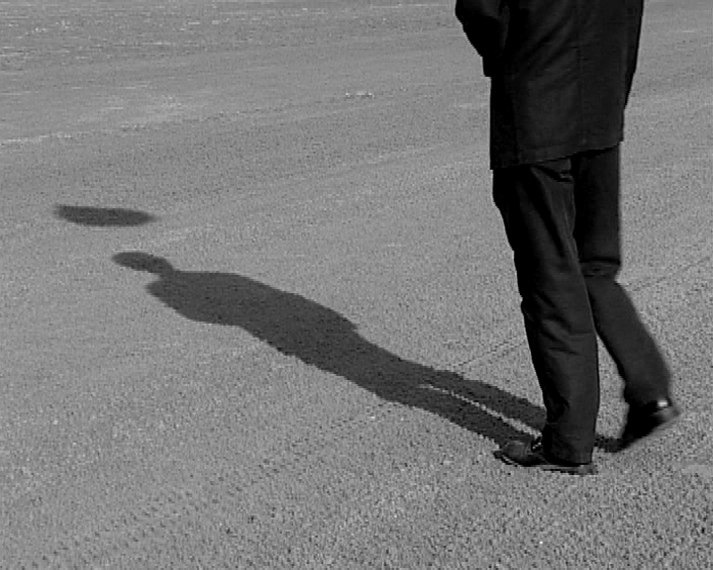
shadow.
I’M BLACK.

Slide 9
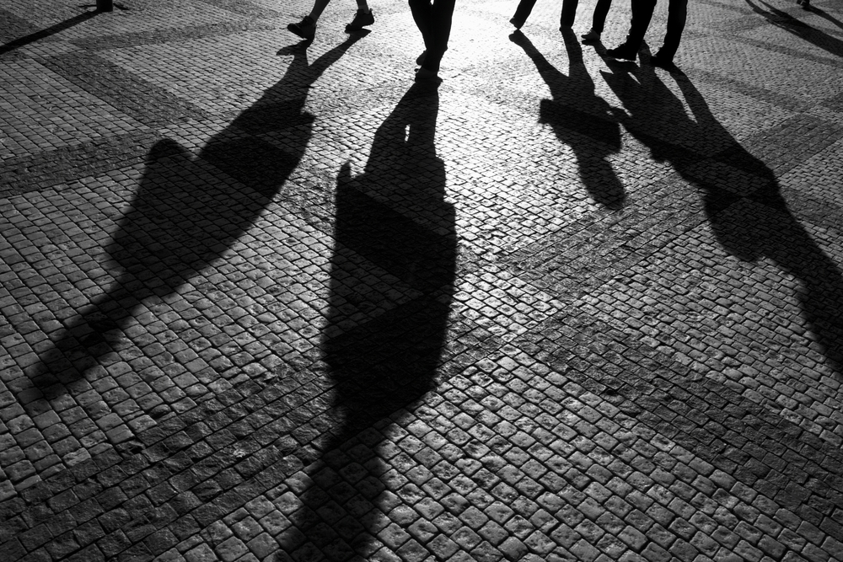
I lie down in the shadow

Slide 10
No longer the light of my dream before me,
Above me.

Slide 11
No longer the light of my dream before me,
Above me.

Slide 12
Only the thick wall

Slide 13
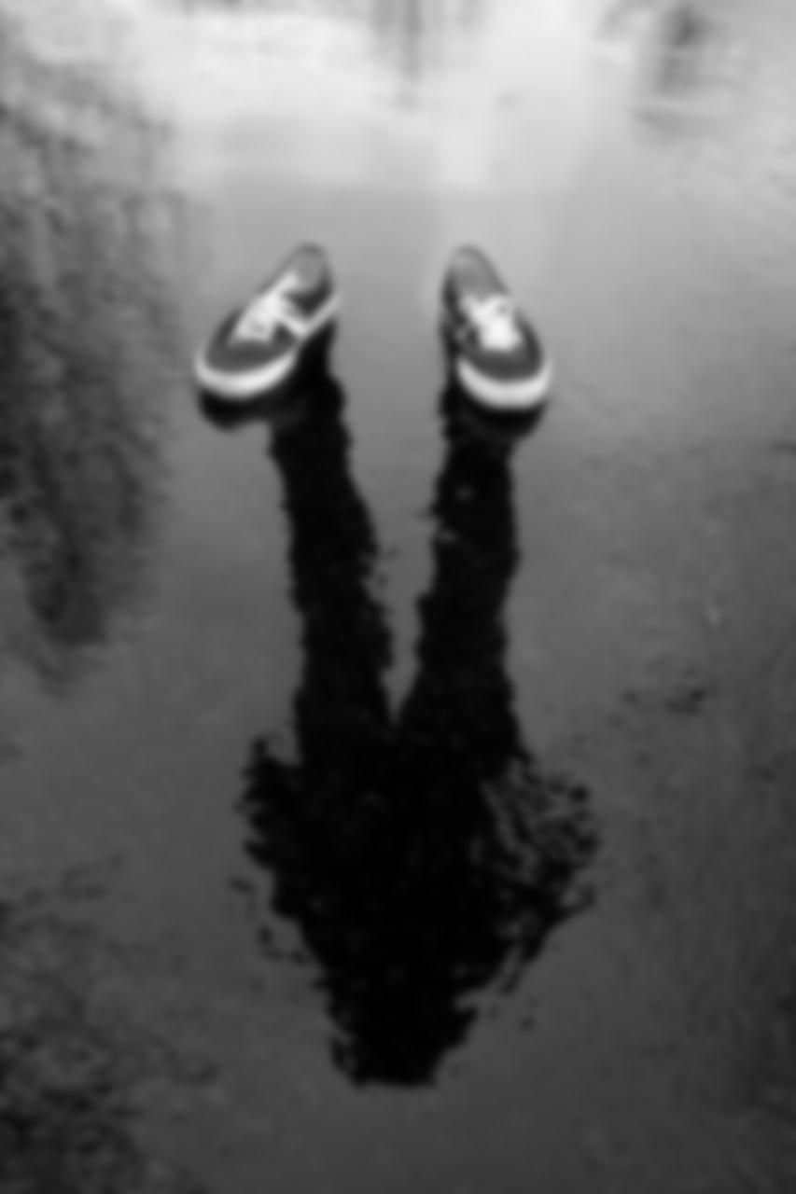
Only the shadow

Slide 14
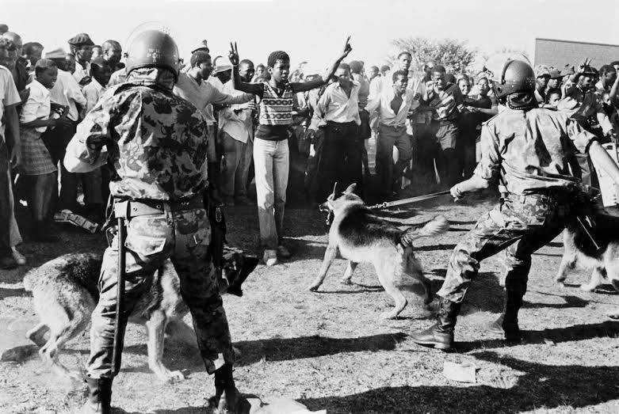
My hands! My dark hands!

Slide 15
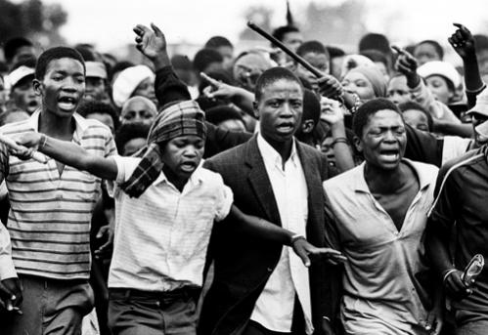
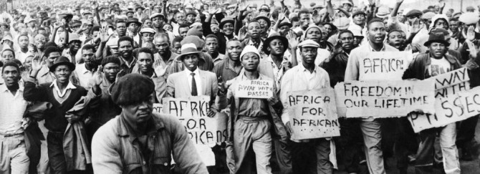
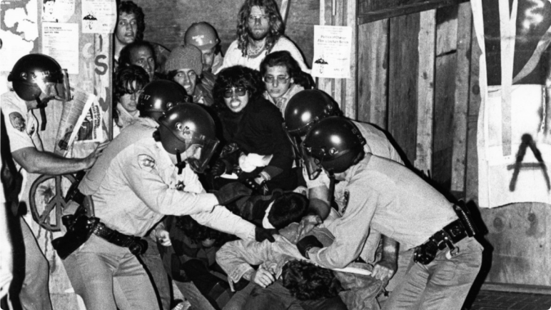
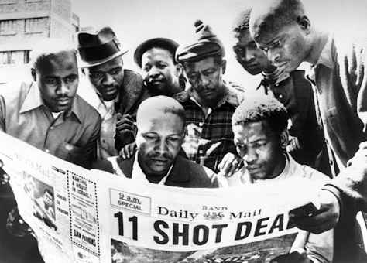
Break through the wall

Slide 16
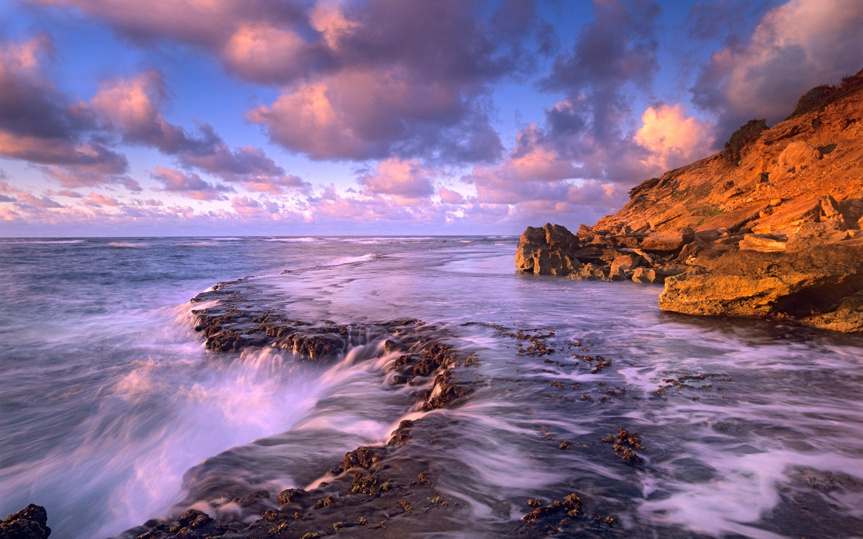
Find my dream.

Slide 17
Help me to shatter this darkness

Slide 18
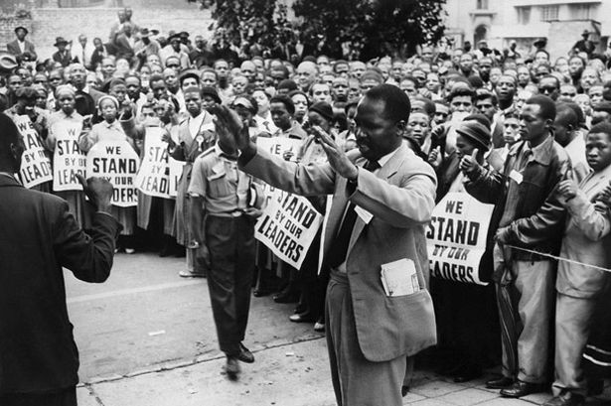
To smash this night,
to break this shadow

Slide 19
Into a thousand lights of sun
Into a thousand whirling dreams

