Slide 1
מערכת שידורים לאומית
Notes:
כל התמונות כאן מ- freepic ומהספר HIGH SKY שאושר לנו

Slide 2
Occupations
English - Speaking
Teacher: Rivka Rosenberg

Slide 3
Can you…?
understand basic information about common occupations, especially if articulated clearly and supported by pictures
use words from Band II in the context of occupations

Slide 4
Occupations

Slide 5
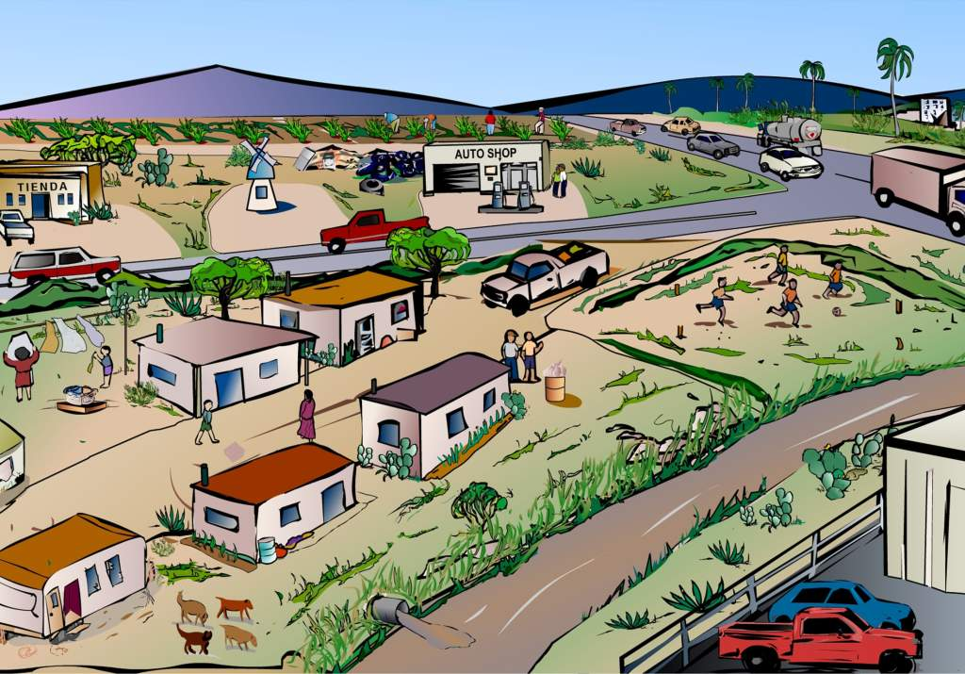
WHAT Do they do?

Slide 6
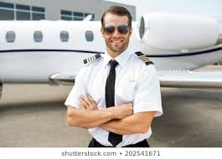
Occupations

Slide 7
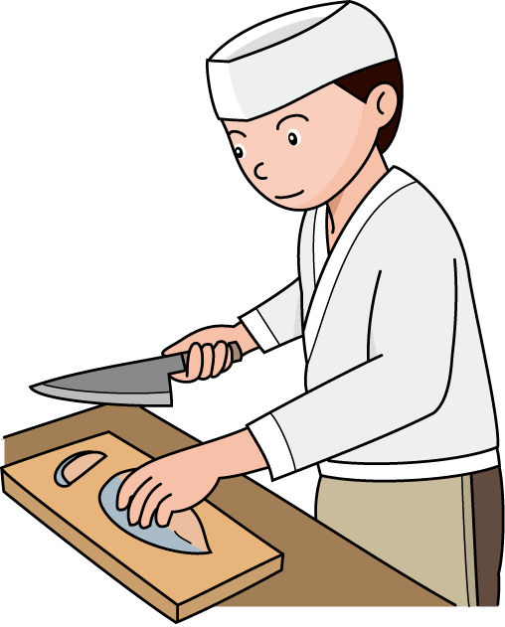
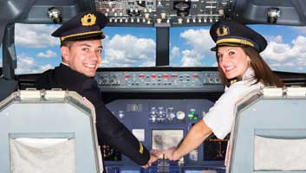
Occupations

Slide 8
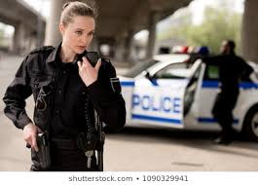
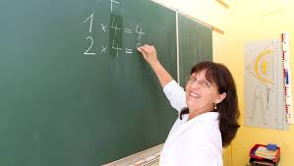
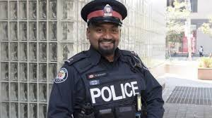
Occupations

Slide 9
Occupations

Slide 10
What’s his job?
GREAT
He’s an artist.
He’s an architect.
He’s an actor.

Slide 11
What are their jobs?
GREAT
They are nurses.
They are teachers.
They are pilots.

Slide 12
What’s his job?
GREAT
He’s a teacher.
He’s an accountant.
He’s a doctor.

Slide 13
What’s her job?
GREAT
She’s a teacher.
She’s a nurse.
She’s a policewoman.

Slide 14
What’s his job?
GREAT
He’s a doctor.
He’s a chef.
He’s a nurse.

Slide 15
What’s her job?
GREAT
She’s a teacher.
She’s a doctor.
She’s a secretary.

Slide 16
What’s his job?
GREAT
He’s a teacher.
He’s a judge.
He’s a policeman.

Slide 17
What’s her job?
GREAT
She’s a nurse.
She’s a hairdresser.
She’s a teacher.

Slide 18
What are their jobs?
GREAT
They are doctors.
They are pilots.
They are teachers.

Slide 19
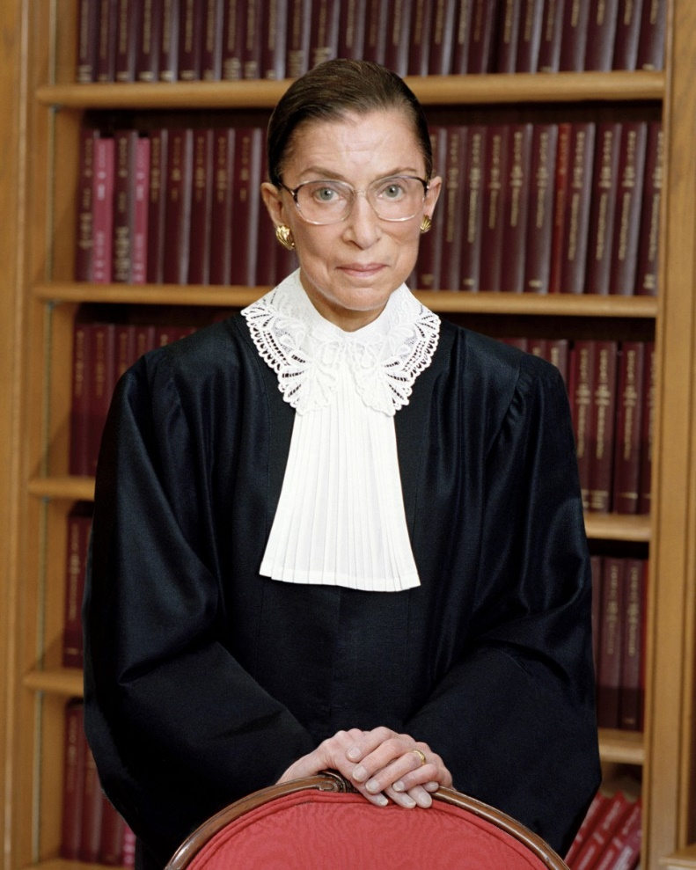
What’s her job?
GREAT
She’s a doctor.
She’s a teacher.
She’s a judge.

Slide 20
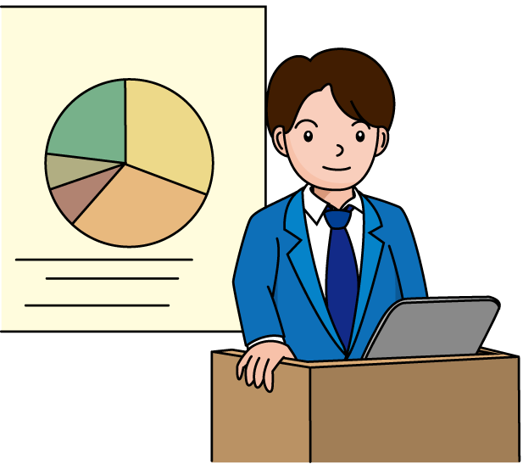
What’s his job?
GREAT
He’s a judge.
He’s a professor.
He’s a hairdresser.

Slide 21
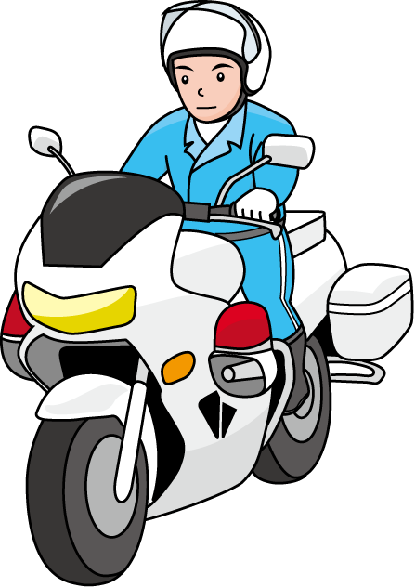
What’s his job?
GREAT
He’s a nurse.
He’s a teacher.
He’s a policeman.

Slide 22
What’s his job?
GREAT
He’s a lawyer.
He’s a nurse.
He’s a policeman.

Slide 23
Speak up!

Slide 24
What do you do? What is your job? What is your profession? I am a…. I am an…. | במה את\אתה מתעסק\ת? אני...
policeman - policewoman | שוטר-שוטרת
judge | שופט
chef | שף
accountant | רואה חשבון
architect | ארכיטקט
pilot | טייס
teacher | מורה
professor | פרופסור
doctor | רופא
hairdresser | ספר
lawyer | עורך דין
nurse | אחות-אח

Slide 25
Video Taping Activity
Make a 30 second interview clip about 3 people.
Choose 3 people.
Ask them:
What is your job?
Where do you work?
Do you like your job?
Record the answers and share the interview with your family, friends and teacher.

Slide 26
Self Assessment
Watch your recording and then fill in the table.
 | Yes | No | Not sure
I can ask questions about occupations in English.
I can answer questions about occupations in English.

Slide 27
Break

Slide 28
What do you do? What is your job? What is your profession? I am a…. I am an…. | במה את\אתה מתעסק\ת? אני...
policeman - policewoman | שוטר-שוטרת
judge | שופט
chef | שף
accountant | רואה חשבון
architect | ארכיטקט
pilot | טייס
teacher | מורה
professor | פרופסור
doctor | רופא
hairdresser | ספר
lawyer | עורך דין
nurse | אחות-אח

Slide 29
Jobs

Slide 30
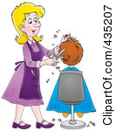
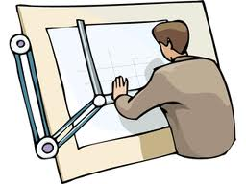
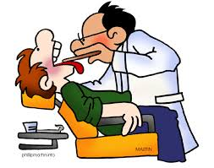
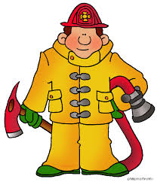
architect
nurse
doctor
hairdresser
engineer
waiter
policeman
dentist
postman
electrician
mechanic
fireman

Slide 31
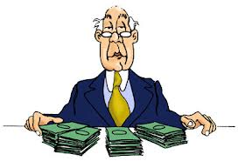
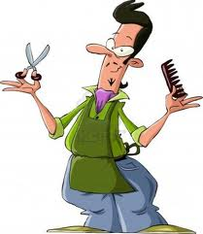
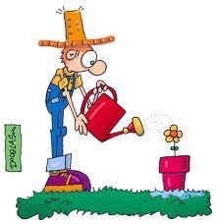
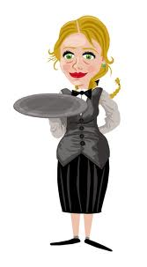
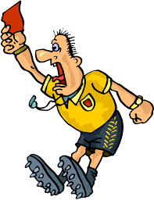
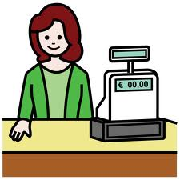
bus driver
accountant
singer
hairdresser
gardner
waitress
referee
cashier
workman

Slide 32
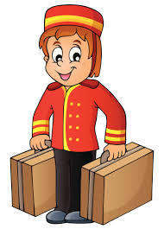
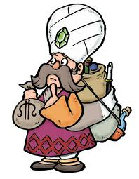
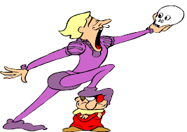
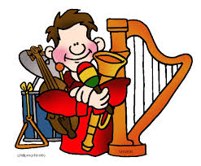
secretary
lawyer
sales person
bell boy
pilot
astronaut
flight attendant
merchant
carpenter
chef
actor
musician

Slide 33
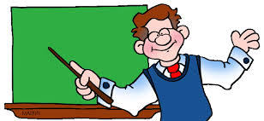
Who….?
takes you to Paris?
catches a thief
cuts your hair
teaches in a school
helps sick people

Slide 34
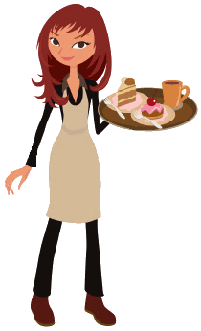
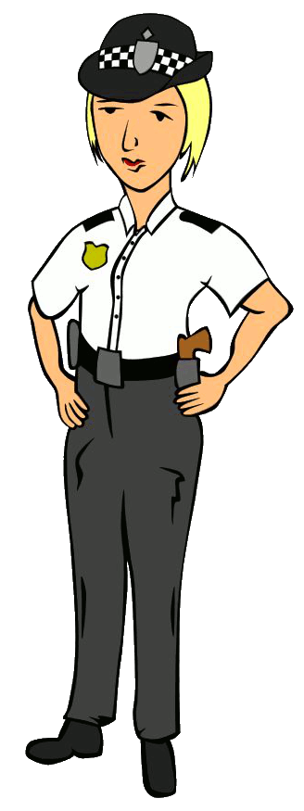
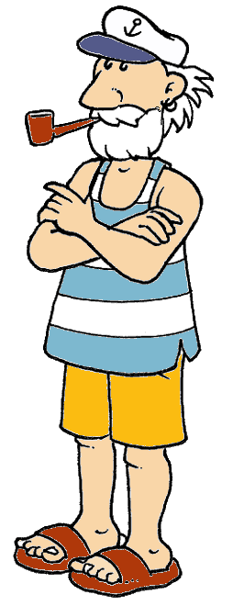
PICTIONARY

Slide 35
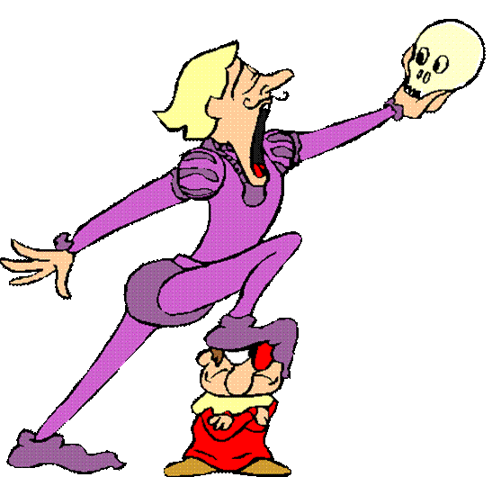
actor

Slide 36
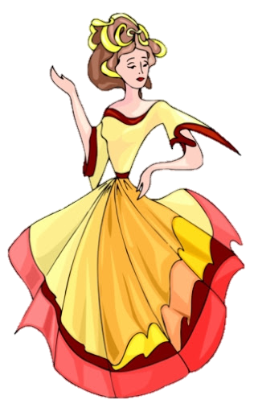
actress

Slide 37
architect

Slide 38
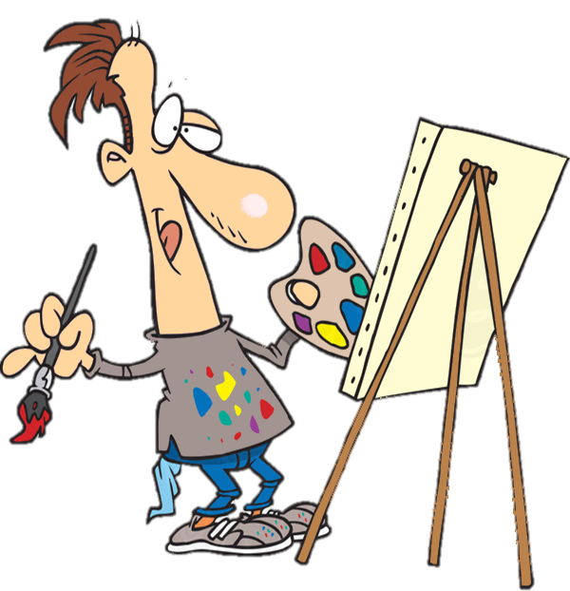
artist

Slide 39
astronaut

Slide 40
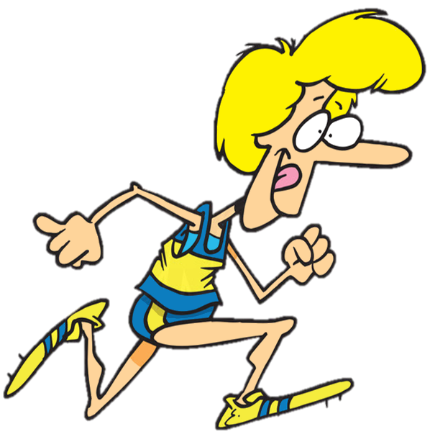
athlete

Slide 41
baker

Slide 42
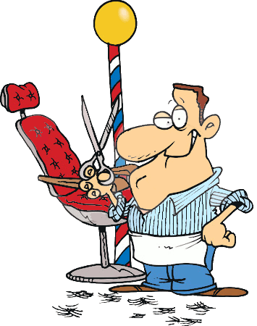
barber

Slide 43
gardner

Slide 44
businessman

Slide 45
butcher

Slide 46
carpenter

Slide 47
computer programmer

Slide 48
cook

Slide 49
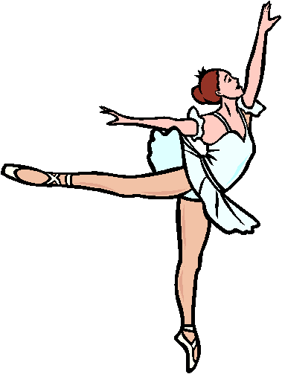
dancer

Slide 50
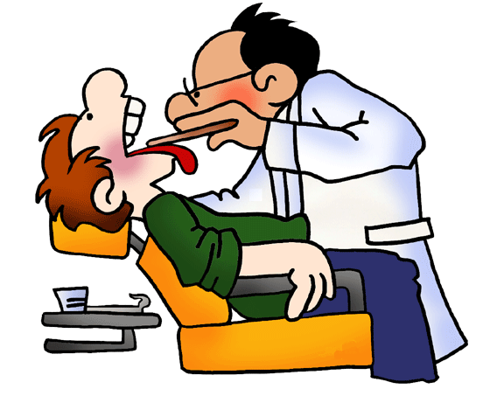
dentist

Slide 51
doctor

Slide 52
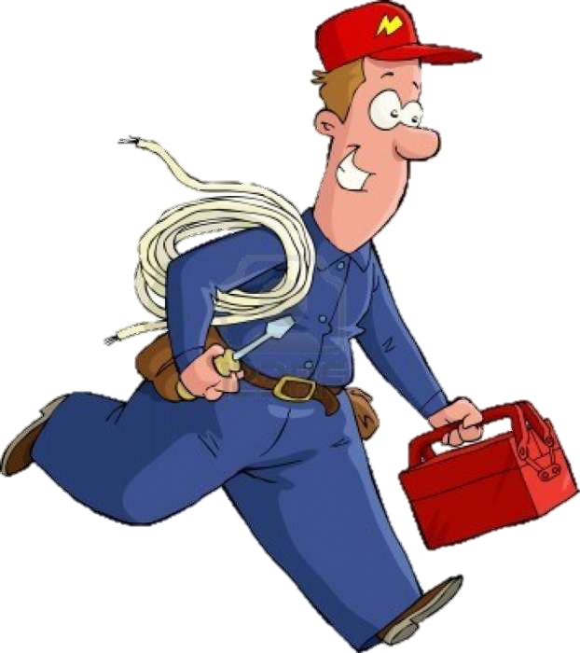
electrician

Slide 53
factory worker

Slide 54
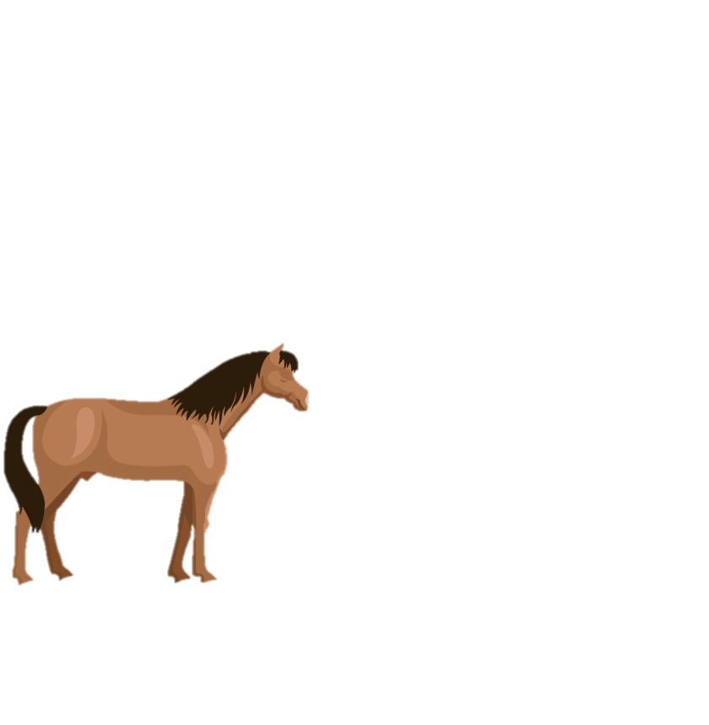
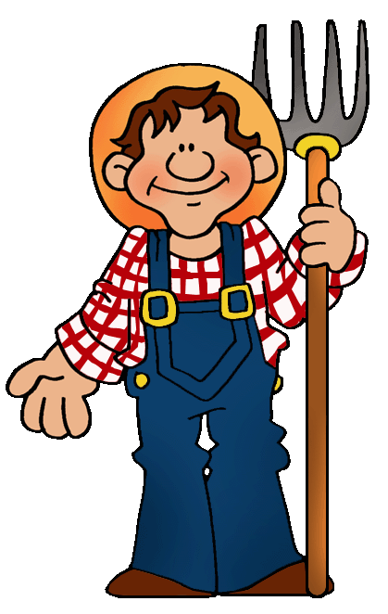
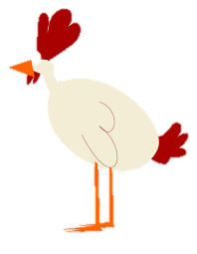
farmer

Slide 55
firefighter

Slide 56
gardner

Slide 57
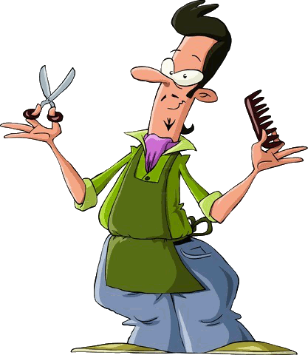
hairdresser

Slide 58
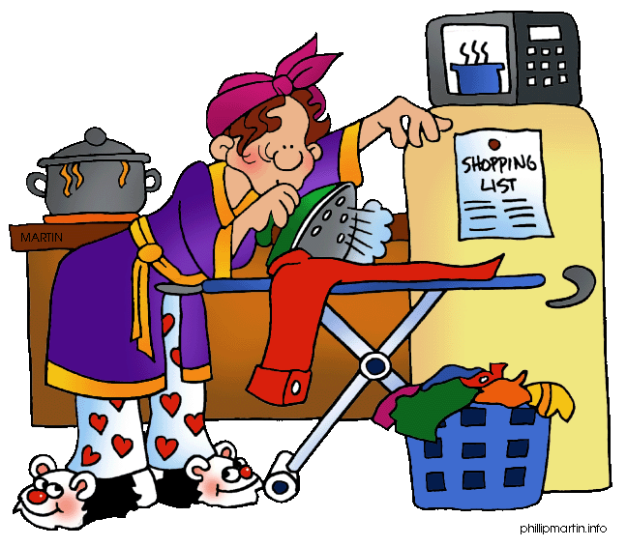
housewife

Slide 59
judge

Slide 60
lawyer

Slide 61
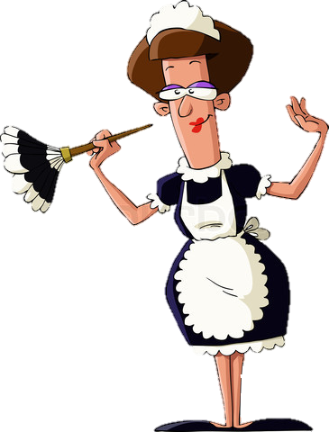
maid

Slide 62
mechanic

Slide 63
musician

Slide 64
nurse

Slide 65
office worker

Slide 66
painter

Slide 67
pilot

Slide 68
plumber

Slide 69
policewoman

Slide 70
postman

Slide 71
sailor

Slide 72
scientist

Slide 73
secretary

Slide 74
shop assistant

Slide 75
singer

Slide 76
soldier

Slide 77
street sweeper

Slide 78
taxi driver

Slide 79
teacher

Slide 80
vet

Slide 81
waiter

Slide 82
waitress

Slide 83
welder

Slide 84
writer

Slide 85
Now you can…
understand basic information about common occupations, especially if articulated clearly and supported by pictures
use words from Band II in the context of occupations

Slide 86
Occupations
English- Speaking
Teacher: Rivka Rosenberg

Slide 87
השימוש ביצירות במהלך שידור זה נעשה לפי סעיף 27א לחוק זכות יוצרים, תשס"ח-2007. אם הינך בעל הזכויות באחת היצירות, באפשרותך לבקש מאיתנו לחדול מהשימוש ביצירה, זאת באמצעות פנייה לדוא"ל rights@education.gov.il
שימוש ביצירות מוגנות בזכויות יוצרים ואיתור בעלי זכויות

