Slide 1

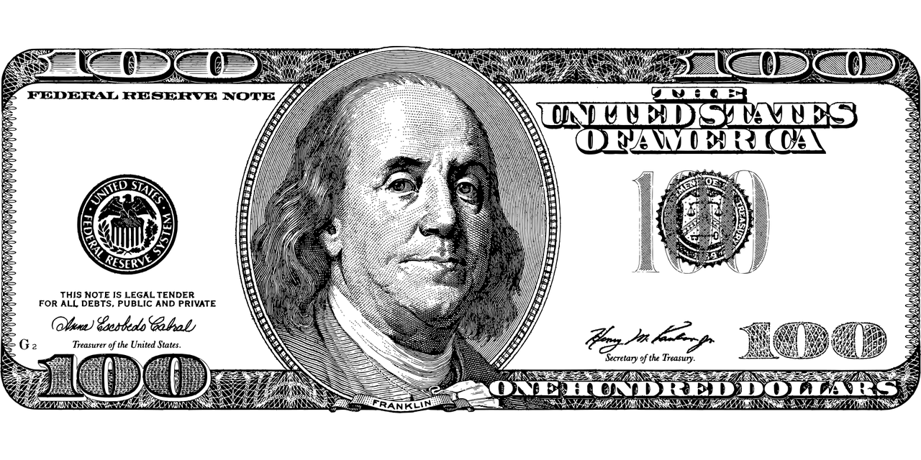
Financial Management For Teenagers
יחידת לימוד בנושא ניהול פיננסי לכיתה ט'
בה"ס של החופש הגדול

Slide 2
Can you? מטרות יחידת הלימוד
Can you talk about money and teenagers using varied vocabulary?
Can you watch a video clip and learn how to manage your money better?
Can you write what you think about money?
Can you define short-term goals and long-terms goals regarding your money management?
Notes:
Can you? מטרת השיעור
Written Reception (WR):
Can understand the main points made in informational texts that deal with the topic (adapted CEFR A2)
Can understand most general factual information on familiar subjects of interest
Spoken Production (SP):
Can express opinions on subjects relating to everyday life
Can present his/her opinion in a structured, coherent manner especially provided he/she can prepare in advance (A2)
Written Production (WP):
Can work out how to communicate the main point(s) he/she wants to convey, exploiting available resources and limiting the message to what he/she can recall or find the means to express
Spoken Interaction (SI):
Can interact with reasonable ease in structured situations, short social exchanges, and conversations using vocabulary from Bands I & II.

Slide 3

Lesson 1
Write 10-15 words/phrases you think of when you hear the word MONEY
Introduction הקדמה קצרה לנושא
Time: 10 minutes.
Write the words in your notebooks or on a poster. In small groups choose the most common answers and present in class.
Notes:
For online lessons : you might want to use any digital tool you like.
For F2F lessons: Students can write in their notebooks or on the board or a poster. Students can choose the most common answers of their group members.
(individual work, group work)

Slide 4
Spoken interaction/Writing Production/ summarizing texts
האזנת הנשמע/ כתיבת רשימת מילים/סיכום השיר
Time: 25 minutes.
Click on the quotes. Watch and listen to the following famous songs.
Choose the one you like best and explain why.
Look for the lyrics of the song.
Make a list of the new words you learned
Write the message of the song in your own words in no more than 2 sentences
"I don’t need no dollar bills to have fun”
Sia
Well let me tell you something all that glitters ain't gold
Aloe Blacc - I Need A Dollar
Money can't buy me love
The Beatles
Money must be funny in the rich man's world
ABBA
Money can’t buy us happiness
Jessie J - Price Tag

Slide 5
סיכום ו"כרטיס יציאה"
(Wrap-up & Exit Ticket) – 5 דקות
Exit Ticket: My Song Discovery
Name: ____________________ Date: ___________________
1. Your Selection
The song I liked best is: _______________________ I chose this song because: ______________________________________
2. New words I learned from the lyrics:
3. The Core Message
Summarize the message of the song (maximum 2 sentences):

Slide 6
Lesson 2
Introduction הקדמה קצרה לנושא
Time: 10 minutes.
Why do you think teenagers need to learn about financial management. List 4 reasons:
Try to answer the question by completing the following sentences:
Teenagers….
In order to …
In the 21st century, ….
Our future...

Slide 7
Lesson 2
Differential Learning
הוראה דיפרנציאלית
Why do you think teenagers need to learn about financial management? List 4 reasons:
Teenagers…
...need to understand the difference between "want" and "need."
...often spend money on things they don't really use.
...should practice how to save a little bit of money every month.
...want to be independent and make their own decisions.
In order to…
...buy a new phone or a laptop, we must learn to save.
...avoid wasting money, we need to make a simple budget.
...help our families, we should know how much things cost.
...feel confident, we need to know how to manage our bank accounts.

Slide 8
Lesson 2
Differential Learning
Why do you think teenagers need to learn about financial management? List 4 reasons:
In the 21st century,….
...everything is digital, so it is very easy to spend money online.
...prices are going up, so we must be very careful with our cash.
...we have many choices, and we need to choose the best one.
...apps and games always want us to buy more things.
Our future…
...will be better if we start learning about money today.
...depends on the good habits we create right now.
...is more secure when we have some savings for emergencies.
...starts with the small choices we make in school.

Slide 9
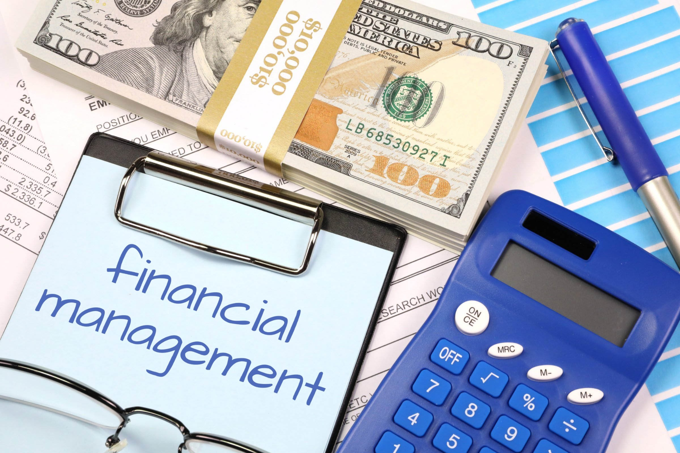
Avery, Eric, Jackson, Charlie and Heily talk about money and teenagrs.
Listen, write down and prepare to share ONE interesting fact you learned from the video that you didn’t know before
20 minutes
האזנת הנשמע/ כתיבה ושיחה/
Spoken Reception, written production and spoken interaction
Watch this YouTube video:
MONEY MANAGEMENT 101
https://pix4free.org/photo/35397/financial-management.html

Slide 10
1. What is a budget?
a) A list of things to buy
b) A plan to manage money
c) A type of bank account
d) A job for teenagers
2. Why is it good to save money?
a) To buy everything now
b) To have money for the future
c) To spend more on gifts
d) To avoid working
3. Can teenagers open a bank account by themselves?
a) Yes, always
b) No, never
c) Sometimes, with help from parents
d) Only if they have a job
4. What should you do to keep your online bank account safe?
a) Share your password with friends
b) Change your password often and check your account
c) Use the same password for everything
d) Ignore your bank statements
5. Why do you think it is important to learn about money management when you are a teenager? Explain.
______________________________
_______________________________
______________________________
_______________________________
15 minutes
Summary of the video and Exit Ticket
סיכום השיעור וכרטיס יציאה

Slide 11

Lesson 3
Introduction הקדמה קצרה לנושא
Time: 10 minutes.
What are some of the things YOU would like to learn this year about money management?
Complete the sentences:
I would like to know….
I would like to learn…
I would like to know how to ….
https://commons.wikimedia.org/wiki/File:Quizz_transparent.png

Slide 12
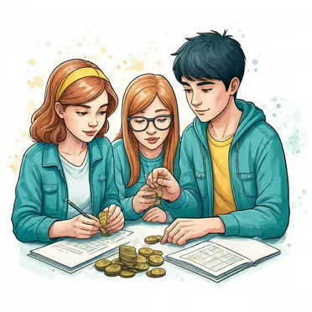
How can you be successful in your money management?
Meet Emerie Tolman. Listen carefully to her presentation!
Spoken reception/spoken interaction/written production
האזנת הנשמע/ מענה לשאלות
Time: 25 minutes.
Watch this YouTube video:
MONEY MANAGEMENT FOR TEENS

Slide 13
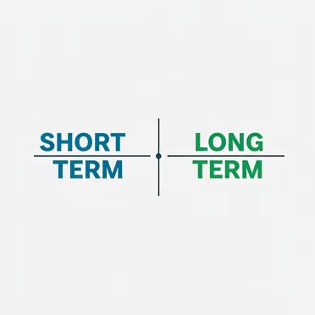
What did Emerie talk about?
She spoke about short-term goals. For example: _____________________
She spoke about long-term goals. For example: _____________________
What is one of YOUR short term goal?
_____________________________________________________________
What is one of YOUR long-term goals?
_____________________________________________________________

Slide 14
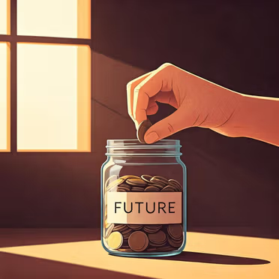
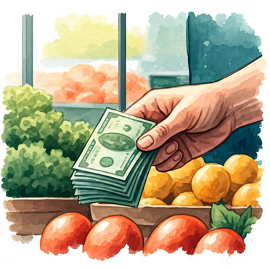

Emerie talks about 3 things we do with money...
Fill out the chart (according to Emerie’s video):
What are the things we do with money? | How can we do them?
Making money
Saving money
Spending money

Slide 15

Do you remember? Let’s check your memory
What does Emerie do to make money?
What does Emerie’s mother do for a living?
What means of payment does Emerie mention in her video? (Can you think of other ways she hasn’t mentioned?)
4. What 2 types of bank accounts does Emerie mention?

Slide 16
Take this online exit ticket
10 minutes
Summary of the lesson and Exit Ticket
סיכום השיעור וכרטיס יציאה
Here are some of the terms which we discussed in the lesson:
short-term goals
checking account
cash
saving money
a check
spending money
budget
making money
saving account
credit card

Slide 17
Lesson 4
What is the best advice you can give a friend about money management? Work with a partner to prepare and present a one-minute talk together.
20 minutes
Introduction, review terms, spoken production
Review the terms you learned in your previous lesson. Then students answer this worksheet.
checking account
cash
short-term goals
saving money
a check
spending money
budget
making money
saving account
credit card

Slide 18

Short Survey - What do you think?
20 minutes
Spoken Interaction
You received a sum of money in the amount of NIS 10,000 as a gift and you decided to deposit it in a two-year savings account with an annual interest (ריבית שנתית) of 10%. How much money will you have after two years?
You entered a store to buy one shirt for 60 NIS. You see a sign: 'Buy 2 and get the 3rd for half price!' You decide to buy all three.
1. What was the total amount you spent?
2. What was the 'average' price of each shirt?
3. Financial Reflection: Did you actually 'save' money, or did the store successfully get you to spend 90 NIS more than you planned?"

Slide 19
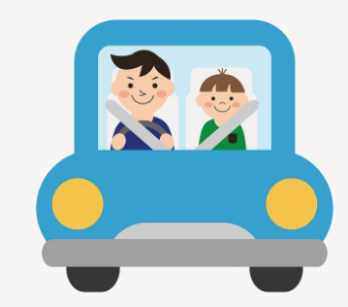
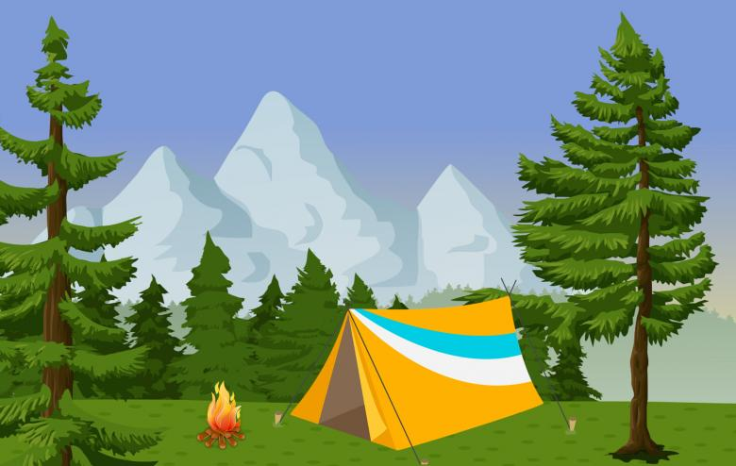
What do you think? Survey (continued)
3. Dana, 17, works in a clothing store, and earns 1,500 NIS a month. She wants to save 3,000 NIS for driving lessons. She would like to start in six months. How much money does she have to save each month to reach her goal?
4. Yair, 16, worked during the summer vacation at a summer camp. At the end of the month, he received a pay slip and a check for NIS 3,000. On the pay slip, 270 NIS were deducted for social security and health care. What's wrong in this?

Slide 20
What did you learn today?
10 minutes
Summary of the lesson and Exit Ticket
סיכום השיעור וכרטיס יציאה
1. The Consumer Trap
When I see a "Sale" in a store, I should not just look at the price of one item. I should ask myself:
________________________________________________________________________
2. My Rights as a Worker
If I work at a job and my boss takes money from my paycheck for taxes or health insurance (and I am under 18), I know that:
________________________________________________________________________
3. The Goal of Saving
To reach a big goal (like driving lessons or a laptop), it is not enough to just "hope" to have enough money. I learned that I must:
________________________________________________________________________
4. The Power of Interest
When I put money in a savings account instead of keeping it in my drawer, my money grows because:
____________________________________________________________________________

Slide 21

Lesson 5 - Buy Wisely
Introduction הקדמה קצרה לנושא
Time: 15 minutes
Spoken Interaction
How do shopping malls make us buy?
What are some of the strategies shopping malls use to promote
sales and make us buy more? Class discussion.
In pairs, answer the following questions:
Do you think malls do these things?
1. Malls play music to make you stay longer.
Yes / No / Maybe
2. Malls hide the exits so you walk past more shops.
Yes / No / Maybe
3. Malls use special smells to make you feel hungry.
Yes / No / Maybe
4. Malls put cheap things near the door.
Yes / No / Maybe
5. Malls have no windows so you don't know what time it is.
Yes / No / Maybe
After the video, check your predictions. Were you right?

Slide 22

Lesson 5 - Buy Wisely
Time: 10 minutes
Spoken reception/spoken interaction/written production
שיחה/האזנת הנשמע/ מענה לשאלות
How do shopping malls make us buy?
Watch this YouTube video
Before your watch the video clip, answer these questions
1. When did you last go to a mall or a supermarket? What did you buy?
2. Did you buy anything you did not plan to buy? What was it?
3. Look at the title: "How malls make you buy." What do you think the video is about?
Watch this video clip and answer the following questions:
What are some of the strategies shopping malls use to promote sales and make us buy more?

Slide 23

Lesson 5 - Buy Wisely
הכנת פוסטר בקבוצות
Time: 20 minutes.
Spoken Interaction & Written Production
How do shopping malls make us buy?
These points will help you:
Why do stores hide everyday items?
How are malls built?
Do malls have natural light?
How are store entrances designed?
Why is there so much noise in malls?
Why is IKEA mentioned?
Group work
Plan and prepare a poster to raise awareness about buying wisely. Share the posters in class and online.

Slide 24
Lesson 5 - Buy Wisely
Differential Learning
הוראה דיפרנציאלית
Make a "Smart Shopper" Poster
Copy and complete these sentences:
Malls and Time: Malls do not have windows or clocks because...
Store Entrances: The entrance has many items because...
Shopping Rule: When I go to a mall, I should...
IKEA Tip: IKEA has a path because…
_______________________________
Group work
Make a "Smart Shopper" Poster. Create a poster that teaches others how to shop wisely!

Slide 25
Lesson 5 - Buy Wisely
Additional Links
An online lesson from the British Council about money
https://learnenglishteens.britishcouncil.org/study-break/magazine-zone/money
Board game: https://www.allthingstopics.com/money.html
Money conversation questions https://www.englishalex.com/post/25-money-conversation-questions-for-a2-b1-english-learners-free-pdf

