Slide 1
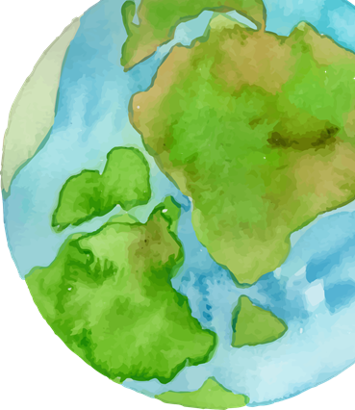
ENGLISH
CONNECT
Dear English Teachers,
Welcome to the second issue of English Connect!
We are delighted to bring you this edition, which includes updates, news, and information about upcoming events.
As we approach the end of March, the school year is quickly drawing to a close. I want to thank each of you for your dedication and hard work through what has been a challenging year. March and April are also months filled with holidays that reflect the diversity of our community of English teachers. I would like to extend my best wishes for health and prosperity to you and your families as we celebrate Purim, Ramadan, Eid al-Fitr, Pesach, Easter, and the Nabi Shu’ayb Holiday.
On May 14th, we will mark the first-ever English Day, themed Triple Well-Being, focusing on self-care, people care, and Earth care. I am eager to see the inspiring community projects you will lead with your students and hope the day, which will feature broadcasts and activities, will be both meaningful and memorable. The most exciting aspect of this initiative is that our entire community of English educators and learners will engage in purposeful, impactful learning. Together, we are committed to providing our students with high-quality instruction that builds their confidence on their journey to mastering English.
Enjoy this issue, and enjoy the upcoming well-deserved breaks! Sincerely yours,
Dr. Elias Farah
Chief Inspector of English (JH & HS)

Slide 2
UPDATES FROM RAMA
Internal Writing Assessment Task for 9th grade
As outlined in the Table of Specifications for the External Tnufa Exam, the internal writing assessment is now available for classroom administration. It is accompanied by an answer key. We encourage all schools to make use of this writing task, which serves as a formative assessment tool to objectively measure students’ written production. The decision regarding how to use the grade is entirely up to you.
You can access the writing task HERE.
The External Tnufa Exam, which many 9th-grade students took, is now available on the Rama website, along with the answer key.
ACE7 - Assessment of Competence in English for 7th grade
The ACE7 helps you identify areas of strengths and weaknesses in individual EFL performance and guides you in planning differentiated instruction and intervention plans based on pupils' individual needs.
An online webinar about the ACE test will take place on: Monday, April 28 between 14:30-16:00
On the agenda:
Learn about the advantages of the test for the benefit of formative evaluation and the planning of adapted instruction
Receive technical guidance on the Intelligence System Tvuna
Link to register for the meeting: https://forms.gle/GHbEoJEpjNpJNBdDA Link to Tvuna: https://rama.edu.gov.il/go/tvuna

Slide 3
Updates on the portal:
WE'RE EXCITED TO ANNOUNCE THAT THE JUNIOR HIGH AND HIGH SCHOOL PAGES ON THE PORTAL HAVE A NEW LOOK! THEY'VE BEEN REDESIGNED TO BE MORE FRIENDLY AND ACCESSIBLE FOR EVERYONE. PLEASE LOOK HERE.
External Tnufa
https://pop.education.gov.il/tchumey_daat/english/chativat-beynayim/english- pedagogy /presentations-conferences/
PISA 2025
PISA 2025 Foreign Language Assessment, Dr. Elias Farah (posted February, 2025)
AI Month
Throughout February, the Ministry of Education celebrated AI Month with a range of engaging webinars and activities. You can find the related materials here:
Our Padlet has all the resources from AI month. https://meyda.education.gov.il/files/Pop/0files/english/Chativa-Elyona/PadletAIMonth.xlsx
In the above link you will find:
The recording of the AI webinar si=5zOYzdM8MLOobAmF
https://youtu.be/T7Xn8sAuACo?
Our WhatsApp group for AI for announcements and discussions.
Our Practices which were designed especially for the AI month. (A pedagogical practice is a pattern of action designed to meet a need in an educational context). A list of all the approved tools in the Ministry of Education.
Summary of the guidelines for the use of AI in the education system.
Guides on how to use the free Magic School Enterprise teacher accounts provided by the Ministry of Education.
Do you belong to our Whatsapp Community?
If not - click here to join.

Slide 4
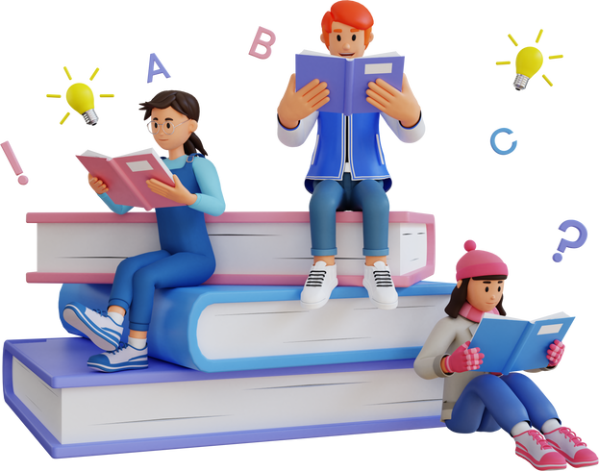
BAGRUT UPDATES
The Bagrut Handbooks have been updated.
COBE
Answer Key - COBE Simulations Summer 2025 (4-5 points). (posted February, 2025)
BOOST
Answer Key - BOOST Simulation Summer 2025. (posted February, 2025)
Answer Key - BOOST Simulation Charedi Summer 2025. (posted February, 2025)
Reminder - Teachers who intend to test Special Ed students in the COBE summer moed MUST be approved testers (בוחן) on the experts site.
Please note that there are 3 different statuses on the experts site:
בוחן הערכה חלופית- for reporting internal literature grades (can be approved by the school principal)
בוחן הקלות בעל פה - for oral exams of written modules A,C,E & G (can be approved by the school principal)
בוחן - for testing and reporting oral exams with a human tester for sheelonim 16385, 16485, 16585 (must be approved by the Testing Department and the English Inspectorate)
Schools must make sure these teachers are approved םינחוב BEFORE they test.
In order to be approved, testers must upload their English teaching license / certificate, academic degree, courses they took in the last 2-3 years and a letter from the principal.
For any technical help - teachers may approach the Marvad technicians : מוקד המרב"ד
073-3938900

Slide 5
The WhatsUp Project
A unit on respect
GEO English
A new GeoEnglish online course has recently been launched, integrating geographical topics with language learning through Content and Language Integrated Learning (CLIL). This approach offers teachers an innovative way to combine subject knowledge with language development.
The CLIL framework is evident in the course's mini-lesson designs. For example, a lesson on Developed vs. Developing Countries introduces key content by explaining the differences between these classifications. Language objectives focus on using comparative adjectives to discuss development status.
Vocabulary instruction is approached in two ways: introducing new concepts (e.g., Gross Domestic Product) and reinforcing related terms (e.g., economic, inequality).
Teachers also participate in map skills workshops to enhance their ability to interpret political, physical, and climate maps. Additionally, the course fosters exploration of global issues. For instance, teachers examine the water crisis in the Middle East, studying the historical significance of rivers such as the Euphrates, Tigris, and Nile. This includes discussions on geopolitical tensions over water rights and environmental challenges like drought and climate change. The course also encourages critical thinking about potential solutions, such as cooperative water management and sustainable practices.
For further details, please contact: tammarshmerler@gmail.com

Slide 6
Celebrating Diversity: March and April in Israel
In our previous issue, we explored the rich tapestry of celebrations that take place in January. Now, as we move into March and April, we continue our journey through the diverse traditions observed in Israel, each carrying deep cultural and spiritual significance.
Purim, a joyous Jewish holiday, is filled with costumes, storytelling, and giving to others, commemorating the survival of the Jewish people in ancient Persia. Soon after, Passover (Pesach) arrives, marking the Exodus from Egypt and celebrating freedom with special meals and traditions.
International Women's Day and Mother's Day honor the strength and dedication of women by recognizing their achievements and celebrating their role in the family and society. These occasions remind us of the importance of equality and appreciation.
As Ramadan begins, Muslims embark on a month of fasting, self-discipline, and spiritual growth. The days of devotion culminate in Eid al-Fitr, a joyous festival marking the end of the fast, filled with generosity, feasting, and communal prayers.
For Christians, Easter is a time of profound significance, celebrating resurrection and renewal. Whether through church services, festive meals, or egg-decorating traditions, the holiday carries messages of hope and faith.
The Druze community gathers to honor Nabi Shu'ayb, a revered prophet, at his tomb in the Galilee. This pilgrimage is a time of prayer, communal bonding, and reaffirming values of unity and heritage.
As English teachers, we have the unique opportunity to bring these diverse traditions into our classrooms, sparking curiosity and deepening cultural understanding. By engaging students in discussions, texts, and activities around these celebrations, we not only build their language skills but also foster respect and appreciation for the traditions that shape our shared society.
CLICK HERE for suggested activities for each celebration. CLICK HERE for Purim activities.
CLICK HERE for Passover activities.

Slide 7
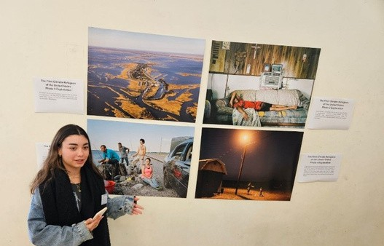
Diplomacy Major - Photojournalism Summit Day
In the months of January and February, the Diplomacy Major held interschool summit days in which 10th grade Diplomacy students from around the country collaborated and learned about global issues through the lens of World Press Photo Competition photo essays. Some schools also hosted professional photojournalists or other relevant speakers. Students worked in groups, presenting professional photo essays they had studied, enriching their knowledge of international events, and creating their own photo essays.
Student from Meshutaf Hof Hacarmel presenting a winning photo essay, “The First Climate Refugees of the United States,” at a Summit Day hosted by Tichon Hamoshava.
Spring Update for EFL Teachers
ESRA - English Tutoring Program: Chat Away
Give your 8th–12th grade students the opportunity to improve their English-speaking skills from the comfort of their home!
Ha-Kaveret – Professional Development for Teachers
Customize your learning experience with Ha-Kaveret Mix & Match! Build your own 30-hour program by selecting from a variety of new English courses, covering both high school and elementary levels. Plus, explore general courses to enhance your classroom skills. Find out more: Ha-Kaveret
Dig into Digital – Moodle Courses for Bagrut Prep
For 11th & 12th Grade :
Do you have students who will be taking different Bagrut modules this summer than the ones they initially prepared for? Our Moodle courses are designed to help them adjust and succeed! Refer your students for focused independent preparation and set them on the path to success.
And for the rest? We've got them covered too!
For Grades 7–9: Independent learning courses like Let’s Talk, English for Hi-Tech, and Climate Change help students strengthen their English skills.
For High School: Additional digital resources for all Bagrut modules ensure students are well-prepared for their exams.

