Slide 1
The structure and format of data

Slide 2
Learning intentions
We will be learning about the structure of data, specifically to,
understand the difference between structured and unstructured data
understand how computers have different display formats for data
understand there are different file formats for storing and sharing information

Slide 3

Background
Data can take a variety of forms, from numbers stored in databases to voice recordings and images.
Data can be categorised as quantitative or qualitative.
In this lesson we are going to look at how computers structure and display data and then the file formats for storing and sharing it.

Slide 4

Why this is important?
Computers can make use of data when it is held in a structured way.
However, 80%-90% of data that is held is unstructured.
Understanding whether your data is held in a structured way will help you decide if you need to manipulate it before you start your analysis.

Slide 5
Definition
Structured data
Ordered in rows and columns (tabular) with clearly defined data categories

Slide 6

Show me…
Here are an example of Structured data
The data is organised into columns and rows
date | location | max_temp | min_temp | wind_speed
01/01/2021 | Thornhill | 10 | -2 | 9.73
02/01/2021 | Kingsbarns | 13 | 0 | 6.86
03/01/2021 | Dalkeith | 8 | 3 | 7.80
04/01/2021 | Killin | 6 | -5 | 8.70
It is easy to find the information you are looking for

Slide 7
Definition
Semi-structured data
Uses markers to organise and describe the structure giving it flexibility. Data can vary in order and length.

Slide 8
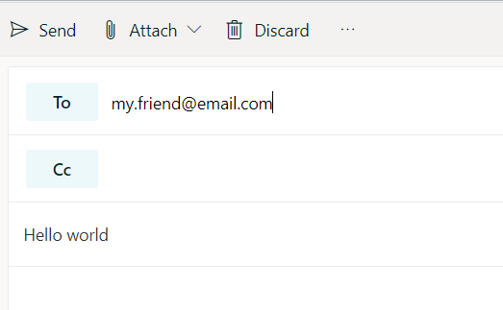
Show me…
Here are an example of semi-structured data
An email is semi-structured
There are markers to give the data structure
Would need pre-processing before a computer could analyse it
The length of the email can vary

Slide 9
Show me…
Here are an example of semi-structured data. This is an extract from a JSON dataset.
"id": "nd76881",
"impact": {
"gap": 122.0,
"magnitude": 1.43,
"significance": 31
},
"time": {
"day": 27,
"epoch": 1469593183550,
"full": "2020-07-27 00:19:43",
"hour": 0,
"minute": 19,
"month": 7,
"second": 43,
"year": 2020
}
},
There are markers
(e.g. column headings, markers separating data)
The length of the data elements can vary, and the order is not important
https://think.cs.vt.edu/corgis/csv/earthquakes/

Slide 10
Definition
Unstructured data
No pre-defined structure, typically contains lots of text

Slide 11
Show me…
Here are some examples of unstructured data
Social media post
Voice transcript
Document

Slide 12
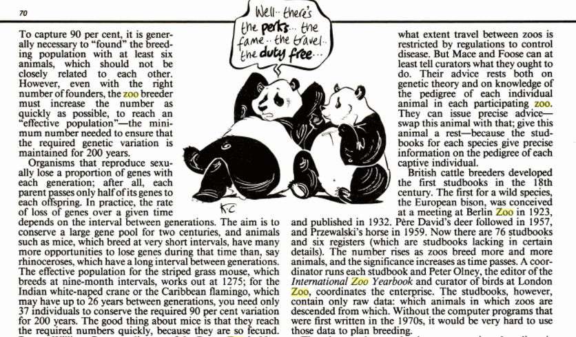
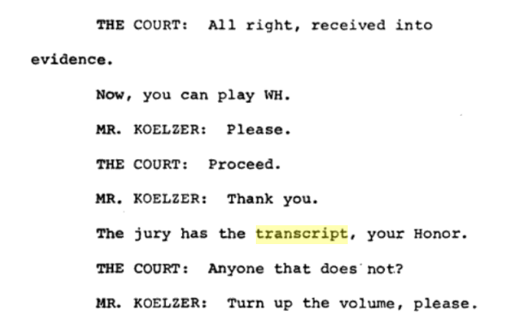
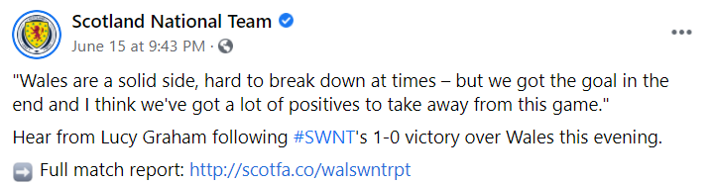
Show me…
Here are some examples of Unstructured data

Slide 13
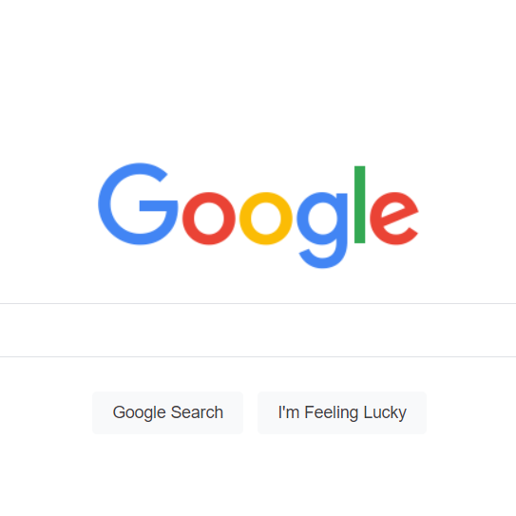
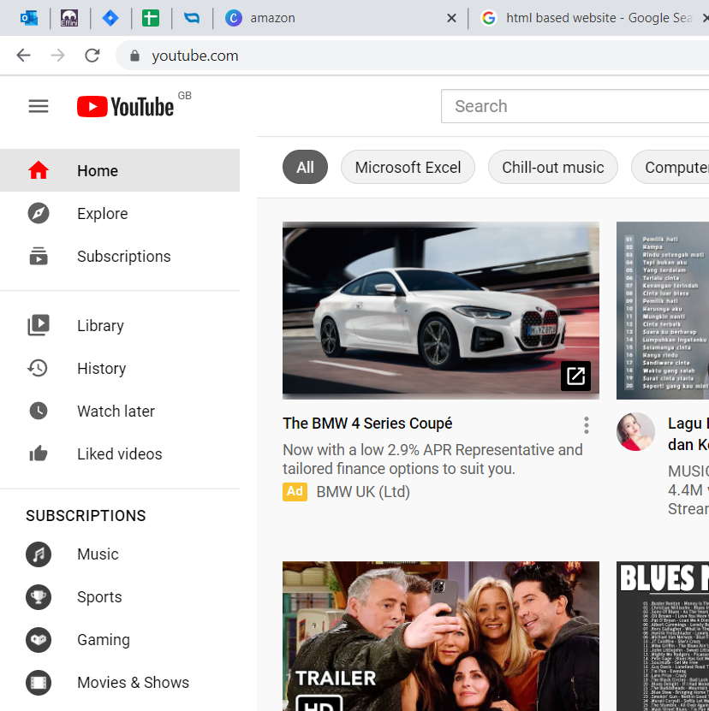
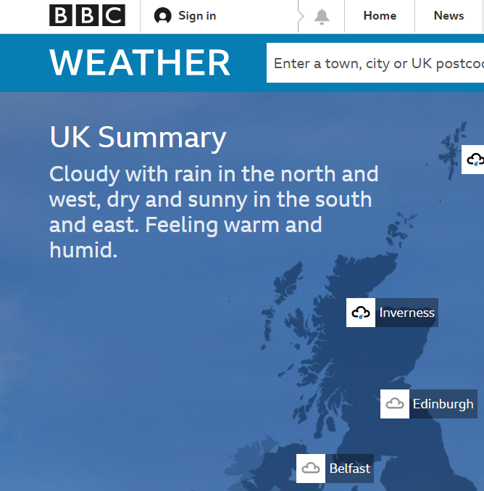
Example
Is a html based webpage structured, semi-structured or unstructured?
It is semi-structured.
It uses markers (e.g., <h1>, <p>) to structure the data.
But the data elements can vary in length and order.
<html>
<body>
<h1>Hello world</h1>
<p>This is my first webpage</p>
</body>
</html>

Slide 14
Your turn…
For each of these examples, decide if they are structured, semi-structured or unstructured.
Structured data Ordered in rows and columns (tabular) with clearly defined data types
Semi-structured data Uses markers to organise and describe the structure giving it flexibility. Data can vary in order and length.
Unstructured data No pre-defined structure, typically contains lots of text
Text in a book
Table of data
Webpage

Slide 15
Your turn…
For each of these examples, decide if they are structured, semi-structured or unstructured.
Text in a book
is unstructured
Table of data is structured
Webpage is semi-structured

Slide 16
Next steps
Complete questions 1 to 6 in section 1
of ‘The structure and format
of data’ workbook.

Slide 17
Display formats

Slide 18

Why this is important?
In order to make it easier to understand for the end user, the way data is displayed can be different to the way that it is stored.
For example,
Date/time
Accounting (£)
Percentage
Number of decimal places

Slide 19
Show me…
The same stored number can be displayed in different ways
0.1428
3 hours 25 mins
14.28%
1/7

Slide 20
Display formats
The display format only changes how the data appears to the end user. The data stored in the computer stays the same.
1 decimal place display format
345.1
Stored data
345.12671485
Stored data
345.12671485

Slide 21

Example
Show the date 1/1/2030 in these different display formats.
Display format | Date
DD/MM/YYYY | 01/01/2030
DD MMM YYYY | 01 Jan 2030
DD-MM-YY | 01-01-30
DD MMMMM YYYY | 01 January 2030

Slide 22

Display formats
To the end user, computers appear to handle lots of different data types.
However, at a fundamental level, computers work in numbers.
Computers need a way of converting the numbers they store to the wide range of letters and symbols the end users need.

Slide 23
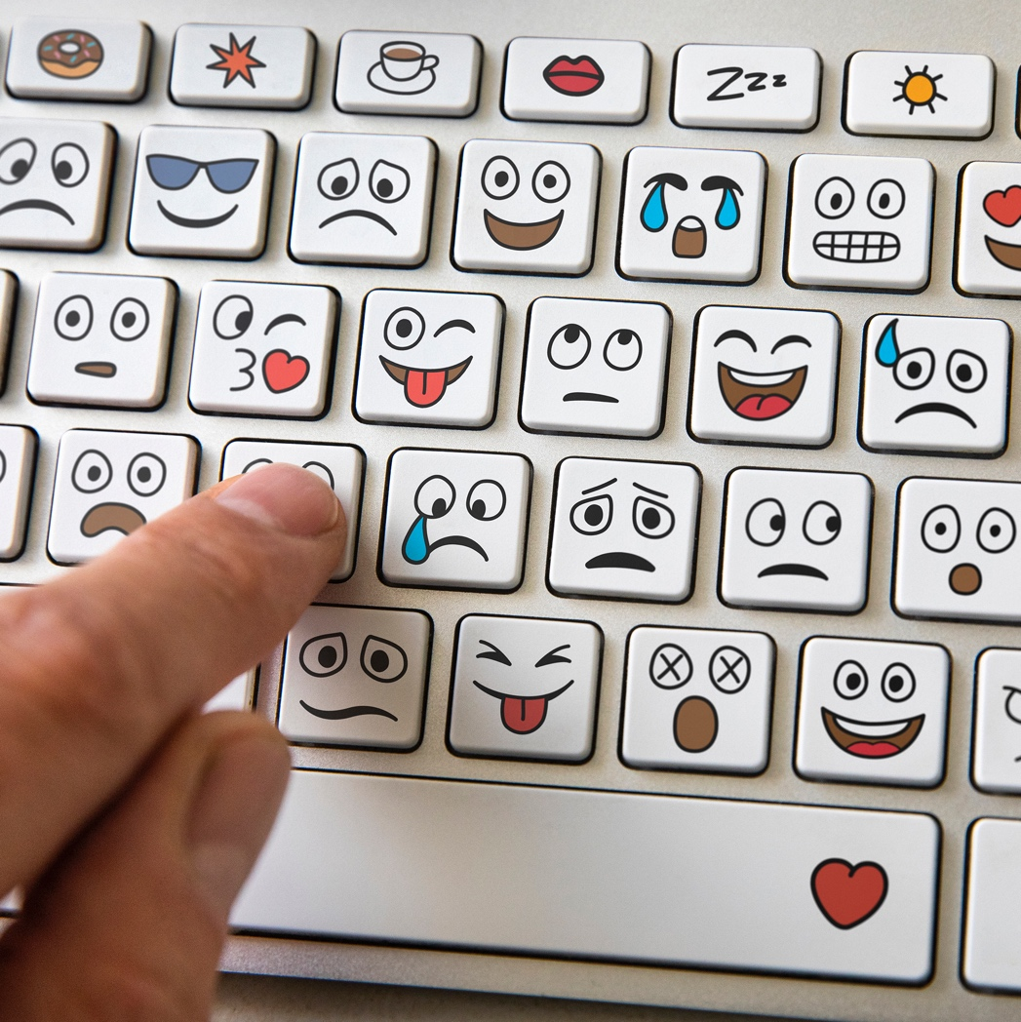


Unicode
Unicode is a standardised system that computers use. It allows letters, symbols, punctuation etc.. to be given a unique number.
It supports the writing systems used by all the world’s languages such as English, Mandarin. It also covers languages like ancient Egyptian hieroglyphics.
For more info: https://home.unicode.org/basic-info/overview/

Slide 24
Show me…
Character strings can be converted to display items or characters
Character string (Unicode) | Displayed item
U+1F600 | 😀
U+1F929 | 🤩
U+2615 | ☕
U+03B1 | α
U+00A9 | ©
U+1300 | ጀ

Slide 25
Your turn…
For the number 0.548, how would it look as,
Percentage
Integer
Accounting (£)
Floating point to 1 decimal place

Slide 26
Your turn…
For the number 0.548, how would it look as,
Percentage | 54.8%
Integer | 1
Accounting (£) | £0.55
Floating point to 1 decimal place | 0.5

Slide 27
Next steps
Complete questions 1 to 4
in section 2 of the
‘The structure and format
of data’ workbook.

Slide 28
File formats

Slide 29

Why this is important?
The file format chosen when saving data determines how you can store, share and use it.
The chosen format should ensure long-term access and preservation of the data.

Slide 30
File formats
These are the most common file formats for these data types.
The most common format for sharing tabular data is a .csv (comma separated value) file.
General-purpose
json
csv
Geospatial shapefiles
shp
dbf
Image
png
jpg
tab
Audio
mp3
wav
Video
mp4
mov

Slide 31

Example
You are running a music festival. What types of files formats could these data items be stored in?
Contact details for people attending | .csv (Database)
Recordings of the songs | .mp3 (Audio)
Promotional photos | .png (Image)

Slide 32
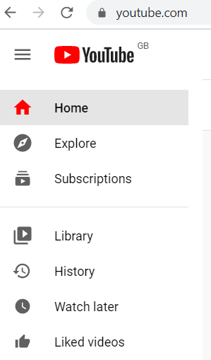
Your turn…
YouTube is a video streaming service. Here are some examples of the types of data they hold. What file formats could these data items be stored in?
Logo for their company
Email addresses for customers
Videos available on its site

Slide 33
Your turn…
YouTube is a video streaming service. Here are some examples of the types of data they hold. What file formats could these data items be stored in?
Logo for their company | .png or .jpg (Image)
Email addresses for customers | .xml or .csv or .tab (Database)
Videos available on its site | .mp4 or .mov (Video)

Slide 34
Next steps
Complete questions 1 to 3
in section 3 of the
‘The structure and format
of data’ workbook.

Slide 35
Learning checklist
I can describe the difference between structured and unstructured data
I can describe common display formats
I can recognise different file formats

Slide 36





How you can use this lesson
You are free to:
Share – copy and redistribute the material in any medium or format
Adapt – remix, transform and build upon the material
Under the following terms:
Attribution — You must give appropriate credit, provide a link to the license, and indicate if changes were made. You may do so in any reasonable manner, but not in any way that suggests the licensor endorses you or your use.
NonCommercial — You may not use the material for commercial purposes.
ShareAlike — If you remix, transform, or build upon the material, you must distribute your contributions under the same license as the original.
© 2021. This work is licensed under a CC BY-NC-SA 4.0 license.
Created by Effini in partnership with Data Education in Schools, The Data Lab and Data Skills for Work, with funding from the Scottish Government.

