Slide 1
The analysis process

Slide 2
Learning intentions
We will be learning what is involved in the analysis process, specifically, what we mean by analysis a structured way of performing analysis (the analysis steps) how to understand data through visual inspection

Slide 3
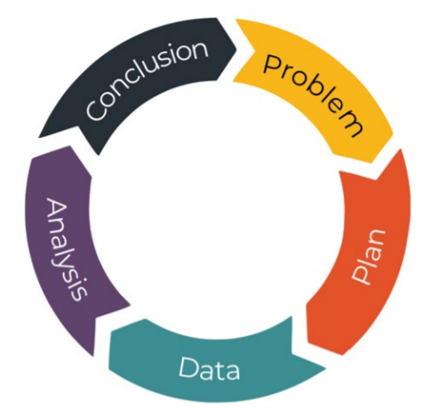
Background
Data science is about trying to solve a problem.
Making sure that you are analysing the data in the most efficient and accurate way possible to solve the problem is very important.
In this lesson, we will look at what is involved in analysing data and steps you can follow to complete your analysis.

Slide 4
Definition
Data analysis
The process of examining data to identify patterns and draw conclusions that will inform decision-making

Slide 5

What do we mean by analysis?
Data analysis essentially involves the transformation of raw data into useful information or insight in a structured and organised way.
This could involve any of the following processes:
Reformatting
Aggregating
Cleansing
Summarising
Modelling
Visualising
Interpreting

Slide 6
The analysis steps
It can be helpful to breakdown the analysis process into these 5 steps,
Data understanding
Data tidying and cleansing
Data manipulation
Identifying patterns
Extracting insights

Slide 7



Why use the analysis steps?
Some benefits of following the analysis steps are:
Minimise mistakes
Easier to reproduce/share work with others if you use a structured approach
Maximise the confidence of the conclusions or insights extracted from the data

Slide 8

The analysis steps
Data understanding
Data tidying and cleansing
Data manipulation
Identifying patterns
Extracting insights
You are looking to
get a feel for the data
understand its size and shape
identify any obvious issues with the data that may need to be addressed.

Slide 9



Why data understanding is important?
Makes sure the calculations you are planning to use are suitable for different data types
Checks that the data has the number of rows and columns you are expecting
Helps you identify any missing values
Data understanding
Data tidying and cleansing
Data manipulation
Identifying patterns
Extracting insights

Slide 10
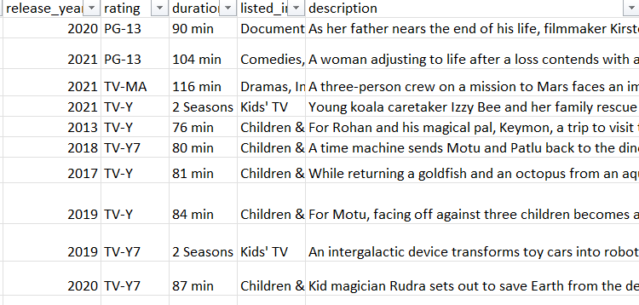
Show me….data understanding
In this dataset we can see there are mixture of quantitative and qualitative data items that would need to be handled differently.
https://www.kaggle.com/shivamb/netflix-shows
This is a section of a dataset showing the programs available on Netflix

Slide 11
Show me….data understanding
Some of columns would need to be manipulated before any analysis could be performed.
rating: categorical variables with fixed sets of valid values
duration: mixture of different time periods and would need to be manipulated to perform any analysis on it
description: free text and difficult to analyse
https://www.kaggle.com/shivamb/netflix-shows
This is a section of a dataset showing the programs available on Netflix

Slide 12

The analysis steps
Data understanding
Data tidying and cleansing
Data manipulation
Identifying patterns
Extracting insights
Tidy and clean the data so it's fit for purpose, such as,
Reformatting data
Reviewing missing values and outliers
Removing duplicates

Slide 13



Why data tidying and cleansing is important?
Keeping any duplicate rows could result in incorrect answers to calculations
Reformatting data can make it easier to view the data
If you have any missing values, you can decide how you are going to handle them before performing any calculations e.g. remove the rows
Data understanding
Data tidying and cleansing
Data manipulation
Identifying patterns
Extracting insights

Slide 14
Show me….data tidying and cleansing
The date_of_birth is difficult to understand in this dataset…..
… but now it has been reformatted it is easier to use.
name | date_of_birth
Taylor Swift | 32,855
Prince | 21,343
Britney Spears | 29,922
Madonna | 21,413
Lewis Capaldi | 35,345
Elvis Presley | 12,792
Dataset tidied and cleansed through reformatting
name | date_of_birth
Taylor Swift | 13 December 1989
Prince | 07 June 1958
Britney Spears | 02 December 1981
Madonna | 16 August 1958
Lewis Capaldi | 07 October 1996
Elvis Presley | 08 January 1935
Reminder: dates are stored as the number of days or seconds passed the ‘epoch’ date. Reformatting changes the display format.

Slide 15

The analysis steps
Data understanding
Data tidying and cleansing
Data manipulation
Identifying patterns
Extracting insights
The data manipulation can be done through processes such as,
Extracting, selecting and reordering data
Summarising and grouping data
Merging or joining data

Slide 16



Why data manipulation is important?
Join and merging multiple datasets allows you bring together data from different tables into a single dataset
Focusing on only the information you need can minimise mistakes and make any patterns easier to spot
Creating new variables through extracting or calculations allows you to understand more about the data
Data understanding
Data tidying and cleansing
Data manipulation
Identifying patterns
Extracting insights

Slide 17

Your turn…
Can you think of any processes you could use to manipulate the rows or columns in a dataset?
For example, you could ,
select (or choose to keep) only the columns you need
create a new variable by extracting data items
Data understanding
Data tidying and cleansing
Data manipulation
Identifying patterns
Extracting insights

Slide 18
Your turn…
Here are some processes you could use to manipulate the rows or columns in a dataset.
Select columns
Create new variable by calculation
Subset data items
Reorder columns
Reformat columns
Remove duplicates
Sort or filter rows
Creating new variables by extracting
Creating new variable by combining data items
Group and summarise

Slide 19

The analysis steps
Data understanding
Data tidying and cleansing
Data manipulation
Identifying patterns
Extracting insights
In this stage you look for relationships and patterns in the data.
This can be done through plotting graphs or using calculations designed to measure relationships.

Slide 20



Why identifying patterns is important?
You can test ideas for relationships or patterns in the datasets
Identify trends in a dataset
Spot unusual data items that might need more investigation
Data understanding
Data tidying and cleansing
Data manipulation
Identifying patterns
Extracting insights

Slide 21
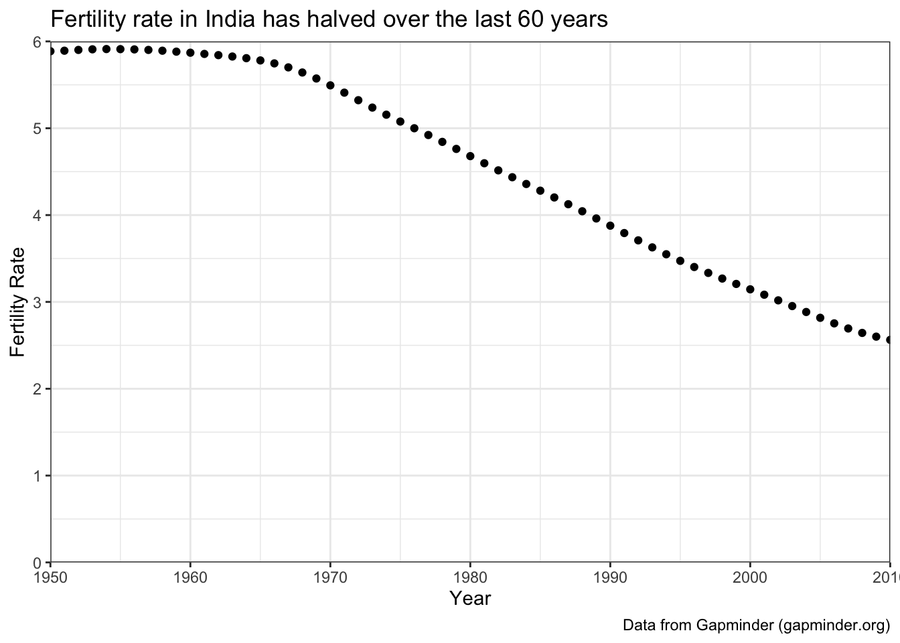
Show me….identifying patterns
This graph shows the fertility rate in India over the last 60 years.
This would have been created during the identifying patterns of the analysis steps.

Slide 22

The analysis steps
Data understanding
Data tidying and cleansing
Data manipulation
Identifying patterns
Extracting insights
At this stage you need to highlight any patterns/relationships that will allow someone to take action to solve the problem you are investigating.
All patterns/relationships should be double checked to see if insights are true in other datasets or time frames. Also that no mistakes have been made during any of the analysis stages.

Slide 23



Why extracting insights is important?
Turns data into actions that can solve problems
Allows you check your conclusions in different datasets/time frames so you are confident in the results
Sense check your results against how you expect them to look
Data understanding
Data tidying and cleansing
Data manipulation
Identifying patterns
Extracting insights

Slide 24

Your turn…
Imagine you are given a dataset that looks at the average temperature of the world by year to analyse.
You are told it is ready for the identifying patterns analysis step.
However it contains duplicate rows as the data cleansing and tidying step was missed.
What impact do you think this could have on the results of the analysis?
Data understanding
Data tidying and cleansing
Data manipulation
Identifying patterns
Extracting insights

Slide 25
Your turn…
Some of the issues could be,
Calculations give the wrong answers
Incorrect patterns/relationships identified
Propose the wrong action to solve the problem.

Slide 26
Next steps
Complete sections 1 and 2 of the
‘The analysis process’ workbook.

Slide 27

Data understanding
All analysis activities should start with an understanding of the data being analysed.
This involves
Visual inspection of the dataset
Reviewing any associated data dictionaries for the dataset
Understanding the size and shape
Identifying any obvious issues
Calculating summary statistics (e.g. count, max, mean)
Data understanding
Data tidying and cleansing
Data manipulation
Identifying patterns
Extracting insights

Slide 28
Data understanding through visual inspection
In this lesson we are now going to look at visual inspection part of data understanding.
Visual inspection can be done without writing any code or creating new datasets.
Data understanding
Data tidying and cleansing
Data manipulation
Identifying patterns
Extracting insights

Slide 29
Definition
Visual inspection
To get a basic understanding of a dataset by looking at it

Slide 30
Show me…
Through a visual inspection of this dataset we can see,
Mix of string and numeric data items
There are missing values (NA) in the hair_colour column
Hair and skin colours can take multiple values.
Sample of information about Star Wars© characters from SWAPI (www.swapi.tech)

Slide 31
Show me…
Through a visual inspection of this dataset we can see,
name | year_birth | also_known_as
Macbeth | 1040 | The Red King
William I | 1165 | The Rough
Malcolm III | 1058 | Great Chief
David I | 1124 | The Saint
William I | 1165 | The Rough
Malcolm III | 1058 | Great Chief
David I | 1124 | The Saint
Mix of string and numeric data items
There are duplicate rows that would need to be handled in the data tidying and cleansing step.

Slide 32
Your turn…
By looking at this dataset, what can you see about the,
Data types?
Any missing values?
Any duplicate rows?
location | temperature | dawn | dusk
Edinburgh | 15 | 03:30 | 22:50
Paris | 21 | 05:09 | 22:28
Sydney | 17 | 06:25 | 17:21
New York | NA | 04:54 | 20:55
Edinburgh | 15 | 03:30 | 22:50

Slide 33
Your turn…
Data types
Mix of string, numeric and dates
Any missing values
There is a missing temperature for New York
Any duplicate rows
The row containing Edinburgh is in the dataset twice
location | temperature | dawn | dusk
Edinburgh | 15 | 03:30 | 22:50
Paris | 21 | 05:09 | 22:28
Sydney | 17 | 06:25 | 17:21
New York | NA | 04:54 | 20:55
Edinburgh | 15 | 03:30 | 22:50

Slide 34
Next steps
Complete section 3 and 4 of the
‘The analysis process’ workbook.

Slide 35
Learning checklist
I can describe what is meant by analysis
I can describe/explain a structured way of performing analysis (the analysis steps)
I can describe what it means to visually inspect data as part of the data understanding step
I can perform a visual inspection of a simple dataset

Slide 36





How you can use this lesson
You are free to:
Share – copy and redistribute the material in any medium or format
Adapt – remix, transform and build upon the material
Under the following terms:
Attribution — You must give appropriate credit, provide a link to the license, and indicate if changes were made. You may do so in any reasonable manner, but not in any way that suggests the licensor endorses you or your use.
NonCommercial — You may not use the material for commercial purposes.
ShareAlike — If you remix, transform, or build upon the material, you must distribute your contributions under the same license as the original.
© 2021. This work is licensed under a CC BY-NC-SA 4.0 license.
Created by Effini in partnership with Data Education in Schools, The Data Lab and Data Skills for Work, with funding from the Scottish Government.

