Slide 1
Creating variables by extracting and combing in Excel

Slide 2
Learning intentions
We will be learning how to create new variables, specifically to,
understand what it means to extract data to create a new variable
how to create simple new variables by extracting data in Excel
understand what it means to combine data to create a new variable
how to create simple new variables by combining data in Excel.

Slide 3
Creating new variables from strings
first_name | last_name | full_name
Hermione | Grainger | H. Grainger
Jay | Gatsby | J. Gatsby
Elizabeth | Bennet | E. Bennet
Scout | Finch | S. Finch
When you have variables that contain strings you can combine multiple data items or extract data items from it.

Slide 4
Creating new variables from dates
When you have variables that contain dates you can extract data items from them, to create new variables.
event | date | year
Rosa Parks arrested for not moving to the back of the bus | 01-12-1955 | 1955
First successful human heart transplant performed | 02-01-1968 | 1968
First Mickey Mouse comic strip appears | 13-01-1930 | 1930
WWII begins as Germany invades Poland | 01-09-1939 | 1939

Slide 5
Definition
Extract
To split or select part of an existing data item in a dataset to make a new variable.

Slide 6
Extracting data
When data is collected it can sometimes contain multiple pieces of information in a single column.
It can be easier to analyse if it is split into multiple variables.
Date and Time
01/05/2021 09:45:03
Date
01
Month
05
Year
2021
Hour
09
Minute
45
Second
03

Slide 7
Show me…
Extract the athletes first names from these names.
name | date_of_birth
Usain Bolt | 21-07-1986
Muhammad Ali | 17-01-1942
Chris Hoy | 23-03-1976
Liz McColgan | 24-05-1964
first_name
Usain
Muhammad
Chris
Liz
Extract

Slide 8
Show me…
Extract the year of birth from these dates of birth.
name | date_of_birth
Usain Bolt | 21 Aug 1986
Muhammad Ali | 17 Jan 1942
Chris Hoy | 23 March 1976
Liz McColgan | 24 May 1964
year_of_birth
1986
1942
1976
1964
Extract

Slide 9
Definition
Substring
A sequence of characters that exist inside a string

Slide 10
Show me…
Reminder
A string is a collection of characters combined to create alphanumeric text​
String
Substring
Friday
The substring is any sequence of characters that are inside the original text.
We can use the substring text to create new variables.
Fri
Friday!
F
day!
iday

Slide 11
Your turn…
Can you think of some examples of substrings in this string?
"Hello world"

Slide 12
Your turn…
Substring
A sequence of characters that exist inside a string
Here are some examples of substrings in this string.
"Hello world"
"Hello"
"Hell"
"world"
"llo world"
"Hello wor"

Slide 13

Example of extracting from a string
The Community Health Index Number (CHI) helps NHS Scotland uniquely identify patients. The first 6 digits are the patients date of birth (DDMMYY).
Extract the patients date of birth from the chi_number variable.
CHI
1205651234
0608214587
0112054785
3001855478
date_of_birth
120565
060821
011205
300185
Extract 1st 6 characters

Slide 14
Your turn…
You need to find out the towns these people live in. What part of the address do you think you need to extract?
name | Address
Sherlock Holmes | 221B Baker Street, London
Wallace and Gromit | 62 West Wallaby Street, Wigan
The Banks Family | 17 Cherry Tree Lane, London
The Dursley Family | 4 Privet Drive, Little Whinging

Slide 15
Your turn…
You need to find out the towns these people live in. What part of the address do you think you need to extract?
name | Address
Sherlock Holmes | 221B Baker Street, London
Wallace and Gromit | 62 West Wallaby Street, Wigan
The Banks Family | 17 Cherry Tree Lane, London
The Dursley Family | 4 Privet Drive, Little Whinging
Town
London
Wigan
London
Little Whinging
Extract after the comma

Slide 16

Extract in Excel
When you are extracting data to create a new variable in Excel you can split the data based on,
Number of characters
Searching for symbols or characters e.g. comma, space

Slide 17
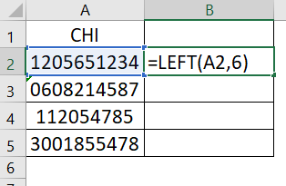
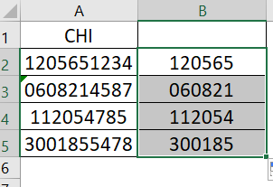
Extract in Excel
You can use the formula below to keep only the number of characters you state, counting from the left of the text.
=LEFT(text,[num_chars])
Extract using a formula to keep the 1st 6 characters

Slide 18
Extract in Excel
Here are some examples of calculations you can use in Excel to extract data.
Formula | Description | Example | Result
LEFT | Extracts a given number of characters from the left side | =LEFT(“apple”,3) | “app”
MID | Extracts a given number of characters from a defined starting point | =MID(“abcde”,2,3) | “bcd”
RIGHT | Extracts a given number of characters from the right side | =RIGHT(“red”,2) | “ed”
For more details of the formulas in Excel, see
https://support.microsoft.com/en-us/excel

Slide 19
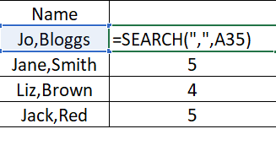
Extract in Excel
If you need to extract data based on a character such as a comma or space, you will need to combine formulas.
Part 1: Search the text for the character.
The SEARCH formula returns the position of the character you are searching for.
=SEARCH(find_text,text)
There is a comma 5 characters from the left.

Slide 20
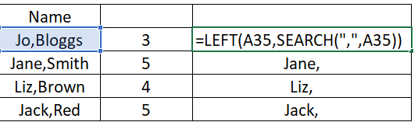
Extract in Excel
Part 2: Use the SEARCH formula to define the number of characters in the LEFT formula.
=LEFT(text,SEARCH(find_text,text))
The left function has kept the first 5 characters.

Slide 21
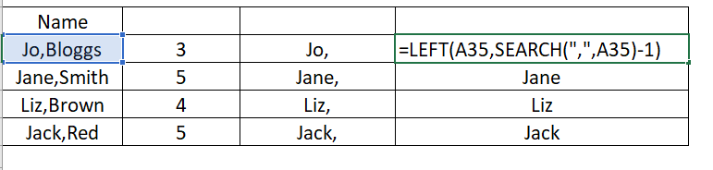
Extract in Excel
Part 3: We don’t need to keep the character we are splitting the data by (e.g. the comma). Therefore we need to take away 1 from the SEARCH function output.
=LEFT(text,SEARCH(find_text,text)-1)

Slide 22
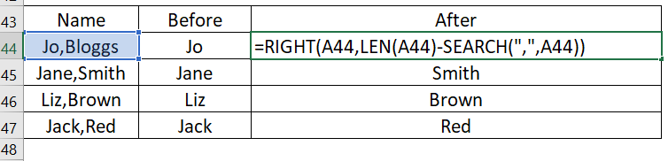
Extract in Excel
If you would like to keep the data after the character. You need to combine the LEN, RIGHT and SEARCH functions.
=RIGHT(text,LEN(text)-SEARCH(find_text,text))

Slide 23
Next steps
Complete section 1 of the
‘Creating variables by extracting
and combining in Excel’ workbook.

Slide 24
Definition
Combine
Join or merge variables to create a single variable.

Slide 25

Combining data
Sometimes we may wish to create a variable by combining two or more data items from the same dataset.
The data items being joined are usually strings.
"Usain" + "Bolt"
"Usain Bolt"

Slide 26
Show me…
Combine the first and last names to make the athletes' names.
first_name | last_name
Usain | Bolt
Muhammad | Ali
Chris | Hoy
Liz | McColgan
full_name
Usain Bolt
Muhammad Ali
Chris Hoy
Liz McColgan
Combine

Slide 27

Example
Combine the name and team of each cyclist, and format like this: Tadej Pogačar (UAE Team Emirates)
cyclist | team
Tadej Pogačar | UAE Team Emirates
Egan Bernal | Team Ineos
Bradley Wiggins | Team Sky
Chris Froome | Team Sky

Slide 28
Example
Combine the name and team of each cyclist, and format like this: Tadej Pogačar (UAE Team Emirates)
cyclist | team | cyclist_and_team
Tadej Pogačar | UAE Team Emirates | Tadej Pogačar (UAE Team Emirates)
Egan Bernal | Team Ineos | Egan Bernal (Team Ineos)
Bradley Wiggins | Team Sky | Bradley Wiggins (Team Sky)
Chris Froome | Team Sky | Chris Froome (Team Sky)

Slide 29
Combining strings in Excel
In Excel there are many different ways to combine data. The simplest way is to use & sign between the strings.
= cell1 & cell2 & cell3 & cell4……
For more options, please see
https://support.microsoft.com/en-us/office/combine-text-from-two-or-more-cells-into-one-cell-81ba0946-ce78-42ed-b3c3-21340eb164a6

Slide 30
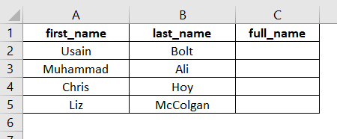
Create a new variable by combining in Excel
We want to create a new variable full_name by combining first_name and last_name.
Step 1. Create a new variable with a heading name of full_name

Slide 31
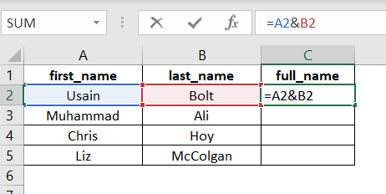
Using & sign
Step 2. In the first row, use the & sign to combine the names.
= first_name & last_name

Slide 32
Adding in other characters
Sometimes we want other characters added into the string such as spaces, full stops or numbers.
You can add any characters (or strings) by putting them in quotes (“ “).
= cell1 & “Text” & cell2 & cell3 & cell4……

Slide 33
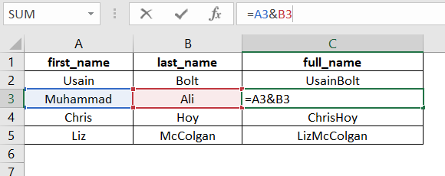
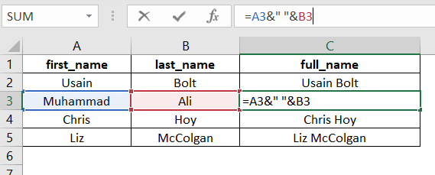
Adding in other characters
= first_name &” ”& last_name
Without added space
With added space

Slide 34
Combining date parts in Excel
If you have the parts of a date (e.g. day, month and year) you can combine them into a single date using the Excel function DATE()
= date(year,month,day)

Slide 35
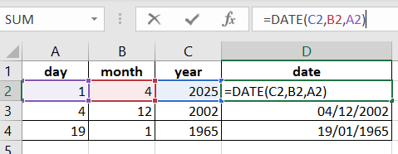
Combining date parts in Excel
Reminder: Date/Time data type
the number of days or seconds passed since the 'epoch' date
= date(year,month,day)
The DATE() function has combined the numbers into a new data item.

Slide 36
Next steps
Complete section 2 of the
‘Creating variables by extracting
and combining in Excel’ workbook.
Then the complete
section 3 - Extension

Slide 37
Learning checklist
I can describe how to create a new variable by extracting data.
I can create new variables in Excel by extracting data.
I can describe how to create a new variable by combining data.
I can create new variables in Excel by combining data.

Slide 38





How you can use this lesson
You are free to:
Share – copy and redistribute the material in any medium or format
Adapt – remix, transform and build upon the material
Under the following terms:
Attribution — You must give appropriate credit, provide a link to the license, and indicate if changes were made. You may do so in any reasonable manner, but not in any way that suggests the licensor endorses you or your use.
NonCommercial — You may not use the material for commercial purposes.
ShareAlike — If you remix, transform, or build upon the material, you must distribute your contributions under the same license as the original.
© 2021. This work is licensed under a CC BY-NC-SA 4.0 license.
Created by Effini in partnership with Data Education in Schools, The Data Lab and Data Skills for Work, with funding from the Scottish Government.

