Slide 1
Qualitative & Quantitative data

Slide 2
Learning intentions
We are learning about the types of data, specifically to understand,
what is quantitative data, and that it can be continuous, discrete
what is qualitative data, and that raw text data can be categorised to allow analysis

Slide 3

Background
Data is being created all the time, from phones, sensors all around us and the internet.
Data is everywhere.
Data facts are distinct pieces of information that are stored and formatted so that they can be automatically interpreted by a computer.

Slide 4
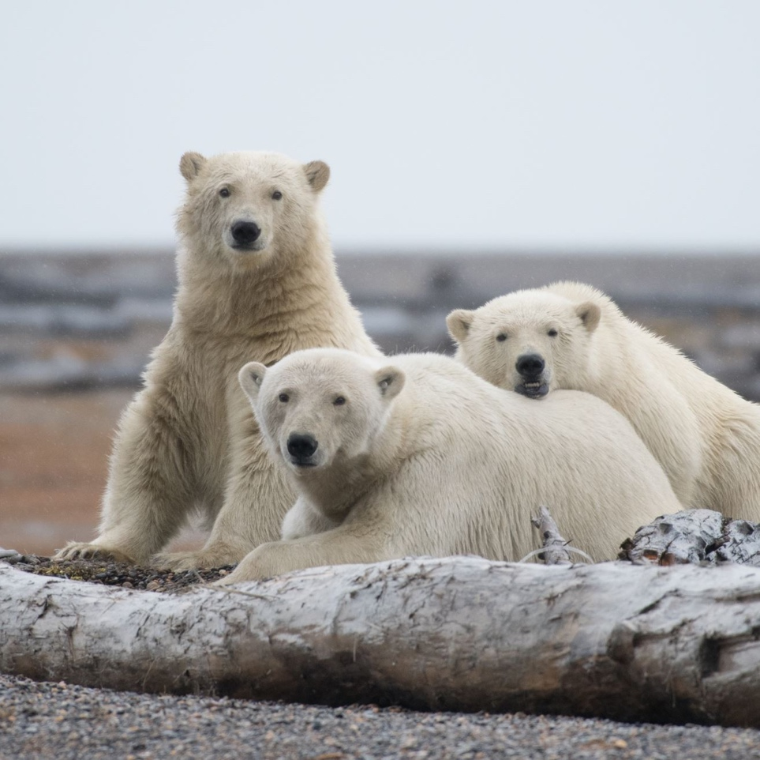


Why this is important?
Data science is about trying to solve a problem.
Whether that is understanding the scale of the climate emergency or tracking the feedback of customers, you can only solve your problem if you have the right data in the right format to analyse.
In this lesson we will look at how data is classified.

Slide 5
Why this is important?
It is important you are aware of the type of data you have, so that you can handle it correctly.
The type of data will determine the maths you can do with it such as add/divide the data.
You might need to manipulate it (e.g. grouping raw text) before you start your analysis.
The type of data will determine what type of graph you can produce.
Your data may contain dates, letters or numbers, they might need to handled differently.

Slide 6

Show me…
Here are some examples of why it’s important
Does calculating the average make sense?
“There were 3.5 people”
You can spot data that looks like
it is in the wrong place
name | age
Kim | 34
Jamie | Brown
Lee | 23

Slide 7

Example
You are looking at the data you hold for your clothes shop. How would you expect these data items to look?
Data item | What would it look like?
People in the shop | Number
Descriptions of clothes | Words
Price of the clothes | Money (£)
Size of clothes | Number or words (10,14,18 or S,M,L,XL)

Slide 8

Your turn…
You are measuring the length of the rooms in your house.
With the data in these formats, would you be able to calculate the average room length?
Kitchen = 1.25 m
Bathroom = 19 tiles
Bedroom = Two metres

Slide 9
Your turn…
Kitchen = 1.25 m
Bathroom = 19 tiles
Bedroom = Two metres
Would you be able to calculate the average room length?
No.
First, you would need to transform the measurements into the same data types (e.g. bedroom length from words to a number) to calculate the average.
Kitchen = 1.25 m
Bathroom = 1.83 m
Bedroom = 2.0 m

Slide 10
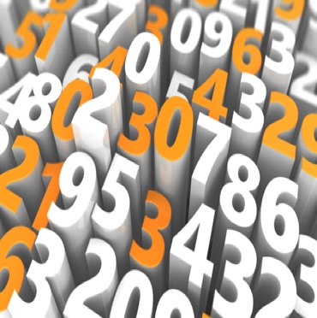
Definition
Quantitative
Measures of values or counts and expressed as numbers

Slide 11
Show me…
Here are some examples of quantitative data
Date
Length of road
Temperature
Pass rate of a test
Number of candles on a cake
Number of people
on the beach

Slide 12



Example
Quantitative
Measures of values or counts and expressed as numbers
What type of quantitative data could a restaurant hold?
number of customers
price of the food
volume of milk held in the fridge

Slide 13


Your turn…
Which of these do you think are quantitative data types?
Number of carrots
Average rain fall
Amount of honey
Types of cars
Quantitative data
Measures of values or counts and expressed as numbers

Slide 14
Your turn…
Which of these do you think are quantitative data types?
Number of carrots
Average rain fall
Amount of honey
Types of cars
Number of carrots, average rain fall, and amount of honey are all quantitative data types because you can either measure or count them.

Slide 15

Definition
Qualitative
Descriptive, normally using words rather than numbers

Slide 16
Show me…
Here are some examples of qualitative data
Survey responses
Colours
Article in a paper
Names
Song titles
Days of the week

Slide 17

Example
Qualitative
Descriptive, normally using words rather than numbers
What type of qualitative data could a restaurant hold?
Descriptions of the food on the menu
Customer comments
Which days they receive deliveries

Slide 18

Your turn…
Which of these do you think are qualitative data types?
Hair colour
House style
Number of candles on a cake
Crops grown on a farm
Qualitative data
Descriptive, normally using words rather than numbers

Slide 19
Your turn…
Which of these do you think are qualitative data types?
Hair colour
House style
Number of candles on a cake
Crops grown on a farm
Hair colour, House style and crops grown on a farm are all qualitative data types.
They are all described by words, e.g black hair, detached house, wheat in a field.

Slide 20


Understanding ‘raw text’ data
Raw text qualitative data is important as it allows researchers to understand thoughts and feelings, which could be missed by a quantitative data type.
“Everything was amazing.
Thank you so much!”
“I enjoyed my visit,
but it was very quick”

Slide 21
Understanding ‘raw text’ data
Often in data science raw text data is categorised in order to facilitate analysis and reporting.
This must be done carefully so that the thoughts and feelings are not misinterpreted.
Satisfied?
“I enjoyed my visit,
but it was very quick”
Unsatisfied?

Slide 22


Quantitative & Qualitative Data
This mnemonic may help you remember the difference between quantitative & qualitative data.
quantitative
qualitative ​
quantity
quality
numbers
words (description )

Slide 23
Next steps
Complete questions 1 to 6
in section 1 of the
‘Quantitative & Qualitative’ workbook.

Slide 24

Data categories
Quantitative data can be continuous (e.g. height) or discrete (e.g. number of people)
Continuous
Discrete

Slide 25

Definition
Discrete
Whole numbered data, obtained by counting

Slide 26
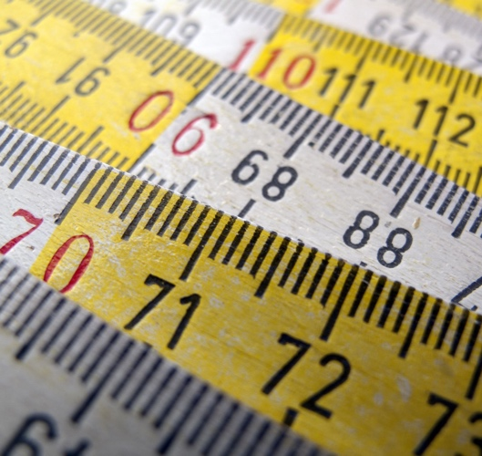
Definition
Continuous
All possible values, obtained by measuring

Slide 27
Show me…
These are discrete
These are continuous
Number of eggs for sale
Number of goals scored
Number of animals in a park
Shoe size
Average rain fall
Height of a mountain
Length of a room
Time to run a race

Slide 28

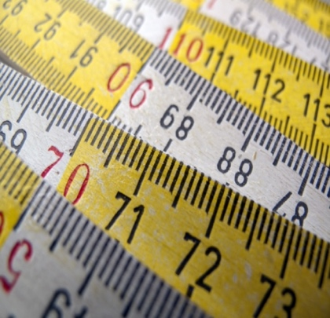
Example
Discrete Whole numbered data, obtained by counting
Continuous All possible values, obtained by measuring
You are setting up your own café and are thinking about all the data you could hold. List the data under the headings of,
Discrete
Continuous
number of customers
length of the tables
number of tables in the restaurant
volume of milk held in the fridge
number of customer reviews on their website
average amount of left-over food

Slide 29

Your turn…
Why would the number of planes in an airport be a ‘discrete’ data type?

Slide 30
Your turn…
Why would the number of planes in an airport be a ‘discrete’ data type?
It is quantitative data.
It is obtained by counting.
It is whole-numbered data; you can not meaningfully have 1.56 planes.

Slide 31
Next steps
Complete questions 1 to 7
in section 2 (discrete vs. continuous) of the
‘Quantitative & Qualitative’ workbook.

Slide 32
Learning checklist
I can describe the difference between qualitative and quantitative data.
I can identify continuous and discrete data.

Slide 33





How you can use this lesson
You are free to:
Share – copy and redistribute the material in any medium or format
Adapt – remix, transform and build upon the material
Under the following terms:
Attribution — You must give appropriate credit, provide a link to the license, and indicate if changes were made. You may do so in any reasonable manner, but not in any way that suggests the licensor endorses you or your use.
NonCommercial — You may not use the material for commercial purposes.
ShareAlike — If you remix, transform, or build upon the material, you must distribute your contributions under the same license as the original.
© 2021. This work is licensed under a CC BY-NC-SA 4.0 license.
Created by Effini in partnership with Data Education in Schools, The Data Lab and Data Skills for Work, with funding from the Scottish Government.

