Slide 1
Creating new variables by calculation in Excel

Slide 2
Learning intentions
We will be learning how to create new variables in Excel, specifically to,
understand what it means to create a new variable by performing calculations using existing data
how to create simple new variables by performing a calculation in Excel
understand the concept of conditional statements for creating new variables.

Slide 3
Definition
Variable
A column of data that only contains one data type

Slide 4
Variables
In data science columns of data are often referred to as variables.
Each variable only contains one data type such as numbers, text, date or time.

Slide 5

Background
When a data scientist receives a dataset, it is rarely in a format that will allow them to start analysis right away. It often needs to be manipulated first.
Variables (columns) can be manipulated in a dataset by reordering or selecting them.
You can also manipulate datasets by creating new variables of data in the dataset.

Slide 6



Why this is important?
Some benefits of creating new variables of data are,
Allows you to understand more about the data
Allows you to perform calculations such as adding, subtracting, dividing
You can compare different data items

Slide 7

Example
What are the variables in this dataset?
event | time | runner
Marathon (men) | 2:01:39 | Eliud Kipchoge
Marathon (women) | 2:14:04 | Brigid Kosgei
The variables are,
event, time, runner

Slide 8
Your turn…
What do you think the variables are in this dataset?
event | athlete | nationality | date | location
Long jump (men) | Mike Powell | USA | 30 Aug 1991 | Tokyo
Long jump (women) | Heike Drechsler | Germany | 13 Feb 1988 | Vienna
Triple jump (men) | Jonathan Edwards | United Kingdom | 7 Aug 1995 | Gothenburg
Triple jump (women) | Yulimar Rojas | Venezuela | 21 Feb 2020 | Madrid
Variable
A column of data that only contains one data type

Slide 9
Your turn…
What are the variables in this dataset?
The variables are
event
athlete
nationality
date
location
event | athlete | nationality | date | location
Long jump (men) | Mike Powell | USA | 30 Aug 1991 | Tokyo
Long jump (women) | Heike Drechsler | Germany | 13 Feb 1988 | Vienna
Triple jump (men) | Jonathan Edwards | United Kingdom | 7 Aug 1995 | Gothenburg
Triple jump (women) | Yulimar Rojas | Venezuela | 21 Feb 2020 | Madrid

Slide 10
Next steps
Complete questions 1 to 4
in section 1 of the
‘Creating new calculated variables in Excel’
workbook

Slide 11
Definition
Create by calculation
To perform calculations on one or more data items in a dataset to make a new variable

Slide 12

Creating new variables
Some of the most common calculations performed on columns of data to create new variables are,
Adding
Subtracting
Multiplying
Dividing
Average (mean, mode or median)
A | B | A+B | A-B | A/B
5 | 1 | 6 | 4 | 5
10 | 2 | 12 | 8 | 5

Slide 13
Creating new variables
You can also create new variables by comparing data items such as,
What is the minimum of the variables?
What is the maximum of the variables?
Deciding if a variable is greater than, less than or equal to a number
A | B | Minimum of A and B | Maximum of A and B | Is column A greater than 11?
5 | 1 | 1 | 5 | FALSE
10 | 2 | 2 | 10 | FALSE
15 | 3 | 3 | 15 | TRUE
20 | 4 | 4 | 20 | TRUE

Slide 14

Show me…
Add VAT of 20% to these items. (price_inc_VAT = price x 1.2)
item | price | price_inc_VAT
Hat | £5.00 | £6.00
Top | £10.00 | £12.00
Jumper | £15.00 | £18.00
Socks | £2.50 | £3.00
This is a new variable in the dataset

Slide 15
Show me…
What is the maximum distance that the athletes threw their javelins over their 3 attempts?
Maximum of each row
name | throw_1 | throw_2 | throw_3
Jack | 25.6 | 32.8 | 45.5
Jill | 46.2 | 33.5 | 21.0
max
45.5
46.2

Slide 16

Example
How long did it take these people to run 5km?
name | start_time | end_time
Layla | 12:00 | 12:35
Jamie | 10:30 | 11:00
Greg | 11:00 | 11:45
Kim | 09:30 | 09:59

Slide 17
Example
How long did it take these people to run 5km?
time_to_run = end_time – start_time
Name | start_time | end_time | time_to_run
Layla | 12:00 | 12:35 | 00:35
Jamie | 10:30 | 11:00 | 00:30
Greg | 11:00 | 11:45 | 00:45
Kim | 09:30 | 09:59 | 00:29
We have created a new variable time_to_run by calculating the difference between the start and end times.

Slide 18

Your turn…
Imagine you own a gym and want to work out how long your staff worked for you.
How do you think you would create a new variable years_employed?
name | year_started | year_left | years_employed
S. Philips | 1998 | 2008
J. King | 2012 | 2020
P. McDonald | 2017 | 2022
L. Whyte | 2019 | 2021

Slide 19
Your turn…
Imagine you own a gym and want to work out how long your staff worked for you.
New variable years_employed = year_left – year_started
name | year_started | year_left | years_employed
S. Philips | 1998 | 2008 | 10
J. King | 2012 | 2020 | 8
P. McDonald | 2017 | 2022 | 5
L. Whyte | 2019 | 2021 | 2

Slide 20
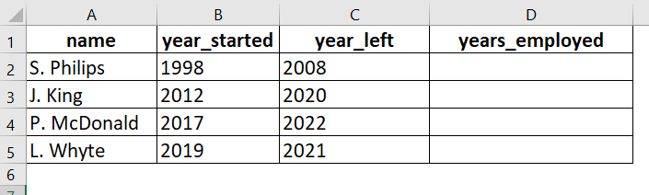
Name the new variable
Step 1.
Type in the name of the new variable in the column heading where you are going to create the new data.

Slide 21
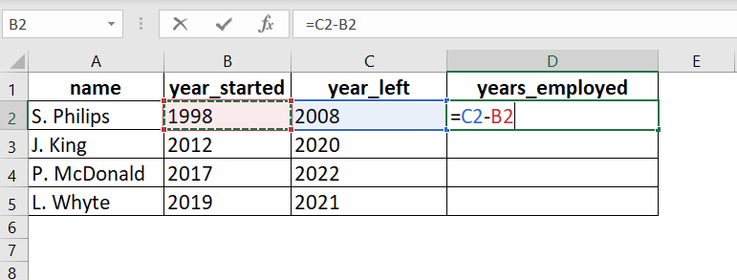
Calculation
Step 2.
In the first row of the new variable, type in the calculation you will use to create the new column of data.

Slide 22
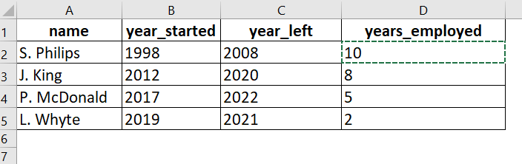
Create in Excel
Step 3.
Copy the calculation you have just typed into the first row, and paste into the remaining rows of the new variable.

Slide 23
Create in Excel
Here are some examples of calculations you can use in Excel to create new variables.
Calculation | Formula
Adding | =sum(A,B,C,D…)
Subtracting | =B-A
Multiple | =product(A,B,C,D…)
Dividing | =B/A
Maximum | =max(A,B,C,D….)
Minimum | =min(A,B,C,D,…)
Average (mean) | =average(A,B,C,D,…)
For more details of the formulas in Excel, see
https://support.microsoft.com/en-us/excel

Slide 24
Next steps
Complete questions 1 to 11
in section 2 of the
‘Creating new calculated variables in Excel’
workbook

Slide 25
Definition
Conditional
Performs one action if the condition is True and a different action if the condition is False

Slide 26
Conditional statements
IF something is true
THEN this
ELSE that
Conditional statements are useful when comparing data items.
The statement can compare strings (such as names, colours, places) or numbers.

Slide 27

Show me…
IF it is raining
THEN take an umbrella
ELSE leave umbrella at home

Slide 28

Show me…
IF driving to Edinburgh
THEN turn left
ELSE turn right

Slide 29

Your turn…
What do you think you could write in the IF statement gaps to show that,
“you need to charge up your phone when the battery power is less than 5%”?
IF [blank ]
THEN [ blank ]
ELSE [ blank ]

Slide 30
Your turn…
What do you think you could write in the IF statement gaps to show that,
“you need to charge up your phone when the battery power is less than 5%”?
IF battery_power<5%
THEN plug in
ELSE don’t

Slide 31

Your turn…
What do you think you could write in the IF statement gaps to show that,
“you can cross the road when the light turns green”?
IF [blank ]
THEN [ blank ]
ELSE [ blank ]

Slide 32
Your turn…
What do you think you could write in the IF statement gaps to show that,
“you can cross the road when the light turns green”?
IF light is green
THEN walk
ELSE wait

Slide 33





Show me…
By using conditional formulas (or IF statements) you can categorise or compare data items.
Animal | Is it green?
Peacock | True
Zebra | False
Tiger | False
Frog | True
Puffin | False
IF animal is green
THEN True
ELSE False

Slide 34

Example
Which of these people have won more than 10 Grand Slam Tennis titles?
Create a new variable a value of Yes if the tennis player has won more than 10 titles, otherwise its No.
name | grand_slam_titles
Billie Jean King | 8
Steffi Graf | 22
Pete Sampras | 14
Bjorn Borg | 11

Slide 35
Example
Which of these people have won more than 10 Grand Slam Tennis titles?
name | grand_slam_titles | more_than_10_titles
Billie Jean King | 8 | No
Steffi Graf | 22 | Yes
Pete Sampras | 14 | Yes
Bjorn Borg | 11 | Yes
IF Grand_slam_titles >10
THEN Yes
ELSE No

Slide 36
IF statement in Excel
We are now going to use the IF statement in Excel to create the new variable.
IF something is true THEN this ELSE that
=IF(logical_test, [value_if_true], [value_if_false])

Slide 37
Logical Test
Here are some examples of the logical tests you can use in the IF statement.
Logical_test
Equals | variable_1=variable_2
Less than | variable_1<variable_2
More than | variable_1>variable_2

Slide 38
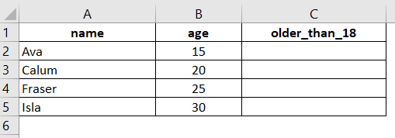
Name the new variable
Step 1.
Type in the name of the new variable in the column heading where you are going to create the new data.

Slide 39
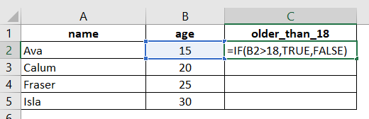
Calculation
Step 2.
In the first row of the new variable, type in the calculation you will use to create the new column of data. In this case it is an IF statement.

Slide 40
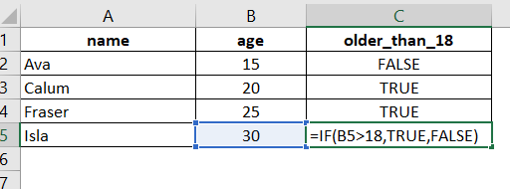
IF statement in Excel
Step 3.
Copy the calculation you have just typed into the first row, and paste into the remaining rows of the new variable.

Slide 41

Text in formulas
If you are going to use text in formulas, you need to wrap the text in quotes (e.g. “Text”).
The only exception to that is using TRUE or FALSE, which Excel automatically understands.

Slide 42
Next steps
Complete questions 1 to 8
in section 3 of the
‘Creating new calculated variables in Excel’
workbook

Slide 43

Missing values
When creating new variables there are some situations that might cause issues in your dataset.
Some of the most common issues are caused by:
Missing values
Zero (0) values

Slide 44
Missing values
Datasets quite often will have missing or blank information.
In this example, R. Evans is still working for the company so doesn’t have a year they left.
Can you think of any solutions for dealing with this missing value so you can calculate years_employed?
name | year_started | year_left | years _employed
S. Philips | 1998 | 2008
J. King | 2012 | 2020
P. McDonald | 2017 | 2022
L. Whyte | 2019 | 2021
R. Evans | 2016

Slide 45
Missing values
Some possible solutions are,
Put a value such as NA (Not Available), NaN (Not a Number) or NULL to show that an answer couldn’t be calculated
Remove the row and only calculate based on people who have left.
name | year_started | year_left | years _employed
S. Philips | 1998 | 2008 | 10
J. King | 2012 | 2020 | 8
P. McDonald | 2017 | 2022 | 5
L. Whyte | 2019 | 2021 | 2
R. Evans | 2016 |  | NA

Slide 46
Handling zero (0) values
When creating a new variable you might come across a row where you are trying to divide by 0.
Like with a missing value you can:
Put a value such as NA, NaN or NULL to show that an answer couldn’t be calculated
Remove the row
average_price = total_sales/number_sold
item | total_sales | number_sold | average_price
trainers | £30 | 3 | £10.00
top | £15 | 2 | £7.50
shorts | £10 | 4 | £2.50
socks | £0 | 0 | !can’t divide by 0

Slide 47

Documentation best practice
When creating new variables it is best practice to write down why you are creating it and the calculation/formula used.
This can be within the file you are using to create it or as a separate document.

Slide 48
Learning checklist
I can describe how to create a new variable by performing calculations.
I can create new variables in Excel by performing calculations.
I can describe the concept of conditional formulas.
I can use conditional formulas in Excel.

Slide 49





How you can use this lesson
You are free to:
Share – copy and redistribute the material in any medium or format
Adapt – remix, transform and build upon the material
Under the following terms:
Attribution — You must give appropriate credit, provide a link to the license, and indicate if changes were made. You may do so in any reasonable manner, but not in any way that suggests the licensor endorses you or your use.
NonCommercial — You may not use the material for commercial purposes.
ShareAlike — If you remix, transform, or build upon the material, you must distribute your contributions under the same license as the original.
© 2021. This work is licensed under a CC BY-NC-SA 4.0 license.
Created by Effini in partnership with Data Education in Schools, The Data Lab and Data Skills for Work, with funding from the Scottish Government.

