Slide 1
Keeping organisational data secure
Version: 1.0

Slide 2
Learning intentions
We will be looking at how organisations keep data secure, specifically, What happens if organisations don’t keep data secure What is GDPR What are your data rights under the law How encryption and backups keep data safe

Slide 3

Background
When you share your data with a company or organisation, you trust that they will keep it safe. Unfortunately this doesn’t always happen.
In this lesson will look at times when companies have not kept data secure; and what laws and tools are in place to protect the data an organisation holds.

Slide 4



What could happen if data isn’t kept secure…
Customers could lose confidence in the company and stop doing business with them
Companies could be fined by organisations that oversee data protection
The competitors of an organisation could see their private information, which could give the competitor an advantage

Slide 5
Definition
Data breach
An incident that has affected the security of personal data
Next we will watch a video on some of the worst data breaches.

Slide 6

https://www.youtube.com/watch?v=0f-uFn-5hck

Slide 7
Top 5 data breaches
These data breaches resulted in financial and reputational damage to these companies.
Company | Number of customers affected | What happened?
Yahoo! | 3 billion | Data was hacked by a “state-sponsored actor”.
Facebook | 540 million | Published by Facebook developers.
Marriott | 500 million | Legacy/old systems were able to be hacked.
Equifax | 147 million | Hackers spotted software that hadn’t been updated and used this to help them access the data.
Capital One | 100 million | Data hacked by former Amazon Web Service (AWS) employee.

Slide 8

More organisational data breaches
Data breaches often happen because,
employees don’t realise the impact of sharing information
people have not updated software on their devices
companies continuing to use old/legacy systems that are vulnerable to attacks
companies working unlawfully
Hackers can then use these errors to help them access the information.
If you are working for an organisation that uses data, you have a responsibility to keep that data safe.

Slide 9
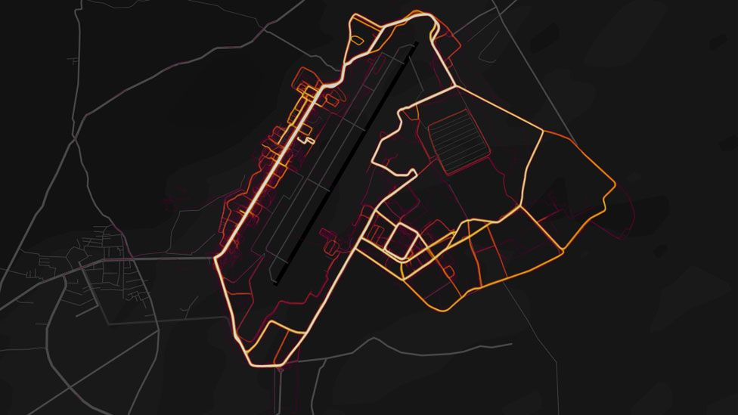
Show me…
Online fitness tracker Strava legally published “heatmaps” that showed the paths that its users had run or cycled.
This data did not contain any personal details. It appeared to be an interesting use of their data that could be benefit its users.
However, the fitness trackers were being used by the US military. This meant the heat maps showed undisclosed locations of military bases and routes taken by soldiers, which put the personnel at risk of attack.
The movements of soldiers within Bagram air base - the largest US military facility in Afghanistan (BBC article Jan 2018)
https://www.bbc.co.uk/news/technology-42853072

Slide 10

Show me…
In May 2022, Facial recognition company Clearview AI was fined £7.5million for illegally using images of British people scraped from the internet. The company illegally set up a database of 20 billion faces without the individual’s knowledge or permission.
Clearview AI was then offering an app where you could upload a photo to try and identify the person against this unlawful database.
As well as being fined, the company was ordered to stop obtaining data of UK residents and to delete the data they had already collected.
news.sky.com/story/facial-recognition-company-clearview-ai-fined-7-5m-for-illegally-using-images-of-brits-scraped-from-online

Slide 11
Next steps
Complete questions 1 to 6
in section 1 of the
‘Keeping organisational data secure’ workbook.

Slide 12
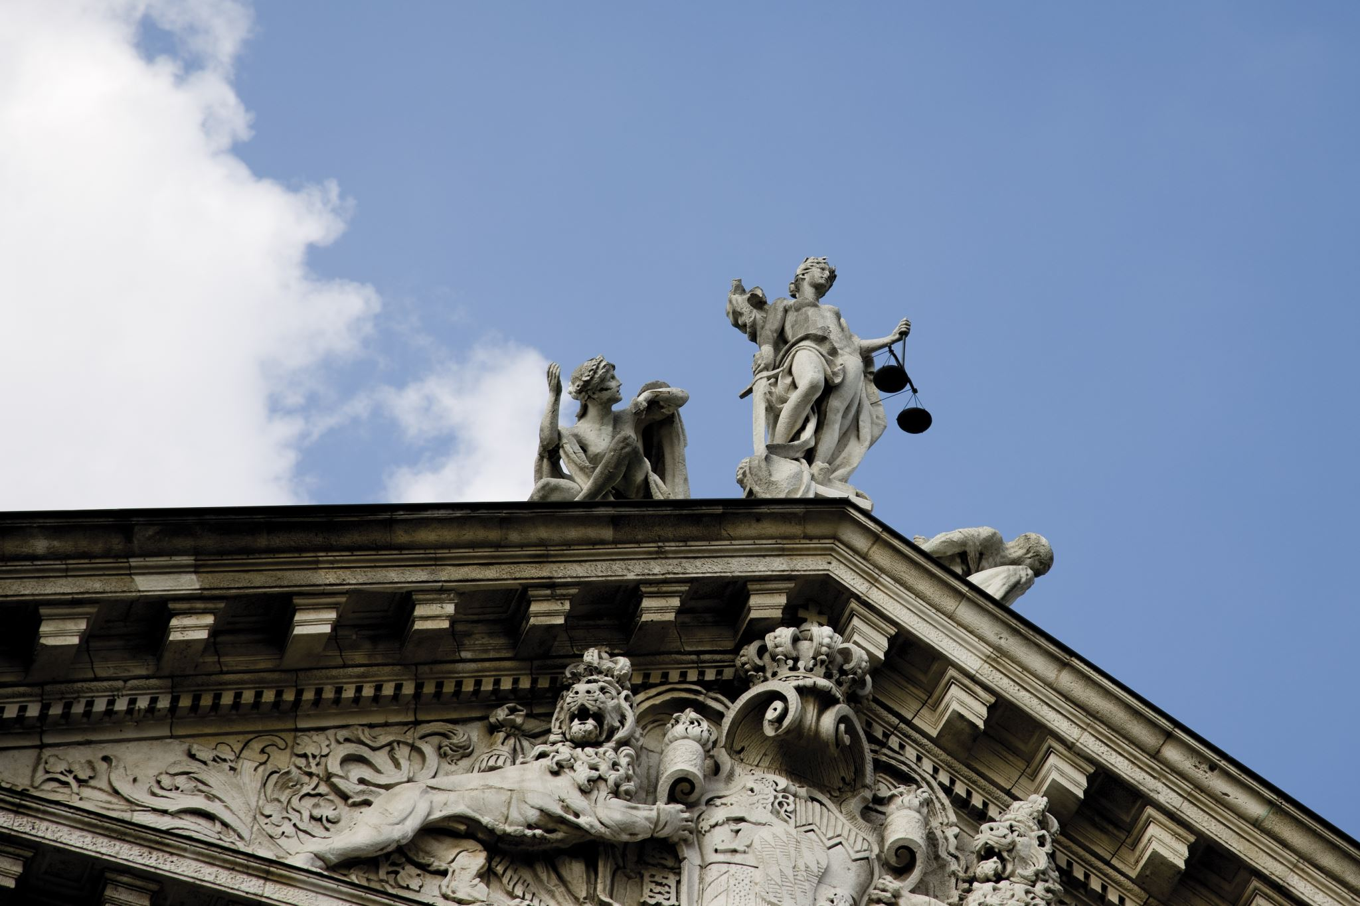
How the law can protect your data
We have seen that companies don’t always look after the data they hold on individuals in ways you might expect.
Now, we are going to look at the laws that protect our data and how they make it clear what organisations can and cannot do with it.

Slide 13
Definition
GDPR
Regulations (UK & EU) that govern the way that organisations can use, process and store personal data

Slide 14
GDPR - what are your data rights?
Right to be informed
Individuals know at the point of data collection, what information is being collected, what it is being used for, why that information is required and how long that will be kept.
Right of access
Individuals can ask to see what data is held on them.
Right to rectification
If data is incorrect/incomplete, individuals have the right to ask for it to be fixed or updated
Right to erasure
Also known as the right to be forgotten, individuals can ask for personal data to be erased.

Slide 15
GDPR - what are your data rights?
Right to restrict processing
The data can be stored, but individuals can ask to limit how their data is used
Right to data portability
Individuals are allowed to move their data between different providers. e.g. smart meters
Right to object
It is possible to object to data being processed. e.g. unsubscribing from a newsletter.
Rights in relation to automated decision making and profiling
It is possible to ask to speak to a person, rather than have automated decisions made about an individual e.g. when applying for a credit card

Slide 16

What this means for you…
If a company holds personal data about you it has to be,
Accurate
Only used for the reason you agreed to
Deleted if you ask
You can move data between providers (such as wearable devices)
You can ask to see what they hold on you
Companies use privacy notices to explain how they will use your personal data.

Slide 17
Definition
Privacy notice
Information that tells individuals how an organisation will use, store or share their personal data

Slide 18
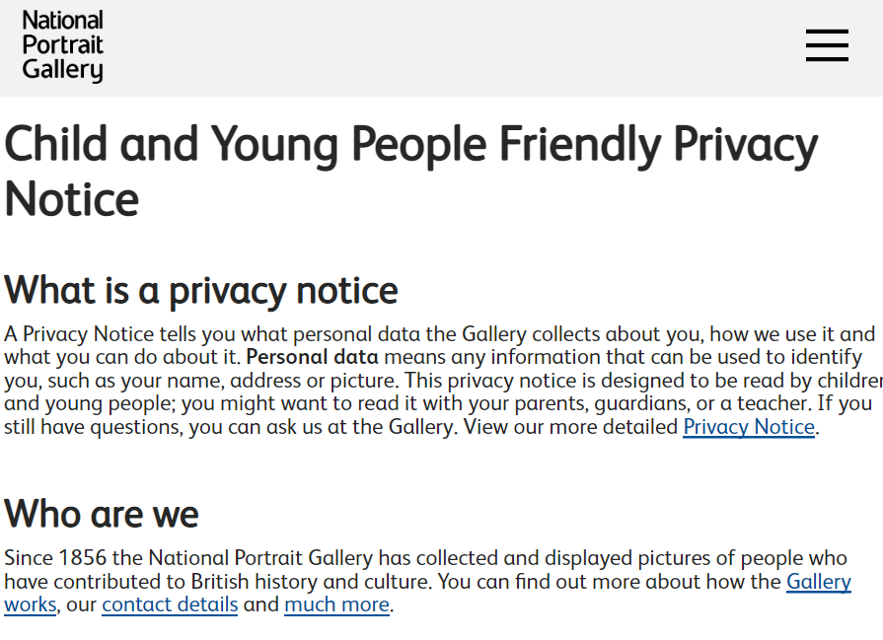
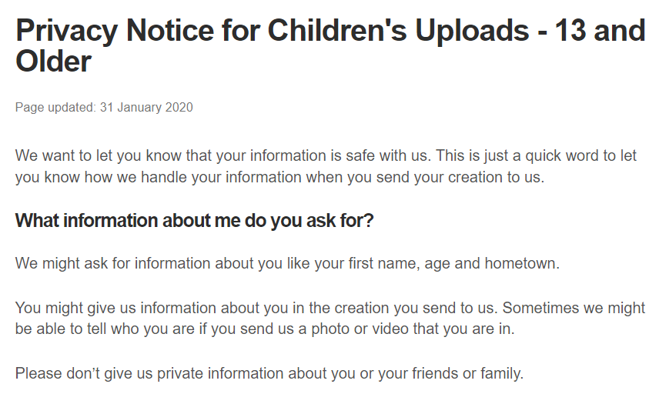
Show me…
Here are examples of privacy notices from the National Portrait Gallery and the BBC.
https://www.npg.org.uk/about/gallery-planning-and-policies/child-and-young-people-friendly-privacy-notice
https://www.bbc.co.uk/usingthebbc/privacy/childrens-uploads-privacy-notice-13

Slide 19



Roles within GDPR
Within GDPR there are many different roles described, and their associated rights and responsibilities.
We are going to look at the roles of
Data subject
Data controller
Data processor
Data subject
Data protection officer
Data controller
Data protection authority
Data processor

Slide 20
Definition
Data subject
The identified or identifiable living individual to whom the personal data relates.

Slide 21
Definition
Data controller
Determines why and how personal data is processed in an organisation

Slide 22
Definition
Data processor
Processes the personal data on behalf of the controller

Slide 23




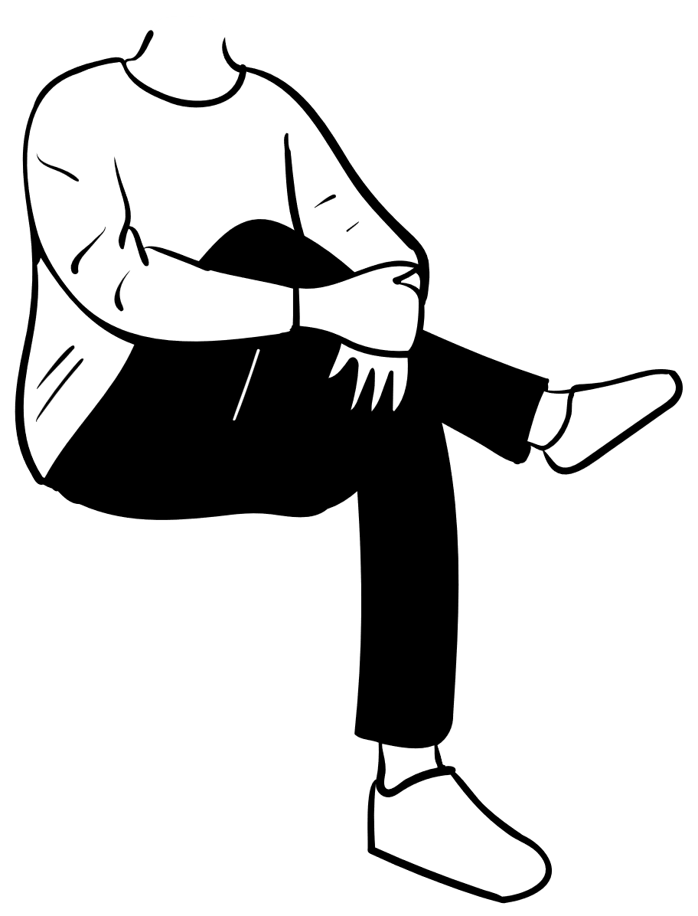

Show me…
Any time an organisation holds your personal data, you are a data subject.
The person who decided how the data is used within the organisation is the data controller.
The data processor will follow the instructions of the data controller to process the data.
Personal data
Data subject
Data controller

Slide 24
Subject access request
Individuals can ask to see what data is held on them. This is called a Subject Access Request.
You can make a subject access request to find out:
what personal information an organisation holds about you
how they are using it
who they are sharing it with
where they got your data from
Companies should not charge a fee and should deal with the request within one month.
Dear Sir/Madam,
SUBJECT ACCESS REQUEST
I am writing to make a subject access request.
Full name:
Address:
Email address:
Please supply the data about me I am entitled to under data protection law including:

Slide 25

Your turn…
As a data subject, you can submit a subject access request to any organisation that holds your data.
What organisations can you think of that you could submit a subject access request to?

Slide 26
Your turn…
Here are some organisations you could submit a subject access request to,
Doctors
School/college/employer
Mobile phone company
Social media company
Bank

Slide 27

More on GDPR
As a data subject you have the right to check the information that an organisation is correct. If it’s not accurate, you can ask for it to be corrected.
You also have the right to have ask for your data to be deleted if it is not required any more. Often referred to as the right to be forgotten, individuals can ask for personal data to be erased.
This request may be refused in certain circumstances e.g. for crime prevention, financial security, public health concerns or freedom of information.

Slide 28
Show me…
[Your full address] [Phone number] [The date]
[Name and address of the organisation] [Reference number (if applicable)]
Dear [Sir or Madam / name of the person you have been in contact with]
Right to erasure
[Your full name and address and any other details such as account number to help identify you]
I wish to exercise my right of erasure under data protection law.
[Give details of what personal data you want erased/deleted.]
You can find guidance on your obligations under information rights legislation on the website of the Information Commissioner’s Office (www.ico.org.uk) as well as information on their regulatory powers and the action they can take.
Please send a full response within one calendar month confirming if you will comply with my request. If you cannot respond within that timescale, please tell me when you will be able to respond.
If there is anything you would like to discuss, please contact me.
Yours faithfully [Signature]
Here is a template letter from the information commissioner's office (ico) you can use if you wish to contact an organisation to have your personal data deleted.

Slide 29

Your turn…
Think about any organisations that you have given your personal data to in the past.
Are there any that you could contact to delete your personal data (under the right to erasure)?

Slide 30

Your turn…
Here are some examples of places you might want to contact to get your personal data deleted,
After you have cancelled your gym membership, they no longer need a record of your health conditions
Social media or gaming apps you used as a child
Magazine subscription that you have cancelled, they no longer need your address

Slide 31
Next steps
Complete questions 1 to 5
in section 2 of the
‘Keeping organisational data secure’ workbook.

Slide 32
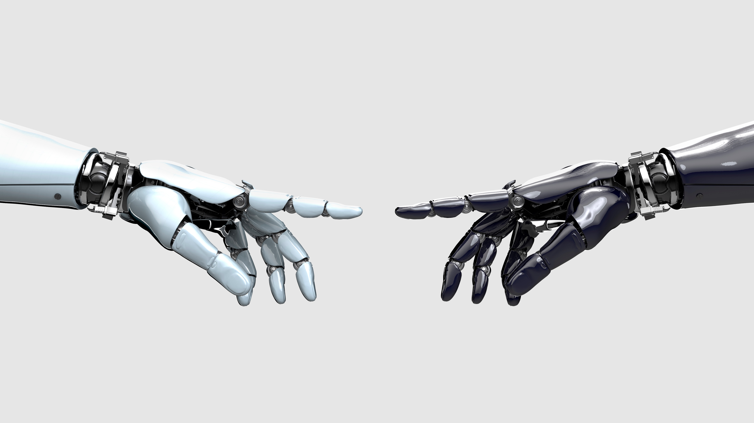
What technology can be used to protect data
Organisations can use technology to help them protect your data and to make sure it is stored securely.
We are now going to look at some of these tools.

Slide 33
Definition
Encryption
To conceal the content of a message to prevent unauthorised people from reading it

Slide 34
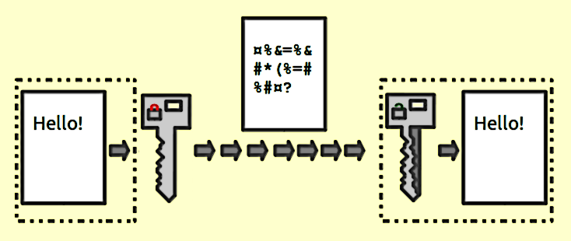
Show me…
Encryption means that information such as text or data is encoded using a key and cannot be understood until it is decoded by another key other end of the information transfer.
Illustration of how encryption is used within servers Public key encryption from Encryption Facts for Kids Kiddle Encyclopedia.

Slide 35


Encryption at rest and in transit
The main way to keep data safe is to encrypt it. It should be encrypted at rest and in transit.
Data | Example | Why?
At rest | When stored on a laptop | If the storage device is stolen or accessed, it can’t necessarily be read.
In transit | When being sent over email | It can’t be intercepted en-route, for example on an open wifi connection.

Slide 36



How to identify encrypted sites
.
It is easy to identify if webpages are encrypted, since they have a web address starting with https rather than http.
They will also show a locked padlock next the website address.
It is important to ensure that when personal data is captured in a web form, the website is always https so that the data is encrypted in transit.

Slide 37
More ways organisations can protect data
Backing up data and code
Data can sometimes be lost accidentally, either through deletion or corruption.
Data should be backed up at regular intervals.
Limiting access
Limit the users that have access to the data.
Good practice to provide access to named individuals who have a valid reason.
Testing and monitoring
Penetration testing is an ethical hacking test to identify weaknesses in security.
Ongoing system monitoring to identify unauthorised data breaches.

Slide 38
Next steps
Complete questions 1 to 3
in section 3 of the
‘Keeping organisational data secure’ workbook.

Slide 39
Learning checklist
I can describe how GDPR supports organisations to manage and secure data. I can describe the rights I have as a data subject. I can describe the responsibilities an organisation has a data controller. I can describe how encryption can be used to manage and secure data.

Slide 40




How you can use this lesson
You are free to:
Share – copy and redistribute the material in any medium or format
Adapt – remix, transform and build upon the material
Under the following terms:
Attribution — You must give appropriate credit, provide a link to the license, and indicate if changes were made. You may do so in any reasonable manner, but not in any way that suggests the licensor endorses you or your use.
NonCommercial — You may not use the material for commercial purposes.
ShareAlike — If you remix, transform, or build upon the material, you must distribute your contributions under the same license as the original.
© 2022. This work is licensed under a CC BY-NC-SA 4.0 license.
Created by Effini in partnership with Data Education in Schools and Skills Development Scotland.

Slide 41
Alternative format
If you require this document in an alternative format, such as large print or a coloured background, please contact
hello@effini.com
or
4th Floor, The Bayes Centre
47 Potterrow
Edinburgh
EH8 9BT

