Slide 1
Practise creating graphs in Excel (part 1)
Version: 1.0

Slide 2
Learning intentions
We will be learning more about creating bar charts and histograms in Excel, specifically, how to amend the font, colour and display format of graph elements how to amend gridlines on a graph how to change the order and gaps of the bars in a bar chart how to change the size of the bins in a histogram.

Slide 3

Background
Creating graphs is a useful tool when looking for patterns as part of the analysis steps.
We have looked at design choices and how to create basic graphs in Excel.
Now we are going to look at how to amend your graph to make it as useful as possible.
Data understanding
Data cleansing
Data manipulation
Identifying patterns
Extracting insights

Slide 4



Why changing the graph style is important?
Make it accessible for everyone (e.g. for someone who is colour blind)
Match the look and feel used within the company you are producing it for
Helps focus the audience of the key messages of the graph/data

Slide 5
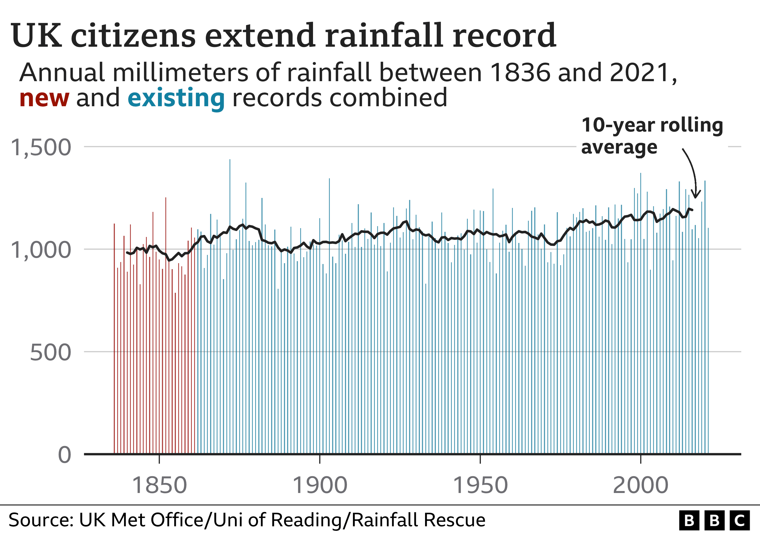
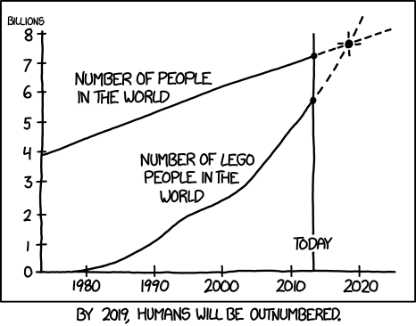
Show me…
Most companies have a defined style they use for producing graphs. Below are examples from BBC and xkcd.
https://www.bbc.co.uk/news/science-environment-60860397
https://xkcd.com/1281/

Slide 6

Creating a bar chart in Excel
In this lesson we are going to use a dataset that shows the number of hours of sunshine in Scottish cities in a year to create a bar chart in Excel.
The instructions in this lesson are for Microsoft Excel on a Windows based machine.
If you are using something different (e.g. Mac) the position of menus/options might be different.

Slide 7
Before vs. after bar charts
Below are graphs created using the sunshine dataset. The first is the default Excel graph, and the other is after it has been amended.
Source: https://www.metoffice.gov.uk/research/climate/maps-and-data/uk-climate-averages

Slide 8
Your turn…
Can you spot the 8 changes that have been made to the graph?

Slide 9
Your turn…
The 8 differences are,
Amend the gridlines
Change the order of the bars
Change the gap between the bars
Change the chart title
Added axis title
Change the font
Change the display format of the numbers
Change the axis range

Slide 10
Amending the default graph
We will start with the Excel default graph and go through the steps to make the following changes,
Add axis title
Change the font
Change the display format of the numbers
Change the axis range
Amend the gridlines
Change the order of the bars
Change the gap between the bars
Change the chart title

Slide 11
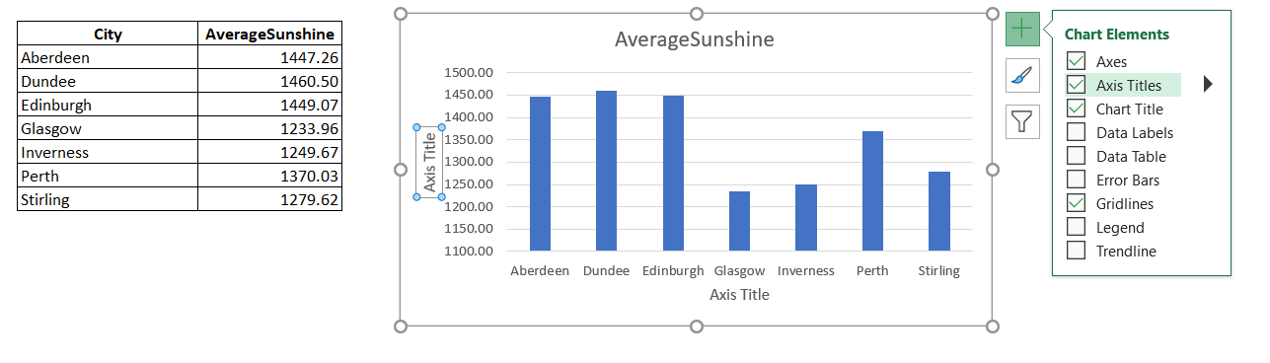
Adding axis titles
Reminder
Axis titles avoid confusion around what is being shown
To add axis or chart titles to a graph, click on the graph then press + button on the right hand side and select chart elements you need.

Slide 12
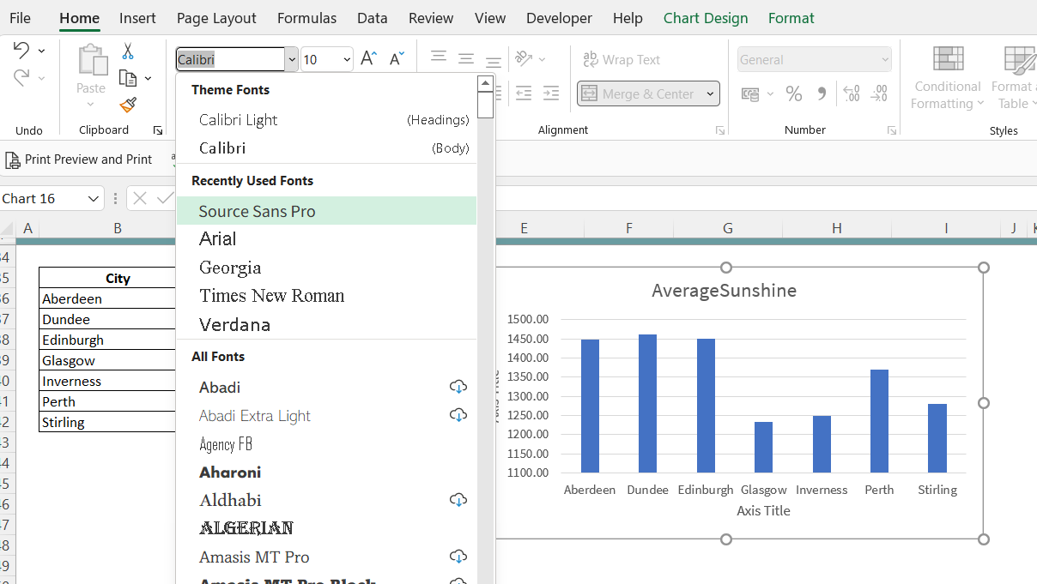
Change the font
Reminder
A consistent font allows the graphics to incorporate branding
To change the font used in the graph,
Click on the graph
Choose the font you would like to use from the drop down menu in the Home ribbon.
You can also change the size, colour etc of the font.

Slide 13
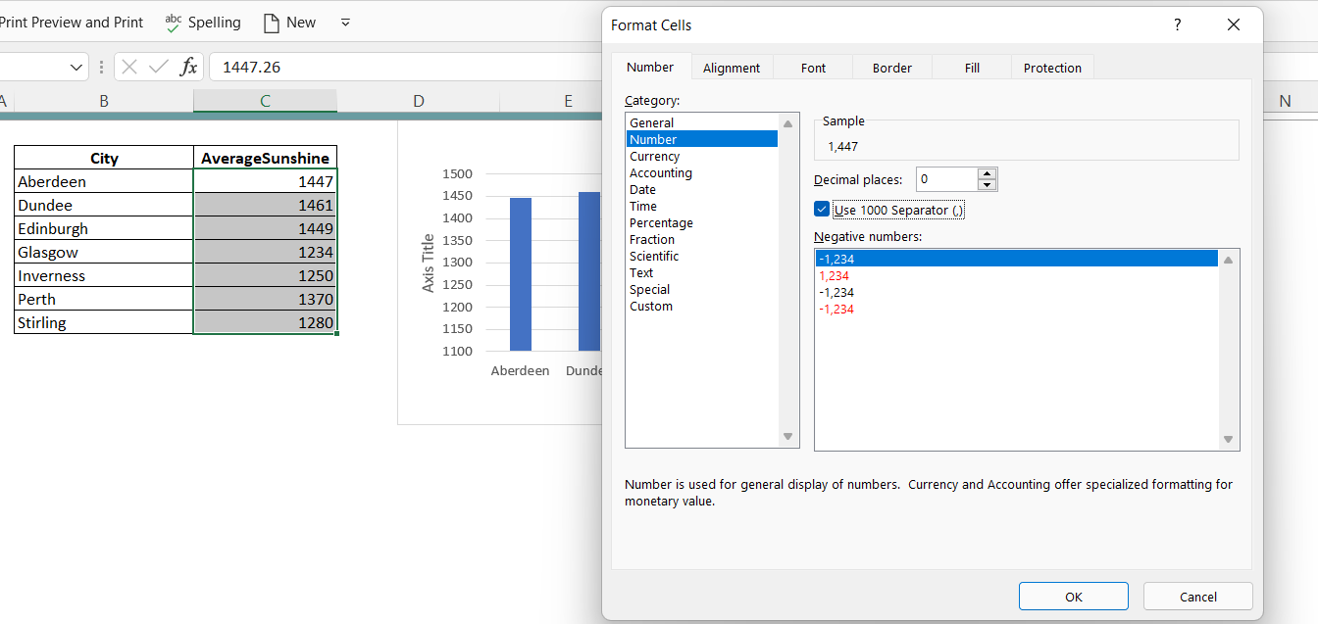
Change the display format
Reminder
Display formats it make the data easier to understand for the user
The way data is displayed in the graph matches the display format of the dataset.
Therefore, the easiest way to change the display format of the graph is to change it in the dataset.
Reminder to open the format cells window, press Ctrl+ 1 (for windows) or Command +1 (for Mac).
Windows | Ctrl + 1
Mac | Command + 1

Slide 14
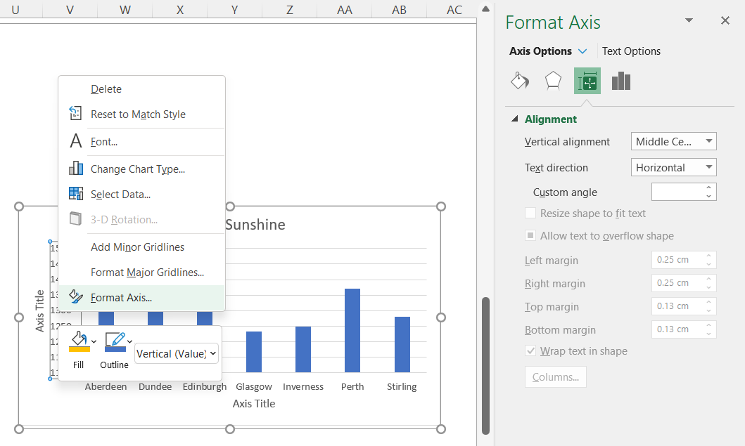
Amending the axis and gridlines
There are lots of options to amend the axis and gridlines in a graph.
These are all done within the Format Axis/Gridline pane.
Right click on the axis or gridline to open the Format Axis/Gridline pane.

Slide 15
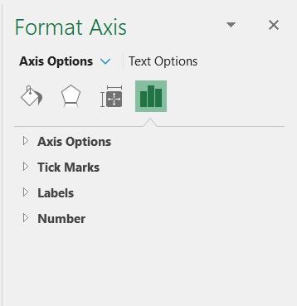
About the Format Axis pane
The Format Axis pane contains lots of options that allow you to change how your graph is displayed, including how to change the text and the axis.
In this lesson we will look at the Axis Options tab.
Fill & Line
Effects
Size & Properties
Axis Options
If you would like to know more about the Format Axis pane, please see https://support.microsoft.com/en-us/office/format-elements-of-a-chart

Slide 16
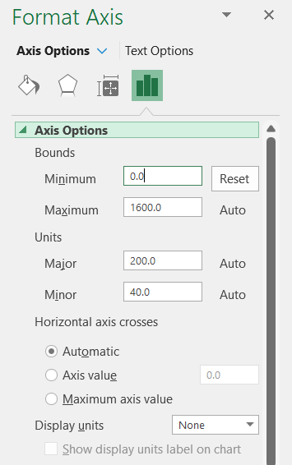
Changing the axis range
Reminder
Aim to start axis at zero
In the Format Axis pane, click on the Axis Options. You can then change the minimum and maximum range of the axis in the Bounds section.

Slide 17
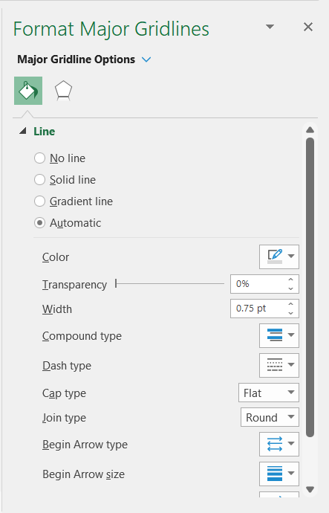
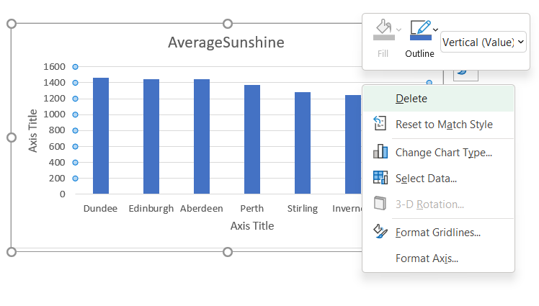
Amend the gridlines
Reminder
Gridlines should not distract from your data
To amend the gridlines, right click on the gridlines and then select Format Gridlines.
For this graph, the gridlines have been removed by selecting the No line option.

Slide 18
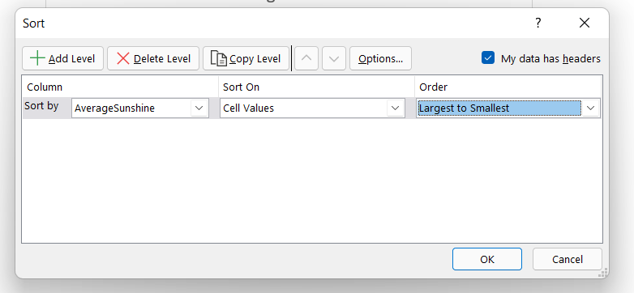
Change the order of the bars
Reminder
The order of the bars can help the reader to understand the graph
To change the order of the bars in the graph you need to change it in the dataset you are plotting.
Highlight the dataset and right click and find the ‘Custom Sort… option. Sorting the dataset will then change the order of the bars in the graph.

Slide 19
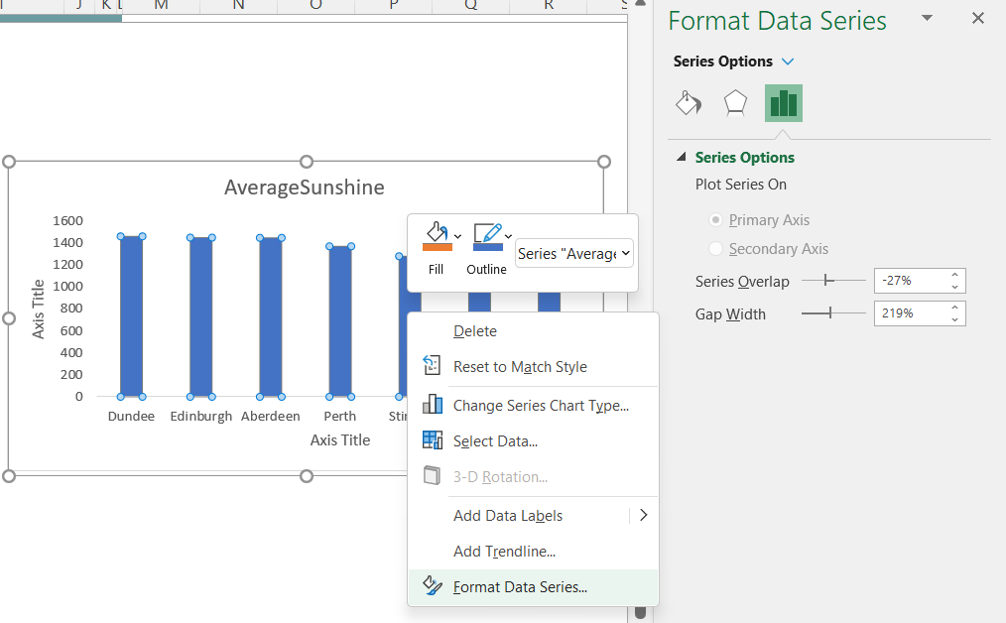
Changing gaps between bars
Reminder
The gap shouldn’t be too thin or too think
Right click on the bars and select Format Data Series…
This opens up the Format Data Series pane.
In the Series Options tab, change the % on the Gap Width option.

Slide 20
Amend the titles of the graphs
Reminder
Descriptive graph titles allow key messages to be easily understood
Now you have amended all the elements of the graph you can update the chart title and axis title.
To amend them, click on the title and you can start typing.

Slide 21
Next steps
Complete sections 1 & 2 of the
‘Practise creating graphs
in Excel (part 1)’ workbook.

Slide 22

Creating a histogram in Excel
Now, we are going to use a dataset that shows the average number of hours of sunshine per day in cities around the world to create a histogram.
Again we will start with the default Excel graph and then amend it.

Slide 23
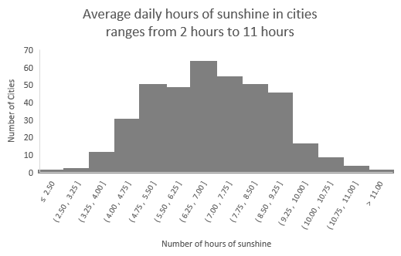
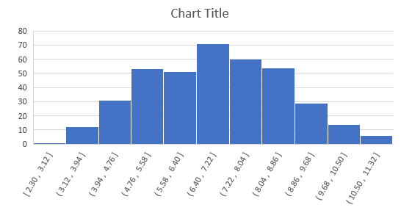
Before vs. after histograms
Below are graphs created using number of hours of sunshine for cities. The first is the default graph created, and the other is after it has been amended.
Source: https://www.kaggle.com/datasets/prasertk/sunshine-duration-by-city

Slide 24
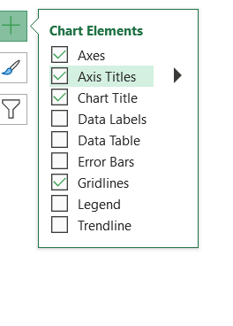
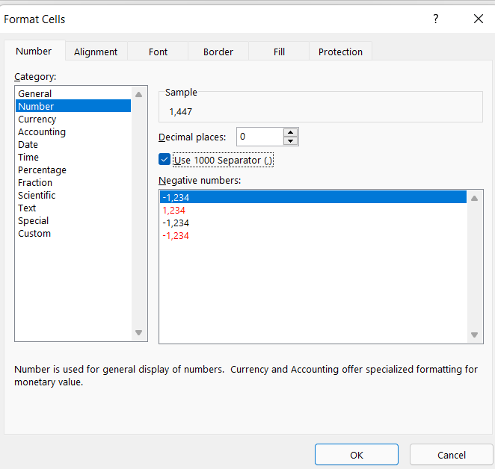
Amending a histogram
All the amendments you were able to make to the bar chart, for example
changing the font
changing the display formats
changing the gridlines
adding axis titles
can be made in the same way to a histogram.

Slide 25
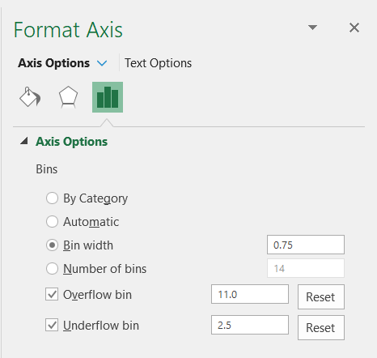
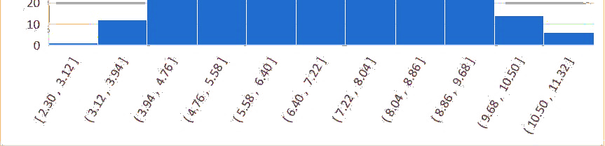
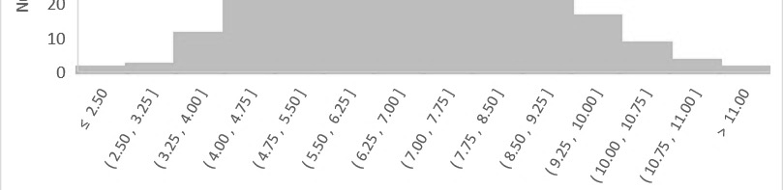
Amending the size of the bins
Reminder
Size of the bin can change the appearance of the graph
To amend the size of the bins, first you need to right click on the axis and select Format Axis.
You can amend the size of the bins based on width (e.g. 0.75) or number of bins (e.g. 14).
The overflow bin and underflow bin set the minimum and maximum points of the axis.

Slide 26
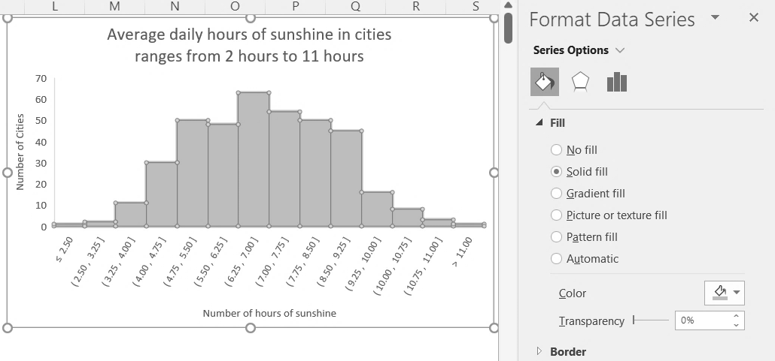
Changing the colour of bars
Reminder
Colours should be accessible for colour-blind readers
To amend the change the colour of the bars, first you need to right click on the bars and select Format Data Series.
You can change the colour and whether you want the colour to be transparent.

Slide 27
Next steps
Complete sections 3 & 4 of the
‘Practise creating graphs
in Excel (part 1)’ workbook.
Then complete the extension section.

Slide 28
Learning checklist
I can change the font, colour and display format of graphs in Excel. I can add/remove the gridlines on graphs in Excel I can change the order and gap of the bars in a bar chart in Excel I can change the start and end points, and size of the bins in a histograms in Excel.

Slide 29





How you can use this lesson
You are free to:
Share – copy and redistribute the material in any medium or format
Adapt – remix, transform and build upon the material
Under the following terms:
Attribution — You must give appropriate credit, provide a link to the license, and indicate if changes were made. You may do so in any reasonable manner, but not in any way that suggests the licensor endorses you or your use.
NonCommercial — You may not use the material for commercial purposes.
ShareAlike — If you remix, transform, or build upon the material, you must distribute your contributions under the same license as the original.
© 2022. This work is licensed under a CC BY-NC-SA 4.0 license.
Created by Effini in partnership with Data Education in Schools, The Data Lab and Data Skills for Work, with funding from the Scottish Government.

Slide 30
Alternative format
If you require this document in an alternative format, such as large print or a coloured background, please contact
hello@effini.com
or
4th Floor, The Bayes Centre
47 Potterrow
Edinburgh
EH8 9BT

