Slide 1
Creating graphs in Excel
Version: 1.0

Slide 2
Learning intentions
We will be learning about creating graphs in Excel, specifically, how creating graphs fits into the analysis steps process of creating bar charts and histograms process of creating line graphs and scatterplots

Slide 3

Background
During the identifying patterns stage of the analysis steps you look for relationships and patterns in the data.
This can be done through plotting graphs or using calculations designed to measure relationships.
In this lesson, we will be looking at how to create graphs in Excel that you can be used to look for relationships and patterns.
Data understanding
Data cleansing
Data manipulation
Identifying patterns
Extracting insights

Slide 4



Why identifying patterns is important?
You can test ideas for relationships or patterns in the datasets
Identify trends in a dataset
Spot unusual data items that might need more investigation
Data understanding
Data cleansing
Data manipulation
Identifying patterns
Extracting insights

Slide 5

Graphs in Excel
In this lesson we are going to look at how to create some of the common graphs used in data science. These are:
Bar charts
Histograms
Scatterplots
Line graphs

Slide 6

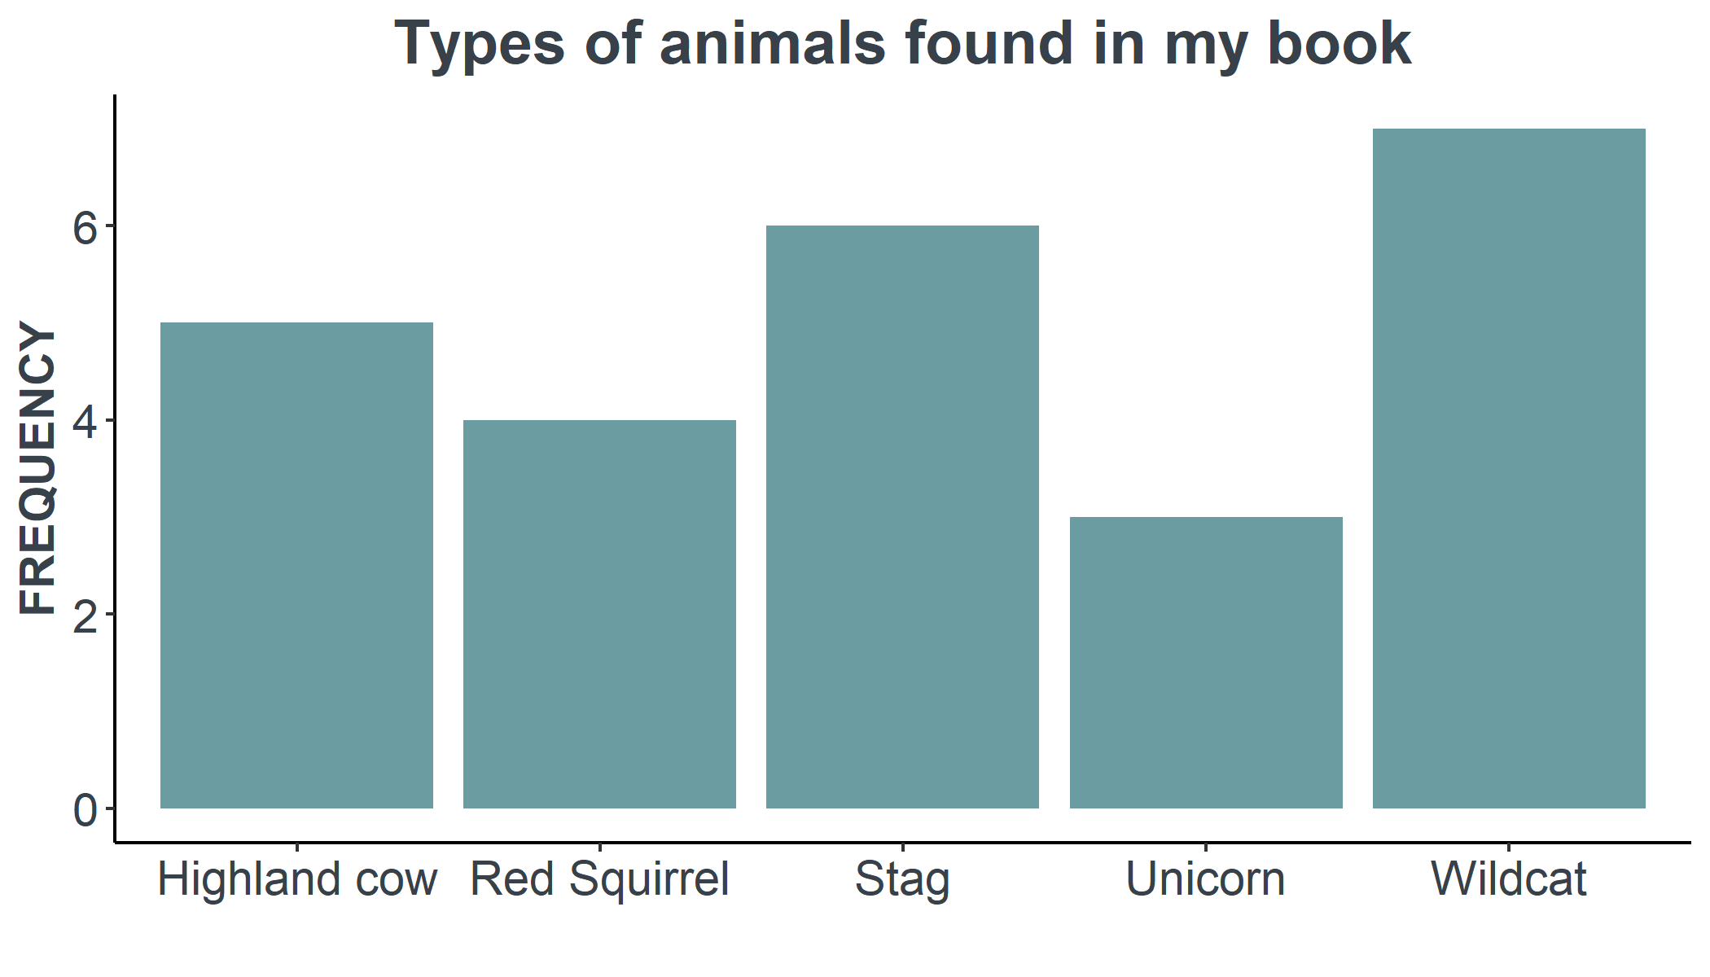


When should you use a bar chart?
Bar charts should be used if you want to
compare numeric values across different categorical data.

Slide 7
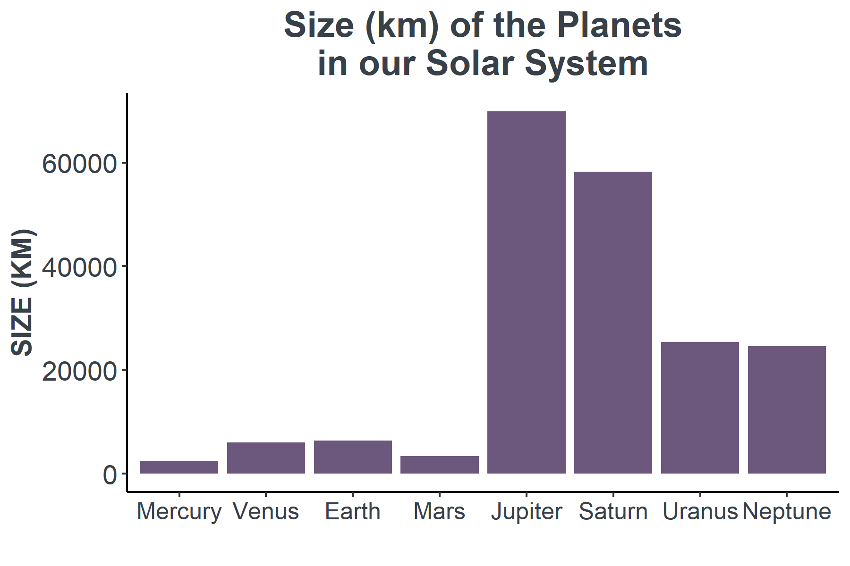
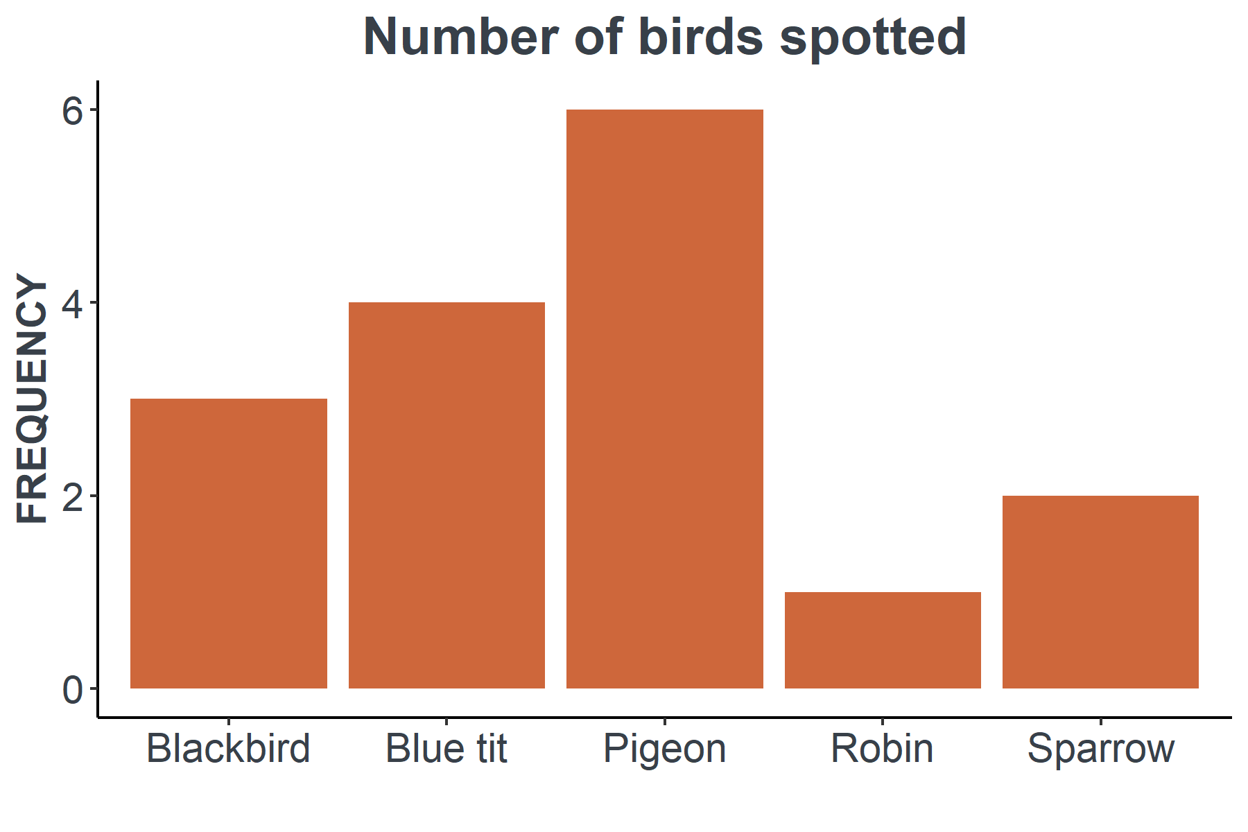
Show me…
These plots compare a number (frequency or size) against a categorised data item.

Slide 8
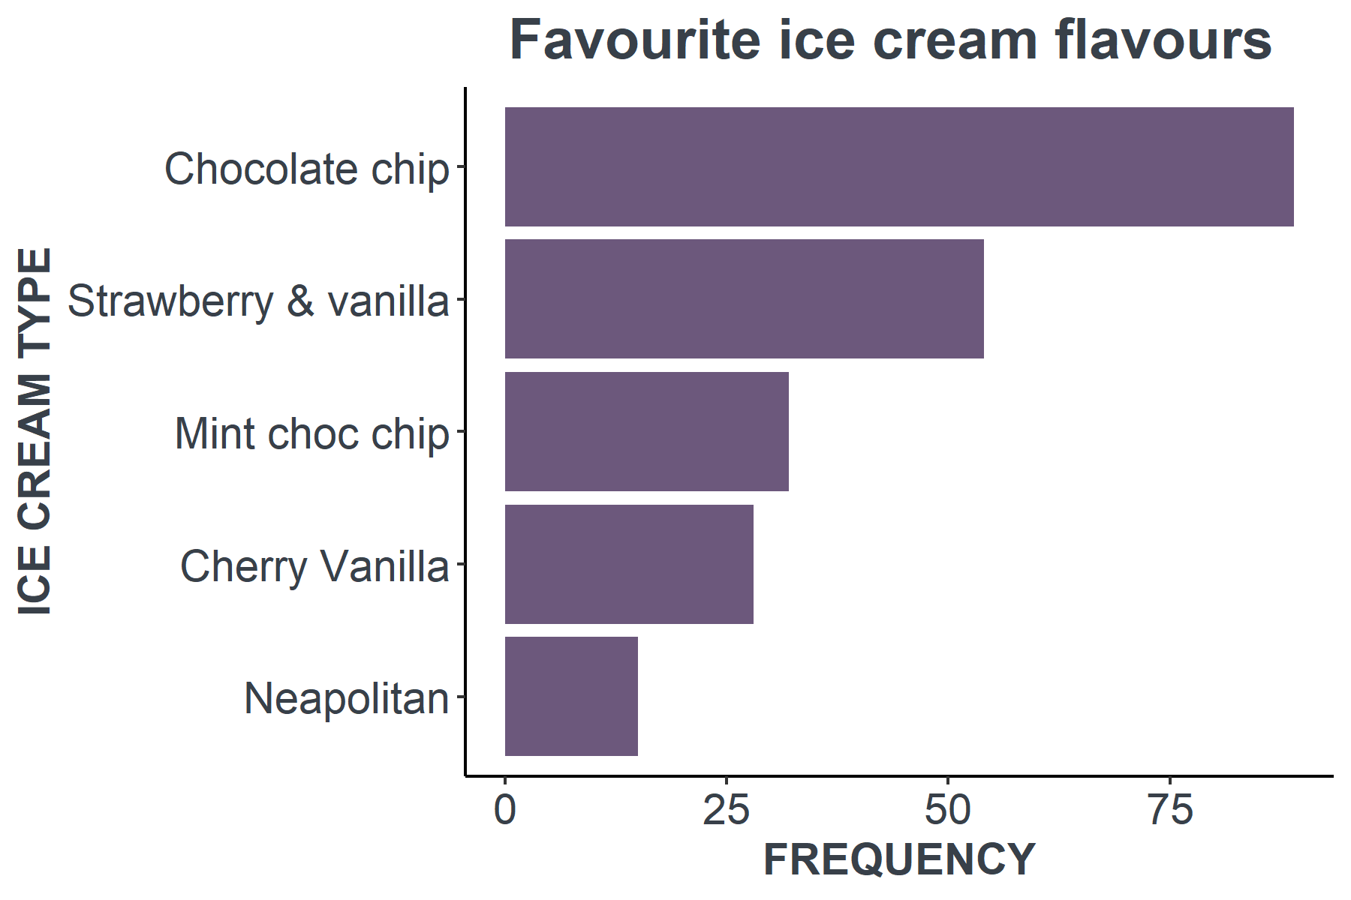
Bar chart best practice
Bars normally show the counts or sizes of categorical data.
Since there is no connection between the bars, they are shown not touching.
A horizontal bar graph is often a good option when there are many categories, or the category labels are long.
It is also possible to reorder the bars, which makes it easier to see the smallest and largest categories.

Slide 9

How to create bar charts
We are now going to look at how to create bar charts in Excel.
We are going use a dataset that shows the amount of caffeine in drinks.
drink | caffeine_mg
Caffe Nero Coffee | 160
Chai Tea | 50
Coca-Cola Caffeine Free | 0
Coca-Cola Classic | 34
Costa Coffee | 277
Diet Coke | 46
Dr Pepper | 42
Fanta | 0
Irn-bru | 30
Lipton Iced Tea | 25
McDonalds (McCafe) Mocha | 167
https://www.caffeineinformer.com/ & https://www.kaggle.com/heitornunes/caffeine-content-of-drinks
Source:

Slide 10
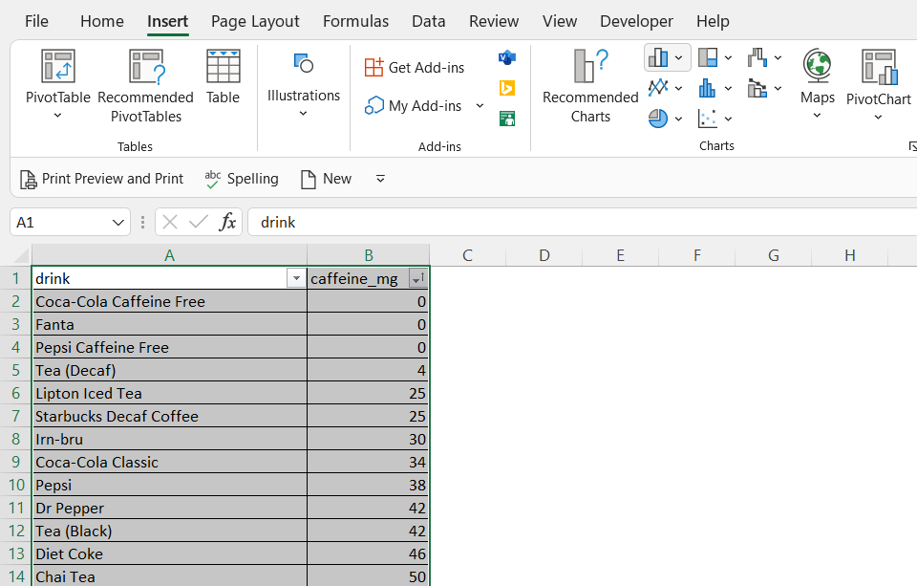
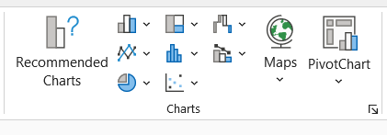
Insert of bar chart
Step 1.
Highlight the dataset you are going to plot.
Then in the Insert tab, click on the icon that looks like a bar chart.

Slide 11
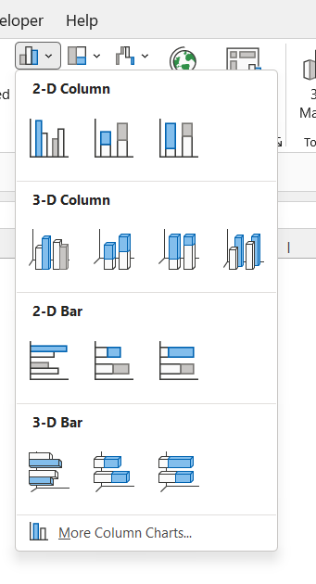
Select the type of bar chart
Step 2.
Select the type of bar chart you would like from the drop down list.
In this case we will use a horizontal bar chart.

Slide 12
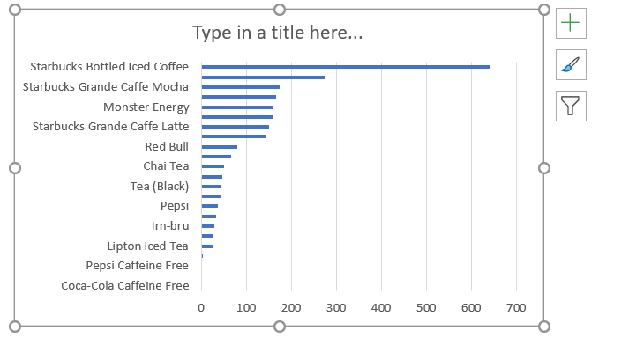
Amend your graph
Step 3.
Click on the + symbol next to the graph to add elements to graph such as Axis Titles.
Then right click on any element you would like to change (e.g. the Title, Axis title)

Slide 13
Next steps
Complete questions 1 to 8
in section 1 of the
‘Creating graphs in Excel’ workbook.

Slide 14
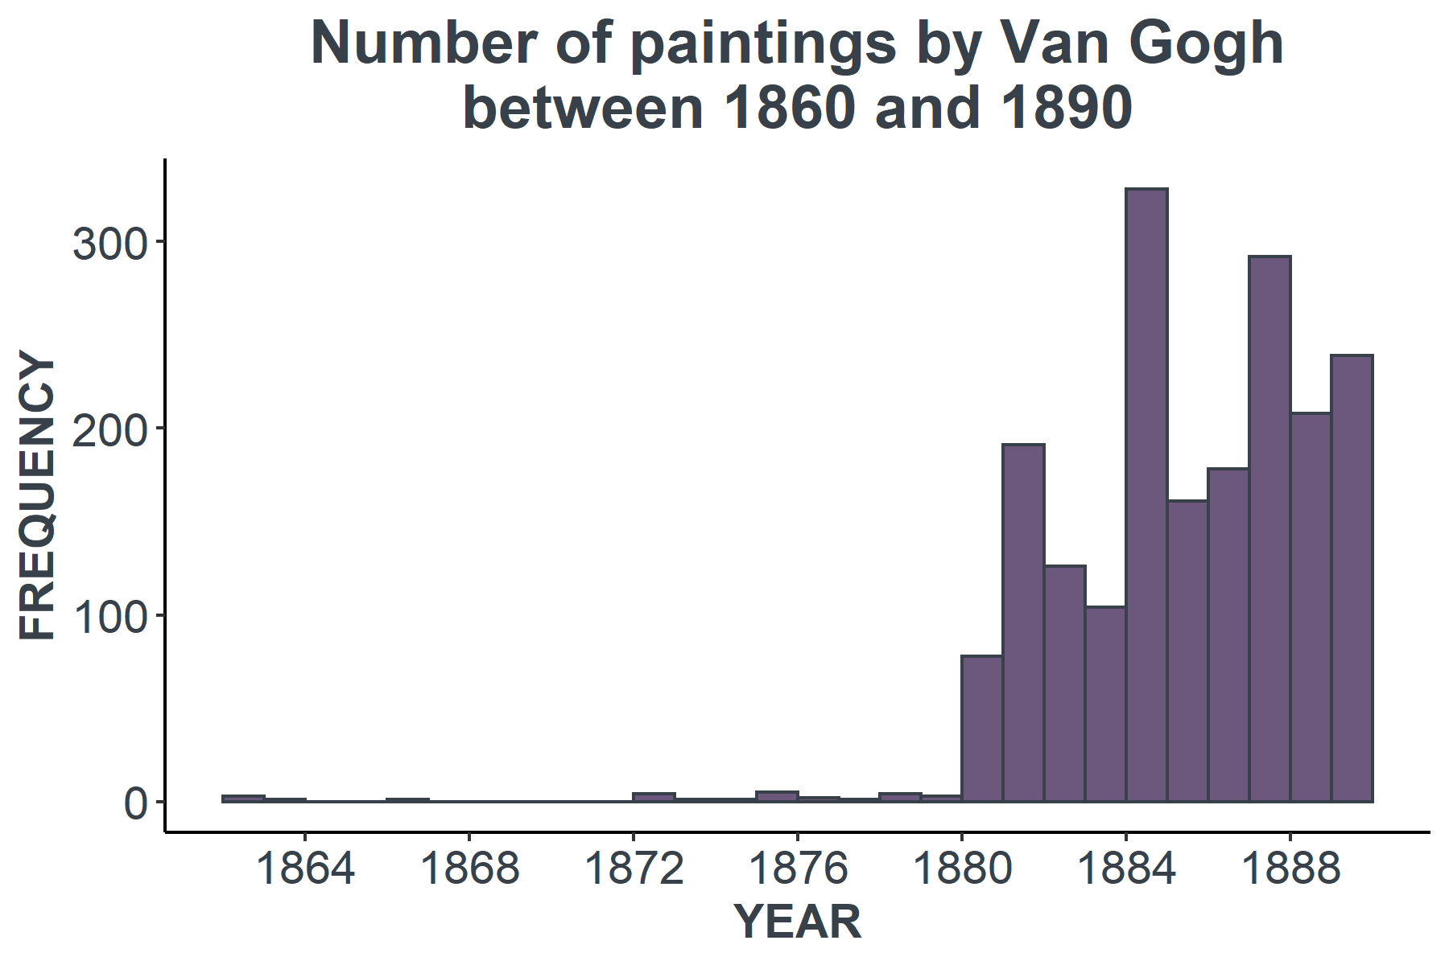

When should you use a histogram chart?
Histograms should be used if you want to compare numeric data. The numeric data on the x-axis should be grouped into bins.

Slide 15

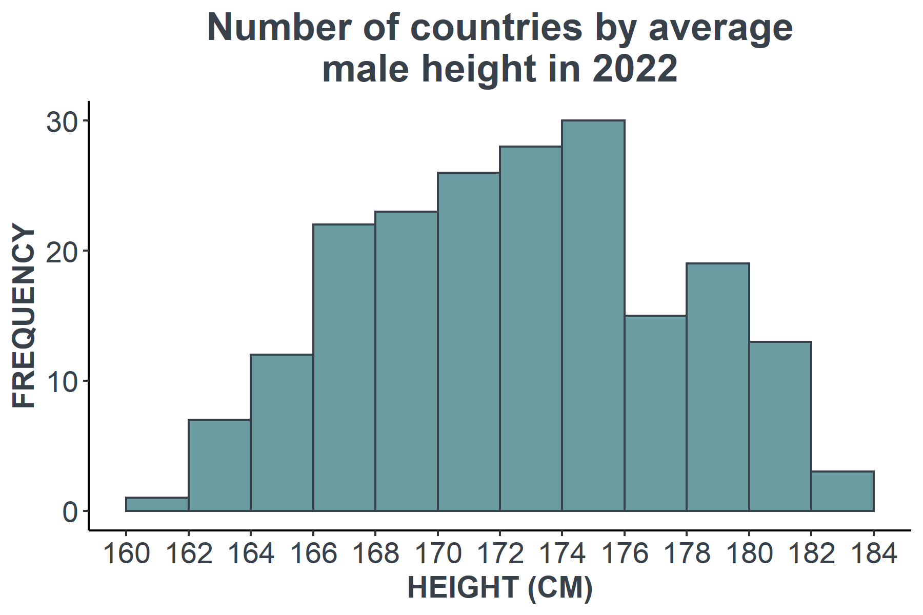
Show me…
This plot shows the average male height (cm) by country.
Each bar covers a 2cm range (e.g. 164 -166cm)
Source:
https://www.kaggle.com/majyhain/height-of-male-and-female-by-country-2022

Slide 16
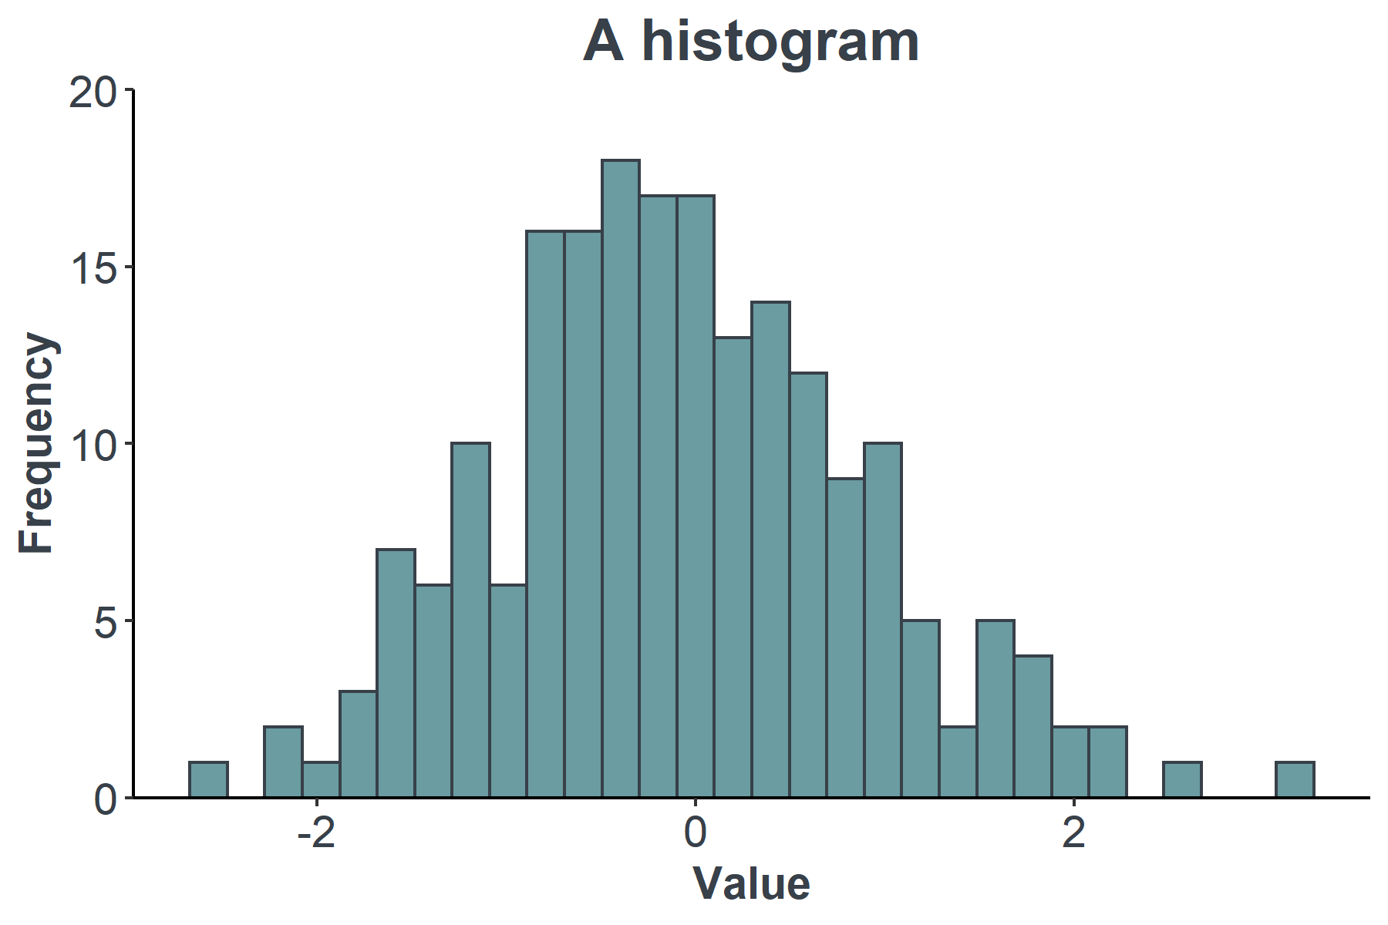
Histogram best practice
The bars on a histogram should always be displayed as touching, since the variable shown on the x-axis is continuous.
If there are gaps between the bars, then that implies missing data in that range.

Slide 17

How to create histogram
We are now going to look at how to create histograms in Excel.
We are going use a dataset that shows the average female height by country.
country_name | female_height_cm
Afghanistan | 156
Albania | 162
Algeria | 162
American Samoa | 168
Andorra | 166
Angola | 158
Antigua and Barbuda | 166
Argentina | 161
Armenia | 160
Australia | 165
Austria | 167
Azerbaijan | 161
Bahamas | 163
Bahrain | 158
Bangladesh | 152
Barbados | 166
Belarus | 167
Source:
https://www.kaggle.com/majyhain/height-of-male-and-female-by-country-2022

Slide 18
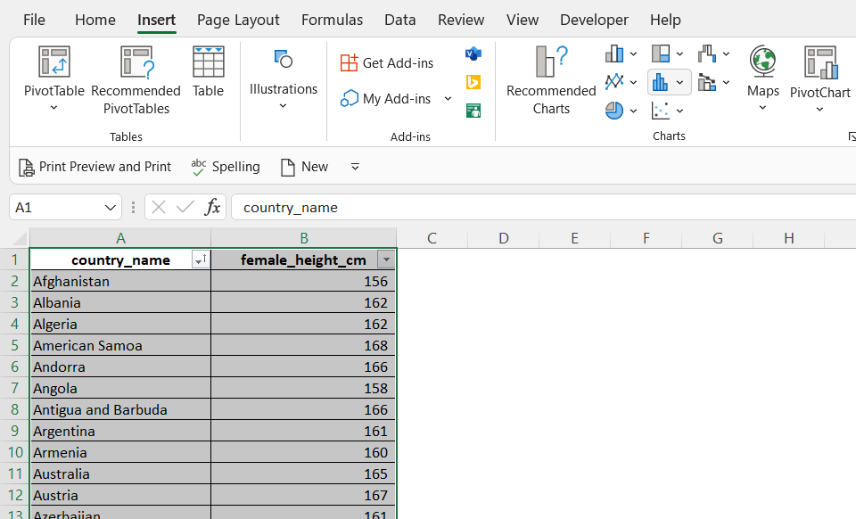
Insert a histogram
Step 1.
Highlight the dataset you are going to plot.
Then in the Insert tab, click on the icon that looks like a histogram chart.

Slide 19
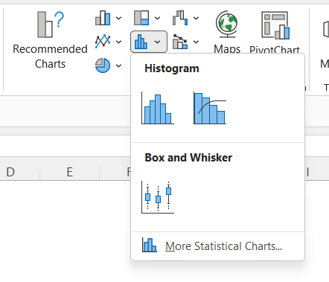
Select the appropriate histogram
Step 2.
Click on the standard histogram icon in the drop down list.
The graph will now appear in the workbook.

Slide 20
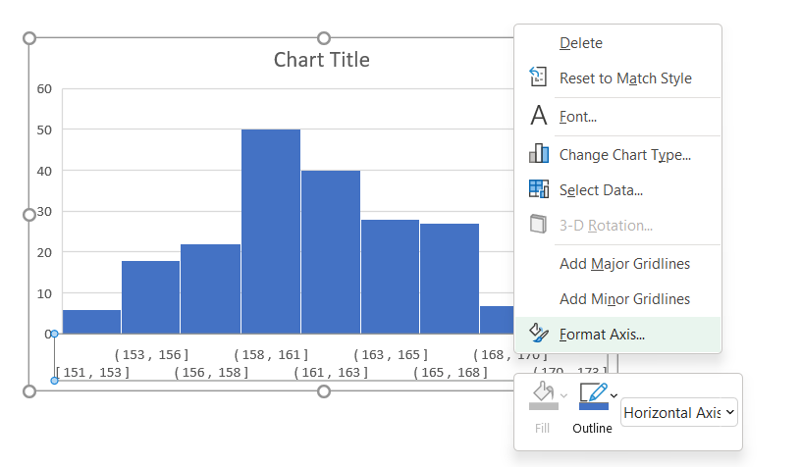
Amend the size of the bins
Step 3.
Excel will automatically decide how to group your data into bins.
Often the size of the bins will need to be amended.
Right click on the values in the x-axis, then select Format Axis.

Slide 21
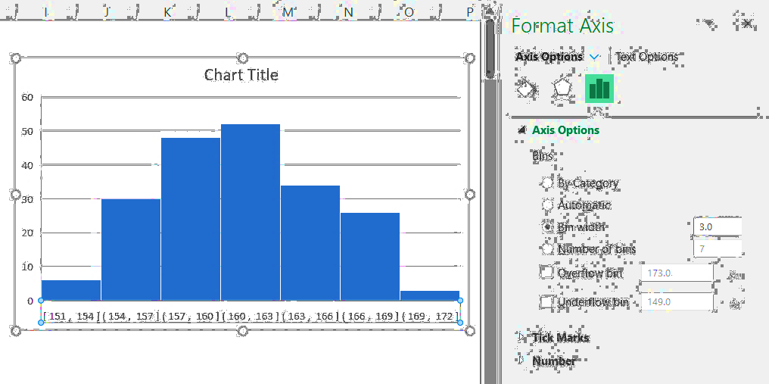
Amend the size of the bins
Step 4.
The Format Axis editor will now be open.
You can change the size of the bins either based on the width or the number of bins.
In this case the size of the bin has been changed to 3cm (e.g. 157 – 160cm)

Slide 22
Histogram vs. bar chart
Histograms and bar charts can look similar, but there are some key differences that can help you decide which one to use.
 | Bar chart | Histogram
Show categorical variables | ✓ | ✗
Reorder bars | ✓ | ✗
Touching bars | ✗ | ✓

Slide 23

Your turn…
This dataset shows the names given to baby girls born in Scotland in 2020.
If you wanted to plot a graph of this data, should you use a histogram or a bar chart?
name | number_babies
Isla | 347
Olivia | 334
Emily | 300
Freya | 284
Ava | 276
Sophie | 275
Ella | 267
Grace | 261
Amelia | 254
Lily | 208

Slide 24
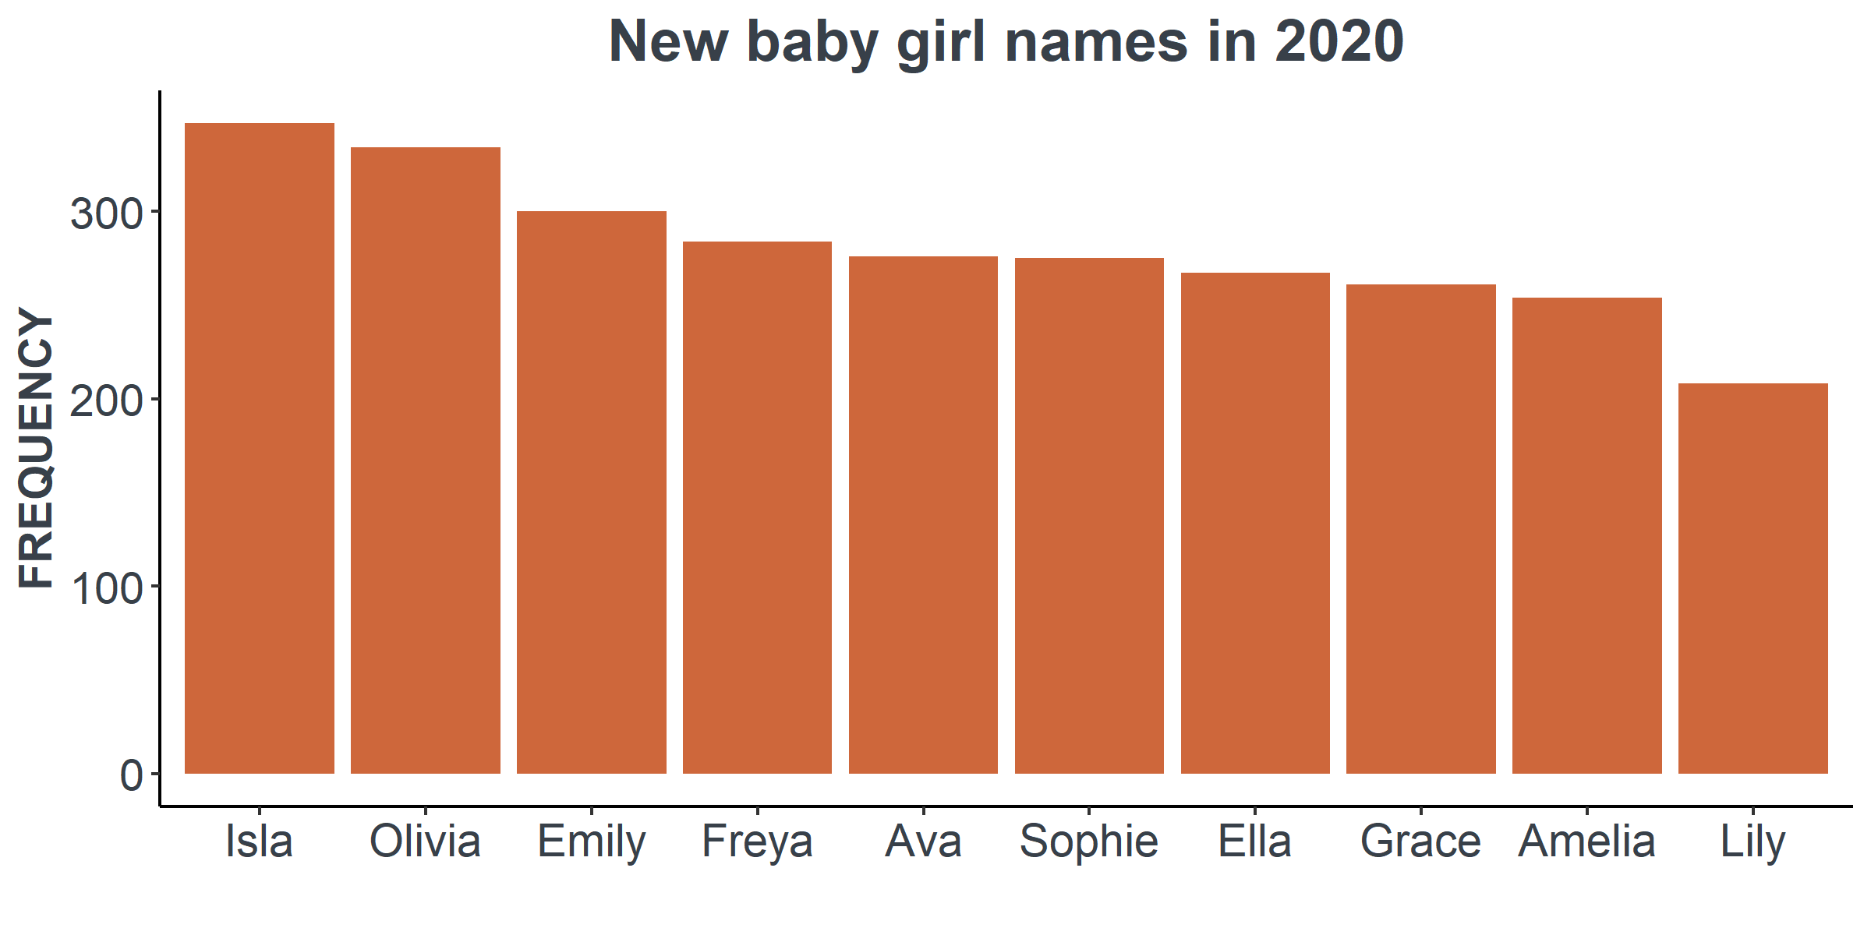
Your turn…
The graph needs to plot numeric data against different categorial values , so it needs to be a bar chart.
name | number_babies
Isla | 347
Olivia | 334
Emily | 300
Freya | 284
Ava | 276
Sophie | 275
Ella | 267
Grace | 261
Amelia | 254
Lily | 208

Slide 25
Next steps
Complete questions 1 to 5
in section 2 of the
‘Creating graphs in Excel’ workbook.

Slide 26

When should you use a line graphs?
Line graphs should be used to show the change of a numerical value as another quantity varies.

Slide 27
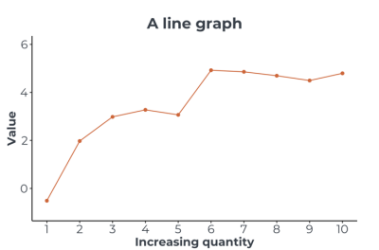
When should you use line graphs?
Line graphs compare two numeric values.
The x-axis is often time but could be another varying quantity such as temperature or distance.
The data points in a line graph are joined sequentially by lines.

Slide 28
Show me…
These lines graphs shows numeric change compared with another numeric variable.

Slide 29

How to create a line graph
We are now going to look at how to create a line graph in Excel.
We are going use a dataset that shows the male life expectancy in Scotland by year from 1980 to 2018.
year | male_life_expectancy
1982 | 69.11
1983 | 69.34
1984 | 69.60
1985 | 69.87
1986 | 70.01
1987 | 70.21
1988 | 70.35
1989 | 70.55
1990 | 70.76
Source:
https://www.nrscotland.gov.uk/statistics-and-data/statistics/statistics-by-theme/life-expectancy/life-expectancy-in-scotland/2018-2020/data-tables

Slide 30
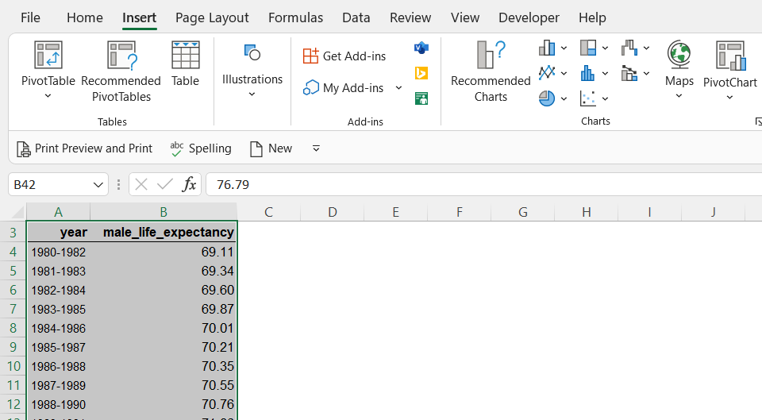
Insert a line graph
Step 1.
Highlight the dataset you are going to plot.
Then in the Insert tab, click on the icon that looks like a line graph.

Slide 31
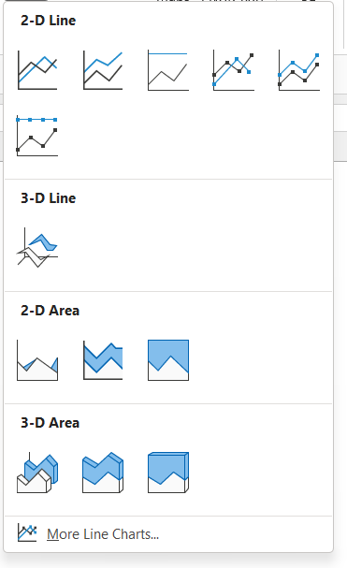
Select the type of line graph
Step 2.
Select the type of line graph you would like from the drop down list.
The graph will now appear in the workbook.

Slide 32
Next steps
Complete questions 1 to 5
in section 3 of the
‘Creating graphs in Excel’ workbook.

Slide 33
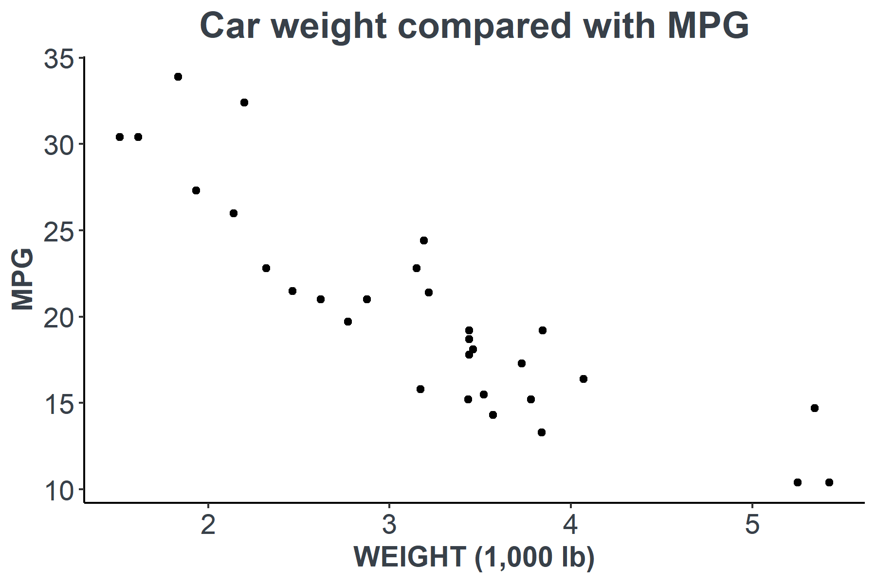

When should you use a scatterplots?
Scatterplots should be used when you want to show the relationship between two numeric variables.

Slide 34
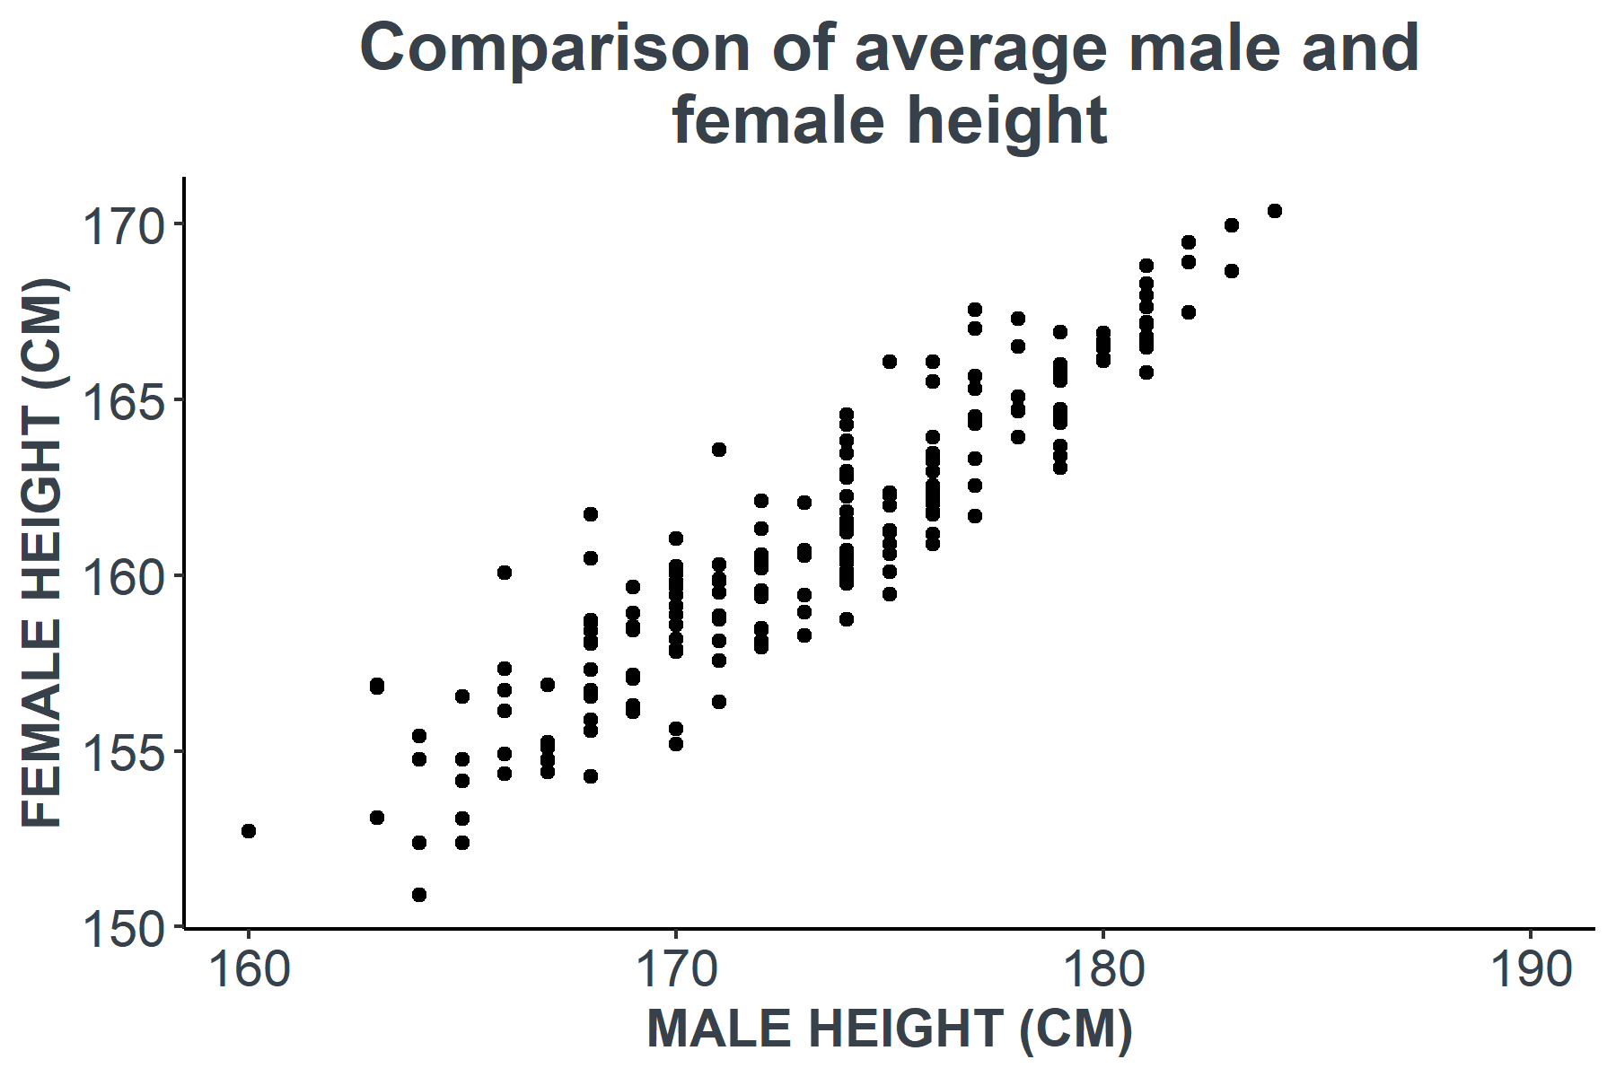
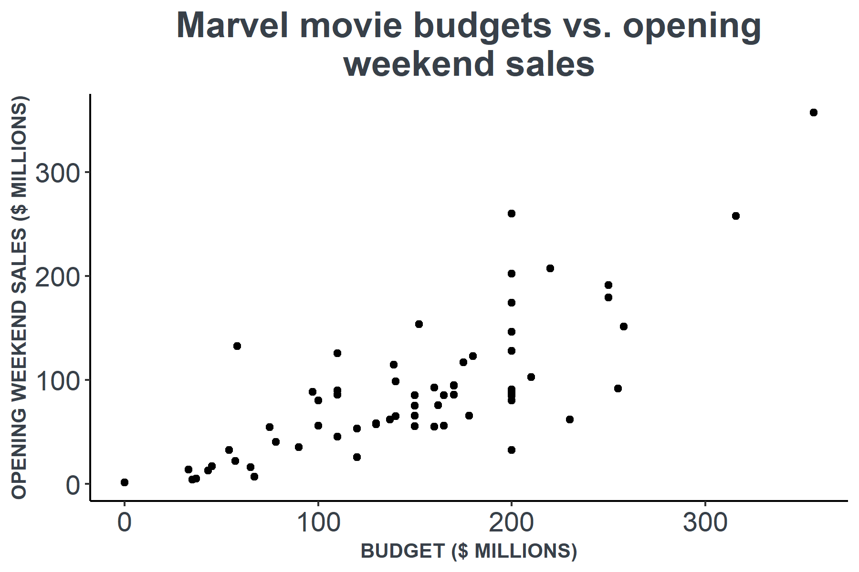
Show me…
These scatterplots show the relationship between two numeric variables.

Slide 35

How to create a scatterplot
We are now going to look at how to create a scatterplot in Excel.
We are going use a dataset that shows the percentage of empty and occupied houses by council area in Scotland.
Council_Area | Occupied | Vacant
Na h-Eileanan Siar | 86.6% | 8.1%
Argyll and Bute | 88.8% | 4.7%
Orkney Islands | 90.1% | 5.6%
Shetland Islands | 91.4% | 7.0%
Highland | 93.1% | 3.8%
Scottish Borders | 93.4% | 4.9%
Aberdeen City | 93.7% | 5.6%
Dumfries and Galloway | 93.8% | 4.3%
Moray | 94.2% | 4.1%
Aberdeenshire | 94.3% | 4.7%
North Ayrshire | 94.4% | 3.4%
Source:
https://www.nrscotland.gov.uk/statistics-and-data/statistics/statistics-by-theme/households/household-estimates/2020

Slide 36
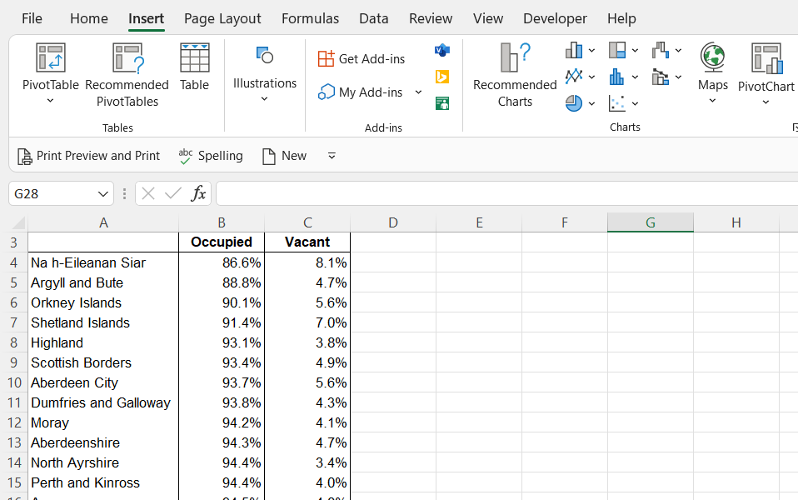
Insert a scatterplot
Step 1.
Highlight the dataset you are going to plot.
Then in the Insert tab, click on the icon that looks like a scatterplot.

Slide 37
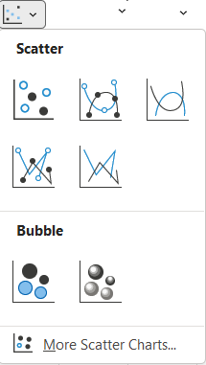
Select the type of scatterplot
Step 2.
Select the type of scatterplot you would like from the drop down list.
The graph will now appear in the workbook.

Slide 38
Next steps
Complete questions 1 to 5
in section 4 of the
‘Creating graphs in Excel’ workbook.

Slide 39
Learning checklist
I can describe how creating graphs is part of the analysis steps. I can create bar charts in Excel. I can create histograms in Excel. I can create line graphs in Excel. I can create scatterplots in Excel.

Slide 40





How you can use this lesson
You are free to:
Share – copy and redistribute the material in any medium or format
Adapt – remix, transform and build upon the material
Under the following terms:
Attribution — You must give appropriate credit, provide a link to the license, and indicate if changes were made. You may do so in any reasonable manner, but not in any way that suggests the licensor endorses you or your use.
NonCommercial — You may not use the material for commercial purposes.
ShareAlike — If you remix, transform, or build upon the material, you must distribute your contributions under the same license as the original.
© 2022. This work is licensed under a CC BY-NC-SA 4.0 license.
Created by Effini in partnership with Data Education in Schools, The Data Lab and Data Skills for Work, with funding from the Scottish Government.

Slide 41
Alternative format
If you require this document in an alternative format, such as large print or a coloured background, please contact
hello@effini.com
or
4th Floor, The Bayes Centre
47 Potterrow
Edinburgh
EH8 9BT

