Slide 1
Summarising datasets in Excel

Slide 2
Learning intentions
We will be learning to summarise datasets in Excel, specifically to calculate the total, count, min/max and average of rows data group rows of data based on logical criteria perform calculations on grouped data

Slide 3

Background
When trying to solve a problem in data science understanding the data you have is fundamental.
Rows of data can be filtered and sorted to help you understand your data.
In this lesson we will look at how you can also summarise and group rows of data.

Slide 4




Why this is important?
Some benefits of grouping and summarising data are,
Makes the data easier to work with
Focus on the important messages
Allows you to simplify your dataset
Helps you describe your data, e.g., What is the total? How many rows to you have?

Slide 5
Definition
Summarise
To condense the rows in a dataset (often to a single value) by performing a calculation on the data items within a variable.

Slide 6

Summarising data
In the similar way that you can perform calculations on columns of data, you can perform calculations on rows of data.
The most common calculations performed on rows of data are,
Count (number of rows)
Total
Average

Slide 7
Show me…
The new rows created by summarising are often shown as a separate dataset.
Original dataset
Summarised dataset
animal | age_yrs
Lion | 10
Tiger | 2
Elephant | 15
Penguin | 3
Parrot | 5
summary | age_yrs
Count | 5
Total | 35
Average (mean) | 7
Summarise

Slide 8
Show me…
When you are summarising a dataset you can select the required variables and then summarise them.
month | number_sold | price | income
Jan | 6 | 41 | 246
Feb | 5 | 27 | 135
Mar | 4 | 46 | 184
Apr | 6 | 28 | 168
May | 2 | 41 | 82
Summarise
total_number_sold | total_income
23 | 851

Slide 9

Example
This dataset shows the test results for 5 pupils. Summarise the test results in this dataset by calculating,
Count
Average (mean)
Maximum test score
Minimum test score
pupil_ID | test_1 | test_2 | test_3
GH1254 | 50% | 36% | 72%
SE1547 | 45% | 64% | 94%
DM4758 | 90% | 48% | 78%
KL4758 | 32% | 93% | 52%
PM4575 | 85% | 86% | 92%

Slide 10
Example
Summarise the test results in this dataset.
Original dataset
Summarised dataset
pupil_ID | test_1 | test_2 | test_3
GH1254 | 50% | 36% | 72%
SE1547 | 45% | 64% | 94%
DM4758 | 90% | 48% | 78%
KL4758 | 32% | 93% | 52%
PM4575 | 85% | 86% | 92%
summary | test_1 | test_2 | test_3
Count | 5 | 5 | 5
Average | 60% | 65% | 78%
Maximum | 90% | 93% | 94%
Minimum | 32% | 36% | 52%

Slide 11

Your turn…
What do you think the count, maximum and minimum would be in this dataset?
ocean | depth_m
Pacific | 3,970
Atlantic | 3,646
Indian | 3,741
Arctic | 1,205

Slide 12
Your turn…
What do you think the count, maximum and minimum would be in this dataset?
ocean | depth_m
Pacific | 3,970
Atlantic | 3,646
Indian | 3,741
Arctic | 1,205
summary | depth_m
Count | 4
Maximum | 3,970
Minimum | 1,205
Summarise

Slide 13
Summarise in Excel
We are now going to look at summarising datasets in Excel.
The table below shows the formulas we will need for this.
Calculation | Formula
Total | =sum(A,B,C,D…)
Maximum | =max(A,B,C,D….)
Minimum | =min(A,B,C,D,…)
Average (mean) | =average(A,B,C,D,…)
Count | =count(A,B,C,D,…)
For more details of the formulas in Excel, see
https://support.microsoft.com/en-us/excel

Slide 14
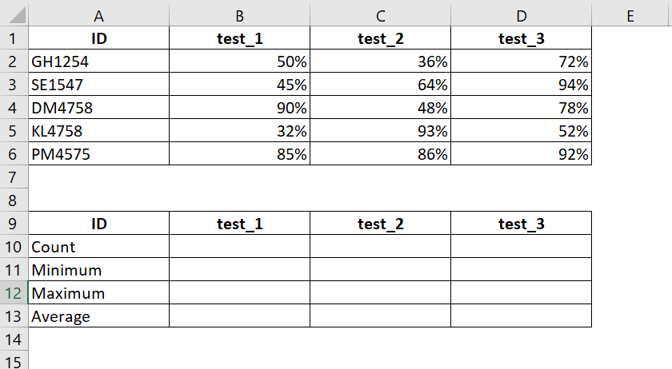
Summarising in Excel
Step 1.
Create a new dataset with the variable headings you have selected and row labels for summary types you will calculate.

Slide 15
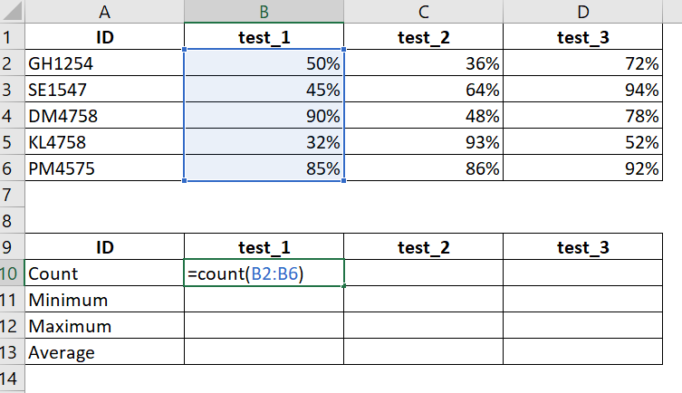
Summary formulas in Excel
Step 2.
Type in the calculation you will use to summarise the data.

Slide 16
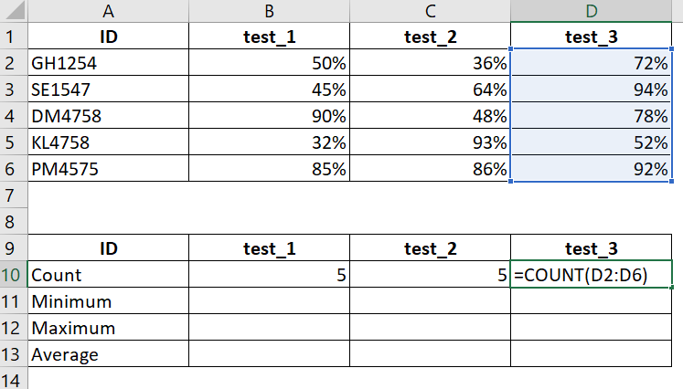
Copy formulas
Step 3.
Copy the calculation you have just typed into the first variable, and paste into the remaining variables of the new row.

Slide 17
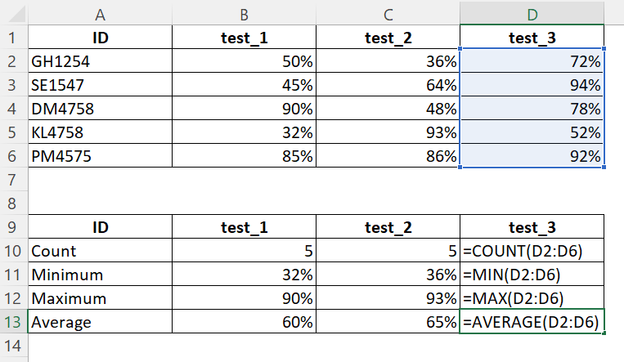
Summarise in Excel
Step 4.
Repeat the process for any other summary calculations you need.

Slide 18
Next steps
Complete questions 1 to 6
in section 1 of the
‘Summarising datasets in
Excel’ workbook.

Slide 19
Definition
Group
To split a dataset into sets of rows based on some criteria.

Slide 20






Show me…
These animals have been grouped by colour

Slide 21

Grouping data
In the last section we looked at summarising all the rows in a dataset.
Now we are going to look at how to split datasets into sets of rows then summarise these groups of rows.
In data science, it is more usual (and useful) to summarise grouped data.

Slide 22
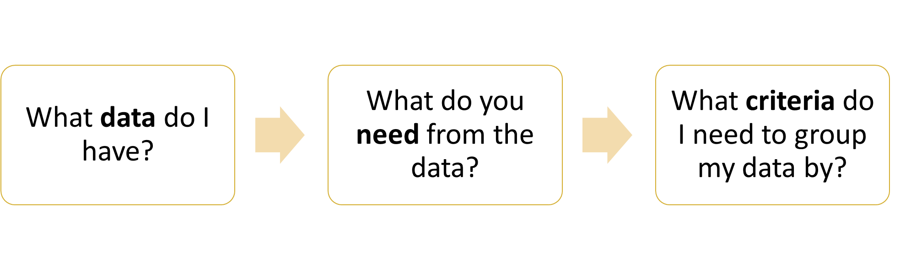
Grouping data
When grouping data it can help to think about the following questions,

Slide 23
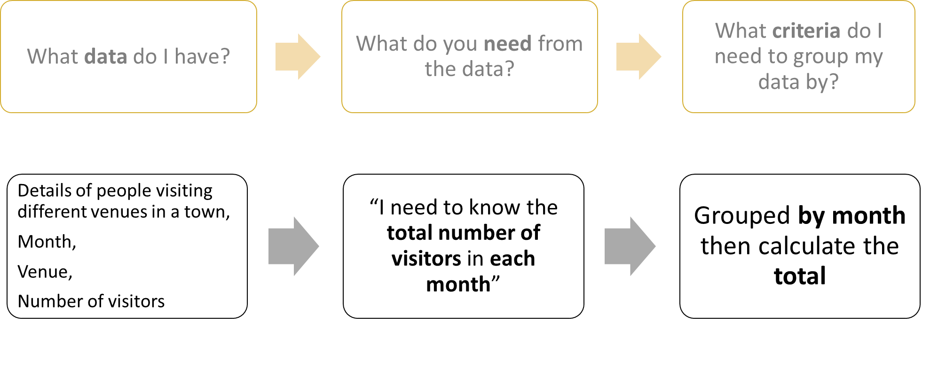
Grouping data

Slide 24
Grouping data
“I need to know the total number of visitors in each month”
month | venue | number_visitors
January | Café | 300
January | Ice cream shop | 50
January | Restaurant | 2,500
February | Café | 200
February | Ice cream shop | 40
February | Restaurant | 1,000
month | total_number _visitors
January | 2,850
February | 1,240
Group by month
Then summarise

Slide 25

Your turn…
You need to calculate the total_sales grouped by different criteria.
Can you think of some criteria you could use to group this dataset? e.g. group by price
product | colour | type | price | sales
Apple | Pink | Fruit | £1.00 | £53.00
Banana | Yellow | Fruit | £0.50 | £40.50
Carrot | Orange | Vegetable | £0.50 | £37.00
Dragon fruit | Pink | Fruit | £1.00 | £15.00
Pepper | Yellow | Vegetable | £0.50 | £12.50

Slide 26
Your turn…
product | colour | type | price | sales
Apple | Pink | Fruit | £1.00 | £53.00
Banana | Yellow | Fruit | £0.50 | £40.50
Carrot | Orange | Vegetable | £0.50 | £37.00
Dragon fruit | Pink | Fruit | £1.00 | £15.00
Pepper | Yellow | Vegetable | £0.50 | £12.50
It could be grouped by:
Colour
Type
Price
colour | total_sales
Pink | £68.00
Yellow | £53.00
Orange | £37.00
type | total_sales
Fruit | £108.50
Vegetable | £49.50
price | total_sales
£1.00 | £68.00
£0.50 | £90.00

Slide 27
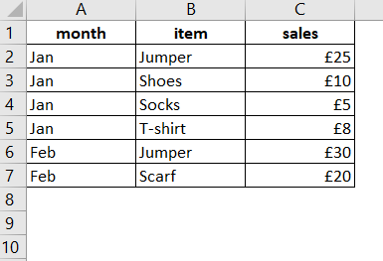
How to group a dataset in Excel
We are now going to look at how to group this dataset in Excel and calculate,
Number of sales by month (Count)
Total sales by month (Sum)

Slide 28
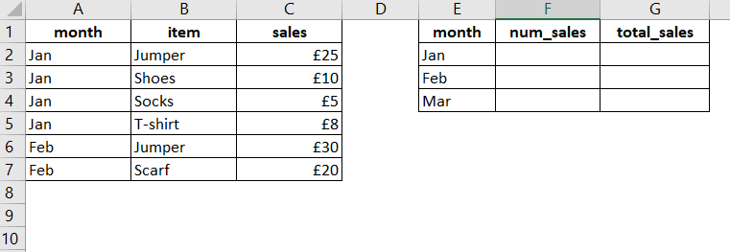
Setting up a grouped dataset in Excel
Step 1.
Create a new dataset with the variable headings and the data items you want to group by, in this case by month.

Slide 29
COUNTIF
Step 2.
As we want to count the number of sales by month, we can use an Excel function COUNTIF.
=countif(Where do you want to look?, What do you want to look for?)

Slide 30
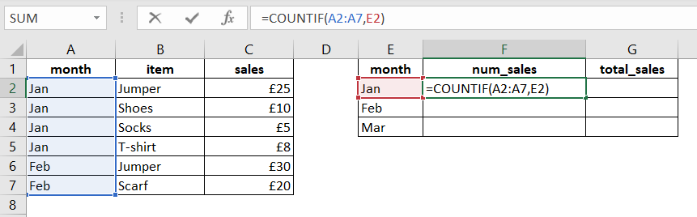
COUNTIF
=countif(Where do you want to look?, What do you want to look for?)
What do you want to look for?
Where do you want to look?
This formula looks for the string “Jan” in the cells A2 to A7 and returns the number of times it finds it.

Slide 31
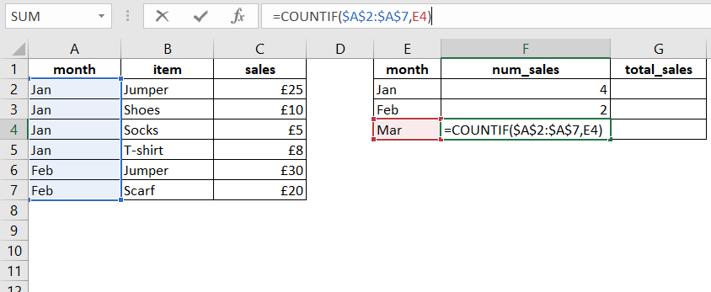
COUNTIF
Step 3.
Copy the formula and paste it into the remaining rows.
There were
4 items sold in January,
2 in February
and 0 in March.

Slide 32
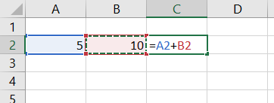
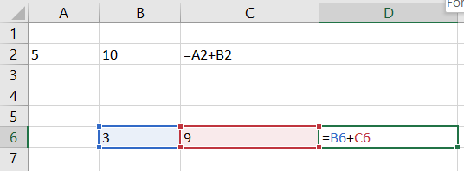
Relative vs. absolute cell references
When you type a formula that uses cell names (e.g. A2) in Excel it is looking at where the cells are compared to the formulas.
In this example, the formula is adding the 2 cells to its left.
When you copy the formula to another part of the sheet it is still adding the 2 cells to its left.
These are called relative cell references.

Slide 33
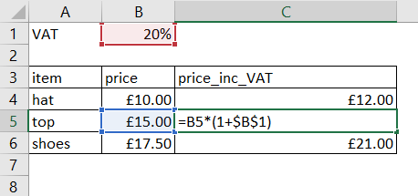
Relative vs. absolute cell references
The cell containing the VAT % is fixed and needs to be used in lots of different formulas.
Relative cell references is the standard way Excel uses formulas, and most of the time is what you will need.
However there are some times when you want specific cell(s) to be used in a formula regardless of where you copy the formula too.
These are called absolute cell references.

Slide 34
Making cells absolute references
By adding dollar signs ($) before the column letter and/or row number, it tells Excel not to change these references when copying and pasting the formula.
It makes the cell reference absolute.
=countif(A2:A7,E2)
=countif($A$2:$A$7,E2)
See ‘Switch between relative, absolute and mixed references’ for more details.
Microsoft support: switch between relative absolute and mixed references

Slide 35
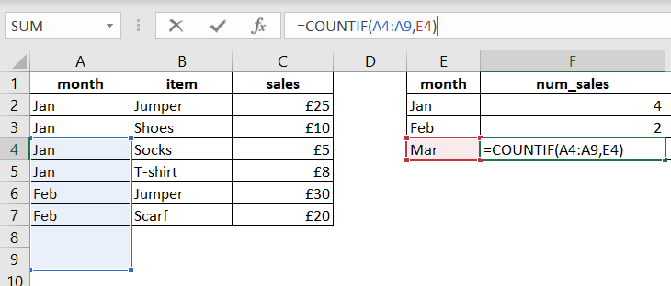
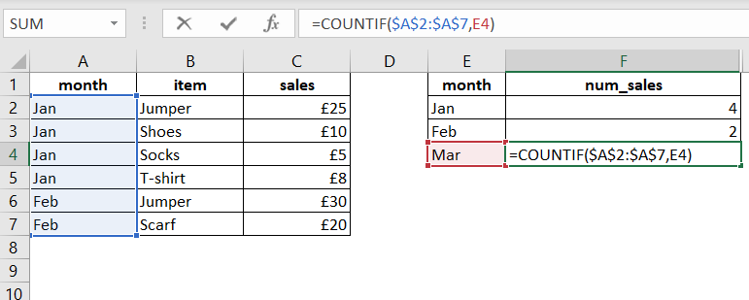
Impact of the $ signs in a formula
Without $ signs in the formula
With $ signs in the formula
The formula is looking in cells A4 to A9 rather than A2 to A7.
By adding the $ signs into the formulas, when the formula has been copied it is still referencing the cells we want.

Slide 36
Next steps
Complete questions 1 to 9
in section 2 of the
‘Summarising datasets in
Excel’ workbook.

Slide 37
More on grouping
As well as counting by a group you can calculate the total, average, maximum or minimum in a group.
Calculation | Formula
Total | =sumifs(sum_range, range, criteria)
Average (mean) | =averageifs(average_range, criteria_range, criteria)
Maximum | =maxifs(max_range, criteria_range, criteria)
Minimum | =minifs(max_range, criteria_range, criteria)

Slide 38
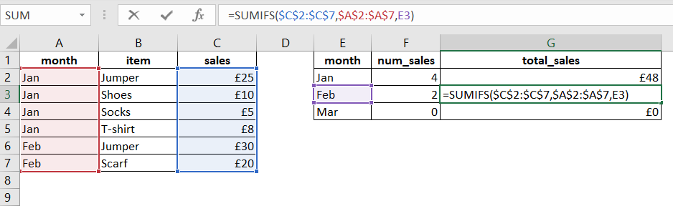
SUMIFS
In this dataset we are looking to create a variable total_sales grouped by month.
=sumifs(sum_range, range, criteria)
criteria
what you are looking for?
range
where you want to look
sum_range
what you want to add up

Slide 39
Next steps
Complete questions 1 to 8
in section 3 of the
‘Summarising datasets in
Excel’ workbook.

Slide 40

Summarising with missing values
Datasets can often contain missing or blank values. This can cause issues when you are summarising them.
How you handle these missing values can impact on your final results.

Slide 41
Summarising with missing values
If a dataset has missing values you can,
Put a value such as NA (Not Available), NaN (Not a Number) or NULL
Remove the row
With both of these options you need to careful when you go on to summarise the dataset.
ID | test_1 | test_2 | test_3
GH1254 | 50% | 36% | 72%
SE1547 | 45% | 64% | 94%
DM4758 | 90% | 48% | 78%
KL4758 | 32% | 93% | 52%
PM4575 | 85% | NA | NA

Slide 42
Show me…
Option 1: Put a value such as NA, NaN or NULL
Option 2: Remove row containing ID PM4575
ID | test_1 | test_2 | test_3
GH1254 | 50% | 36% | 72%
SE1547 | 45% | 64% | 94%
DM4758 | 90% | 48% | 78%
KL4758 | 32% | 93% | 52%
PM4575 | 85% | NA | NA
Average | 60% | 60% | 74%
ID | test_1 | test_2 | test_3
GH1254 | 50% | 36% | 72%
SE1547 | 45% | 64% | 94%
DM4758 | 90% | 48% | 78%
KL4758 | 32% | 93% | 52%
Average | 54% | 60% | 74%
The two options have produced different answers for test_1.

Slide 43
Summarising with missing values
Before you decide which option to use when handling missing values, it helps to think about these questions.
Why is there a missing value?
If you remove the row will you lose information?
Is the missing value likely to be added in later?

Slide 44

Example
Calculate the average price of these video games.
video_game | price
Super Mario Odyssey | 39.99
Call of Duty: Modern Warfare | 27.99
Mario Kart 8 Deluxe | 39.99
Hades | ?
Overcooked! All You Can Eat | 22.85

Slide 45
Example
For this dataset, the row with the missing data has been removed before the average has been calculated.
No information about the price of the games has been lost by removing the row.
video_game | price
Super Mario Odyssey | 39.99
Call of Duty: Modern Warfare | 27.99
Mario Kart 8 Deluxe | 39.99
Hades | ?
Overcooked! All You Can Eat | 22.85
video_game | average_price
All excluding “Hades” | 32.71

Slide 46
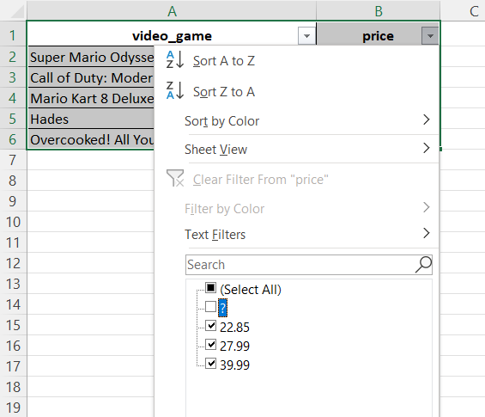
Removing rows from a dataset in Excel
Step 1.
To remove a row of data from a dataset in Excel, you need to follow the same steps as for filtering data.
Reminder: to turn on filters on dataset you need to press,
Windows | Ctrl + Shift + L
Mac | Command + Shift +L

Slide 47
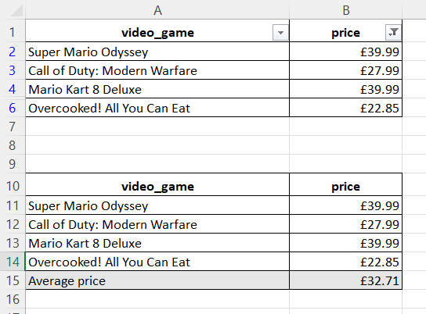
Removing rows from a dataset in Excel
Step 2.
Once you have turned on the filter, you need to select just the rows that don’t have missing values.
Then copy and paste the filtered rows into a new part of the workbook.
You can now summarise the dataset.

Slide 48
Learning checklist
I can describe how to summarise rows of data.
I can describe how to group rows of data based on logical criteria.
I can group and summarise rows of data in Excel.

Slide 49





How you can use this lesson
You are free to:
Share – copy and redistribute the material in any medium or format
Adapt – remix, transform and build upon the material
Under the following terms:
Attribution — You must give appropriate credit, provide a link to the license, and indicate if changes were made. You may do so in any reasonable manner, but not in any way that suggests the licensor endorses you or your use.
NonCommercial — You may not use the material for commercial purposes.
ShareAlike — If you remix, transform, or build upon the material, you must distribute your contributions under the same license as the original.
© 2021. This work is licensed under a CC BY-NC-SA 4.0 license.
Created by Effini in partnership with Data Education in Schools, The Data Lab and Data Skills for Work, with funding from the Scottish Government.

