Slide 1
Data types and storage

Slide 2
Learning intentions
We will be learning about the structure of data, specifically to,
understand the different data types that computers can store
understand how these data types can be combined into data structures
understand the difference between how data is stored and how it is displayed

Slide 3
Background
The way data is displayed to the end user is often different to how it is stored.
How the data is held in a computer can impact on the analysis you can perform on it.
In this lesson we are going to look at the types of data computers store and the structures they hold this data in.
0.1428
3 hours 25 mins
14.28%
1/7

Slide 4

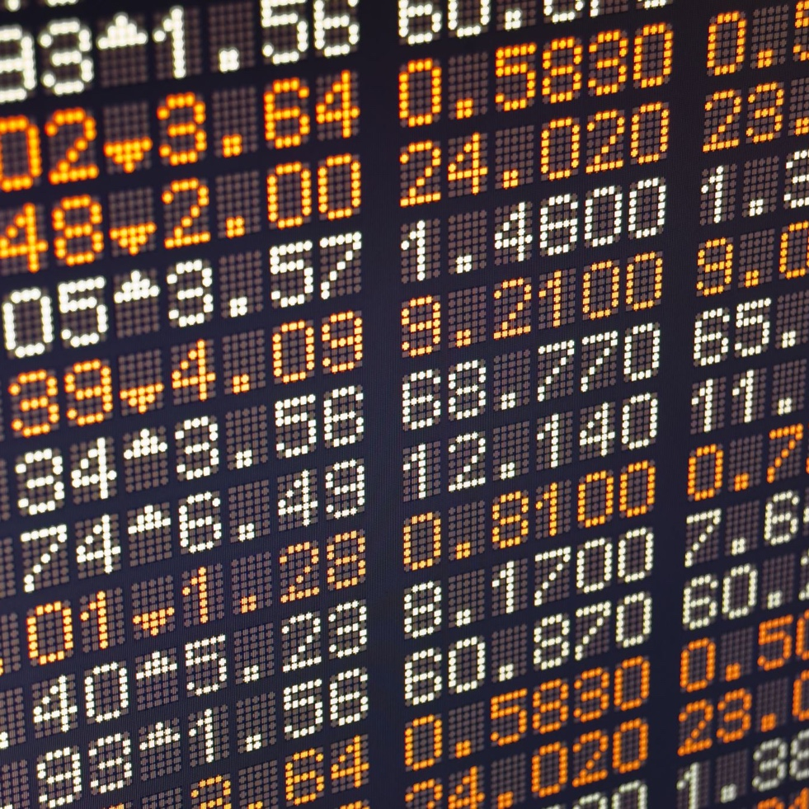

Data types
The data type refers to how data is stored internally to the computer.
The data type defines what calculations the computer can perform on it. (e.g. can you add the data?)
Changing the data type can also affect the precision of the value stored.

Slide 5
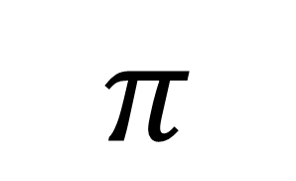
Data types
$$π$$
In data science the precision of a number relates to the number of digits stored in the computer.
By changing the data type, it can change the number of digits the computer stores.
3.14159265359…
3.142
3

Slide 6
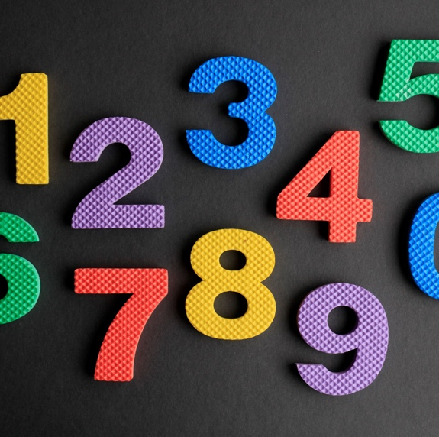
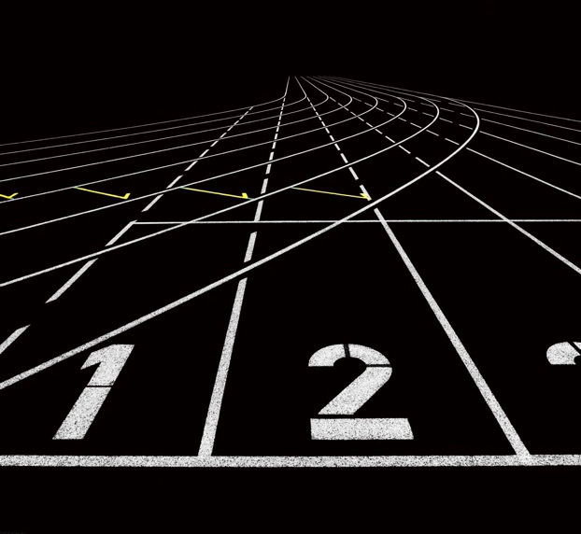
Show me…
Integer | Numbers (positive or negative) with no decimal or fractional parts
-5
-4
-3
-2
-1
0
1
2
3
4
5

Slide 7
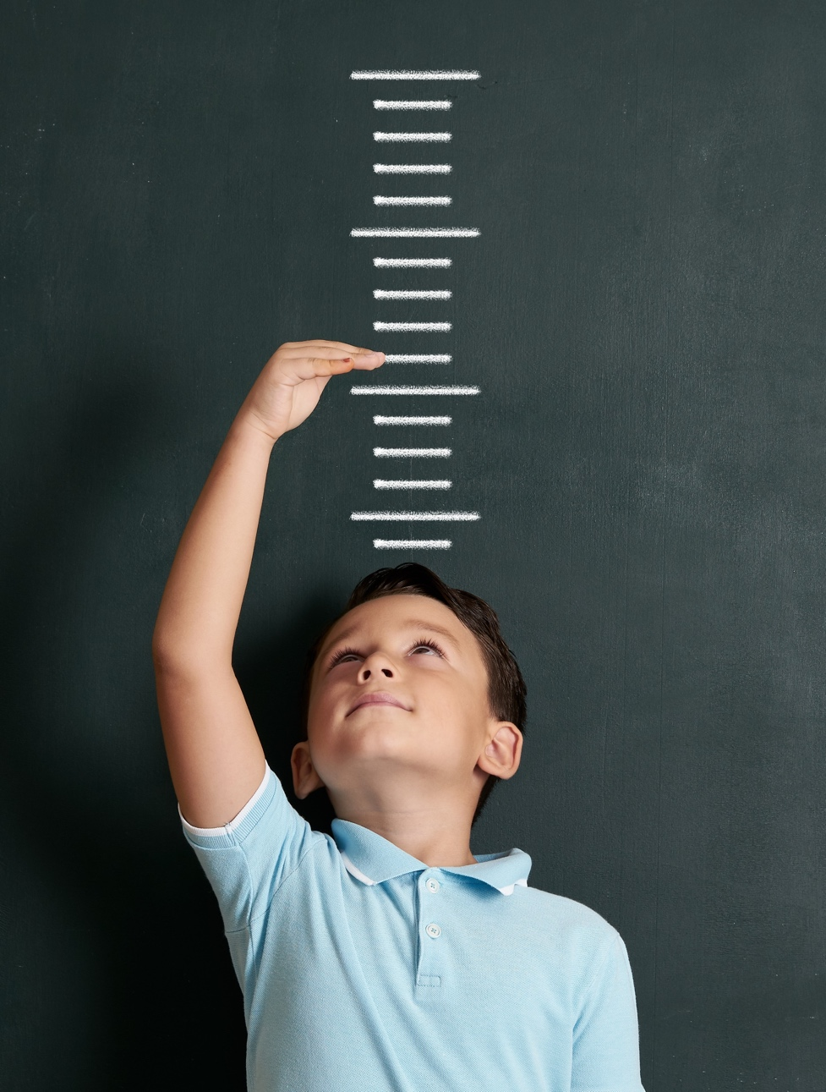
Show me…
Floating point | numbers that contain a decimal or fractional part
123.15
½
-4.33333
0.15
1.0
¾

Slide 8
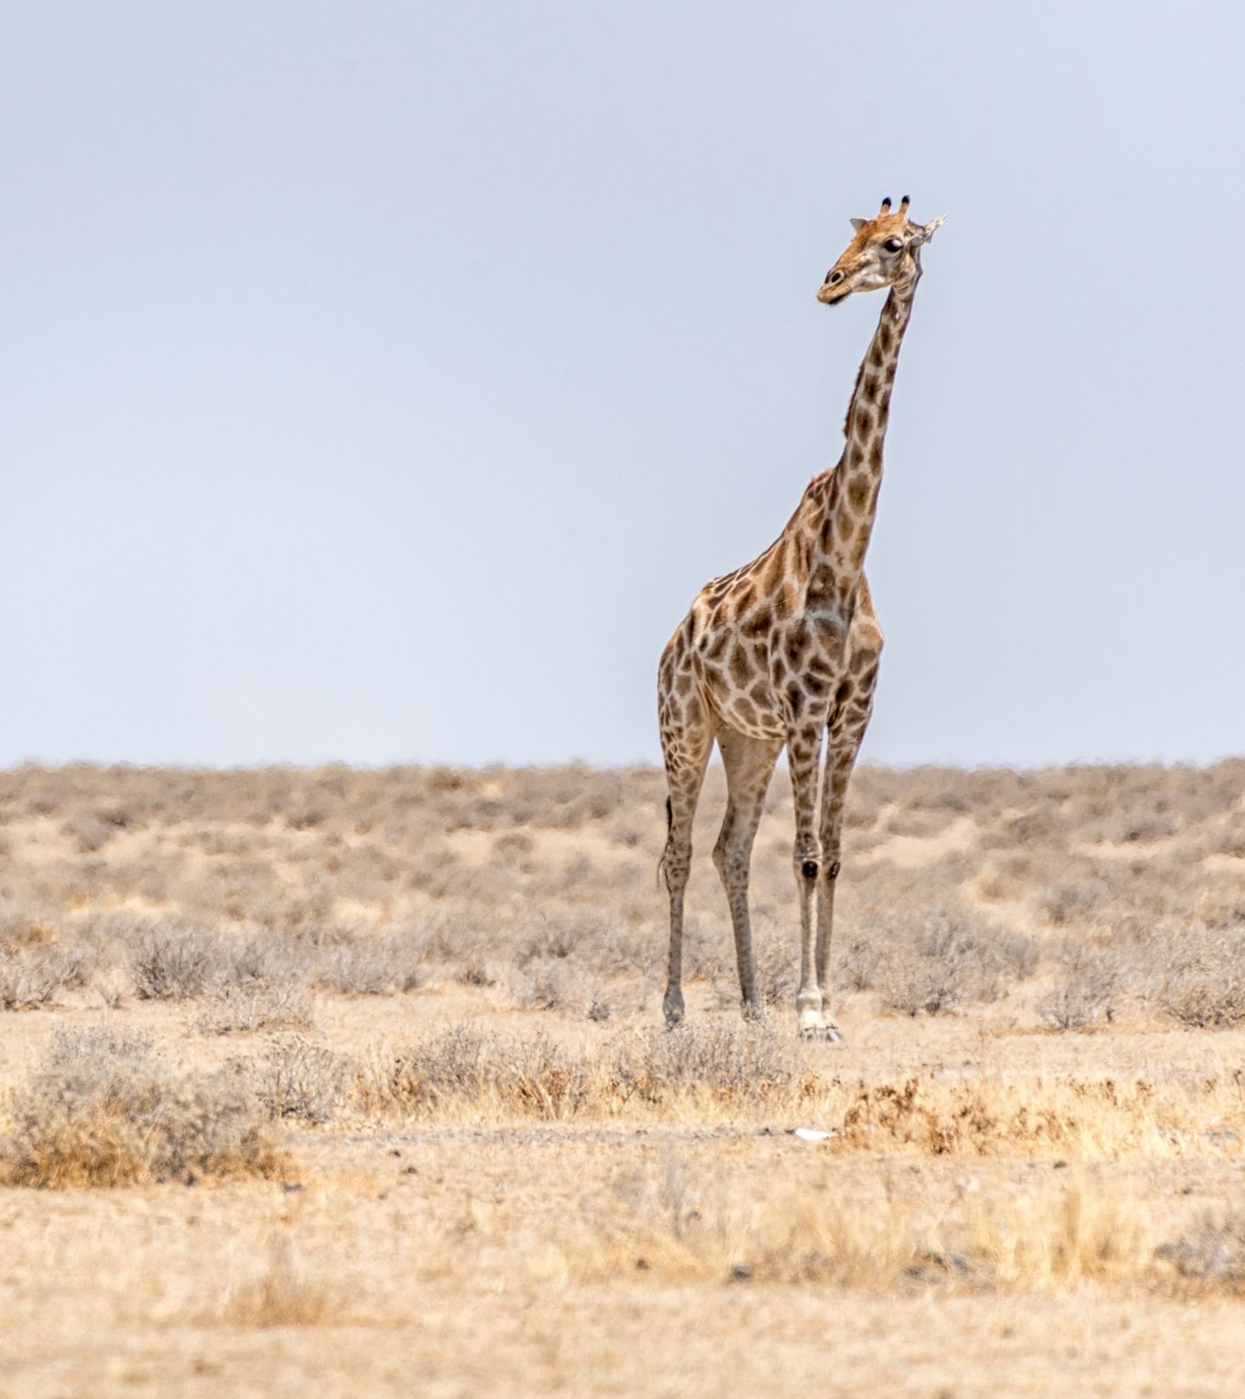
Example
What data type is the height of a giraffe (5.5 metres)?
It is a floating point.
Because it is a number that can contain a decimal or fractional part.

Slide 9

Example
What is the average height(m) of these trees when using different data types?
 | Floating point (2dp) | Integer
tree_1 | 2.12 | 2
tree_2 | 2.49 | 2
tree_3 | 5.13 | 5
Average | 3.25 | 3
There is 0.25m difference in the average height of the trees when using the different data types.

Slide 10
Show me…
Character | a single text character which can be a letter, number or symbol
A
?
f
4
£
&

Slide 11
Show me…
Boolean | can only take two possible values, such as true/false or yes/no.
Boolean data is often stored as 0/1 where 1 is true or yes

Slide 12
Data types
For computers, interpreting days, months, years, minutes and seconds is complicated.
To overcome this, computers process date/time as the time passed since the ‘epoch’ date.
Different software languages use different ‘zero points’ to count time from.
Software/language | Epoch date
Unix (e.g. Python) | 1 Jan 1970
Microsoft Excel | 1 Jan 1900
Windows NT | 1 Jan 1601
MATLAB | 0 Jan 1 BC
Google Sheets | 30 Dec 1899

Slide 13
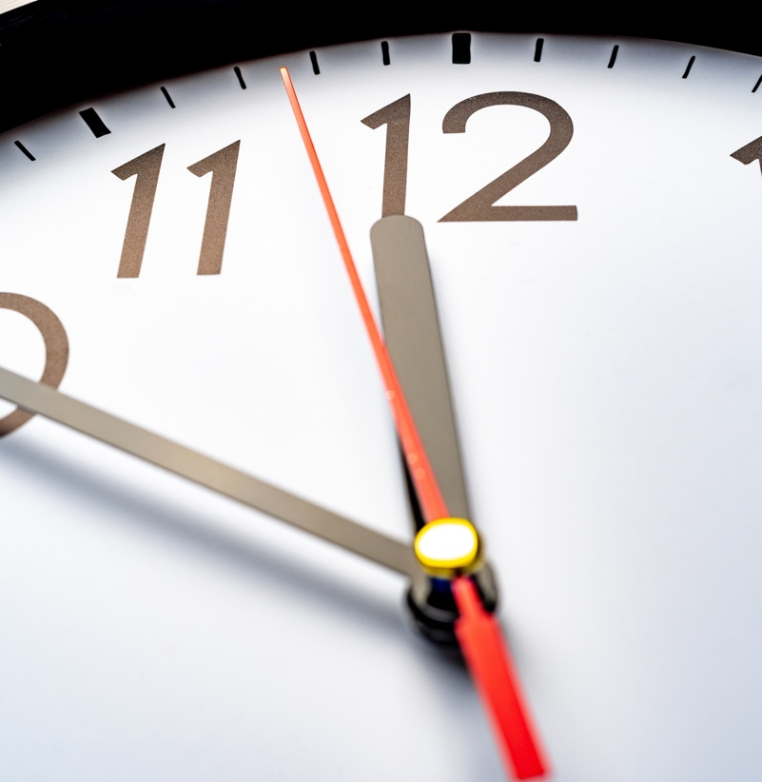
Show me…
Date and time | the number of days or seconds passed since the 'epoch' date
1st Jan 2022 = 44562*
1 hour 30 mins = 0.06
* This example is based on Microsoft Excel.

Slide 14

Example
Date/Time data type
the number of days or seconds passed since the 'epoch' date
What number will Microsoft Excel store when the end user sees the date of 1st January 2030?
In Excel, the ‘epoch’ date is 1/1/1900.
They are 47,484 days between 1/1/1900 and 1/1/2030.
Therefore, Excel will store the number 47,484.

Slide 15

Your turn…
You are collecting data on people attending a lesson. What data types are these?
Integers: numbers with no decimal or fractional parts
Floating point: numbers that can contain a decimal or fractional part
Character: a single text character which can be a letter, number or symbol
Boolean: can take two possible values such as true/false or yes/no.
Date and time: the number of days or seconds passed since the 'epoch' date, normally 1/1/1970.
Information | Example | Data type
Date of lesson | 15/5/2019
Age of student (whole numbers) | 16
Arrived on time? | Yes
Test result (in %) | 75%

Slide 16
Your turn…
You are collecting data on people attending a lesson. What data types are these?
Integers: numbers with no decimal or fractional parts
Floating point: numbers that can contain a decimal or fractional part
Character: a single text character which can be a letter, number or symbol
Boolean: can take two possible values such as true/false or yes/no.
Date and time: the number of days or seconds passed since the 'epoch' date, normally 1/1/1970.
Information | Example | Data type
Date of lesson | 15/5/2019 | Date
Age of student (whole numbers) | 16 | Integer
Arrived on time? | Yes | Boolean
Test result (in %) | 75% | Floating point

Slide 17
Next steps
Complete questions 1 to 4
in section 1 of the
‘Data types and storage’ workbook.

Slide 18

Data structure
Imagine all your clothes in a pile on the floor. How long would it take you to find a specific jumper you want to wear?
Now imagine your clothes are organised in a structured way in your wardrobe and drawers. How long would it take to find your jumper now?
For computers to find data efficiently, the data needs to be held in a structure.

Slide 19
Definition
Data structure
The way data is organised in a computer to make it easier and quicker to use.

Slide 20

Data structures
By using the appropriate data structures, it can allow for faster and easier processing of data.
The structure types normally used to store data are,
String
Array
Dataset

Slide 21
Show me…
Strings | a collection of characters combined to create alphanumeric text
BA1542
Edinburgh
#Friday
@scotland
AA 12 34 56 B
Your Name

Slide 22
Show me…
Substrings | a set of characters that exist inside a string
String
Substring
BA
The substring is any sequence of characters that are inside the original text.
1542
BA1542
BA1
BA154
A154

Slide 23
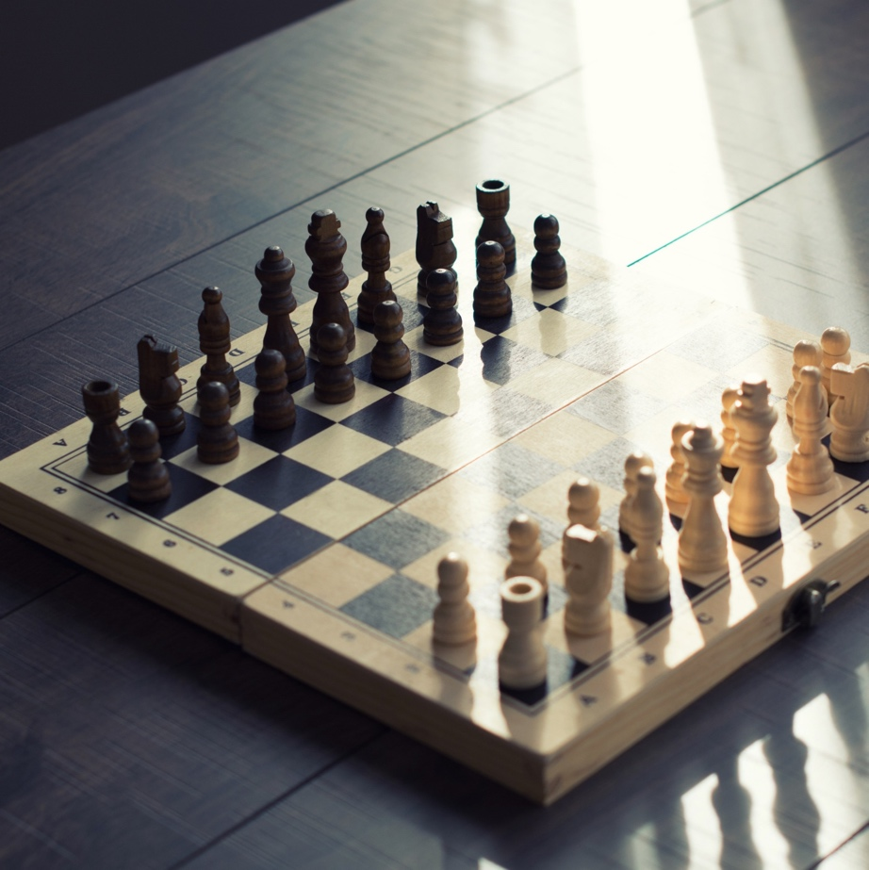

Show me…
Array | a structure of a fixed size which holds items of the same data type
Red | Blue
Yellow | White
Purple | Green
4 | 11 | 15 | 57 | 90

Slide 24
Show me…
Dataset | A two-dimensional structure that has rows and columns.
unique_id | age | score | comment
145G45R | 15 | 100.0 | Pass
1755FG | 43 | 39.5 | Needs retake
LH452d | 34 | 65.0 | TBC
Each column can hold different data types
Every cell must contain some information

Slide 25
Your turn…
How could you turn this shopping list into a dataset with the following headings, “item”, “colour”, “weight_g”, “quantity”?
To buy
Bread
Pasta (500g)
Blue milk
Red milk
5 apples
Dataset
A two-dimensional structure that has rows and columns.

Slide 26
Your turn…
Turn this shopping list into a dataset.
Each column holds a different type of information
To buy
Bread
Pasta (500g)
Blue milk
Red milk
5 apples
item | colour | weight_g | quantity
Bread | NA | NA | 1
Pasta | NA | 500 | 1
Milk | Red | NA | 1
Milk | Blue | NA | 1
Apples | NA | NA | 5
Every cell has some information

Slide 27
Next steps
Complete questions 1 to 4
in section 2 of the
‘Data types and storage’ workbook.
Then complete questions 1 to 5
in section 3 of the
‘Data types and storage’ workbook.

Slide 28
Learning checklist
I can describe common stored data types and understand that they can be different from the displayed format.
I can describe the structures data can be held in.

Slide 29





How you can use this lesson
You are free to:
Share – copy and redistribute the material in any medium or format
Adapt – remix, transform and build upon the material
Under the following terms:
Attribution — You must give appropriate credit, provide a link to the license, and indicate if changes were made. You may do so in any reasonable manner, but not in any way that suggests the licensor endorses you or your use.
NonCommercial — You may not use the material for commercial purposes.
ShareAlike — If you remix, transform, or build upon the material, you must distribute your contributions under the same license as the original.
© 2021. This work is licensed under a CC BY-NC-SA 4.0 license.
Created by Effini in partnership with Data Education in Schools, The Data Lab and Data Skills for Work, with funding from the Scottish Government.

