Slide 1
Practise creating graphs in Excel (part 2)
Version: 1.0

Slide 2
Learning intentions
We will be learning more about creating line graphs and scatterplots in Excel, specifically, how to make standard changes to line graphs and scatterplots how to plot a line graph without date value variables how to add data labels how to amend data points

Slide 3

Background
Creating graphs is a useful tool when looking for patterns as part of the analysis steps.
We have looked at design choices and how to create basic graphs in Excel.
Now we are going to look at ways to amend line graphs and scatterplots.
Data understanding
Data cleansing
Data manipulation
Identifying patterns
Extracting insights

Slide 4
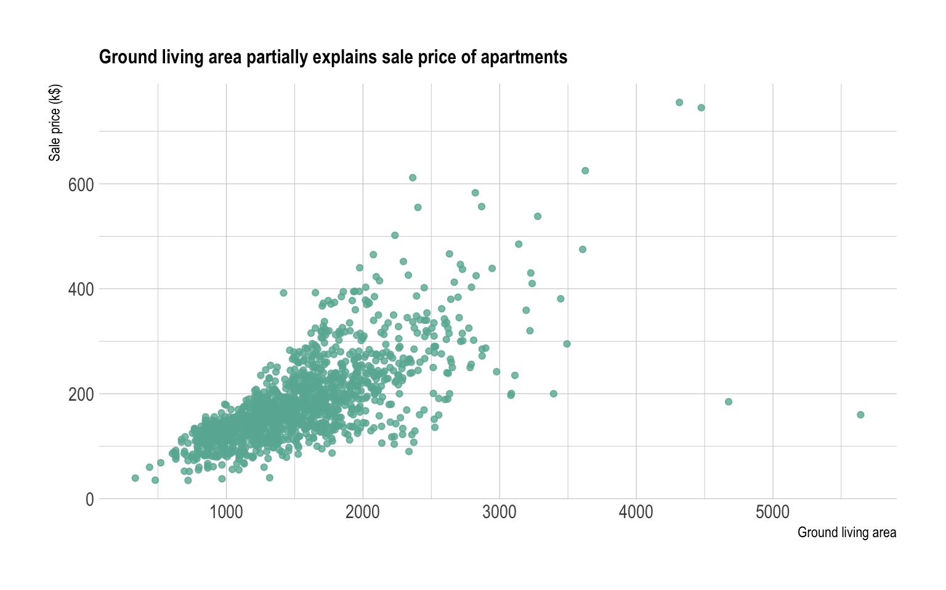
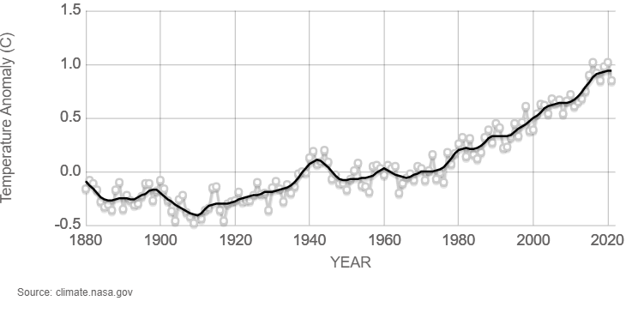
Show me…
Below are examples of line graphs and scatterplots used by NASA and data-to-viz.com
https://climate.nasa.gov/vital-signs/global-temperature/
https://www.data-to-viz.com/graph/scatter.html

Slide 5

Creating a line graph in Excel
In this lesson we are going to use a dataset that shows the number of weddings in Scotland by year since 1900.
We will start with the default graph and amend it.
The instructions in this lesson are for Microsoft Excel on a Windows based machine. If you are using something different (e.g. Mac) the position of menus/options might be different.

Slide 6
Before vs. after line charts
Below are graphs created using the wedding dataset. The first is the default graph created, and the other is after it has been amended. We will now work through how to create the second graph in Excel.
Source: https://www.nrscotland.gov.uk/statistics-and-data/statistics/statistics-by-theme/vital-events/marriages-and-civil-partnerships/marriages-and-civil-partnership-time-series-data

Slide 7
Amending the default graph
We will start with the Excel default graph and go through the steps to make the following changes,
Fixing common line graph “bug”
Change the display format of the numbers
Removing the legend
Amend the gridlines
Changing the major tick marks
Adding data labels
Change the line

Slide 8
Common “bug” when creating line graphs
Year | Marriages
1900 | 32444
1901 | 31387
1902 | 31913
1903 | 32351
1904 | 32271
1905 | 31270
1906 | 33142
Line graphs generally are used to when you have a date or time variable on the x-axis.
If you have a dataset where the variable isn’t a full date/time value
(e.g. it’s only the month or year part) Microsoft Excel doesn’t plot the data as you expect.
One way of fixing this issue is to convert the variable to a date format.

Slide 9
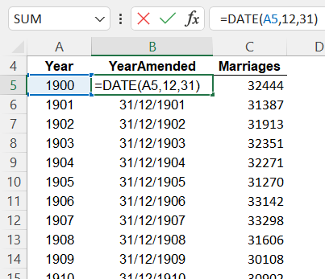
Create new date value from year
The value in the Year variable is seen by Excel as an integer. Line graphs need a date value to work correctly.
By using the DATE function in Excel you can create an new date variable.
=DATE(year,month,day)

Slide 10
Plot the line graph using new variable
By plotting the graph using the new variable (YearAmended), the x-axis looks how you would expect.

Slide 11
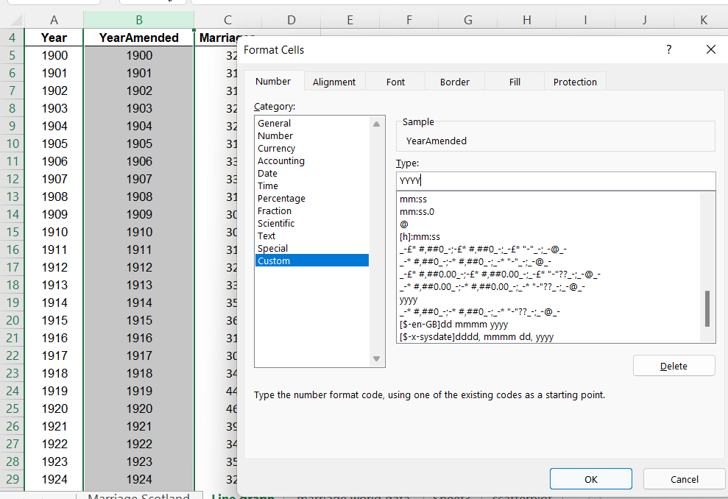
Changing the display format
To change the format of new variable (YearAmended) so it appears as just a year, you need to
Select the variable in the dataset
Open up Format Cells window (Crtl+1).
Click on the ‘Custom’ category.
Type “yyyy” into the Type space.
For more information on creating custom display formats, please see
https://support.microsoft.com/en-us/office/create-and-apply-a-custom-number-format

Slide 12
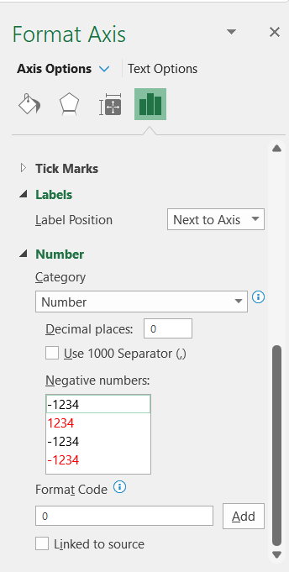
Changing the y-axis display format
As well as changing the display format of the data in the dataset, you can also just change the display format of the numbers in the graph in the Format Axis pane.

Slide 13
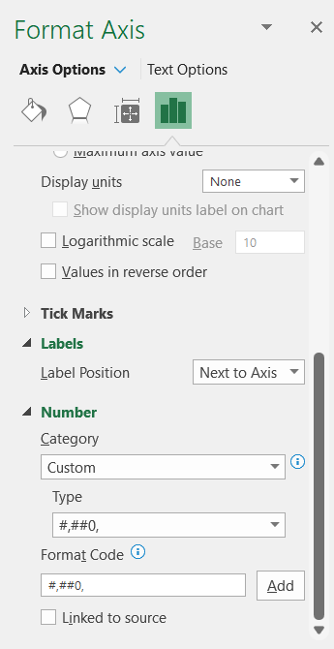
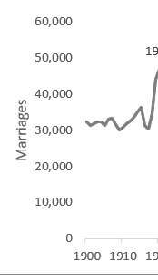
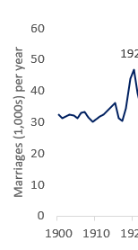
Format numbers in thousands
To change the data so it is shown in thousands you need add a ‘Custom’ Type.

Slide 14
Creating custom data formats thousands
To create a custom thousands data format,
Select Custom from the Category drop down option
Type #,##0, into the Format Code box and then press “Add”
Select the format you have just created (#,##0,) from the Type drop down option

Slide 15
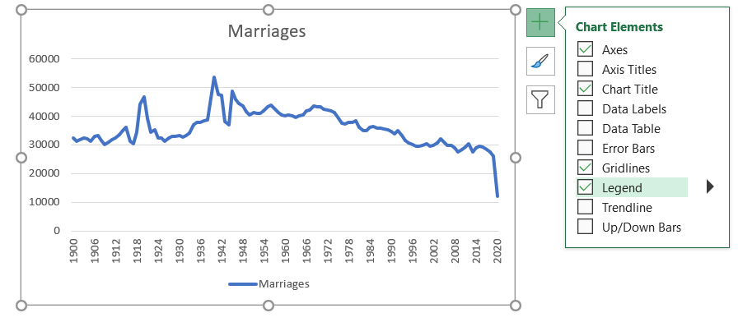
Removing a Legend
To remove a legend from your graph that you do not need.
Click on the + button at the right hand side of the graph
Untick the box next to Legend option

Slide 16
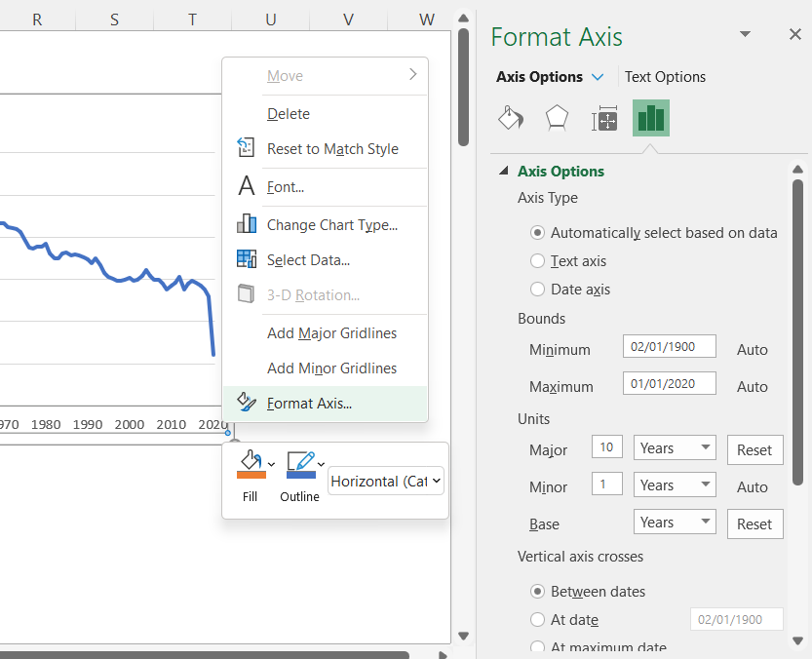
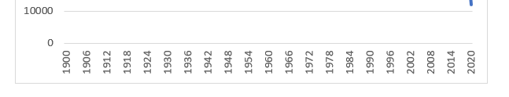
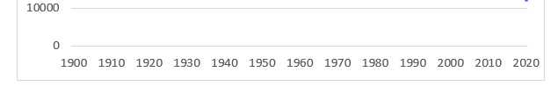
Change the major tick marks
Reminder
Tick marks should be spaced so they make it easier for the reader
You can change how the tick marks are displayed on the x-axis by opening the Format Axis pane.
In this case the major tick marks are going to shown every 10 years.

Slide 17
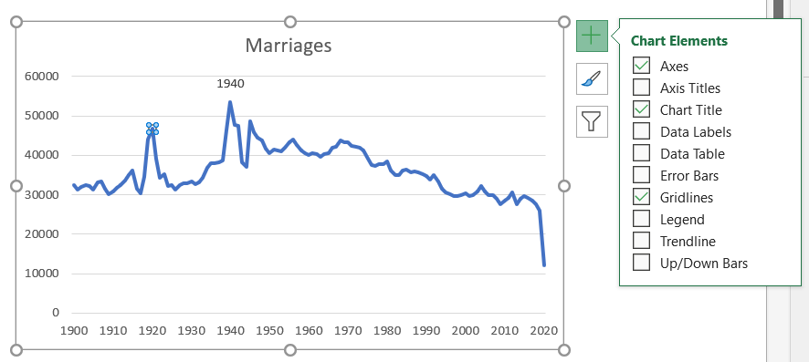
Add data labels
Reminder
Data labels should highlight key information for the reader
If you want to add data labels to specific points on your line graph you need to,
Click on the data point
Select ‘Data Labels’ from the chart elements

Slide 18
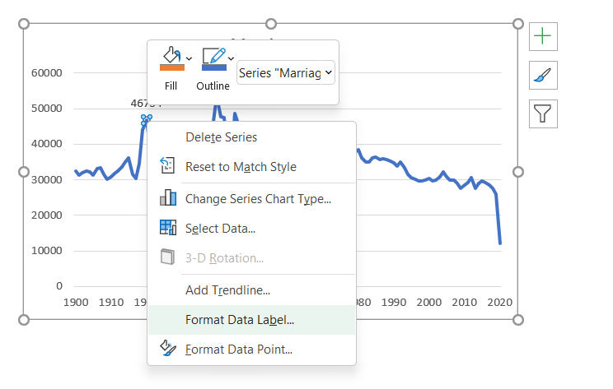
Amend the data labels
When the data label is added to the graph, the default is to show the y-axis value ( e.g. number of marriages).
On this graph we want to label the year instead.
Right click on the data point and select ‘Format Data Label’.

Slide 19
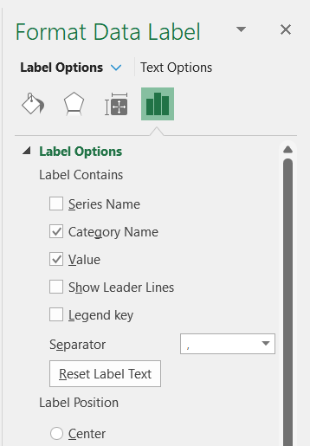
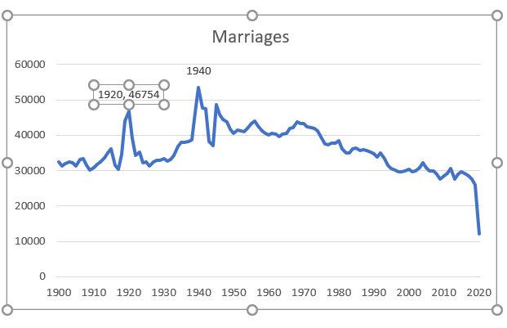
Amend data labels
The label options allows you to change what you want to be shown on the graph.
We want to show the year (from the x-axis) which Excel calls the ‘Category Name’.

Slide 20
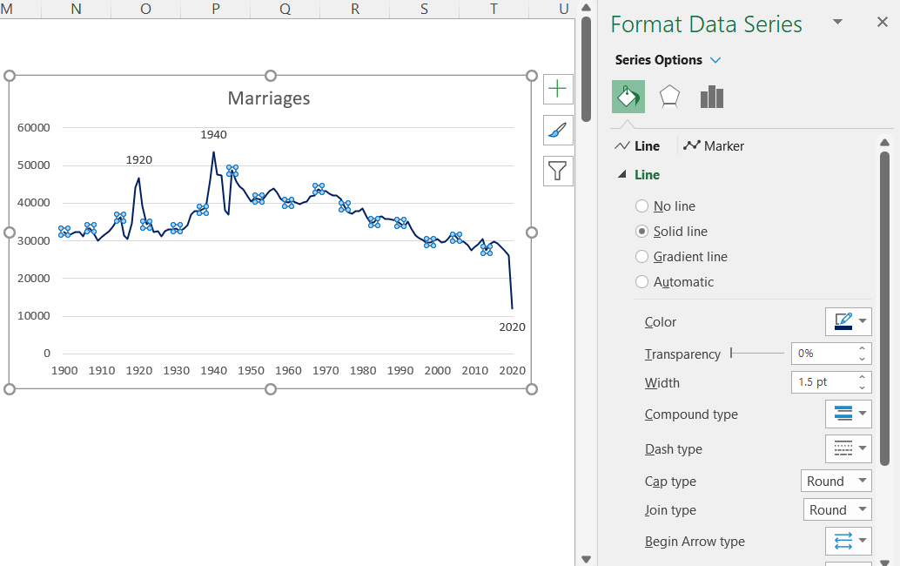
Change the line style
Reminder
Design with accessibility (e.g. colour-blindness) in mind
To change the line style or colour, right click on the line and choose ‘Format Data Series’.
This will open up the Format Data Series pane where you edit the style of the line.

Slide 21
Change the axis and chart titles
Now you have amended the elements of the graph you can change/add axis and chart titles in the same way as you did in previous graphs.

Slide 22
Next steps
Complete questions 1 to 10
in section 1 of the
‘Practise creating graphs
in Excel (part 1)’ workbook.
Then complete questions 1 and 2 in section 2.

Slide 23

Creating a scatterplot in Excel
Now, we are going to use a dataset that has the Happiness index and Life Expectancy of cities to create a scatterplot.
Again we will start with the default Excel graph and then amend it.

Slide 24
Before vs. after scatterplots
Below are graphs created using the happiness vs. life expectancy dataset. The first is the default graph created, and the other is after it has been amended.
Source: https://www.lenstore.co.uk/research/healthy-lifestyle-report/

Slide 25
Amending the default graph
We will start with the Excel default graph and go through these steps to amend the graph,
Add axis title
Amend the gridlines
Change the axis range
Format data points
Add a trendline
Change the chart title

Slide 26
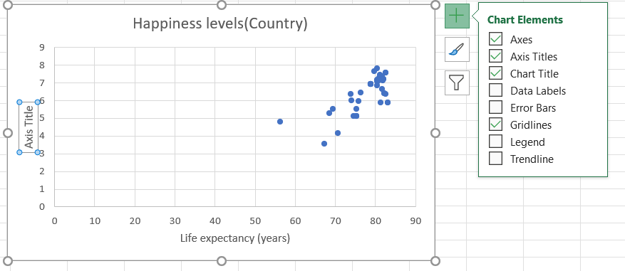
Adding axis titles
Reminder
Axis titles avoid confusion around what is being shown
To add axis or chart titles to a graph, click on the graph then press + button on the right hand side and select chart elements you need.

Slide 27
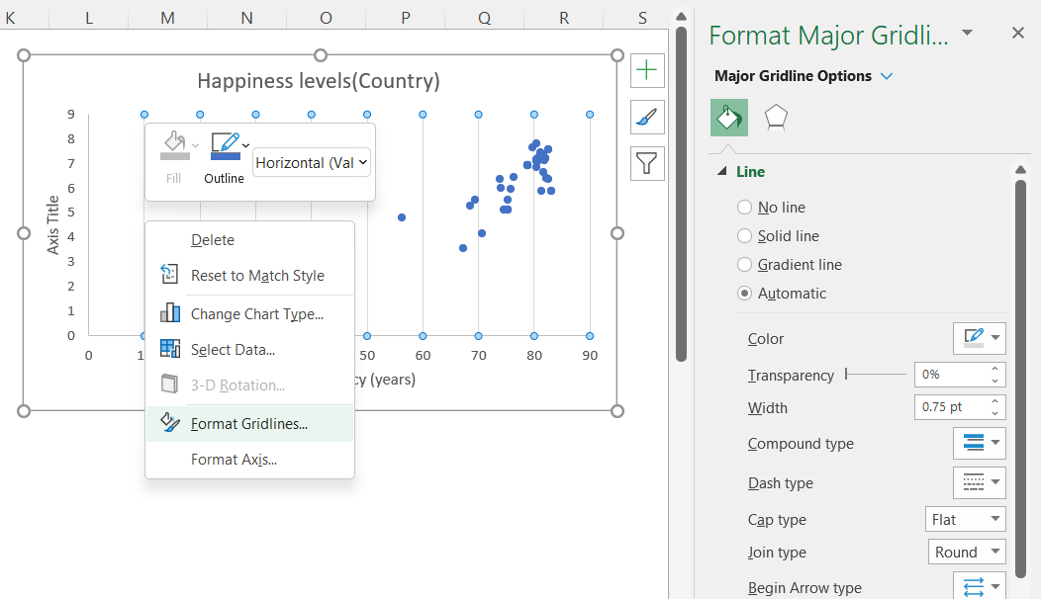
Amend the gridlines
Reminder
Gridlines should not distract from your data
To amend the gridlines, right click on the gridlines and then select Format Gridlines.
For this graph, the gridlines have been removed by selecting the No line option.

Slide 28
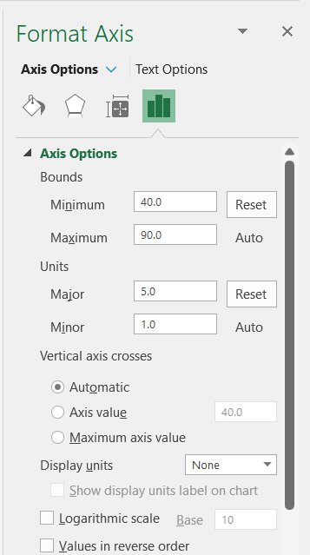
Changing the axis range
In the Format Axis pane, click on the Axis Options. You can then change the minimum and maximum range of the axis in the Bounds section and the major and minor units.

Slide 29
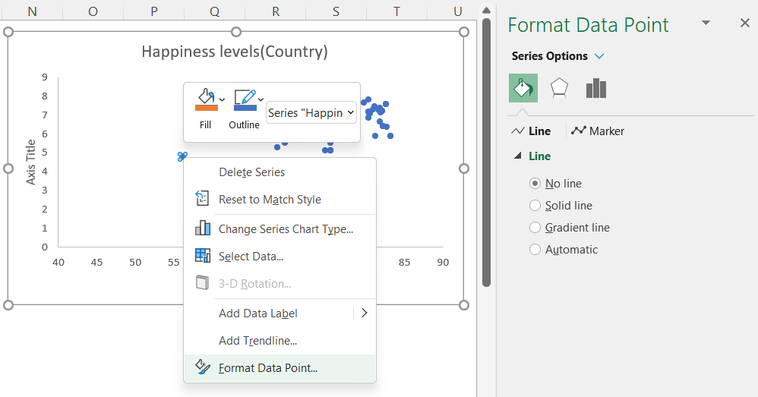
Format data points
Reminder
Design with accessibility (e.g. colour-blindness) in mind
You can change the following about the marker,
Shape
Colour to fill
Colour around the border of the shape
To format the data points click on any of the points then right click and select ‘Format Data Point..’

Slide 30
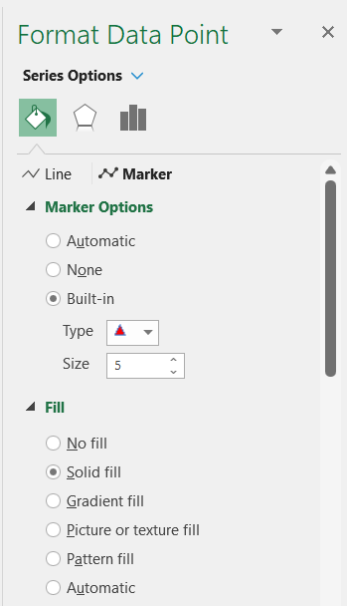
Format data points
You will now have the Format Data Point pane open.
To amend the marker,
Click on the Paint Pot symbol
Click on Marker
Click on Marker Options
You can now change style and colour of the markers.

Slide 31
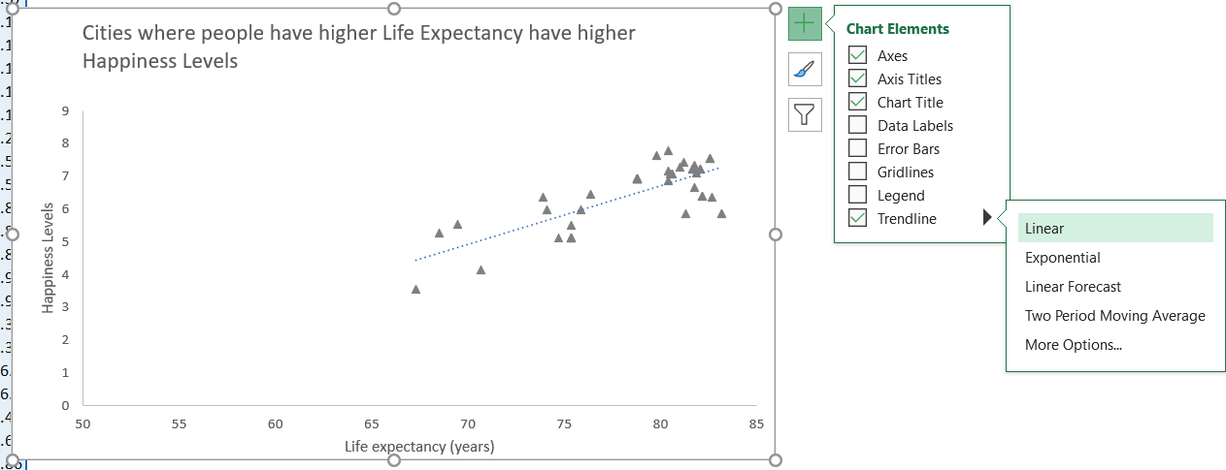
Add a trend line
Reminder
A trendline shows you the pattern of the data
To add a trend line to a scatterplot you can click on the Trendline box in the Chart Elements. The colour and width of the line can be amended in the same way as the line on a line graph.

Slide 32
Amend the chart title
Reminder
Descriptive graph titles allow key messages to be easily understood
As with all the Excel graphs you can amend the chart title by clicking on the title and typing in your new title.

Slide 33
Next steps
Complete questions 1 to 8
in section 3 of the
‘Practise creating graphs
in Excel (part 2)’ workbook.
Then complete questions 1 and 2 in section 4.
Then complete the Extension.

Slide 34
Learning checklist
I can change the font, colour and display format of graphs in Excel I can add/remove the gridlines and legends on graphs in Excel I can plot line graphs without a date value variable I can add data labels to a line graph I can change the style and colour of data points on a scatterplot

Slide 35





How you can use this lesson
You are free to:
Share – copy and redistribute the material in any medium or format
Adapt – remix, transform and build upon the material
Under the following terms:
Attribution — You must give appropriate credit, provide a link to the license, and indicate if changes were made. You may do so in any reasonable manner, but not in any way that suggests the licensor endorses you or your use.
NonCommercial — You may not use the material for commercial purposes.
ShareAlike — If you remix, transform, or build upon the material, you must distribute your contributions under the same license as the original.
© 2022. This work is licensed under a CC BY-NC-SA 4.0 license.
Created by Effini in partnership with Data Education in Schools, The Data Lab and Data Skills for Work, with funding from the Scottish Government.

Slide 36
Alternative format
If you require this document in an alternative format, such as large print or a coloured background, please contact
hello@effini.com
or
4th Floor, The Bayes Centre
47 Potterrow
Edinburgh
EH8 9BT

