Slide 1
Manipulating dataset columns in Excel

Slide 2
Learning intentions
We will be learning how to manipulate data in Excel, specifically,
to be able to select columns
to be able to reorder columns
to be able to reformat columns

Slide 3
Background
When a data analyst is given a dataset to analyse, most of their time is spent manipulating it to allow them to conduct the analysis.
Manipulating
Transforming
Preparing
Wrangling
Many words are used to describe this process, but they all mean the same thing.

Slide 4




Why this is important?
Some benefits of manipulating data are,
Makes it easier for you to understand the dataset you're working with
Helps break the task into manageable chunks
Speeds up data processing
It helps you to focus on what you are planning to do with the data by choosing which columns you need to keep.

Slide 5
Show me…
Here is an example of a dataset that would need the columns to be manipulated.
It would be easier to understand if the start_time and end_time columns were next to each other
There is a column that is no longer needed
end_time | date | old_title | id | start_time
13:06 | 44467 | 0 | 1A | 12:30
02:56 | 29/09/2021 | 0 | 2B | 21:18
23:53 | 44,469 | 0 | 3C | 14:09
16:04 | 44,470 | 0 | 4D | 21:49
Date column has a mixture of formats

Slide 6
Show me…
end_time | date | old_title | id | start_time
13:06 | 44467 | 0 | 1A | 12:30
02:56 | 29/09/2021 | 0 | 2B | 21:18
23:53 | 44,469 | 0 | 3C | 14:09
16:04 | 44,470 | 0 | 4D | 21:49
id | date | start_time | end_time
1A | 28/9/2021 | 12:30 | 13:06
2B | 29/09/2021 | 21:18 | 02:56
3C | 30/9/2021 | 14:09 | 23:53
4D | 1/10/2021 | 21:49 | 16:04
This lesson will show you how to manipulate columns of data, which will make any analysis easier to complete and less prone to errors.

Slide 7
Definition
Select
To choose some of the columns from a dataset

Slide 8
Show me…
Here is an example of selecting columns.
address | price_2017 | price_2018 | price_2019 | price_2020
5 Little Gardens | 50,000 | 55,000 | 60,500 | 66,550
17 Cherry Tree Lane | 65,000 | 71,500 | 78,650 | 86,515
42 Granny Clarks Wynd | 100,000 | 110,000 | 121,000 | 133,100
Select 'address' and 'price_2020' columns
address | price_2020
5 Little Gardens | 66,550
17 Cherry Tree Lane | 86,515
42 Granny Clarks Wynd | 133,100

Slide 9
Example
Select
To choose some of the columns from a dataset
Select the name of the river and its length (km) from this dataset.
river | start_point | length_km
Tay | Ben Lui | 188
Spey | Loch Spey | 172
Clyde | Lowther Hill | 170
Forth | Loch Ard | 47
Nith | Enoch Hill | 114
Tweed | Tweeds Well | 156
river | length_km
Tay | 188
Spey | 172
Clyde | 170
Forth | 47
Nith | 114
Tweed | 156
Select ‘river’ and ‘length_km’

Slide 10
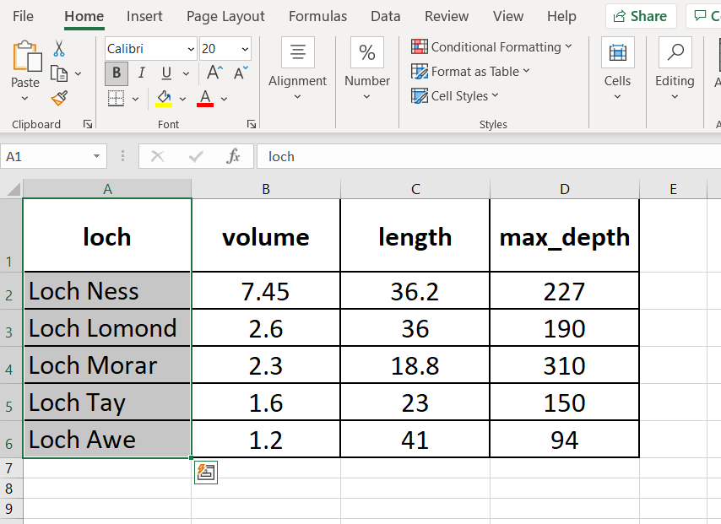
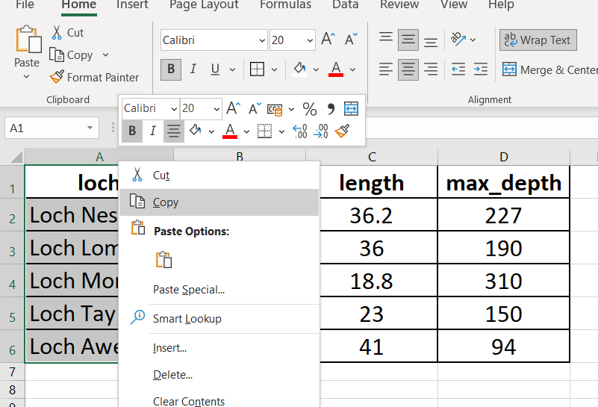
How to Select in Excel
Step 1.
Highlight the column you want to select then ‘Copy’ the column.
Select

Slide 11
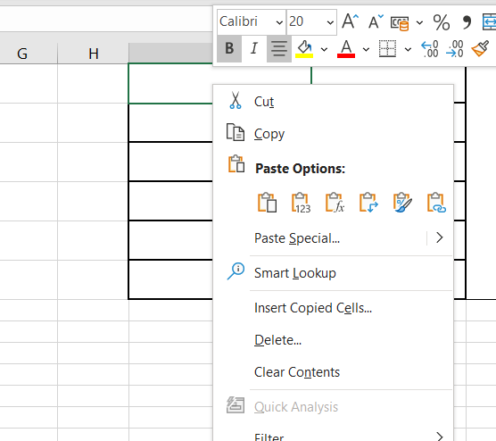
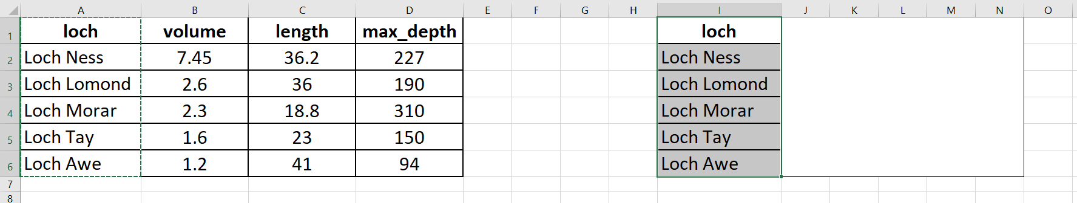
Select in Excel
Step 2.
Click on an empty space of your workbook where you would like new dataset. Paste the selected column.

Slide 12
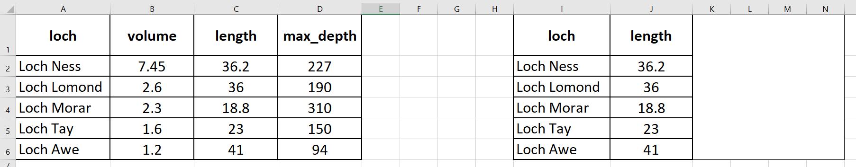
Select in Excel
Step 3.
Repeat steps 1 and 2 until you have selected all the columns you want like to keep.

Slide 13

Your turn…
Which variables to you think you would need to select if you wanted to have the loch name and its length?
loch | volume | length | max_depth
Loch Ness | 7.45 | 36.2 | 227
Loch Lomond | 2.6 | 36.0 | 190
Loch Morar | 2.3 | 18.8 | 310
Loch Tay | 1.6 | 23.0 | 150
Loch Awe | 1.2 | 41.0 | 94

Slide 14
Your turn…
Select the name of the loch and its length from this dataset
loch | volume | length | max_depth
Loch Ness | 7.45 | 36.2 | 227
Loch Lomond | 2.6 | 36.0 | 190
Loch Morar | 2.3 | 18.8 | 310
Loch Tay | 1.6 | 23.0 | 150
Loch Awe | 1.2 | 41.0 | 94
loch | length
Loch Ness | 36.2
Loch Lomond | 36.0
Loch Morar | 18.8
Loch Tay | 23.0
Loch Awe | 41.0
select

Slide 15
Next steps
Complete questions 1 to 8
in section 1 of the
‘Manipulating dataset columns in Excel’ workbook.

Slide 16
Definition
Reorder
To change the order of columns in a dataset

Slide 17


Show me…
Here is an example of reordering columns.
id | fruit | colour
1 | Apples | Red
3 | Bananas | Yellow
5 | Grapes | Green
fruit | id | colour
Apples | 1 | Red
Bananas | 3 | Yellow
Grapes | 5 | Green
Reorder the fruit column to be 1st

Slide 18
Example
Reorder
To change the order of columns in a dataset
Reorder this dataset so that ‘locality’ is the first column.
status | population | locality
Town | 75,120 | East Kilbride
Town | 57,030 | Livingston
City | 148,280 | Dundee
Town | 50,010 | Kirkcaldy
locality | status | population
East Kilbride | Town | 75,120
Livingston | Town | 57,030
Dundee | City | 148,280
Kirkcaldy | Town | 50,010
Reorder

Slide 19



Your turn…
What order do you think these columns could be reordered into so that they are in a logical order?
temperature | dusk | dawn | location
15 | 22:50 | 03:30 | Edinburgh
21 | 22:28 | 05:09 | Paris
17 | 17:21 | 06:25 | Sydney
17 | 20:55 | 04:54 | New York

Slide 20
Your turn…
One option for reordering this dataset is,
temperature | dusk | dawn | location
15 | 22:50 | 03:30 | Edinburgh
21 | 22:28 | 05:09 | Paris
17 | 17:21 | 06:25 | Sydney
17 | 20:55 | 04:54 | New York
location | temperature | dawn | dusk
Edinburgh | 15 | 03:30 | 22:50
Paris | 21 | 05:09 | 22:28
Sydney | 17 | 06:25 | 17:21
New York | 17 | 04:54 | 20:55
Reorder

Slide 21
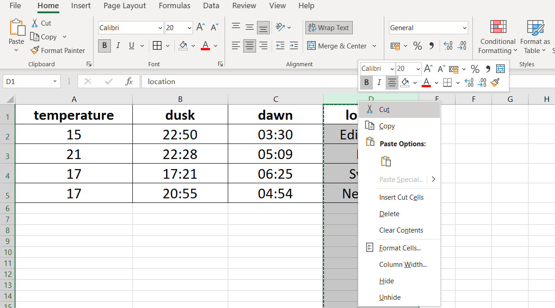
How to Reorder in Excel
Step 1.
Highlight the column you would like to reorder and ‘Cut’ the data

Slide 22
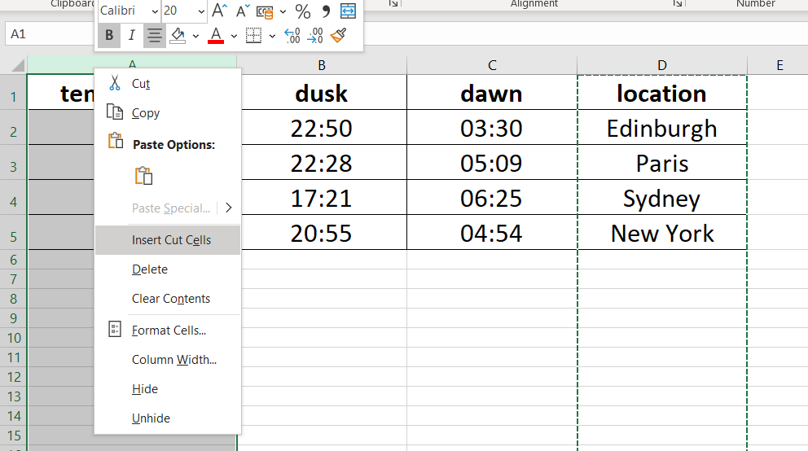
Reorder in Excel
Step 2.
Right click on the column header to the right of where you would like the data to go and click on ‘Insert Cut Cells’

Slide 23
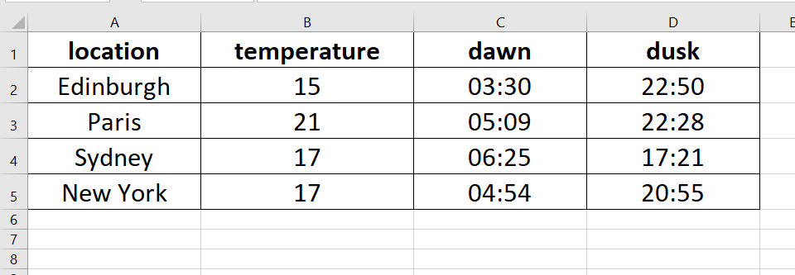
Reorder in Excel
Step 3.
Repeat steps 1 and 2 until the columns are all reordered.
Alternatively, you can follow the steps for selecting columns
and copy and paste them in the new order you need.

Slide 24
Next steps
Complete questions 1 to 8
in section 2 of the
‘Manipulating dataset columns in Excel’ workbook.

Slide 25
Definition
Reformat
To change how data in a column is displayed

Slide 26
Show me…
0.25
6 hours (quarter of a day)
25%
1/4
A number can be reformatted to appear in different ways.
However, the underlying number stays the same.
Changing the display format can make the data easier to understand.

Slide 27
Show me…
Value
0.25
0.5
0.75
1
Value
25%
50%
75%
100%
Value
£ 0.25
£ 0.50
£ 0.75
£ 1.00
Value
1/4
1/2
3/4
1
All of these columns of data have the same stored values,
but they have been reformatted to be displayed differently.

Slide 28
Example
Reformat
To change how data in a column is displayed
Reformat the data in this column so that the values are in £s.
Value
£12.35
0.1233
29/4/1901
154.1259
Value
£12.35
£0.12
£485.00
£154.13
Reformat

Slide 29
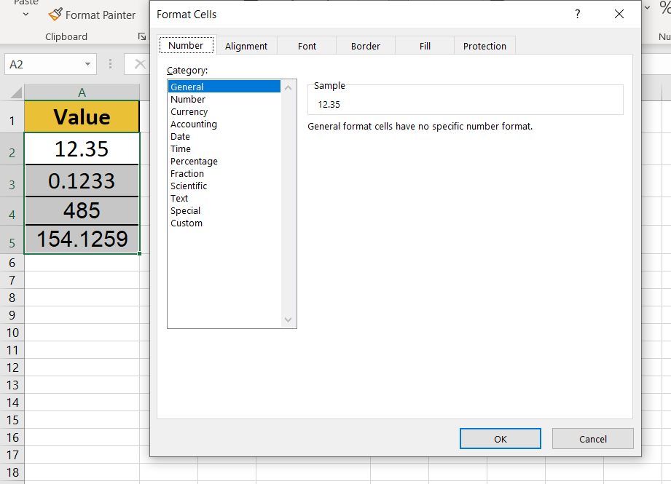
How to Reformat in Excel
Step 1.
Highlight the column of data you would like to reformat
Step 2.
Press ‘Ctrl’ and 1 if you are using Windows or ‘Command’ and 1 for Mac at the same time to open the format cells box
Windows | Ctrl + 1
Mac | Command + 1

Slide 30
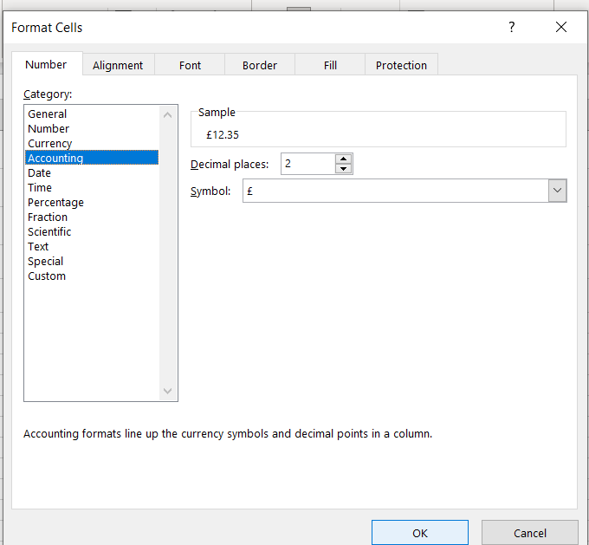
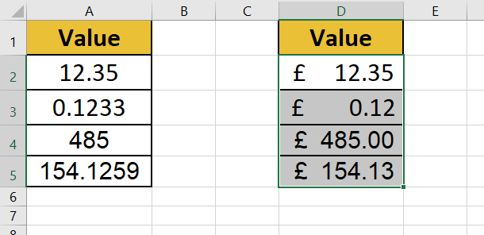
Reformat in Excel
Step 3.
Select the format option you need and press OK.

Slide 31
Next steps
Complete questions 1 to 6
in section 3 of the
‘Manipulating dataset columns in Excel’ workbook.

Slide 32
Additional information
In this lesson we have covered some of the
procedures for manipulating data in Microsoft Excel.
However, there are different options
(including keyboard shortcuts) available.
For more information, please see
https://support.microsoft.com/en-us/excel

Slide 33
Learning checklist
I can describe what is means to select, reorder and reformat columns in a data frame. I can manipulate data by selecting, reordering and reformatting columns in Excel.

Slide 34





How you can use this lesson
You are free to:
Share – copy and redistribute the material in any medium or format
Adapt – remix, transform and build upon the material
Under the following terms:
Attribution — You must give appropriate credit, provide a link to the license, and indicate if changes were made. You may do so in any reasonable manner, but not in any way that suggests the licensor endorses you or your use.
NonCommercial — You may not use the material for commercial purposes.
ShareAlike — If you remix, transform, or build upon the material, you must distribute your contributions under the same license as the original.
© 2021. This work is licensed under a CC BY-NC-SA 4.0 license.
Created by Effini in partnership with Data Education in Schools, The Data Lab and Data Skills for Work, with funding from the Scottish Government.

