Slide 1

Introduction to Generative Artificial Intelligence
Notes:
Introduce the lesson topic:
"Today we will learn about an amazing technology called Artificial Intelligence. We will see its capabilities and explore how it can help us in our daily lives."
Explain to the students that during the lesson, they will learn what Artificial Intelligence is, see real-life examples, understand how AI can assist them, and experiment with designing AI-based recommendations.

Slide 2

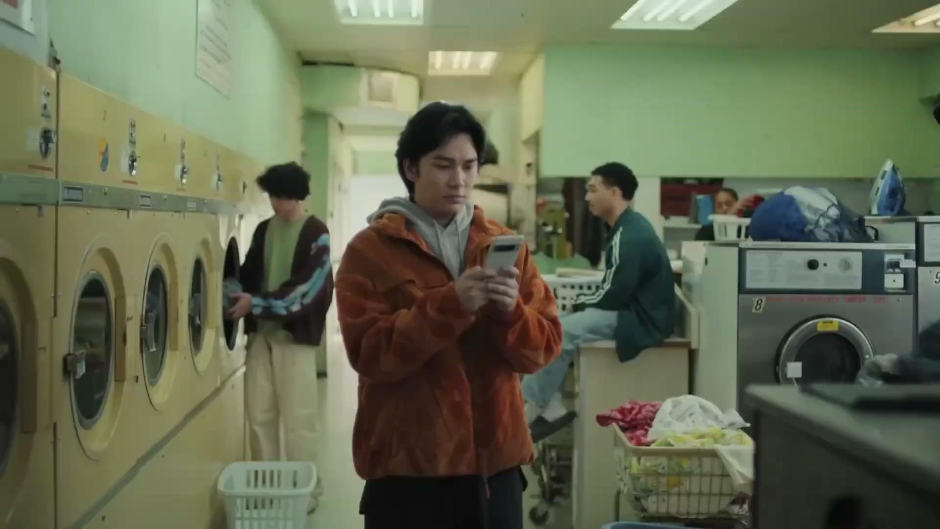
Important Links - Lesson Plan
To save a copy of the presentation:
select from the top menu "File" > "Make a copy" > "Entire presentation".
Choose the location on your computer where the copy will be saved.
Notes:
On this slide, you will find useful links to the lesson plan.
As additional material, in this slide you can find the intro video about prompting without the opening sequence.

Slide 3
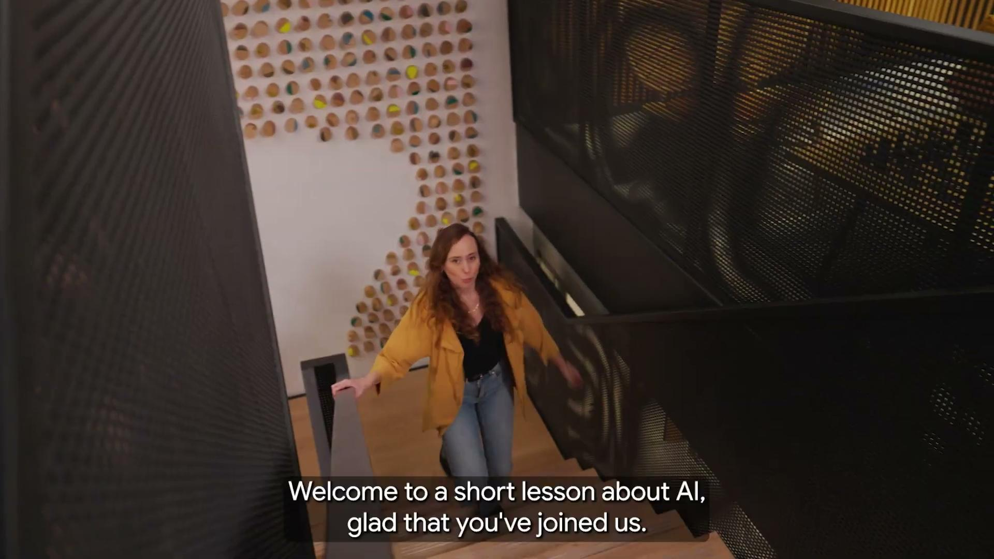
Notes:
Play the video showcasing Google's Gemini, which is an example of a generative AI chatbot.

Slide 4
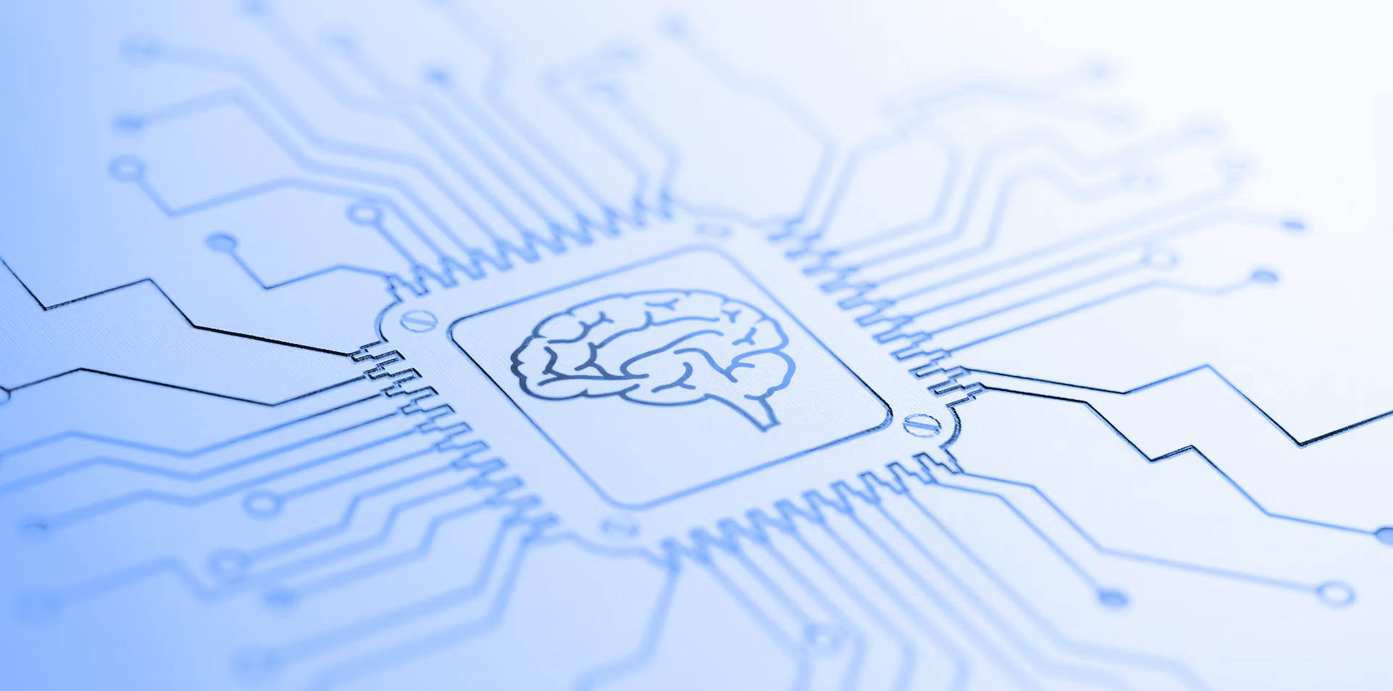
The Tool We Saw In The Video Uses Generative Artificial Intelligence -
What Is It?
Discussion
G
E
N
A
I
-
Notes:
Ask the students: "What is generative Artificial Intelligence?" and allow them to respond.
The definition will appear on the next slide.
Possible Student Responses:
"It's something that can talk to you and provide answers to questions."
"It's a technology that creates images and videos."
"It's robots that will do everything for us." - In response to this, you can say that while AI is indeed advanced, there are still many things we need to do ourselves, such as thinking creatively, tidying up, and cooking - all of which are actions AI cannot yet do well.
"It's a super-smart computer that can do everything for us." - In response to this, show the definition of Artificial Intelligence. Then explain that AI is designed to work with us and enhance our abilities, not to replace us.

Slide 5

Generative Artificial Intelligence
A branch in the field of artificial intelligence that focuses on creating new content, such as text, images, audio, code, and more.
In this case, we saw in the video a generative AI chatbot -
A software that uses generative artificial intelligence and has the ability to communicate with humans naturally.
Definition
Notes:
Explain to the students that in the case we reviewed, Artificial Intelligence can identify which areas are at risk of fire and which are safe.
The Artificial Intelligence performed what is known as classification.

Slide 6
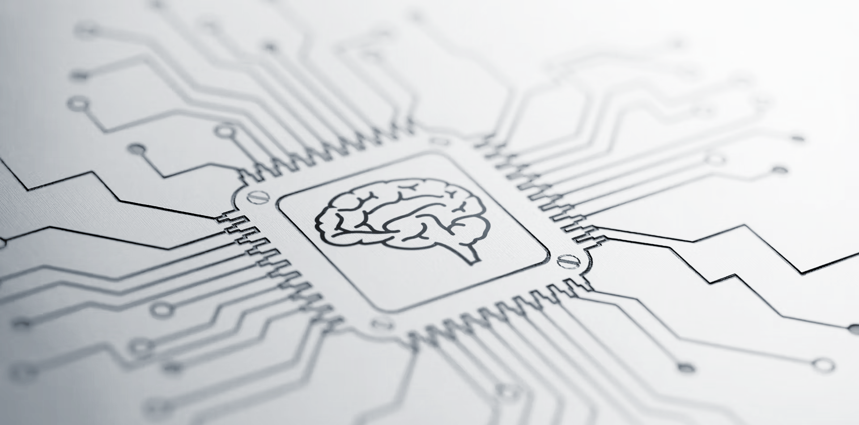
Who Do You Think Can Perform The Following Tasks?
A Computer, A Human, Or Both? Why?
Activity
Notes:
Now, let's ask the students about various tasks and try to understand who can perform them—humans, computers, or both? And why?

Slide 7
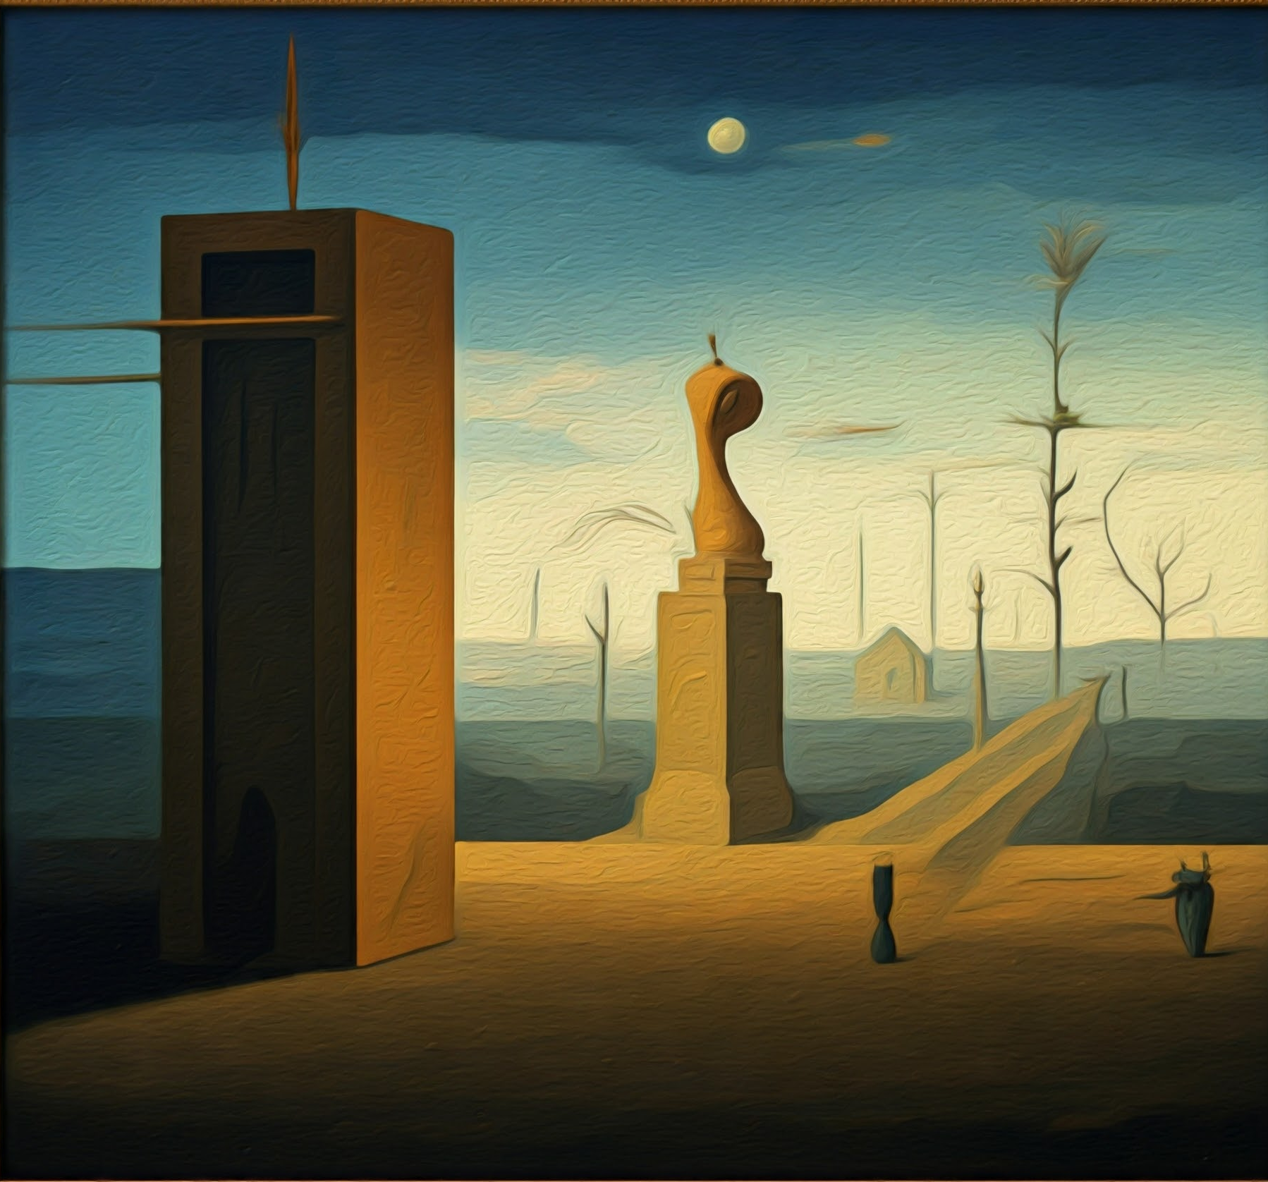
Who do you think could have painted this artwork?
Humans, computers, or both? And why?
Activity
Notes:
Now we will ask the students about various tasks and try to understand who can perform them—humans, computers, or both? And why?
Who do you think could have created the artwork shown on the slide?

Slide 8
Humans can create a painting such as this one.
In this specific case, the painting was created by Gemini.
Activity
Notes:
Who do you think could have painted the artwork shown on the slide?
The artwork is a surrealistic painting. Of course, humans can create such paintings, and the style is even reminiscent of the famous artist René Magritte.
Computers can also create such paintings. In this specific case, the painting was created by Gemini.

Slide 9

Who do you think can play Chess?
Humans, computers, or both? And why?
Activity
Notes:
Can computers play chess?

Slide 10
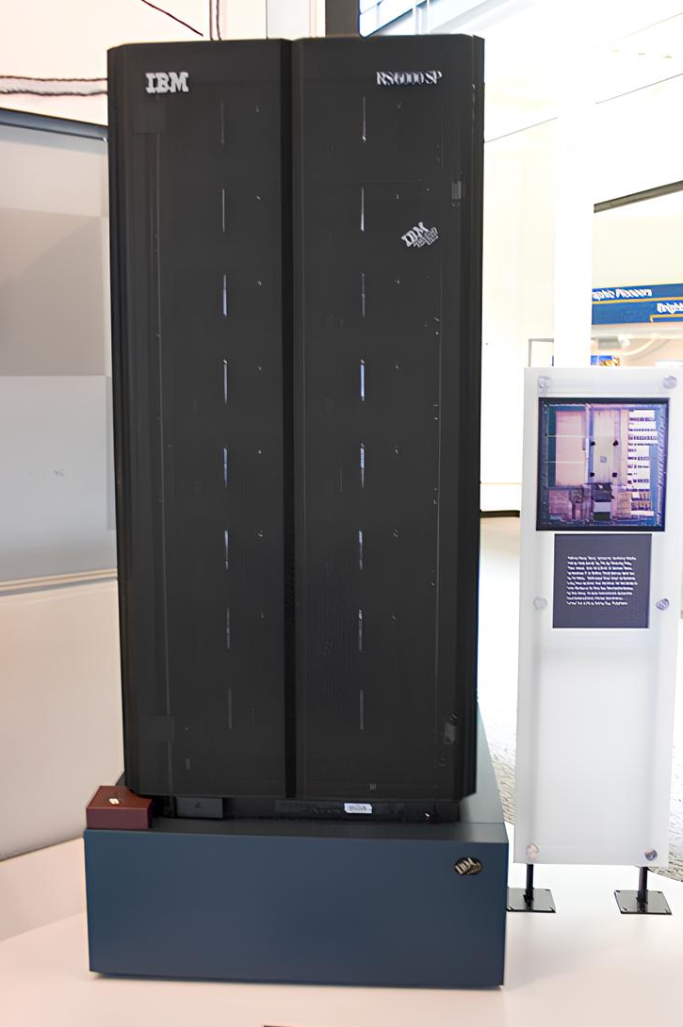
.
Both humans and computers can play Chess.
In 1997, a computer named Deep Blue defeated the world champion Garry Kasparov in a game of Chess.
Activity
Notes:
Of course, humans can play chess, but computers can play chess as well. And they are actually very good at it.
In 1997, a computer named Deep Blue defeated the world champion of Chess, Garry Kasparov.
Image source: Wikipedia .

Slide 11

Who do you think can serve as a judge in court?
A computer, a human, or both? Why?
Activity
Notes:
Can computers serve as judges? Can humans do it?

Slide 12

Computers are capable of helping legal professionals find relevant information.
There are also a number of legal tools that exist today that utilize AI.
However, computers are still not capable of serving as judges in a court the same way humans can.
Activity
Notes:
Although there are currently AI-based tools that can help lawyers find relevant information, rulings, and precedents, computers are still unable to judge in court as humans can.

Slide 13

Who do you think can write or compose a song?
Humans, computers, or both? And why?
Activity
Notes:
Can computers write songs? Can humans?

Slide 14
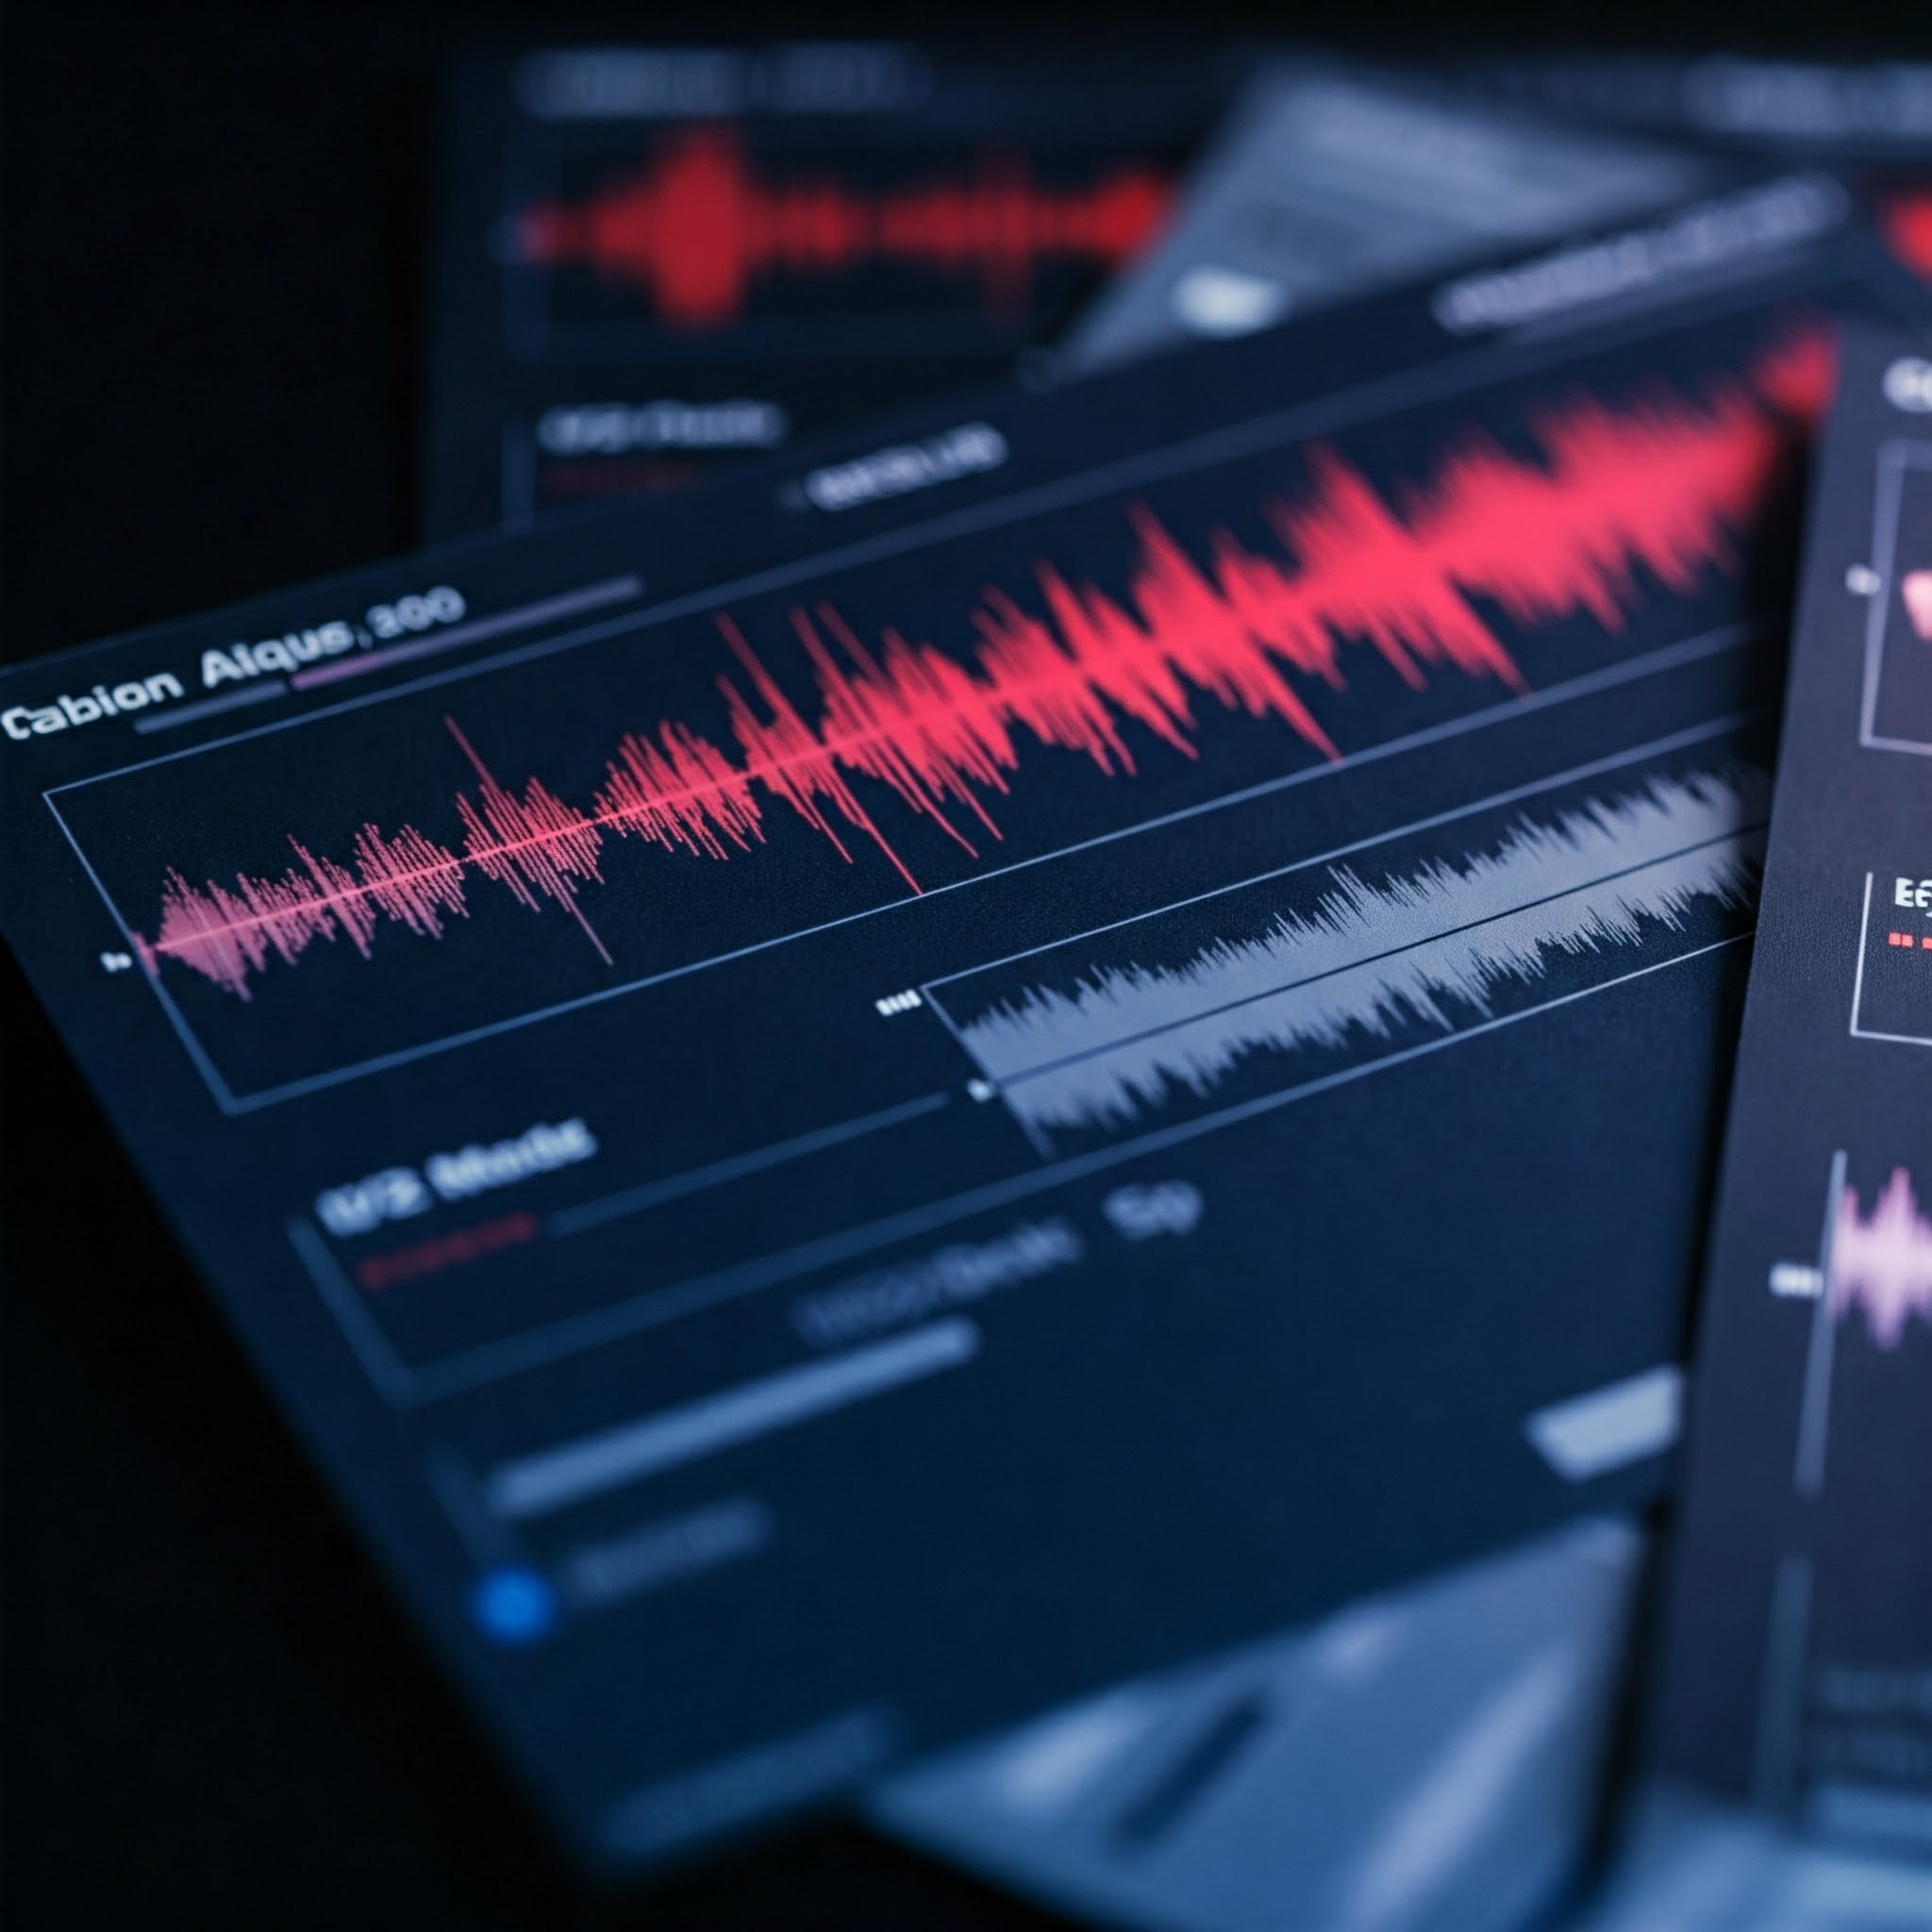
Nowadays, both humans and computers are able to write and compose songs.
Activity
Notes:
Both humans and computers can write and compose songs.
Every day, songs that are written by people are being published, and also songs created by computers.
There are AI tools capable of composing new songs in various styles.

Slide 15

Hand In Hand
There are certain tasks that computers are better at, and other tasks that humans are better at.
When we combine the abilities of humans and computers, we can enhance our capabilities and create new and exciting things.
Notes:
Emphasize to the students the importance of collaboration between humans and computers.
If we learn to use computers effectively, we can create exciting new things!

Slide 16
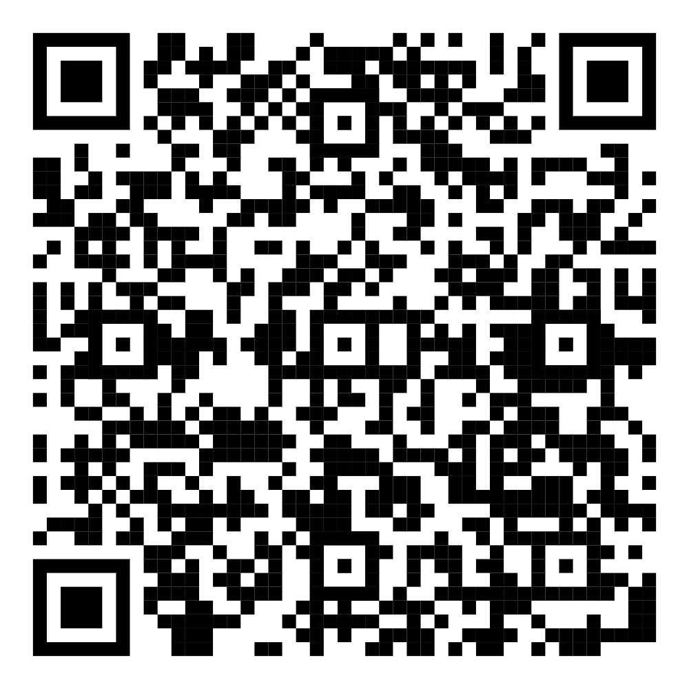
Let's discover how generative artificial intelligence can assist us!
Activity
Open your computers and access the learning module by clicking the link or scanning the QR code.
Notes:
Direct the students to go to the computers and open the Learning Module. This is a time for students to work independently, that will take approximately 45 minutes.
Once the students have completed the module, gather them back together to proceed to the next section: experimenting with a chatbot.

Slide 17


Gemini is Google’s AI-based Chatbot that can assist us in many different areas
Today we will practice using a chatbot.
Here are some examples of areas where it can assist us:
Drafting Messages and Texts
Translating online comments written in a foreign language
Suggestions For Birthday Gifts
Assistance in choosing the next TV show we want to watch
Creating Images
And many more!
Notes:
After the students complete the learning module, provide them with a brief explanation of Gemini, the chatbot they will experiment with.
Explain briefly that Gemini is an AI tool that can assist us in many areas, such as: Drafting messages and texts, Generating new ideas, Planning events, Creating images, Analyzing images, and much more..

Slide 18
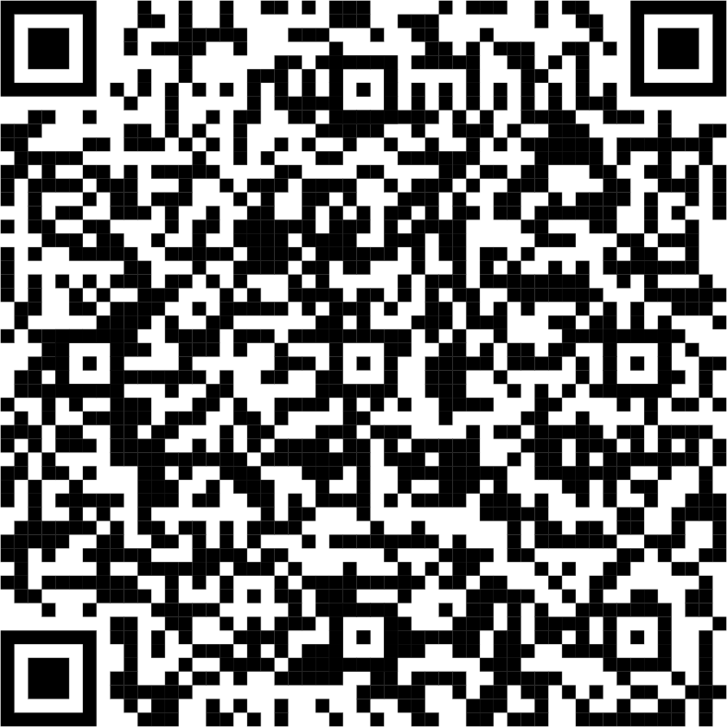
Let’s Practice working with Chatbots
Activity
Click the link or scan the QR code and follow the instructions.
Notes:
After the students have finished the module, they will move on to the Gemini practice.
Display the relevant slide in class and instruct the students to call you once they finish the module so you can guide them to the worksheet with instructions for the activity.
The worksheet can be accessed via a link or a QR code displayed on the screen.
If necessary, students can work in pairs.
Note: Gemini is intended for users aged 13 and up. If your students are younger than 13, conduct the activity as a classroom demonstration using the link.

Slide 19
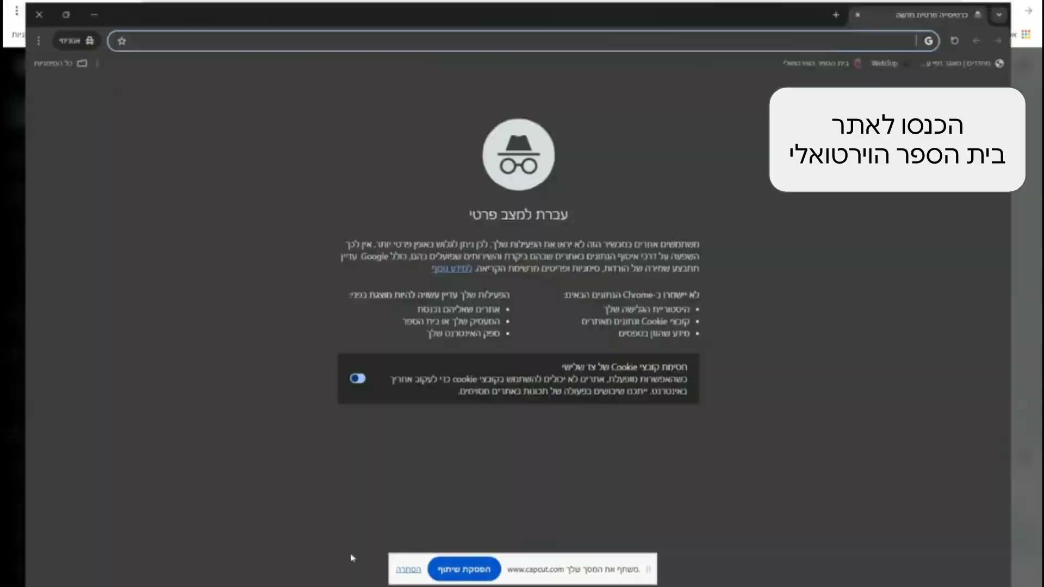
Let's try it ourselves and plan a party using a chatbot!
Connect to Gemini using the Virtual School:
Go to the Virtual School website via Google.
Click on "My Account."
Authenticate your login.
Click on "Drive."
Click on "Google Apps" (the 9-dot button).
Click on "Gemini."
Activity
Notes:
If necessary, explain to the students how to connect to Gemini. (The instructions are also available in the worksheet.)
Students can also work in pairs if preferred.

Slide 20
Share Your Planning Process
Copy the invitation you created and the prompt that generated the invitation.
Paste them in the presentation.
Share: What theme did you choose for your party? What invitation did you create?
Notes:
Direct the students to the presentation you prepared beforehand.
Instruct them to copy the invitation they created, along with the prompt that generated the invitation, into the presentation.
Once done, have them present their work to the class:
Select several students and ask them to share what kind of party they planned, present the invitation they created and the prompt they used to generate the invitation.
This sharing session will give students an opportunity to showcase what they created with AI and to learn from each other's prompts and ideas.

Slide 21
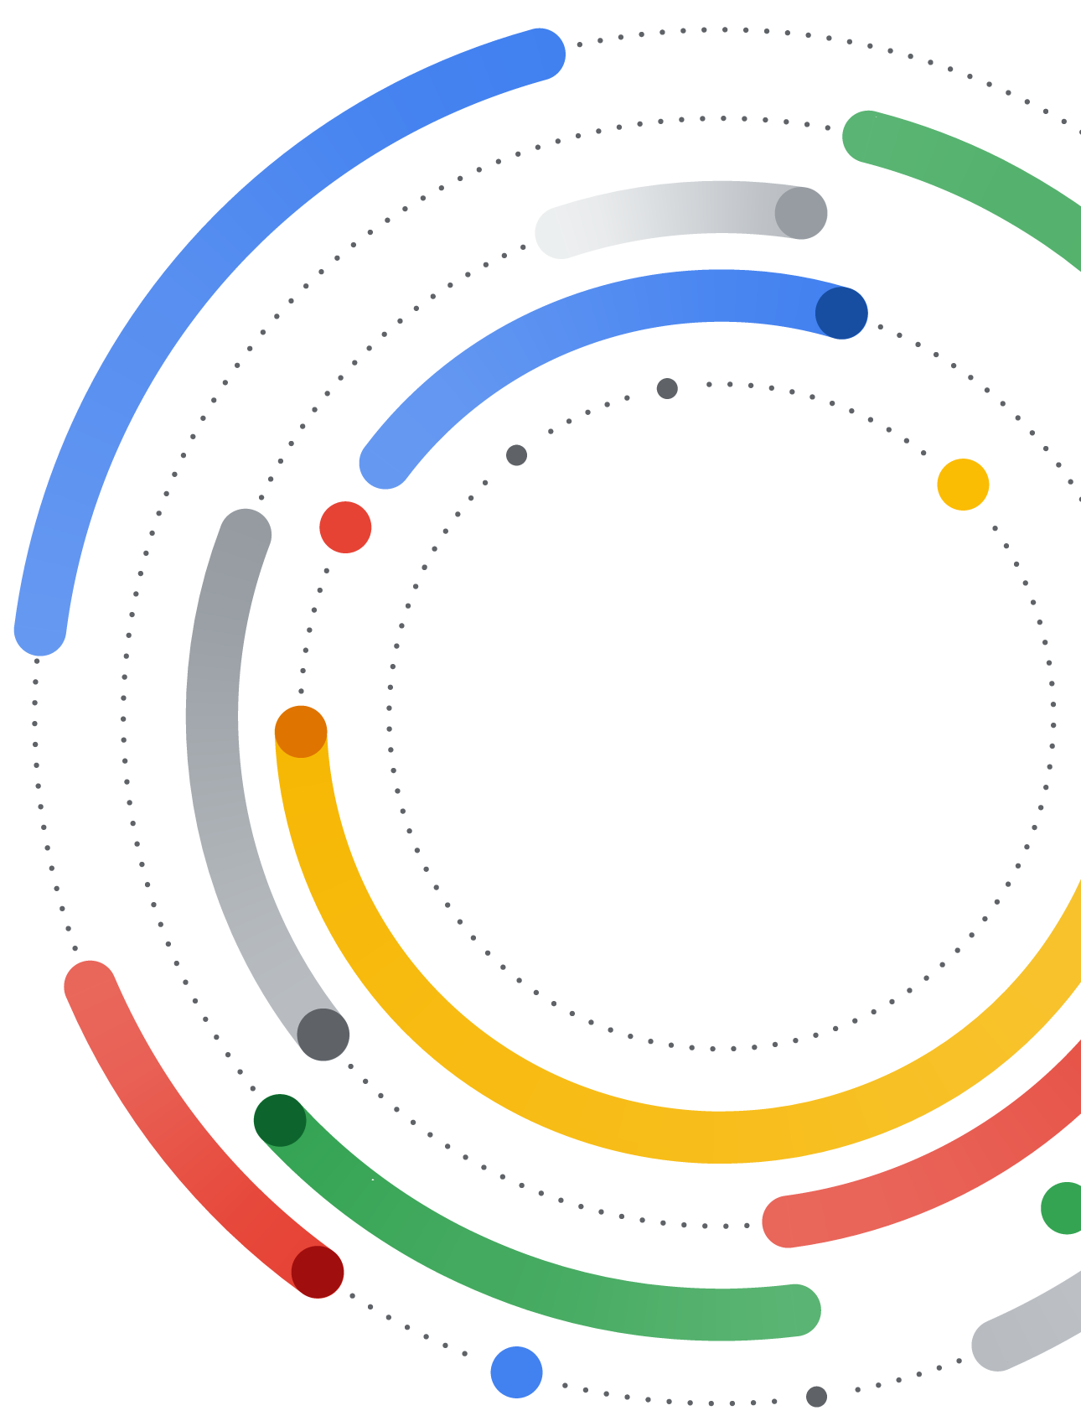
What did we learn about generative artificial intelligence?
What did we learn about Chatbots?
How can chatbots such as Gemini assist us?
Summary
Notes:
Summarize the lesson with the students and review the material learned today.
We got to know Gemini, Google's AI chatbot, We learned what Artificial Intelligence is, we learned what a chatbot is, we explored different uses of chatbots, we discussed AI hallucinations, and practiced Gemini hands-on.
Examples for students’ responses:
What did we learn about Artificial Intelligence today?
"We learned that AI is a technology that enables computers to do things that require learning, thinking, and decision-making, like creating a classroom activity or writing a song."
What did we learn about chatbots?
"Chatbots are a type of software that can communicate with people naturally."
How can chatbots like Gemini help us?
"They can help us plan classroom activities, create images, summarize texts, and brainstorm ideas for games."

