Slide 1
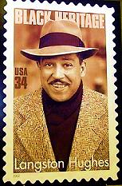
As I Grew Older
By Langston Hughes

Slide 2
It Was A Long Time Ago.

Slide 3
I Have Almost Forgotten My Dream.

Slide 4
But It Was There Then,
In Front of me,
Bright like a sun--
My dream.

Slide 5
And Then The Wall Rose ,
Rose Slowly,
Slowly,
Between Me And My Dream.

Slide 6
Rose Until It Touched The Sky--
The Wall.

Slide 7
SHADOW.

Slide 8
I Am Black.

Slide 9
I Lie Down In The Shadow.

Slide 10
No Longer The Light Of My Dream Before Me,
Above Me.

Slide 11
Only The Thick Wall.
Only The Shadow.

Slide 12
My Hands!
My Dark Hands!

Slide 13
Break Through The Wall!
Find My Dream!

Slide 14
Help Me To Shatter
This Darkness ,
To Smash This Night ,

Slide 15
To Break This Shadow
Into A Thousand Lights Of Sun ,

Slide 16
Into A Thousand
Whirling
Dreams.

Slide 17
THE END…
Made By Tamar & Yaeli.
©all rights reserved

