Slide 1

Ch is for Chocolate
Third Grade | English
With: Suha Athamni
Notes:
כתבו את המלל בהתאם ואת הציוד הדרוש.

Slide 2

What will we do today?
Who am I?
Today we are going to learn about the “ch” sound.
We are going to have fun! Are you ready? Let’s go!
Notes:
משך השקף: 2 דקות
הציגו את עצמכם ואת מהלך השיעור:
מוזמנים לפנות בצורה אישית לתלמידים: דוגמה לטקסט שייאמר בעל פה: "שלום, שמי___. אני מורה ל____ ממקום בארץ____. מה שלומכם? אני שמח/ה שהצטרפתם אליי", וכו'.
נושא השיעור ומה מטרתו: דוגמה לטקסט שייאמר בעל פה: "בשיעור הזה נלמד על_________. הצטרפו אליי ויהיה לנו כיף. מוכנים? מתחילים!"
נתחיל ב…. (שלב פתיח השיעור)
נמשיך בלגלות (שלב הלימוד / הקניה - כתבו כאן שאלה מסקרנת שתיתן מענה על מטרת השיעור)
נתנסה ב… (שלב התרגול / התנסות)
נסכם (שלב סיכום השיעור)

Slide 3
Can you…?
say the letter ch sound?
write ch in a word?
find ch in a word?
read a story?
Notes:
Dear Teacher,
Please take a look at the suggested Can Do statements in the teachers’ checklist. Make sure that you choose can do statements that are meant for 3rd grade from the list of Pre-Foundation statements OR can do statements meant for 4th-6th grade students from the Foundation Level list.
Choose one or two that you aim to achieve in this lesson.
e.g. At the end of this lesson, you can:
recognize a range of basic everyday nouns and adjectives (e.g. colors, numbers, classroom objects) and basic action words (e.g. ‘clap’, ‘stamp’, ‘jump’, ‘walk’) OR
* say how you are feeling using simple words like ‘happy’ accompanied by body language OR
* follow basic instructions for making something (e.g. a mask, a clock), if supported by pictures OR
understand basic written instructions for classroom activities (e.g. read and match)
At the end of the lesson, the student will see the same statements, and you will ask him to decide if he has achieved them.

Slide 4



What do you need to prepare for the class?
Notes:
למחוק שקופית זו אם אין בה צורך.
משך השקף: דקה
בשקף זה ודאו שכולם הצטיידו בעזרים הנדרשים (מומלץ שעזרים אלו יהיו גם אצלכם עבור הדגמה).
מחקו את המיותר או הוסיפו במידת הצורך (הקפידו על זכויות היוצרים).
זה הזמן להציג את כללי ההתנהגות בשיעור: בקשו מהלומדים לסגור חלונות של יישומים אחרים במחשב, להרחיק אמצעים מסיחים, להתיישב בחדר שקט, להניח כוס מים לידם, ובעיקר להתמקד במפגש.

Slide 5
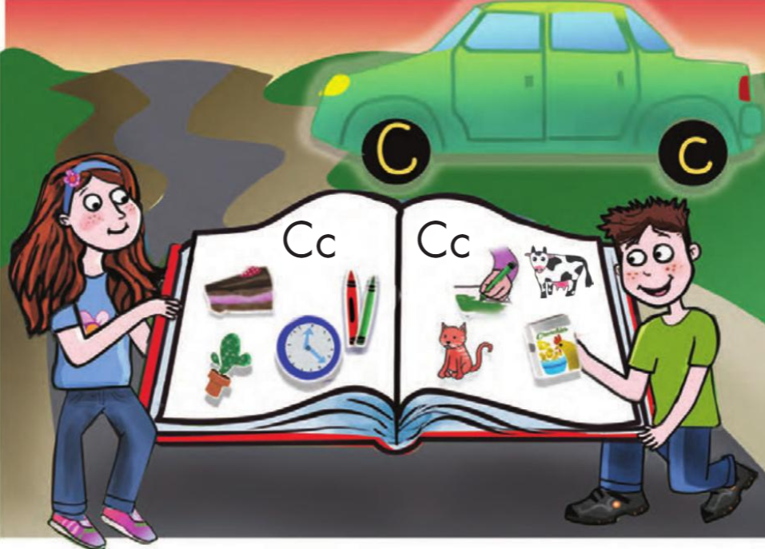
From: LetterQuest,
UPP - University Publishing Projects.
Notes:
Talk about the letter c

Slide 6
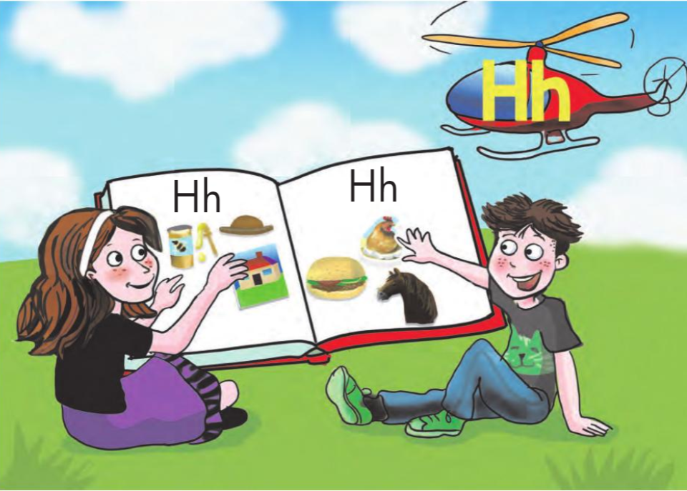
From: LetterQuest,
UPP - University Publishing Projects.
Notes:
Talk about the letter h

Slide 7
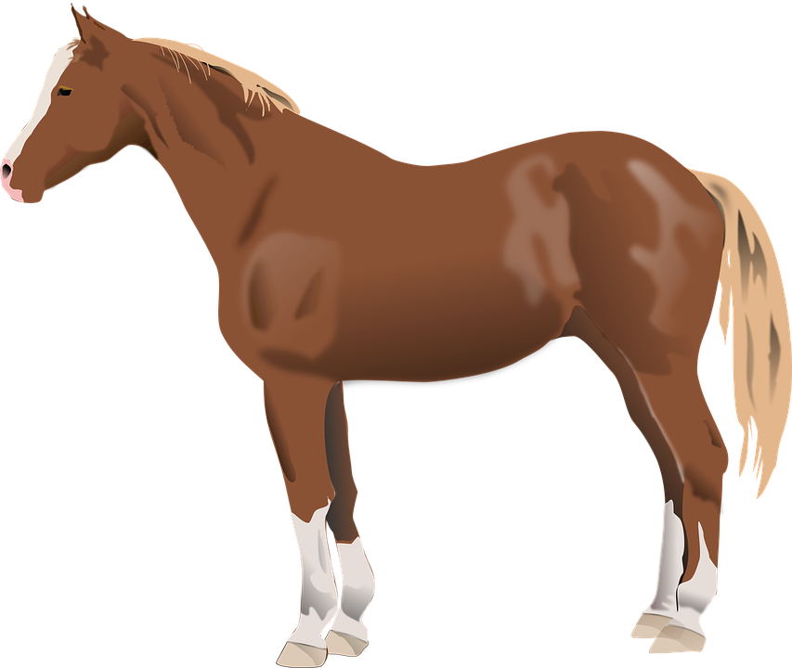


The Horse and the Cat
cat
horse
Notes:
למחוק שקופית זו אם אין בה צורך.
משך השקף: דקה
בשקף זה ודאו שכולם הצטיידו בעזרים הנדרשים (מומלץ שעזרים אלו יהיו גם אצלכם עבור הדגמה).
מחקו את המיותר או הוסיפו במידת הצורך (הקפידו על זכויות היוצרים).
זה הזמן להציג את כללי ההתנהגות בשיעור: בקשו מהלומדים לסגור חלונות של יישומים אחרים במחשב, להרחיק אמצעים מסיחים, להתיישב בחדר שקט, להניח כוס מים לידם, ובעיקר להתמקד במפגש.

Slide 8


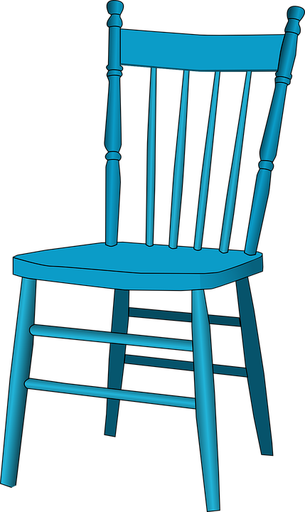
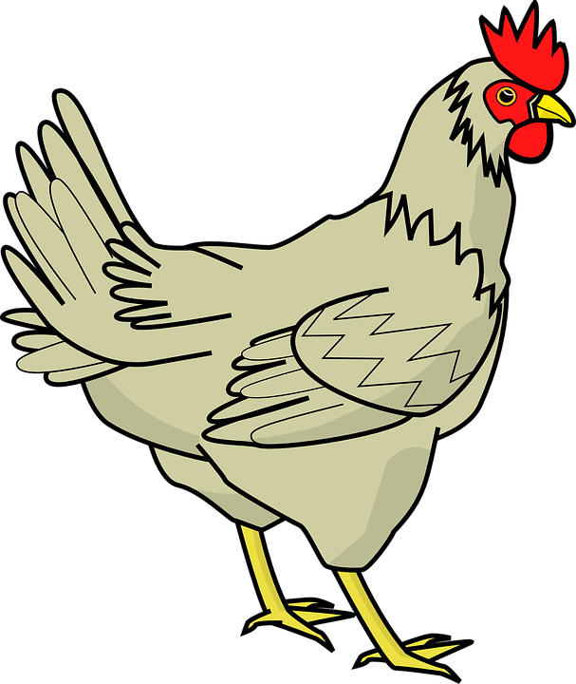

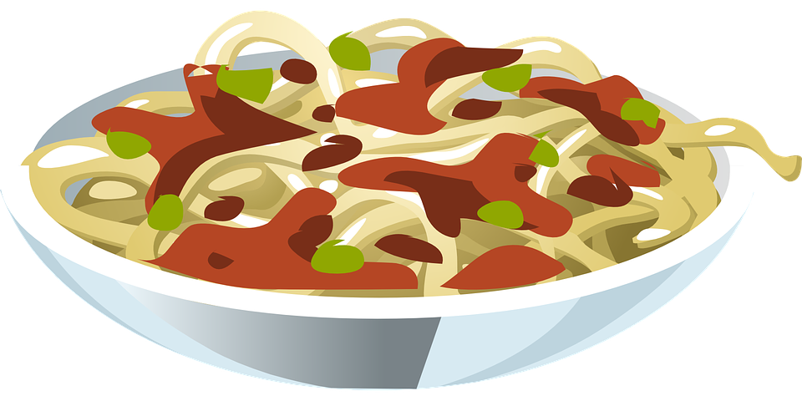
What can we see here?
lunch
chocolate
chair
chicken
chips
Notes:
Teach the words and sound of the ch

Slide 9
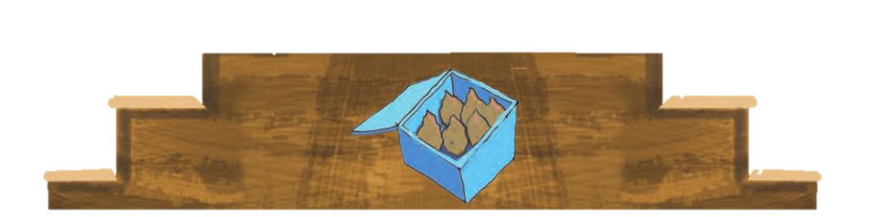

Let’s read
Charlie likes chips for lunch.
lunch
chat
chips
Charlie
Notes:
Practice reading

Slide 10
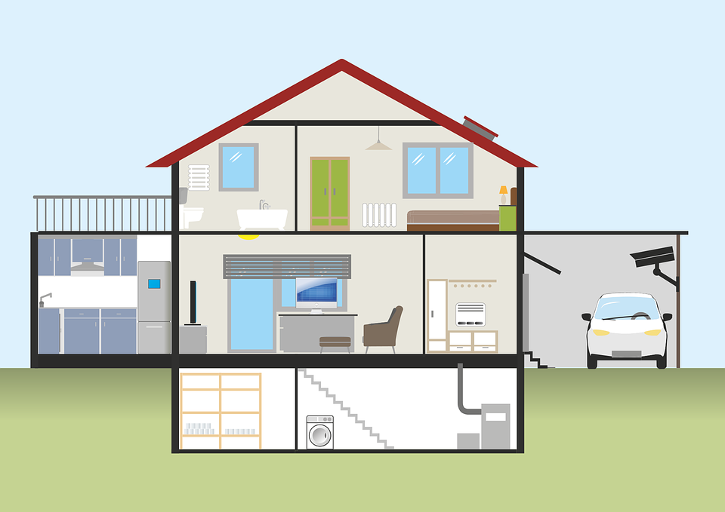
How do we write ch?
h
c
Notes:
Teach how to write the ch + practice -1 minutes

Slide 11
Listen and number
chair
chips
chin
sandwich
chat
chop

Slide 12
Listen and number
chair
chips
chin
sandwich
1
chat
chop

Slide 13
Listen and number
chair
chips
chin
2
sandwich
1
chat
chop

Slide 14
Listen and number
3
chair
chips
chin
2
sandwich
1
chat
chop

Slide 15
Listen and number
3
chair
chips
chin
2
sandwich
1
chat
4
chop

Slide 16
Listen and number
3
chair
5
chips
chin
2
sandwich
1
chat
4
chop

Slide 17
Listen and number
3
chair
5
chips
6
chin
2
sandwich
1
chat
4
chop

Slide 18
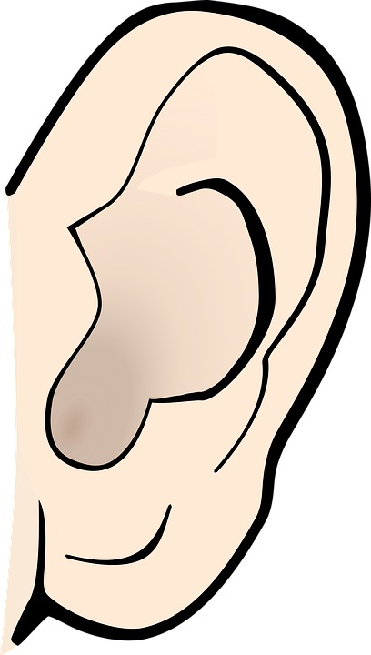

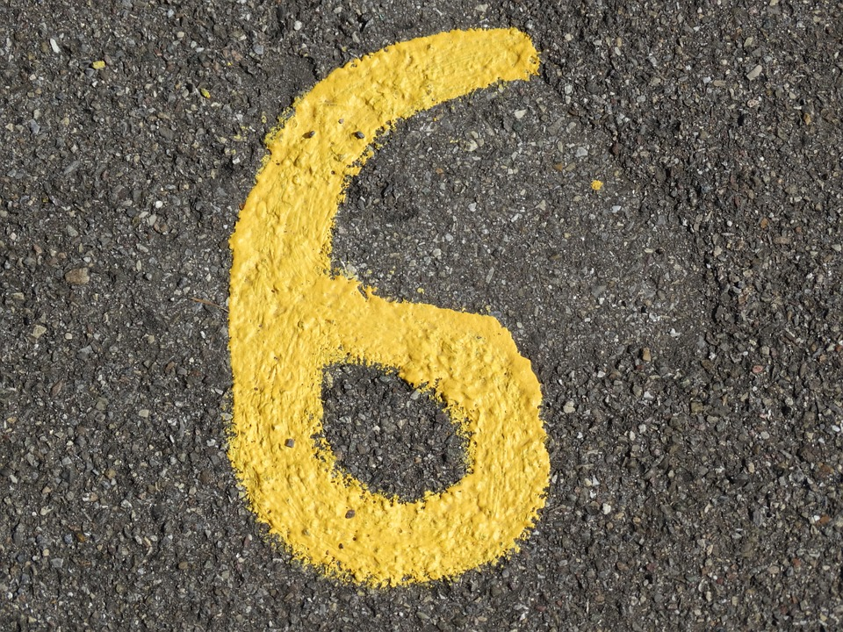

Circle – where do you hear the “ch” sound?

Slide 19
Circle – where do you hear the “ch” sound?
Notes:
להוסיף תמונת אוזן
לשאול אותם באיזה מילה הם שומעים את ch בסוף?

Slide 20
Underline the ch
1
rich
teacher
5
2
chips
6
chin
3
chat
sandwich
7
4
chop
Notes:
Underline the ch sound – 1 minute

Slide 21
Underline the ch
1
rich
5
teacher
2
chips
6
chin
3
chat
7
sandwich
4
chop
Notes:
Say the words and they need to write them in the right place

Slide 22
Circle the words you hear:
rich, chip, tick
chat, cat, rat
chop, shop, top
chat, mat, hat
chin, lunch, chicken
Notes:
Circle the word I say

Slide 23
Circle the words you hear:
rich, chip, tick
chat, cat, rat
chop, shop, top
chat, mat, hat
chin, lunch, chicken
Notes:
Circle the word I say

Slide 24
Circle the words you hear:
rich, chip, tick
chat, cat, rat
chop, shop, top
chat, mat, hat
chin, lunch, chicken
Notes:
Circle the word I say

Slide 25
Circle the words you hear:
rich, chip, tick
chat, cat, rat
chop, shop, top
chat, mat, hat
chin, lunch, chicken
Notes:
Circle the word I say

Slide 26
Circle the words you hear:
rich, chip, tick
chat, cat, rat
chop, shop, top
chat, mat, hat
chin, lunch, chicken
Notes:
Circle the word I say

Slide 27
Circle the words you hear:
rich, chip, tick
chat, cat, rat
chop, shop, top
chat, mat, hat
chin, lunch, chicken
Notes:
Circle the word I say

Slide 28


Let’s learn some new words:
Charlie
hot chocolate
chair
chips
lunch
Notes:
Teach the words and sound of the ch

Slide 29
Which is the right picture?
hot chocolate
Notes:
Teach the words and sound of the ch

Slide 30
Which is the right picture?
hot chocolate
Notes:
Teach the words and sound of the ch

Slide 31
Which is the right picture?
Charlie
Notes:
Teach the words and sound of the ch

Slide 32
Which is the right picture?
Charlie
Notes:
Teach the words and sound of the ch

Slide 33
Which is the right picture?
lunch
Notes:
Teach the words and sound of the ch

Slide 34
Which is the right picture?
lunch
Notes:
Teach the words and sound of the ch

Slide 35
Which is the right picture?
chair
Notes:
Teach the words and sound of the ch

Slide 36
Which is the right picture?
chair
Notes:
Teach the words and sound of the ch

Slide 37
Which is the right picture?
chips
Notes:
Teach the words and sound of the ch

Slide 38
Which is the right picture?
chips
Notes:
Teach the words and sound of the ch

Slide 39

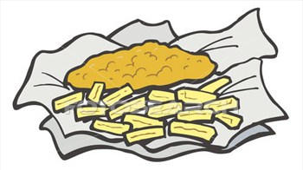
Let’s Read a Story
Charlie
Charlie lives in England.
He likes to eat fish and chips.
He likes to drink hot chocolate.
At lunch, he sits on a chair.
Charlie sits next to Chad.
ch
Notes:
Write sentences – 3 minutes timer

Slide 40

Let’s Read a Story
Charlie
Charlie lives in England.
He likes to eat fish and chips.
He likes to drink hot chocolate.
At lunch, he sits on a chair.
Charlie sits next to Chad.
ch
Notes:
Write sentences – 3 minutes timer

Slide 41
Choose:
1. Charlie (Charlie/ Ben) lives in England.
2. He likes to eat fish and _______ (chips/ salad).
3. Charlie likes to drink hot ________ (tea/chocolate)
4. At lunch, he sits on a ________ (sofa/chair).
5. Chad sits next to ________ (Charlie/Ben).
Notes:
2 minutes

Slide 42
Choose:
1. Charlie (Charlie/ Ben) lives in England.
2. He likes to eat fish and __chips__ (chips/ salad).
3. Charlie likes to drink hot _chocolate_ (tea/chocolate)
4. At lunch, he sits on a __chair__ (sofa/chair).
5. Chad sits next to _Charlie_ (Charlie/Ben).
Notes:
2 minutes

Slide 43

Let’s write
1. _____________
2. _____________
3. _____________
4. _____________
5. _____________
Notes:
Say a word and they need to write it

Slide 44
Let’s write
1. chat
2. chips
3. Chad
4. lunch
5. Ch
Notes:
Say a word and they need to write it

Slide 45
Let’s write
1. chat
2. chips
3. Chad
4. lunch
5. Cha
Notes:
Say a word and they need to write it

Slide 46
Let’s write
1. chat
2. chips
3. Chad
4. lunch
5. Char
Notes:
Say a word and they need to write it

Slide 47
Let’s write
1. chat
2. chips
3. Chad
4. lunch
5. Charlie
Notes:
Say a word and they need to write it

Slide 48
Something Extra
Walk around your house with a camera and take a photo of everything you see that has the ch sound in it.
Make a collage of all these photos, and write the words next to each photo.
Write the title: My ch Collage
Send it to your teacher.

Slide 49

Now I can:
say the ch sound.
write the ch sound.
find the ch sound.
read a story.
1
2
3
4
5
1
2
3
4
5
1
2
3
4
5
1
2
3
4
5
Notes:
I say the sentences and they repeat after me

