Slide 1
מערכת שידורים לאומית

Slide 2
Free to Be You and Me
High School - 5 points
Leah Doryoseph

Slide 3
Today we are going to learn
this song and its history
some useful phrasal verbs and collocations
how to add our own verse to the song
perhaps present it to the class

Slide 4
History
the project
1970s
Gender Stereotypes
Inspire and Awaken the imagination
Laughter
Music

Slide 5
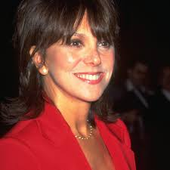
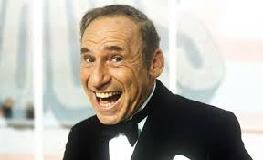
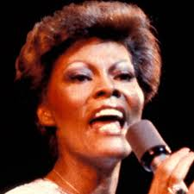
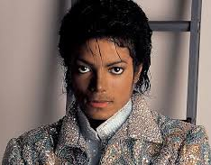
Famous Musicians Involved
Marlo Thomas
Mel Brooks
Michael Jackson
Dionne Warwick
and many, many more!
Notes:
Photo Credits:
Marlo Thomas: https://img.promipool.com/www-promipool-de/image/upload/c_fill,h_1200,w_1200/q_auto:eco/f_jpg/Marlo_Thomas_191025_4_g8akqecqe2
Mel Brooks: https://i.axs.com/2018/09/59549-optimized_5b980c7bae1c7.jpg
Michael Jackson: https://static.billboard.com/files/stylus/100232-michael_jackson2_617_409-compressed.jpg
Dionne Warwick: https://www.biography.com/.image/t_share/MTE1ODA0OTcxODE3NzMxNTk3/dionne-warwick-9524457-1-402.jpg
Marlo Thomas
Alan Alda
Harry Belafonte
Mel Brooks
Rita Coolidge
Billy De Wolfe
Roberta Flack
Roosevelt Grier
Michael Jackson
Kris Kristofferson
Bobby Morse
The New Seekers
Tom Smothers
Cicely Tyson
The Voices of East Harlem
Dionne Warwick
Peter DuPre
Dustin Hoffman
Stuart Pankin
June Angela
Carol Channing
Rafer Johnson
Ron Marshall
Diana Sands
Carole Hart
Norman Steinberg

Slide 6
Brainstorm
What do you think the title means?
“Free to be you and me”
טקסט לדוגמה
be yourself
Freedom
individuality
don't tell me who to be
we are the same
or ...

Slide 7
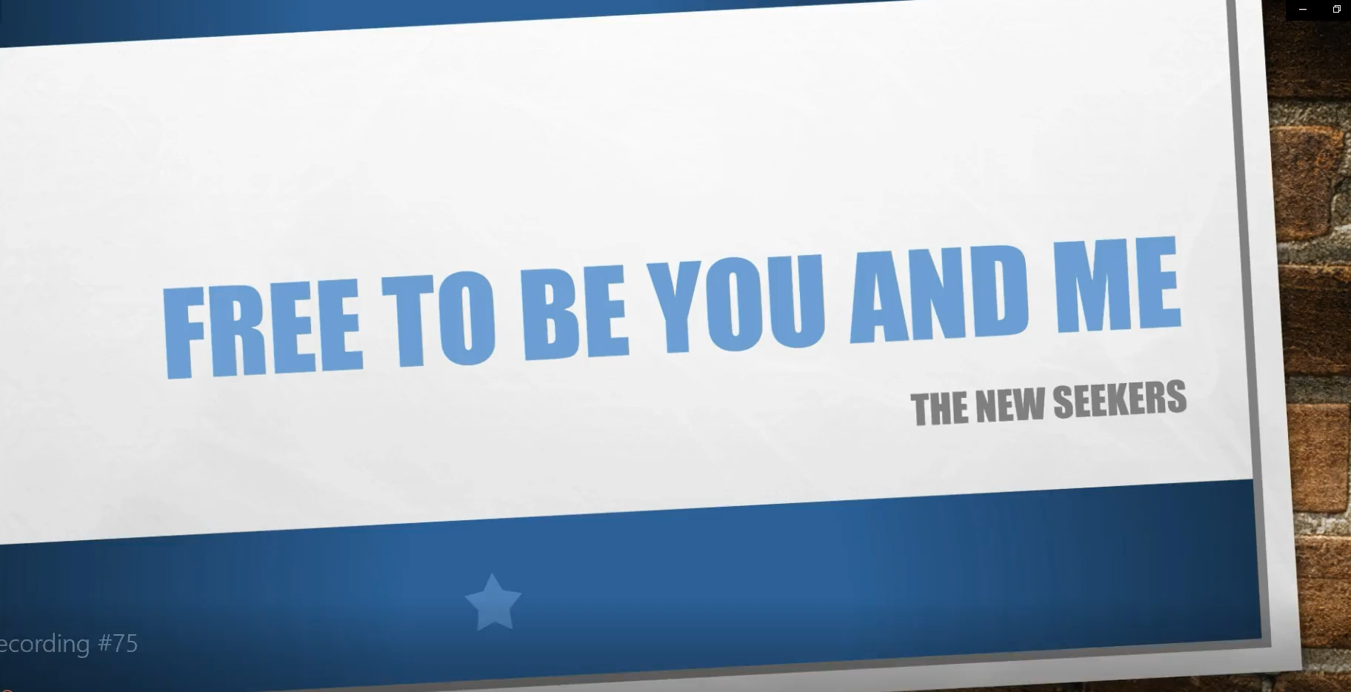
Let’s watch:
Notes:
https://youtu.be/_26FOHoaC78 - without lyrics

Slide 8
Phrasal Verbs
from the song

Slide 9
Free To Be You And Me
Literal Translations:
مجانا لتكون لي ولكم
חופשי להיות אתה ואני
Figurative Meanings:
We can be ourselves
there are no limits on us
no one can tell us who to be
Notes:
majana litakun li walakum
hofshi lihiot ata v’ani

Slide 10
from where we are
Literal Translations:
من أين نحن
מאיפה שאנחנו נמצאים
Figurative Meanings:
from our point of view
starting here

Slide 11
take my hand
Literal Translations:
خذ بيدي
קח את ידי
Figurative Meanings:
be with me
trust me
we are together

Slide 12
his own man / her own woman
Literal Translations:
رجله / امرأتها
האיש שלו / אישה שלה
Figurative Meanings:
be yourself
be an individual
don’t let anyone tell you who you are

Slide 13
lend your voice
Literal Translations:
تضفي صوتك
להשאיל את קולך
Figurative Meanings:
tell others that you agree
speak out
join the crowd

Slide 14
come along
Literal Translations:
تعال
בוא איתי
Figurative Meanings:
join me
come with me
do what I am doing

Slide 15
come with me
Literal Translations:
تعال معي
בוא איתי
Figurative Meanings:
trust me
we are together
follow me and my ideas

Slide 16
to a land
Literal Translations:
إلى أرض
לארץ
Figurative Meanings:
to a place
to a different country
to an open space
destination unknown

Slide 17
Listen Again
Now that we know the words

Slide 18
Analysis
What is the story here?
What is the message?
How does this apply to “me”?

Slide 19
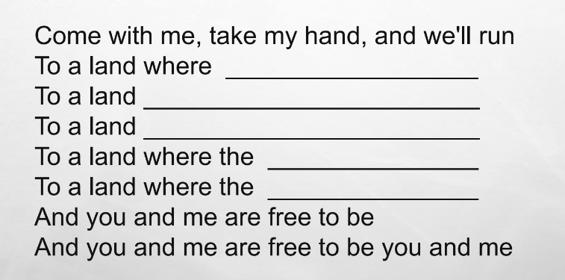
Write your own ideas

Slide 20
Leah’s sample
there is no virus
where schools are open
where we can meet our friends
virus is gone
people are free

Slide 21
Your turn copy this

Slide 22
Grammar Note
relative pronoun
where

Slide 23
Relative Pronouns
Give more information about the subject
where - not a question; it tells us the location of …
Let’s go to the park. (which park?)
Let’s go to the park where the swings are.
Let’s go to a park where we can walk the dog.
Do you remember the trip, (please be more specific)
where we saw the big statue?
Find a place where you can wash your hands!
Notes:
do I have time?
Should I add more here? or pull this into next lesson and expand.

Slide 24
Relative Pronouns
Where
When
Which
That
Who
Whose
Whom

Slide 25

Listen and Write
Notes:
https://youtu.be/_26FOHoaC78

Slide 26
Welcome Back!
Free to Be You and Me
High School - 5 points
Leah Doryoseph

Slide 27
Today we are going to learn
Review - your song
structure of a song
review vocabulary
imaginative writing

Slide 28
Your turn
Notes:
OK, time to share
No, don’t all sing at once
Yes, I like that one … we don’t have the time or method to share them all right now … sing them to your family, friends, record yourself and send it to your teacher

Slide 29
Structure of a Song
There's a land that I see where the children are free
And I say it ain't far to this land from where we are
Take my hand, come with me, where the children are free
Come with me, take my hand, and we'll live
In a land where the river runs free
In a land through the green country
In a land to a shining sea
And you and me are free to be you and me
I see a land bright and clear, and the time's comin' near
When we'll live in this land, you and me, hand in hand
Take my hand, come along, lend your voice to my song
Come along, take my hand, sing a song
For a land where the river runs free
For a land through the green country
For a land to a shining sea
For a land where the horses run free
And you and me are free to be you and me
Every boy in this land grows to be his own man
In this land, every girl grows to be her own woman
Take my hand, come with me where the children are free
Come with me, take my hand, and we'll run
To a land where the river runs free
To a land through the green country
To a land to a shining sea
To a land where the horses run free
To a land where the children are free
And you and me are free to be
And you and me are free to be
And you and me are free to be you and me
Stanza
Chorus
Verse
Tune
Melody
Harmony
Notes:
Stanza - like a paragraph - set of lines grouped with meaning
Verse - the story of the song
Chorus - the repeated emphasis (makes singing along easier)
Tune - the music which goes with the words
Melody - the basic “sentence” of the song (what gets stuck in your head)
Harmony - added variation to enrich the song

Slide 30
Structure of a Song
Verse
1st verse:
There's a land that I see where the children are free
And I say it ain't far to this land from where we are
Take my hand, come with me, where the children are free
Come with me, take my hand, and we'll live
prediction
plan
Notes:
In the first half we worked on the chorus - the part which repeats between the verses
The verses often tell the story
Prediction - and a plan to fullfil it

Slide 31
Structure of a Song
continue the story
2nd verse:
I see a land bright and clear, and the time's comin' near
When we'll live in this land, you and me, hand in hand
Take my hand, come along, lend your voice to my song
Come along, take my hand, sing a song
prediction
plan
Notes:
In the first half we worked on the chorus - the part which repeats between the verses
The verses often tell the story
Prediction - and a plan to fullfil it

Slide 32
Structure of a Song
lead into the ending
3rd verse:
Every boy in this land grows to be his own man
In this land, every girl grows to be her own woman
Take my hand, come with me where the children are free
Come with me, take my hand, and we'll run
prediction
plan
Notes:
In the first half we worked on the chorus - the part which repeats between the verses
The verses often tell the story
Prediction - and a plan to fullfil it

Slide 33
Let’s watch and listen again:
Notes:
https://youtu.be/_26FOHoaC78 - without lyrics

Slide 34
review vocabulary
from the song

Slide 35
Free To Be You And Me
Literal Translations:
مجانا لتكون لي ولكم
חופשי להיות אתה ואני
Figurative Meanings:
We can be ourselves
there are no limits on us
no one can tell us who to be
Notes:
majana litakun li walakum
hofshi lihiot ata v’ani

Slide 36
From where we are
Literal Translations:
من أين نحن
מאיפה שאנחנו נמצאים
Figurative Meanings:
from our point of view
starting here

Slide 37
take my hand
Literal Translations:
خذ بيدي
קח את ידי
Figurative Meanings:
be with me
trust me
we are together

Slide 38
his own man / her own woman
Literal Translations:
رجله / امرأتها
האיש שלו / אישה שלה
Figurative Meanings:
be yourself
be an individual
don’t let anyone tell you who you are

Slide 39
lend your voice
Literal Translations:
تضفي صوتك
להשאיל את קולך
Figurative Meanings:
tell others that you agree
speak out
join the crowd

Slide 40
come along
Literal Translations:
تعال
בוא איתי
Figurative Meanings:
join me
come with me
do what I am doing

Slide 41
come with me
Literal Translations:
تعال معي
בוא איתי
Figurative Meanings:
trust me
we are together
follow me and my ideas

Slide 42
to a land
Literal Translations:
إلى أرض
לארץ
Figurative Meanings:
to a place
to a different country
to an open space
destination unknown

Slide 43
Structure of a song
Word | Arabic | Hebrew
Stanza | مقطع شعر | חרוזה
Verse | بيت شعر | בית
Chorus | لازمه | פזמון חוזר
Tune | نغم | מנגינה
Melody | لحن | מלודיה
Harmony | انسجام | הרמוניה

Slide 44
Task
Let’s roll it all together and write our own

Slide 45
Creative Writing
Dream
ideal world
future possibility
what you want

Slide 46
Creative Writing
Dream
Write
ideal world
future possibility
what you want
chorus - emphasis / main idea
verses - explain the details

Slide 47
Creative Writing
Dream
Write
Use
ideal world
future possibility
what you want
chorus - emphasis / main idea
verses - explain the details
new phrases
relative pronouns

Slide 48
Creative Writing
Dream
Write
Use
ideal world
future possibility
what you want
chorus - emphasis / main idea
verses - explain the details
new phrases
relative pronouns
Publish
share at home
send to your teacher
post on social media

Slide 49
Listen and Write
Notes:
https://youtu.be/_26FOHoaC78

Slide 50
השימוש ביצירות במהלך שידור זה נעשה לפי סעיף 27א לחוק זכות יוצרים, תשס"ח-2007.
אם הינך בעל הזכויות באחת היצירות, באפשרותך לבקש מאיתנו לחדול מהשימוש ביצירה,
זאת באמצעות פנייה לדוא"ל rights@education.gov.il

