Slide 1
מערכת שידורים לאומית

Slide 2
Music from the heart
English, 11th grade, 4 points
Ariel Blacher

Slide 3
Today….
We will learn vocabulary.
We will learn about a special teacher.
We will learn about the importance of music.

Slide 4
How does music make you feel?
Do you listen to music?
How does music make you feel?
Do you play an instrument?
Do you feel pride when you play your instrument for others?
This Photo by Unknown Author is licensed under CC BY-NC

Slide 5
Vocabulary
Impressed ُتَأثّر התרשם | Ability יכולת قدره | Perseverance התמדה ثبات | moved עבר דירה تحرك | Cancel לבטל يلغي
Determination נחישות اصرار | Decide להחליט يقرر | Perform להופיעה يعرض | Young צעיר صغير بالسن | Enough מספיק يكفي
Students תלמידים طلاب | Proven מוכח اثبت | Performance הופעה | Violin כינר كَمَنْجَة
Empower להעצים يشجع | Academic אקדמי أكاديمي |  | Violinist כנר عازف الكمان

Slide 6
A young teacher moves to New York City
Roberta Guaspari moved to East Harlem, a neighborhood in New York City, with her two young sons. She needed a job. She was a violin teacher. She decided to ask the local New York City Central Park East School to hire her as a violin teacher.

Slide 7
Ms. Roberta Guaspari playing the violin
Photo:Mylivingheroes.com

Slide 8
Cause and Effect
What is explained in the first paragraph that we just read?
Violin Teacher Moves
Looks for a local job
She finds a job in East Harlem, New York City

Slide 9
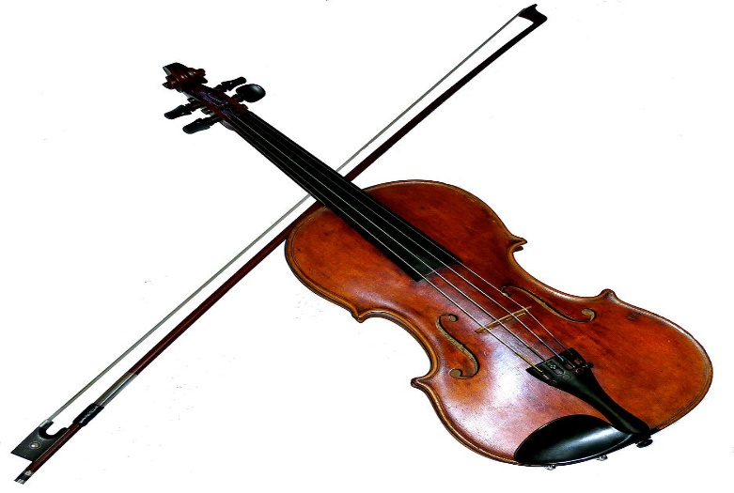
Ms. Guaspari teaches violin
Ms. Guaspari loved teaching her young students. She created a special program called the Strings Program. She would teach large groups of students the elements of playing the violin. At the end of the school year, the school had to cancel the program. They did not have enough funds to continue the Strings Program.
This Photo by Unknown Author is licensed under CC BY-SA

Slide 10
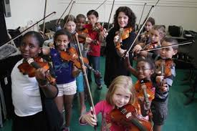
What did the students and parents do?
The students and parents decided to help Ms. Guaspari continue teaching violin to her students. Together, they created the Opus 118 Music Center. She knew that the violin lessons were proven to help students improve their academic performance.
Photo: Nydailynews.com

Slide 11
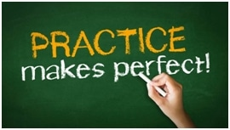
What do you think?
The students improve their academic studies. How?
Why do you think that students start to perform better in their classes due to learning music?
This Photo by Unknown Author is licensed under CC BY

Slide 12
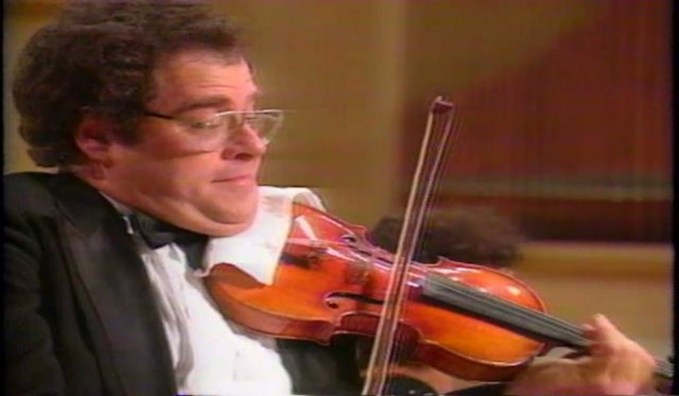
Determined Students Keep Playing Music
Ms. Guaspari’s Opus 118 music students continued to practice. One day, they were asked to perform in Carnegie Hall. Itzhak Perelman, a famous Israeli violinist, agreed to attend the performance. He was truly impressed by the determination of the students.
This Photo by Unknown Author is licensed under CC BY-NC-ND

Slide 13
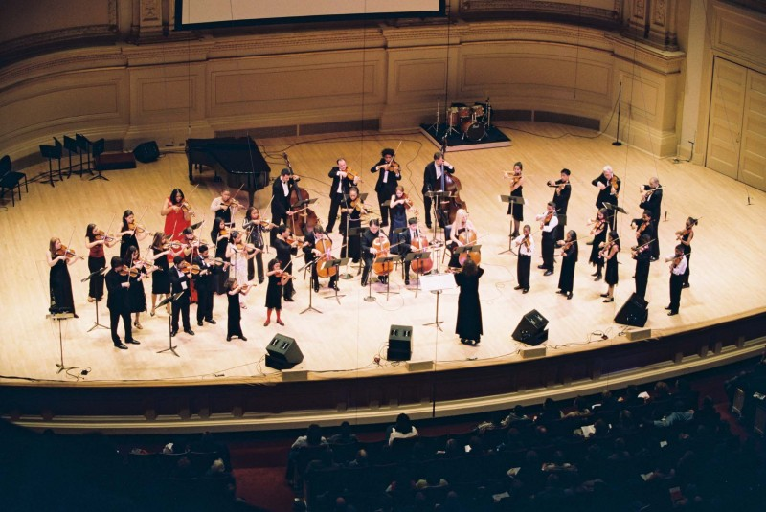
The Power of Music
Ms. Guaspari truly loves her job. She believes that music “empowers these children with the ability to make something beautiful that allows them to believe in themselves and know that they’re special.”
Photo:greatnonprofits.org

Slide 14
A Movie was made about this story
https://www.youtube.com/watch?v=wSYuqFJBcUA

Slide 15
Break

Slide 16
Let’s Review the events in this story
Mrs. Guaspari needs a job
She goes to the local school
Strings Program
Many children learn to play the violin
Program is cancelled due to lack of funds
Opus 118
Children attend Mrs. Guasparii’s program
Starts a Violin program
Chilren perform in a big Hall.
Children perform better in school.

Slide 17
Question 1
Who is Roberta Guaspari?
A. She is a drama teacher.
B. She is an art teacher.
C. She is a soccer player.
D. She is a violin teacher.

Slide 18
Question 2
What happened to the Strings Program?
A.The program lasted for 20 years.
B.The program started dance lessons.
C.The program was cancelled.
D.The program was unsuccessful.

Slide 19
Question 3
Ms. Guaspari believed that music can help students achieve excellence in other school subjects.
(Choose the correct answer)
True
False

Slide 20
Question 4
Who was the famous Israeli violinist that attended the performance of the students?
_________________________________________

Slide 21
Watch this video of the children.
https://www.kaufmanmusiccenter.org/kc/about/opus-118/

Slide 22
Great Quote
From the Movie Music from the Heart
Roberta says to her students before a performance:
“I want you all to take a second and just…breathe. Deep breaths. Now listen to me. I want you all to play from your heart. Forget about the audience, watch me. You’ll all do just find. Just play from your heart.”

Slide 23
What do you think?
Does music affect others?
Can music change your mood?
Can music help you perform better on tests or exams?
Do you ever listen or play music yourself?
How does it make you feel?

Slide 24
What did we learn today?
We learned vocabulary.
We learned about a New York City teacher who made a difference.
We learned that music can change lives.

Slide 25
Itzhak Perelman performs with Opus 118
https://www.youtube.com/watch?v=dZUn9OKUwms

Slide 26
Bibliography
Music of the Heart (1998) https://www.youtube.com/watch?v=NWb5RkZeV4k
https://www.kaufmanmusiccenter.org/kc/about/opus-118/
https://www.kaufmanmusiccenter.org/kc/about/opus-118/
https://www.youtube.com/watch?v=dZUn9OKUwms
https://www.youtube.com/watch?v=wSYuqFJBcUA

Slide 27
השימוש ביצירות במהלך שידור זה נעשה לפי סעיף 27א לחוק זכות יוצרים, תשס"ח-2007. אם הינך בעל הזכויות באחת היצירות, באפשרותך לבקש מאיתנו לחדול מהשימוש ביצירה, זאת באמצעות פנייה לדוא"ל rights@education.gov.il

