Slide 1
מערכת שידורים לאומית
Notes:
כל התמונות כאן מ- freepic ומהספר HIGH SKY שאושר לנו

Slide 2
Out in the Snow
English 7th Grade
Teacher: Rivka Rosenberg

Slide 3
Can you…?
study an ad about ice skating
study important vocabulary and expressions
explore and practice the sound C
explore and practice different connectors

Slide 4
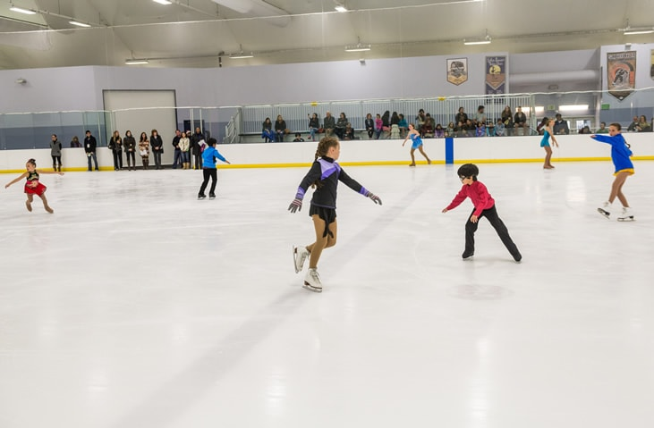
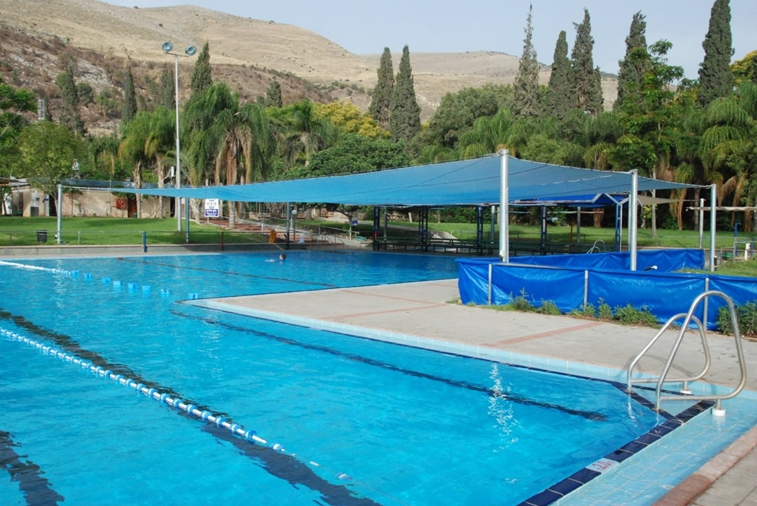
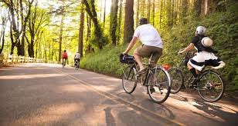
It is almost summer, what activities do you like to do during your summer vacation?

Slide 5
During my summer vacation, I love to do activities to keep me cool, for example:

Slide 6
Today we will read an ad and some reviews about an ice-skating (figure skating) center.

Slide 7
Do you remember?
fall/fell | ליפול, נפל | change | שינוי
online | באינטרנט | ice center | קרח מרכז
ticket | כרטיס | ready | מוכן
vacation | חופשה | save money | לחסוך כסף

Slide 8
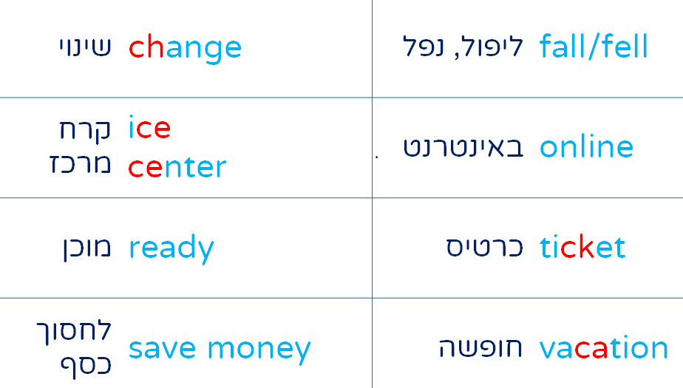
Complete the dialogue
Dana:
Hi, Sara, today is summer vacation.
Would you like to go _____ skating?
Sara:
I don’t know. I will look ______.
Dana:
Thanks. See you soon!
Sara:
Great idea, Dana!
We can go ice skating in Bat Yam!
Dana:
How much is a _______?

Slide 9
Why do you think these words are in red?

Slide 10
5 sounds of the letter C
CH
Soft C
Hard C
CK
teacher check | מורה לבדוק
cake vacation | עוגה חופשה | ice price | קרח מחיר
kick check | לבעוט לבדוק
delicious | טעים
CI=sh

Slide 11
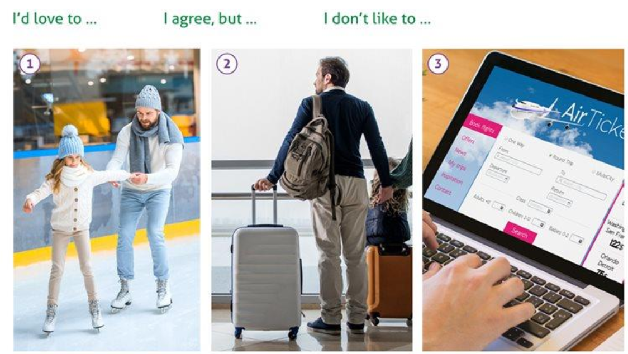
Do you remember these expressions?

Slide 12
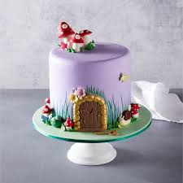
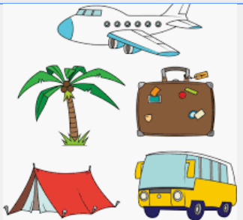
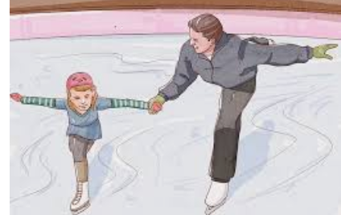
New Vocabulary Words
birthday cake holiday price skater and teacher
at a lesson

Slide 13
Exercise- Match the word to the picture
price holiday skater and teacher
at a lesson birthday cake

Slide 14
Answers
birthday cake holiday price skater and teacher
at a lesson

Slide 15
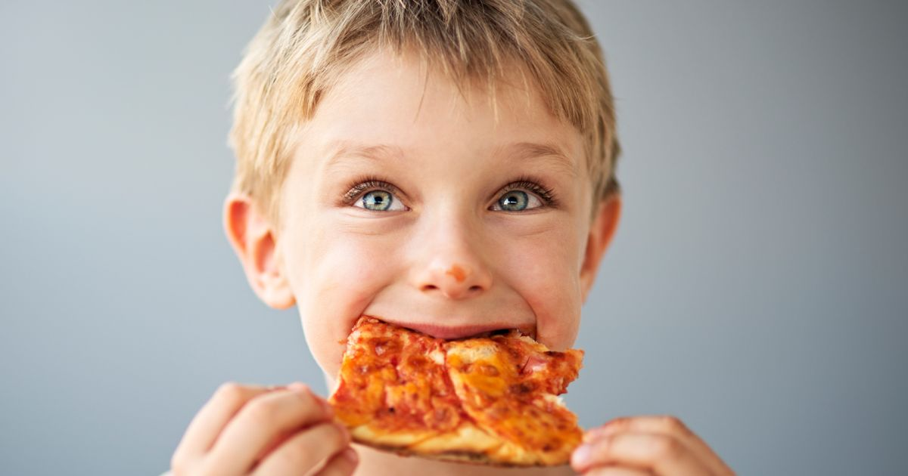
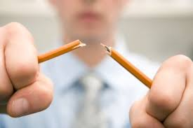
Additional New Vocabulary Words
break/broke check delicious
enjoy

Slide 16
Exercise- Match the words to the pictures
check delicious break/broke
enjoy

Slide 17
Answers
break/broke check delicious
enjoy

Slide 18
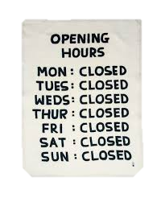
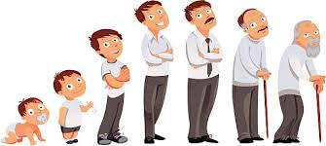
New Expressions
בכלל
דרך אגב

Slide 19
Let Us Play a Summary Game Connect the words/expression to the translation
too many
לכל הגילאים
skater and teacher
לשבור
break
מחליק ומורה
for all ages
יותר מדיי

Slide 20
Answers
too many
לכל הגילאים
skater and teacher
לשבור
break
מחליק ומורה
for all ages
יותר מדיי

Slide 21
Answers
too many
לכל הגילאים
skater and teacher
לשבור
break
מחליק ומורה
for all ages
יותר מדיי

Slide 22
Answers
too many
לכל הגילאים
skater and teacher
לשבור
break
מחליק ומורה
for all ages
יותר מדיי

Slide 23
Answers
firefighters
לכל הגילאים
barbeque
לשבור
Police
מחליק ומורה
for all ages
יותר מדיי

Slide 24
Let us read the ad

Slide 25
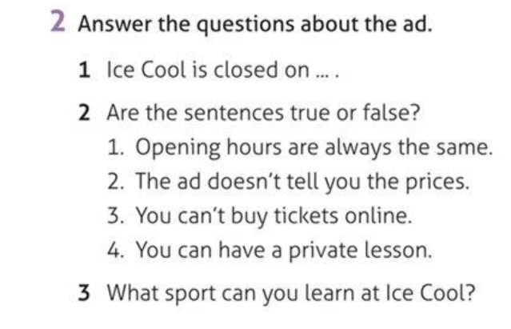
Exercise

Slide 26
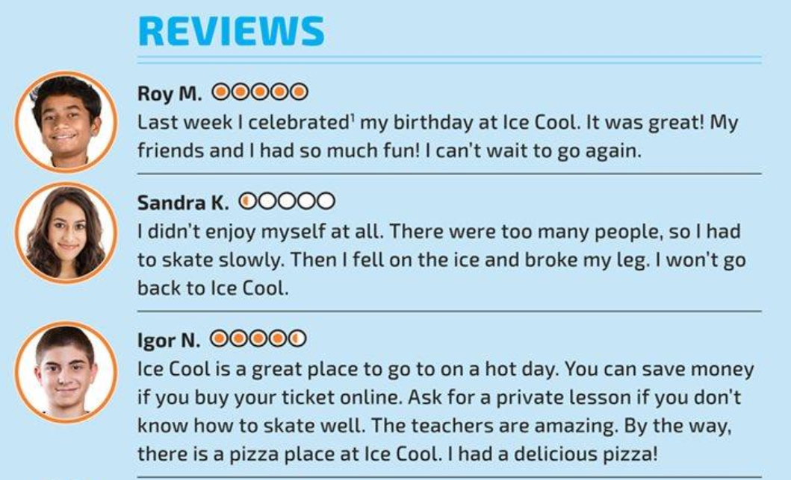

Slide 28
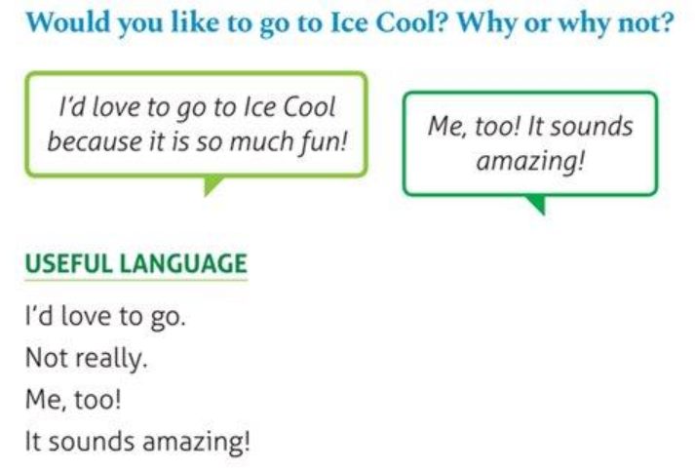
Exercise

Slide 29
Exercise Choose the correct answer

Slide 30
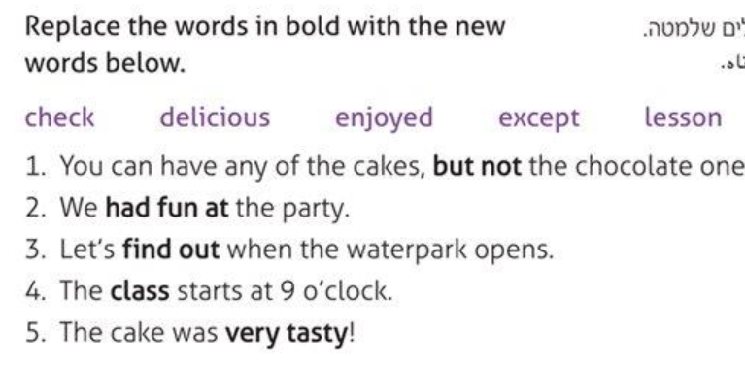
Exercise
90*0

Slide 31
Break

Slide 32
Can you…?
explore and practice the different connectors

Slide 33
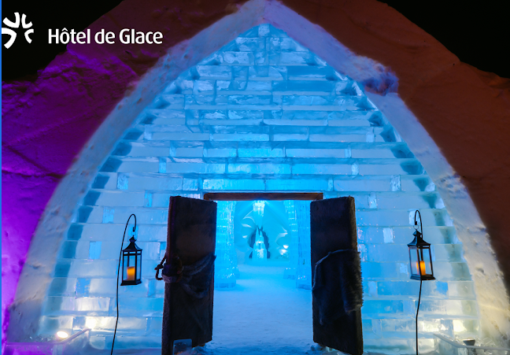
In the summer we can ice-skate in Israel. In the winter, we can fly to Quebec, Canada.
https://www.valcartier.com/en/accommodations/ice-hotel/

Slide 34
Let Us Watch the Video
While you watch, please describe the Ice Hotel in 2 sentences in your notebook.
Use one of the expressions:

Slide 35
Connectors

Slide 36
Exercise

Slide 37
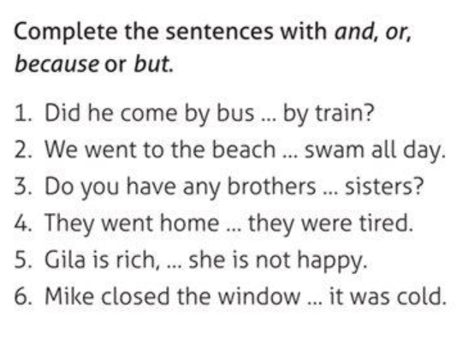
Exercise

Slide 38
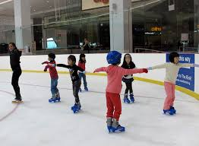
Creative Assignment
Look at the pictures.
In your notebook, write an ad for this skating rink.
Use the connectors:
and, or, because, but

Slide 39
Now, by the end of this lesson, you can…
study an ad about ice skating
study important vocabulary and expressions
explore and practice the sound C
explore and practice different connectors.

Slide 40
Today’s lesson was about
Out in the Snow

Slide 41
השימוש ביצירות במהלך שידור זה נעשה לפי סעיף 27א לחוק זכות יוצרים, תשס"ח-2007. אם הינך בעל הזכויות באחת היצירות, באפשרותך לבקש מאיתנו לחדול מהשימוש ביצירה, זאת באמצעות פנייה לדוא"ל rights@education.gov.il

