Slide 1
מערכת שידורים לאומית

Slide 2
SH sounds Part 2
JHS
Teacher: Rania Essa

Slide 3
Can you?
Read and understand words and sentences that contain “sh” sound.
Can understand a short text.
say the “sh” sounds.
understand a text which contains words with “sh” sound.
understand a simple story with the help of pictures.

Slide 4
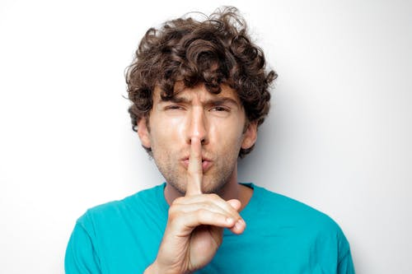
Let’s review!
sh

Slide 5
Tongue Twister Fun
I wish to wish the wish you wish to wish, but if you wish the wish the witch wishes, I won't wish the wish you wish to wish.

Slide 6
Let’s review some words

Slide 7
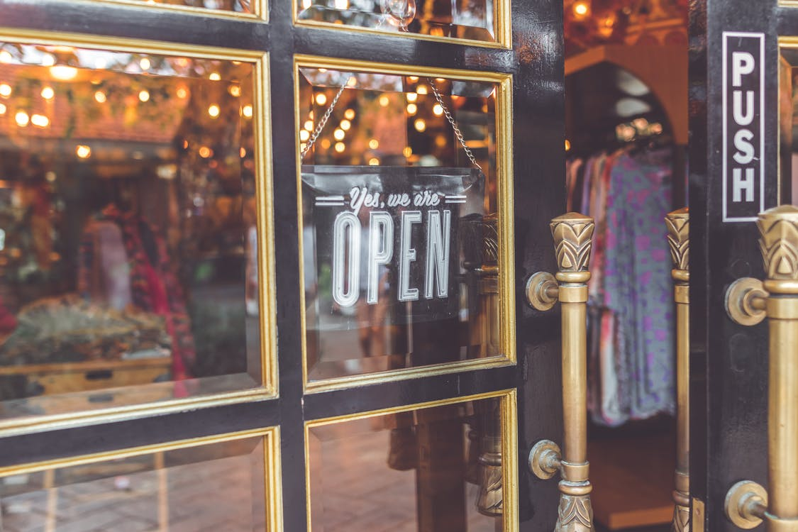
to push
يَدْفَع
לדחוף
fashion
موضة
אופנה
Photo from Pexels

Slide 8
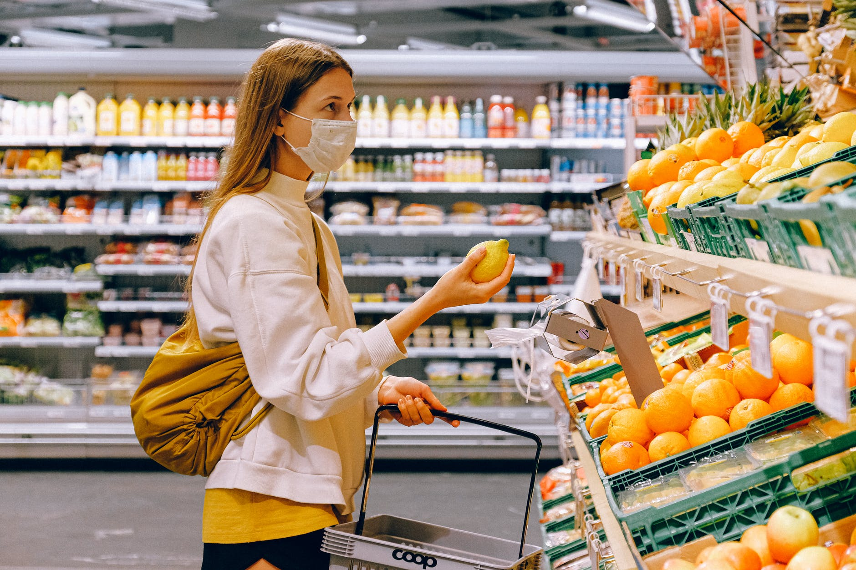
to shop يتسوق לקנות
a supermarket
متجر
סופרמרקט
Photo from Pexels

Slide 9
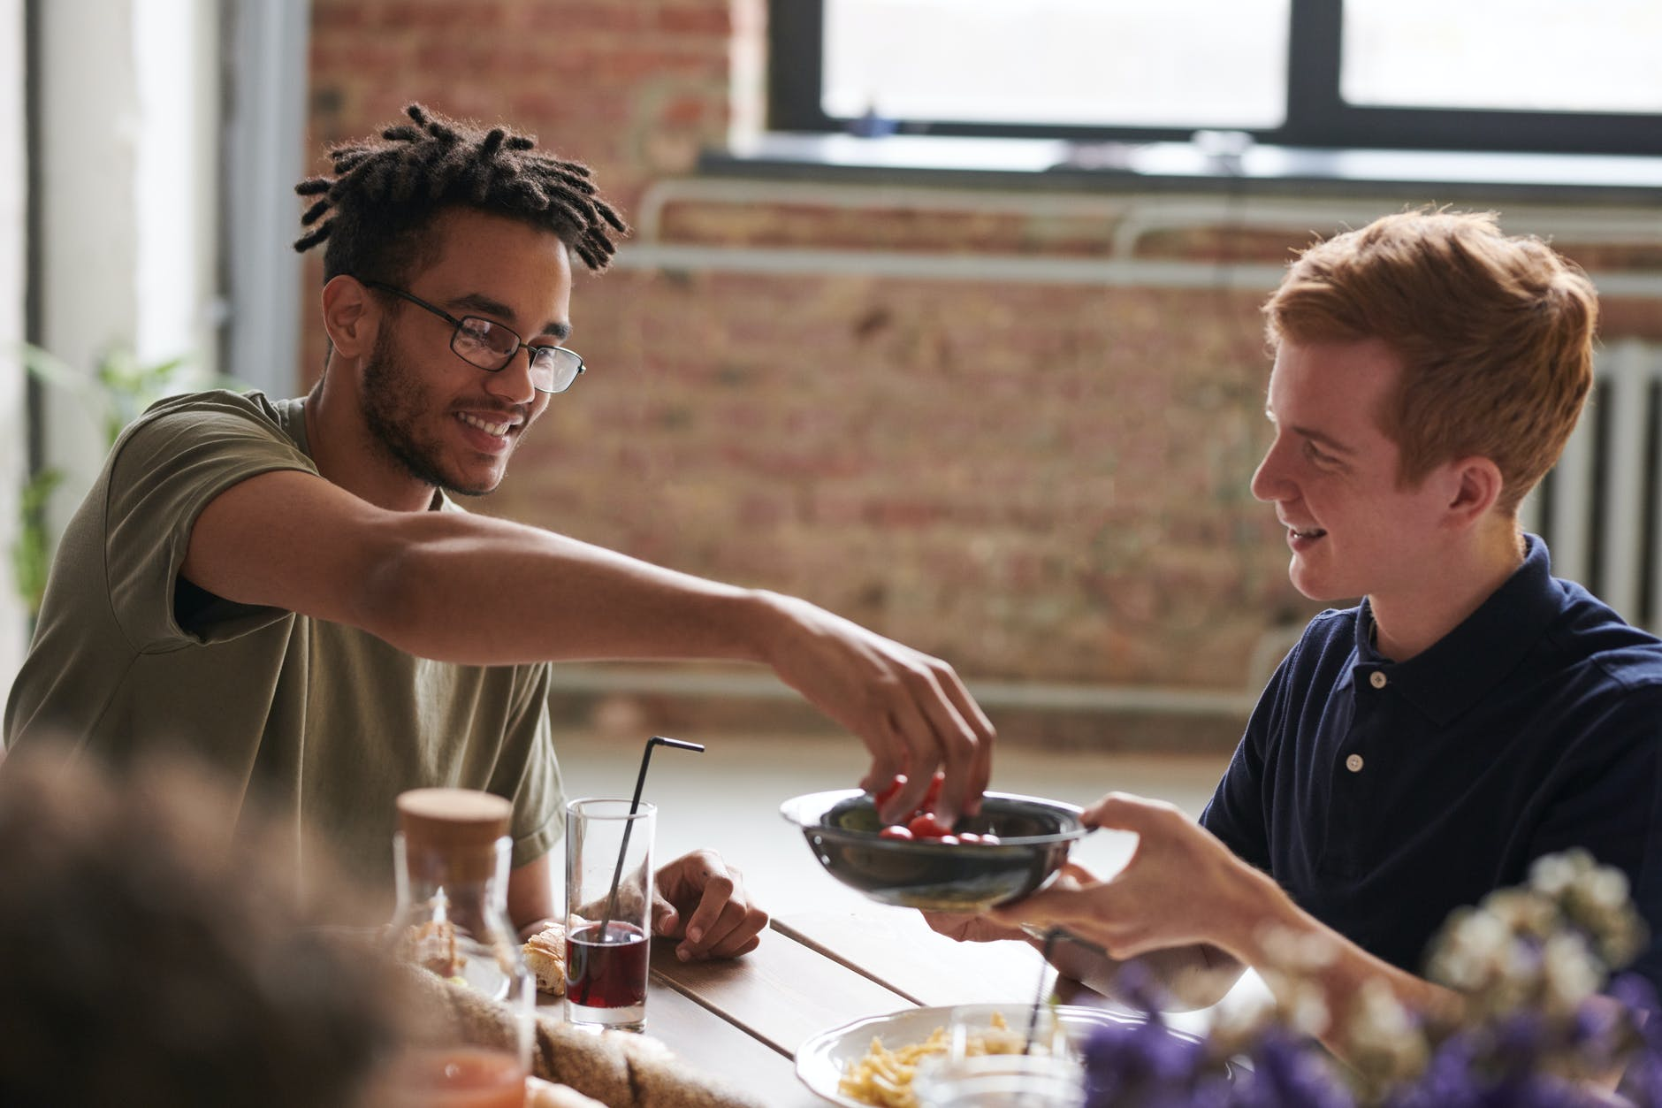
friendship
صداقة
חברות
to share
يشارك
לשתף
Photo from Pexels

Slide 10
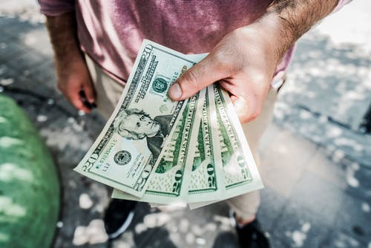
cash
نقداً
מזומן
Photo from Pexels

Slide 11
Let’s review the new words
https://www.online-stopwatch.com/random-name-pickers/crane-machine-name-picker/?r=qo2HZbpEhb

Slide 12
Do you like shopping?

Slide 13
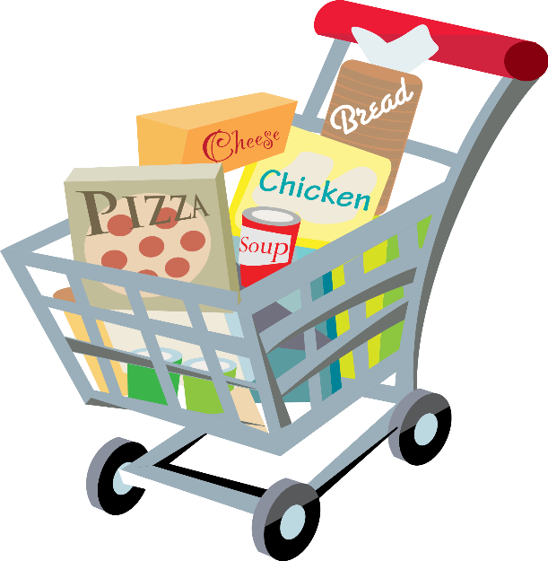
What do you like to shop for?
food
shoes
clothes
books

Slide 14
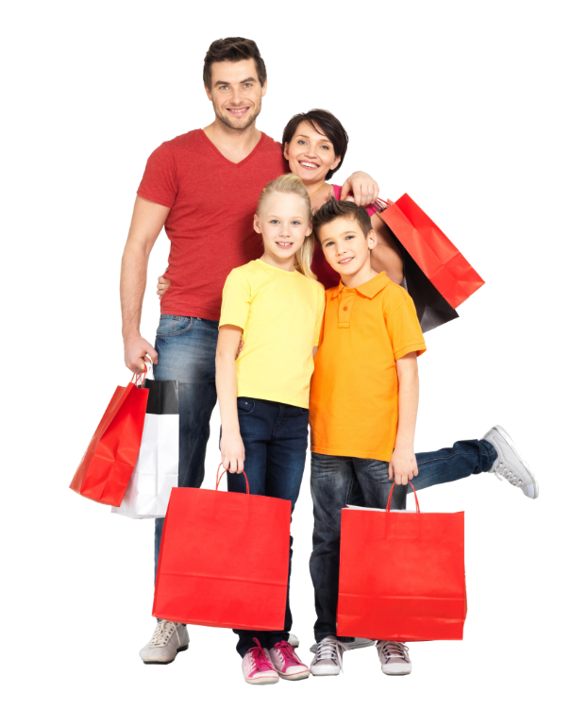
What’s in their shopping bags?
shoes
some fruit
shirts
a toothbrush

Slide 15
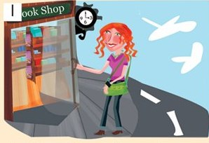
Ashley Goes Shopping
Ashley likes shopping. It’s 3 o’clock and she pushes the door and goes into the book shop.
Adapted from “Goal 2” ECB

Slide 16
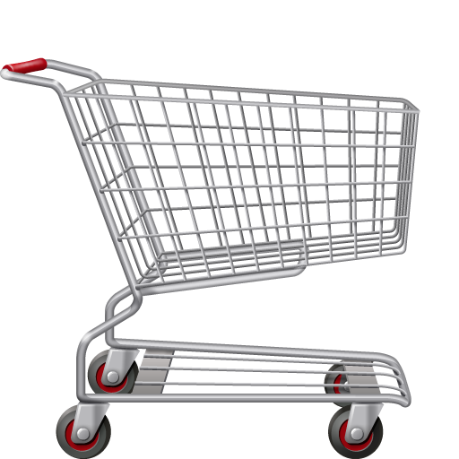
Ashley likes shopping.

Slide 17
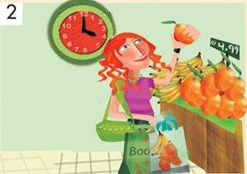
It’s 4 o’clock now. Ashley is in the supermarket. She shops for fruit and pays cash.
Adapted from “Goal 2” ECB

Slide 18
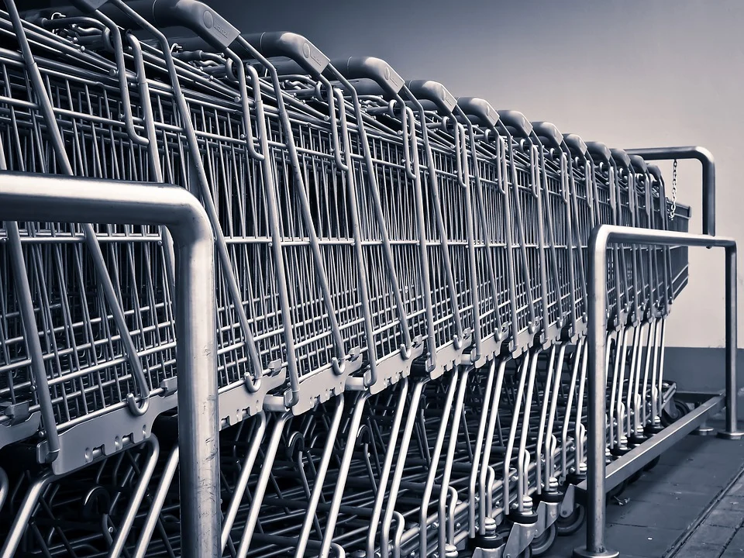
What can you find in a supermarket?
Photo from Pexels

Slide 19
Break
Make a list of things that you want to buy at the supermarket.

Slide 20
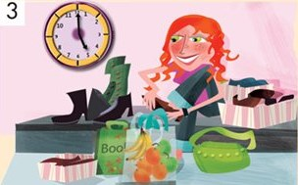
It’s 5 o’clock now. Ashley is in the shoe shop. She loves fashion.
Adapted from “Goal 2” ECB

Slide 21
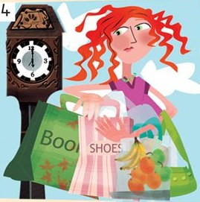
It’s 6 o’clock.
Ashley has three shopping bags. She is also very tired.
Taken from “Goal 2” ECB

Slide 22
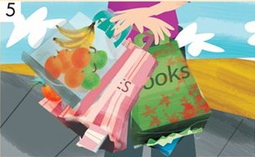
In bag 1 she has ten pencils and three big books. In bag 2 she has apples, oranges and bananas. In bag 3 she has new shoes.
Taken from “Goal 2” ECB

Slide 23
What does Ashley have in her bags?
10 pencils and three big books
apples, oranges and bananas.
new shoes

Slide 24
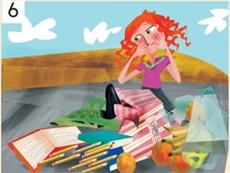
Oh no! Look at the bags! The apples, the oranges, the bananas, the books and the pencils are on the ground.
Taken from “Goal 2” ECB

Slide 25
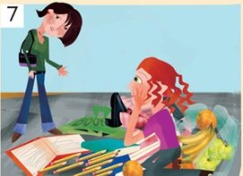
Jen says, “Can I help?”
Taken from “Goal 2” ECB

Slide 26
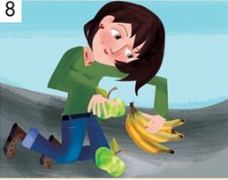
Jen helps and picks up the apples and bananas.
Taken from “Goal 2” ECB

Slide 27
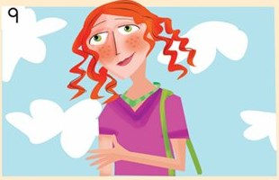
Ashley says, “Thank you.”
Taken from “Goal 2” ECB

Slide 28
Ashley and Jane have a good friendship. They share things that they enjoy.

Slide 29
What do they do together?

Slide 30
Do they fish for fish?
Photo from Pexels

Slide 31
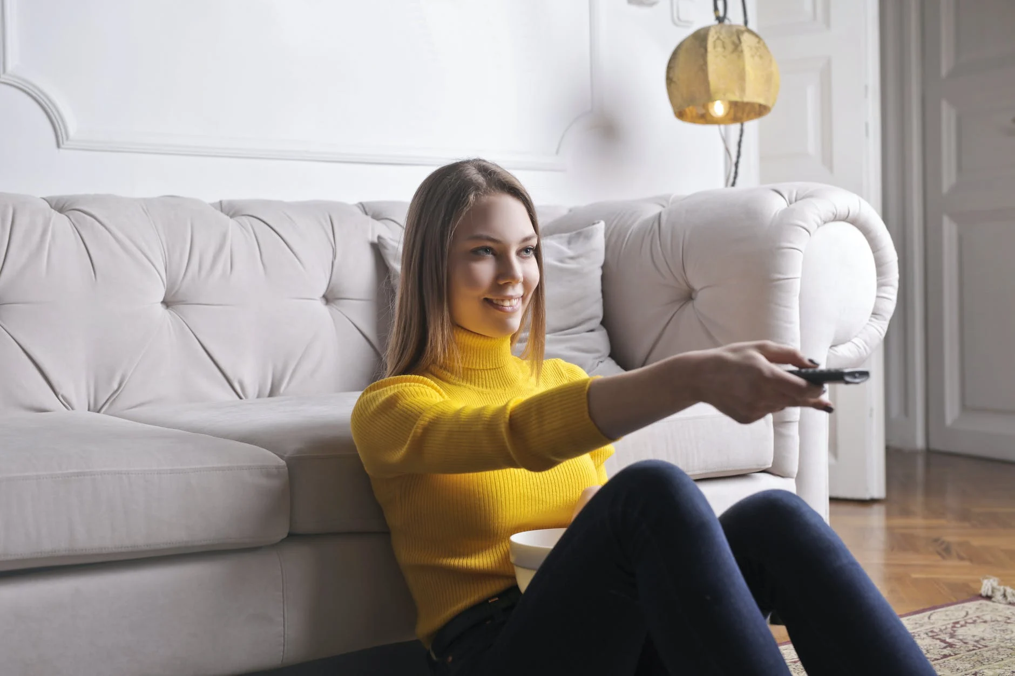
Do they watch fashion shows?
Photo from Pexels

Slide 32
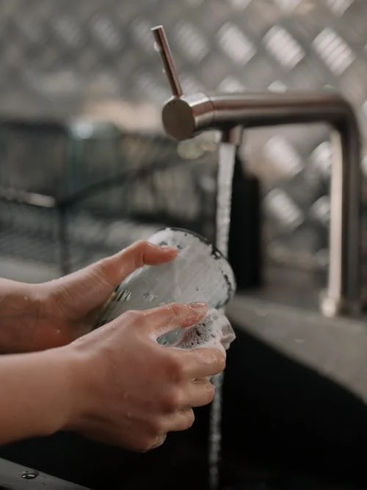
Do they wash dishes?
Photo from Pexels

Slide 33
Can you guess?

Slide 34
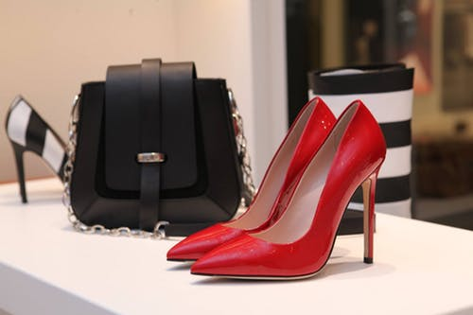
They shop for shiny shoes and pay a lot of cash!

Slide 35
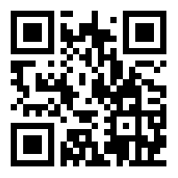
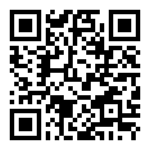
Let’s practice the vocabulary words
Quizlet set- Arabic
Quizlet set- Hebrew
https://qrgo.page.link/b5u2T
https://qrgo.page.link/xM5vW

Slide 36
Self Assessment
 |  |  | I can say the “sh” sounds.
 |  |  | I can understand a text that has words with “sh” sounds .
 |  |  | I can understand a simple story with a help of pictures.

Slide 37
Now you can…
Read and understand words and sentences that contain “sh” sound.
Can understand a short text.
say the “sh” sounds.
understand a text which contains words with “sh” sound.
understand a simple story with the help of pictures.

