Slide 1
מערכת שידורים לאומית
Notes:
כל התמונות כאן מ- freepic ומהספר HIGH SKY שאושר לנו

Slide 2
A Day in Life of a Swimmer
English 10th Grade- 3 points
Teacher: Rivka Rosenberg

Slide 3
Can you…?
listen to a radio broadcast and access
information from it
find important information in a
video

Slide 4
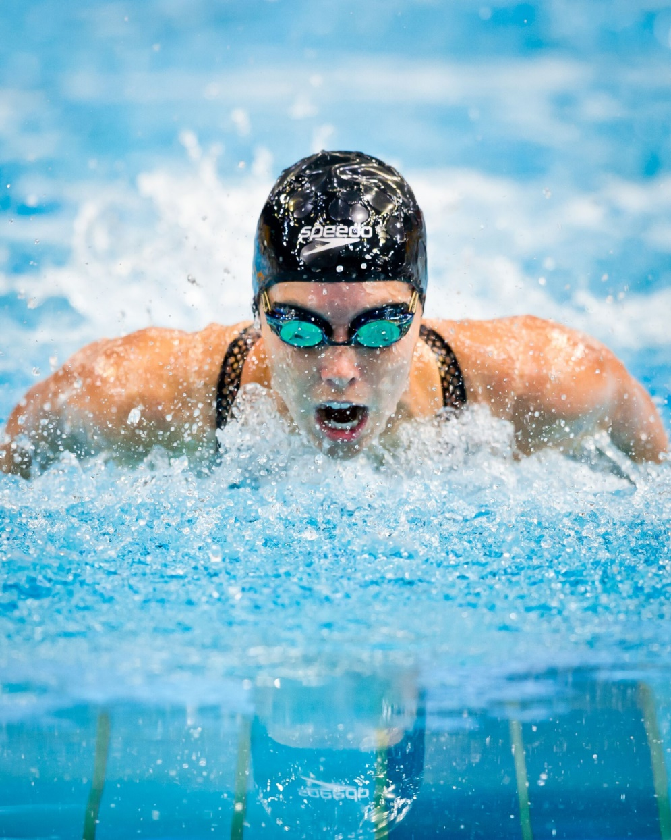
What do you see in the picture? What is she doing? What do you think of when you look at this picture?

Slide 5
The goal of this swimmer is to be her best and win competitions. Do you have a goal? What do you do to reach your goal?

Slide 6
New Vocabulary Words
athlete | ספורטאי | get up | לקום
goal | מטרה | competition | תחרות
go swimming | לשחות | have lunch / dinner | לאכול ארוחת צהריים-ערב
reach your goal להגיע למטרה
strive for excellence לשאוף למצויינות
follow a routine לשמור על שגרה

Slide 7
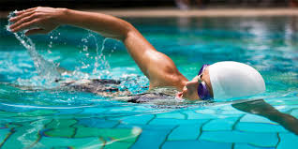
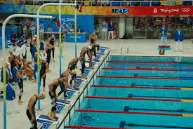
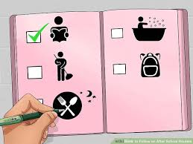
Exercise - Match the word to its picture
A
B
C
D
1.follow a routine 2. competition 3. goal
4. athlete

Slide 8
Answers
4A
3B
2C
1D
1.follow a routine 2. competition 3. goal
4. athlete

Slide 9
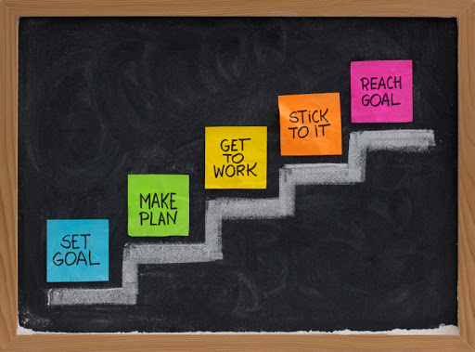
Expressions
reach a goal striving for excellence follow a routine

Slide 10
Exercise – Complete the words in the sentences
Dana is a very serious swimmer. She ___ early to practice.
Dana ________. She gets up every day at 7AM, swims for 9 hours and then goes to sleep at 9PM.
Dana ____ so she must work hard.
Her ____is to win a gold medal in swimming.
1.gets up 2. goal 3. follows a routine
4. strives for excellence

Slide 11
Answers
Dana is a very serious swimmer. She _gets up_ early to practice.
Dana _follows a routine__. She gets up every day at 7AM, swims for 9 hours and then goes to sleep at 9PM.
Dana _strives for excellence_ so she must work hard.
Her _goal_is to win a gold medal in swimming.
1.gets up 2. goal 3. follows a routine
4. strives for excellence

Slide 12
What are we going to learn today
Before you listen
While you listen
After you listen
Listening Comprehension

Slide 13
Preparation - Before you Listen Write a number (1-5) to put these activities in the normal order in the day

Slide 14
Answers
2
3
4
1
5

Slide 15
שגרהRoutine
It is important to follow a routine,
in order to reach your goal.
What is your routine?
How can you improve your routine to reach your goal?

Slide 16
While you listen, look for…
True or False

Slide 17
Let us listen!

Slide 18
Exercise
True False
True False
True False
True False
True False
True False

Slide 19
Answers
True
False
True
False
False
True

Slide 20
Review
Before you listen..
Picture clue
While you listen…
Think of the T/F
After you listen
Exercise- T/F
Listening Comprehension

Slide 21
Break

Slide 22
New Vocabulary Words
athlete | ספורטאי | get up | לקום
goal | מטרה | competition | תחרות
go swimming | לשחות | have lunch / dinner | לאכול ארוחת צהריים-ערב
reach your goal להגיע למטרה
strive for excellence לשאוף למצויינות
follow a routine לשמור על שגרה

Slide 23
Let us listen again

Slide 24
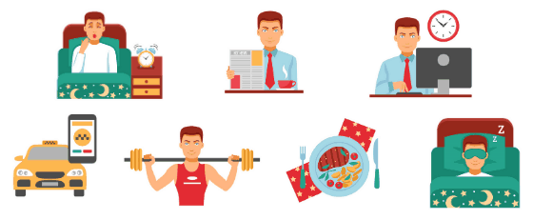
Writing Exercise Answer in your notebook: What is your daily routine like? What time do you get up? What time do you start and finish school? Do you do any activities after school? What do you do? What time do you go to school?

Slide 25
Let us watch
Michael Phelps
The Greatest Swimmer Ever
https://www.youtube.com/watch?v=yzdU3N0_D6o
While you watch, please look for:
What can “push all the pain aside”?

Slide 26
Expressions
reach a goal striving for excellence follow a routine

Slide 27
According to the video…
What does “Mental Power” mean?
Mental power is the ability to think clearly and put all parts of a problem together.
What can “push all the pain aside”?
Mental Power

Slide 28
Writing Exercise Answer in your notebook: What is your goal in life? What do you do to keep your goal? How do you strive for excellence? How do you keep a routine? How can you improve your routine?
For example:
My goal was to become a teacher.
Every day I made a list to do for the day. Every day I practiced my English.

Slide 29
Now you can…
listen to a radio broadcast and access
information from it
find important information in a
video.

Slide 30
Today’s lesson was about
A Day in a Life of a Swimmer

Slide 31
השימוש ביצירות במהלך שידור זה נעשה לפי סעיף 27א לחוק זכות יוצרים, תשס"ח-2007. אם הינך בעל הזכויות באחת היצירות, באפשרותך לבקש מאיתנו לחדול מהשימוש ביצירה, זאת באמצעות פנייה לדוא"ל rights@education.gov.il

